Slide 1
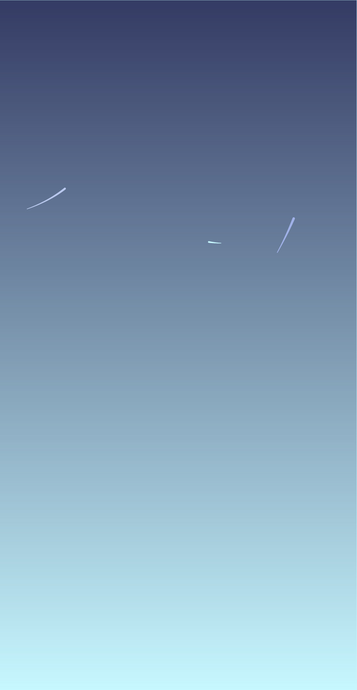
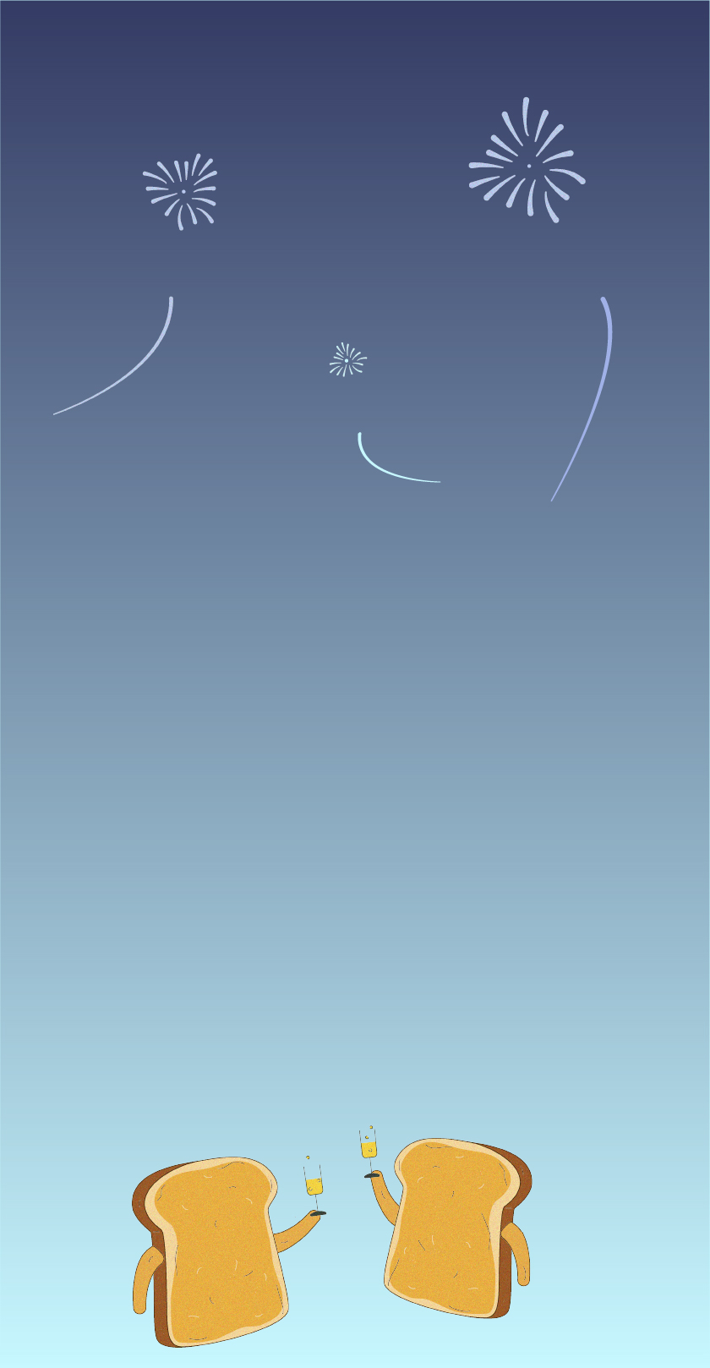
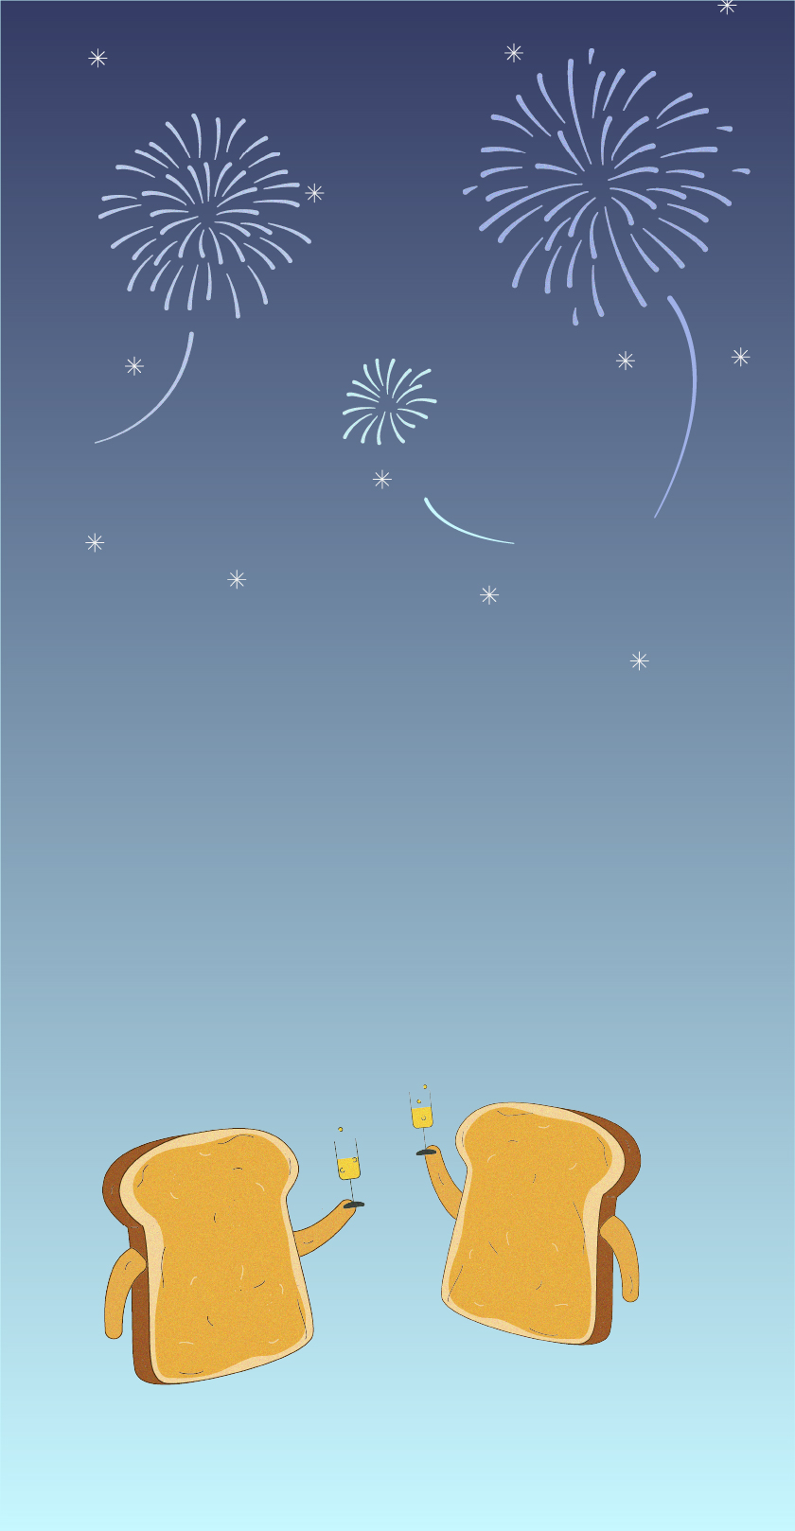
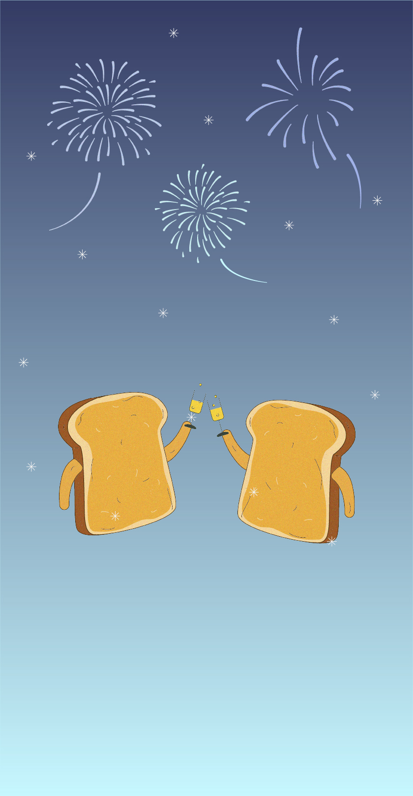
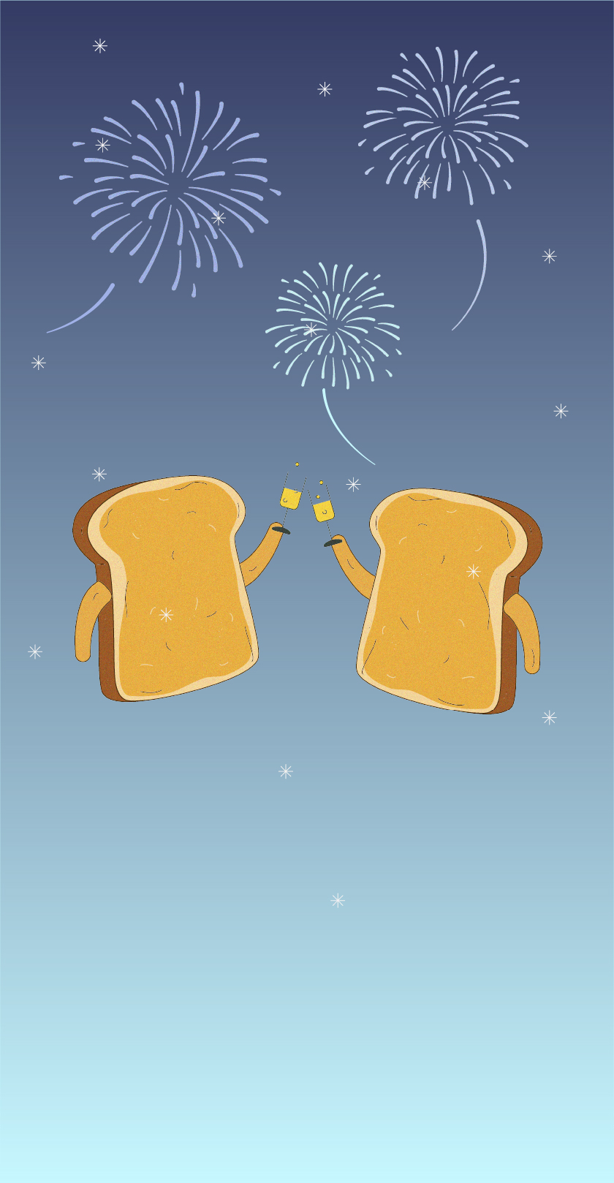
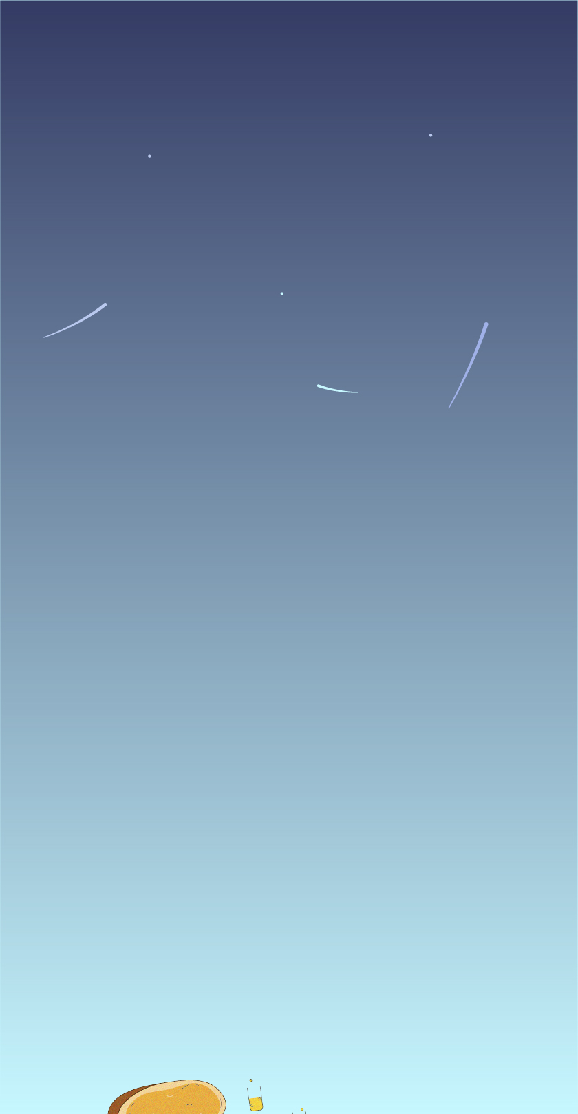
1. Save the images: Right click > Save As Picture
2. To create and tweak your own version, use the following prompt with Veo 3 in Gemini, Adobe Firefly or Google Vids:
Combine these illustrations into an animation. Use the images as a reference for where the objects should move to. Two pieces of toast jump up from the bottom of the screen. They are holding champagne glasses. When the toasts get to the middle of the screen, they clink their glasses together, they are toasting the new year. The style should match the grainy texture in the images provided. The format needs to be an A5 greetings card, in portrait orientation. Fireworks are going off in the background, match the style of fireworks used in the illustrations. It starts to snow halfway through the video. The video length should be 8-10 seconds.

