Slide 1
Communicate effectively with dynamic visual PowerPoint
No, really!

Slide 2
Layout
Advanced PowerPoint training

Slide 3
Compelling Presentation Layouts
Clear Structure
  A strong beginning / middle / end guide the audience through your message logically and smoothly.
Visual Impact
  Clean engaging visuals support key points without overwhelming or distracting from the message.
Audience Connection
  Tailor content to this audience’s specific relevant interests using relatable examples or storytelling.
Confident Delivery
  Speak clearly, maintain good pacing, use body language voice tone, interact with slides to keep attention.

Slide 4




Compelling Presentation Layouts
Clear Structure
Visual Impact
Audience Connection
Confident Delivery
  A strong beginning / middle / end guide the audience through your message logically and smoothly.
  Clean engaging visuals support key points without overwhelming or distracting from the message.
  Tailor content to this audience’s specific relevant interests using relatable examples or storytelling.
  Speak clearly, maintain good pacing, use body language voice tone, interact with slides to keep attention.

Slide 5
Highlighting key information
Advanced PowerPoint training
Notes:
Highlight key information
Masking
Freeform outline

Slide 6
Current project portfolio
Project | Start | End | Location | State | Region | Value ($) | Construction | BusType
100682 | 17-Jul-22 | 11-May-23 | Urban | NY | East | 62,550,000 | Fire Resist | Apartment
100502 | 02-May-22 | 31-Mar-23 | Urban | NY | East | 57,343,200 | Fire Resist | Office Bldg
100275 | 02-Feb-22 | 25-Jan-24 | Urban | NY | East | 53,410,614 | Frame | Construction
100625 | 27-Jun-22 | 07-Apr-23 | Rural | WI | Midwest | 49,837,500 | Fire Resist | Apartment
100574 | 08-Jun-22 | 24-Mar-23 | Urban | VT | Northeast | 37,785,000 | Frame | Apartment
100342 | 03-Mar-22 | 13-Jan-24 | Rural | MI | Central | 39,642,500 | Fire Resist | Apartment
100754 | 10-Aug-22 | 29-May-23 | Rural | MI | Central | 36,909,180 | Metal Clad | Manufacturing
100498 | 03-May-22 | 06-Feb-23 | Urban | MI | Central | 36,356,000 | Fire Resist | Apartment
100678 | 15-Jul-22 | 21-Apr-23 | Urban | NJ | East | 35,245,000 | Masonry | Apartment
100596 | 18-Jul-22 | 28-Mar-23 | Urban | VT | Northeast | 34,841,710 | Metal Clad | Manufacturing
100214 | 05-Jan-21 | 23-Oct-22 | Rural | NY | East | 33,250,000 | Frame | Apartment
100428 | 07-Apr-21 | 05-Jun-22 | Urban | NY | East | 33,000,000 | Fire Resist | Service
100957 | 05-Nov-21 | 05-Nov-22 | Urban | NY | East | 31,285,000 | Frame | Office Bldg

Slide 7
Current project portfolio
Project | Start | End | Location | State | Region | Value ($) | Construction | BusType
100682 | 17-Jul-22 | 11-May-23 | Urban | NY | East | 62,550,000 | Fire Resist | Apartment
100502 | 02-May-22 | 31-Mar-23 | Urban | NY | East | 57,343,200 | Fire Resist | Office Bldg
100275 | 02-Feb-22 | 25-Jan-24 | Urban | NY | East | 53,410,614 | Frame | Construction
100625 | 27-Jun-22 | 07-Apr-23 | Rural | WI | Midwest | 49,837,500 | Fire Resist | Apartment
100574 | 08-Jun-22 | 24-Mar-23 | Urban | VT | Northeast | 37,785,000 | Frame | Apartment
100342 | 03-Mar-22 | 13-Jan-24 | Rural | MI | Central | 39,642,500 | Fire Resist | Apartment
100754 | 10-Aug-22 | 29-May-23 | Rural | MI | Central | 36,909,180 | Metal Clad | Manufacturing
100498 | 03-May-22 | 06-Feb-23 | Urban | MI | Central | 36,356,000 | Fire Resist | Apartment
100678 | 15-Jul-22 | 21-Apr-23 | Urban | NJ | East | 35,245,000 | Masonry | Apartment
100596 | 18-Jul-22 | 28-Mar-23 | Urban | VT | Northeast | 34,841,710 | Metal Clad | Manufacturing
100214 | 05-Jan-21 | 23-Oct-22 | Rural | NY | East | 33,250,000 | Frame | Apartment
100428 | 07-Apr-21 | 05-Jun-22 | Urban | NY | East | 33,000,000 | Fire Resist | Service
100957 | 05-Nov-21 | 05-Nov-22 | Urban | NY | East | 31,285,000 | Frame | Office Bldg

Slide 8

Market share growth

Slide 9
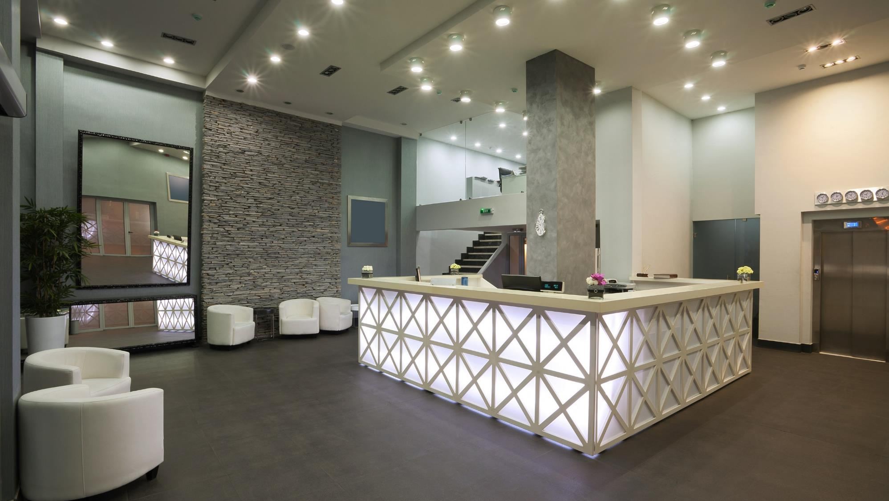
Notes:
Well, it’s combining two techniques. The freeform tool from earlier, and the Boolean merge shapes tools that loyal followers will be intimately familiar with. Let’s start with the freeform tool and use it to trace around the key components that you want to highlight. Remember, the technique here is to click, then let go of the mouse button and move the cursor to the next point in the shape you want to create – if you hold down the mouse button you’ll get a squiggly line as PowerPoint thinks that you’re clicking furiously, and you end up with loads of points in your shape.
Once you’ve got everything outlined, it looks like you’re obscuring all the important stuff, but we’re not done yet. Now, create a box that’s going to cover the entire slide. This is basis for your mask. Use the arrange tools on the home tab to send it backward through the layers, so you can see the shapes you’ve drawn again, and now do a shift click so that you have all four objects selected – the box and the three shapes – and now you’re going to cut out the shapes from the box to create the highlight. Go to the Format tab on the ribbon, to the Merge Shapes drop down on the left, and the choose Subtract. Ta dah! You’ve cut out those shapes from the large box and can only see the important parts of the image. If you’re using PowerPoint 2010, then you’ll have to put the Boolean Merge shape tools into your Quick Access Toolbar, so search Quick Access Toolbar on www.brightcarbon.com and you’ll get a download and video tutorial on how to do it. And if you’re using PowerPoint 2007 or earlier, then sorry folks, but you’re going to have to create the entire thing with the Freeform tool, which is possible, but it is fiddly. Once you’ve got the mask, I’d also recommend going to the fill colours options, then more fill colours, and then add a 20%-30% transparency to the mask, so that you can see where the elements fit into the wider picture for better context. Then simply apply your text labels, and you’re done. A really simple, but powerful technique.

Slide 10
Lack of story
Mind-blowing PowerPoint

Slide 11

Notes:
Morph Exercise
You may have played around with the new PowerPoint morph function in PowerPoint 2016, which works across two slides and recognizes any objects that are on both, and seamlessly transitions from one slide to the next. If you reposition the object on the second slide, during the morph transition, the object will move. Change the colour and it will blend to that new colour. You can even change the shape and size of an object.
That’s cool beans right there. It makes it much quicker to create some fantastic effects. But this is mind blowing stuff.

Slide 12

Research approach
New
technologies
Innovation
Primary
research
Patent
creation

Slide 13
Communicate effectively with dynamic visual PowerPoint
No, really!

Slide 14



BrightCarbon masterclasses
For help creating presentations email
info@brightcarbon.com
Communicate effectively with dynamic visual PowerPoint
One thing to remember
Objective, audience, action + ‘so what?’
A couple of things to try
Columns and grid for greater clarity
Highlighting key elements for focus
Three beat story structure

