Slide 1

FROGvent Calendar
by Emma Haines
Every day leading up to Christmas, meet a festive frog from the garden.
Please note: toads may also be present in the garden.
Have a very Merry Christmas,
love from BrightCarbon!
To:
From:
Click here
to enter the
froggy garden

Slide 2
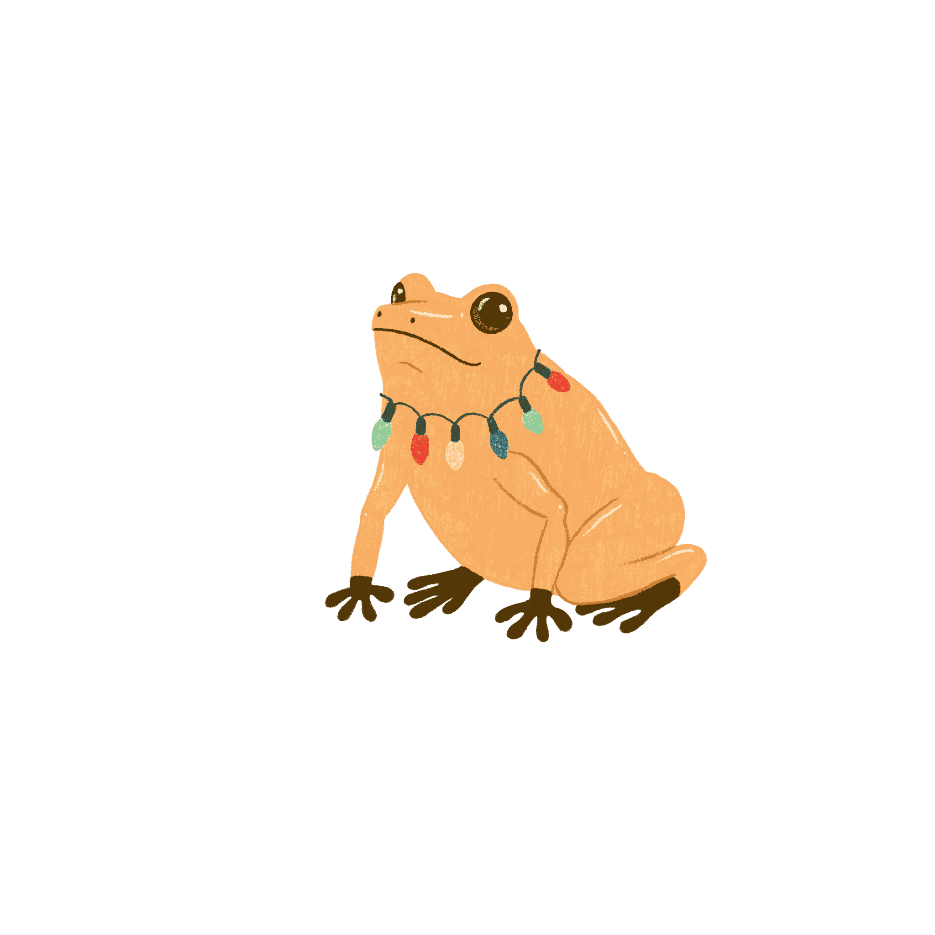
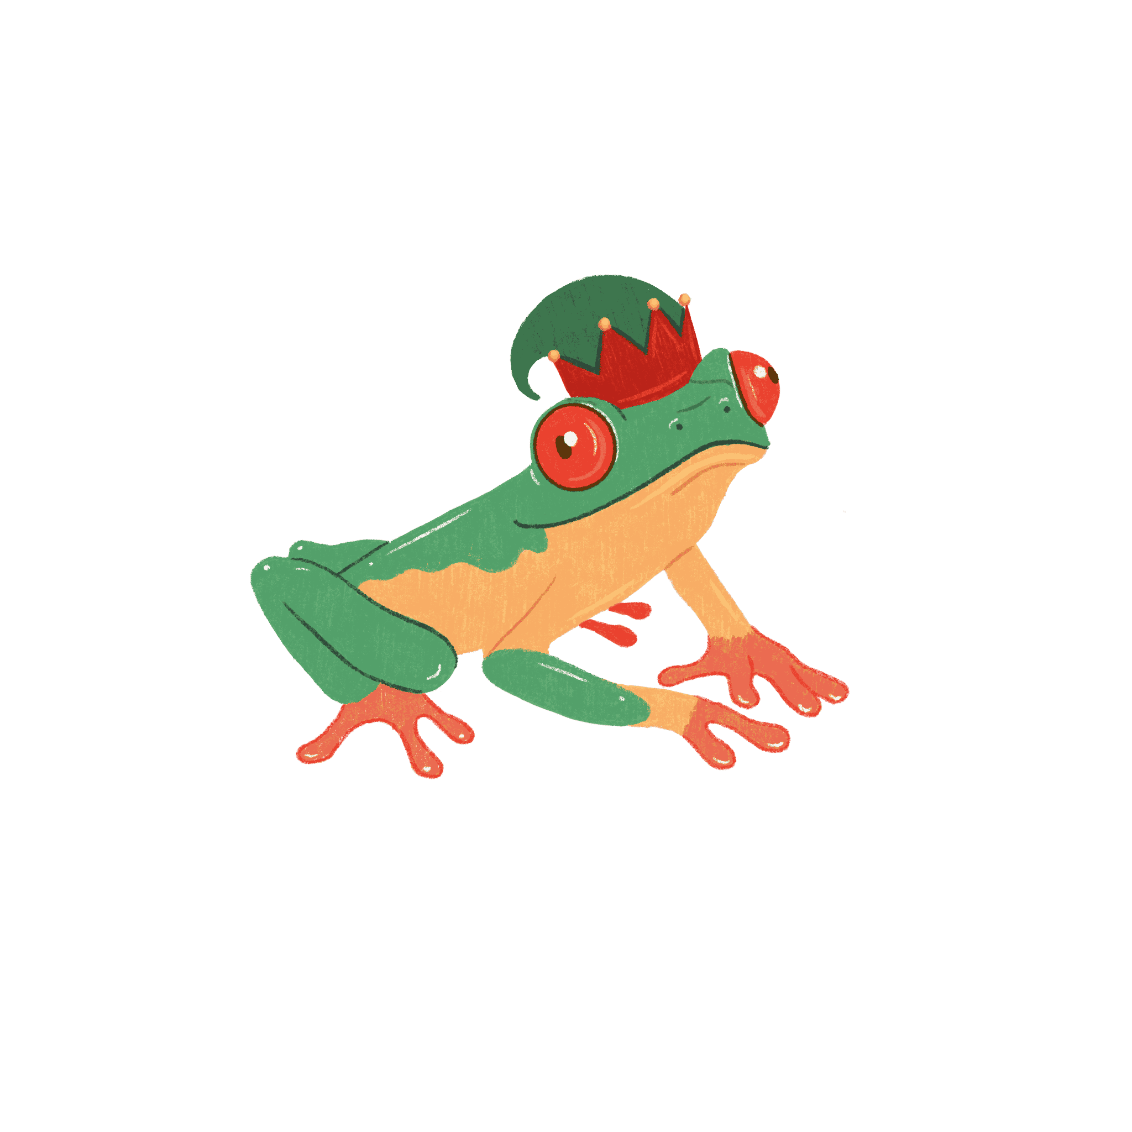
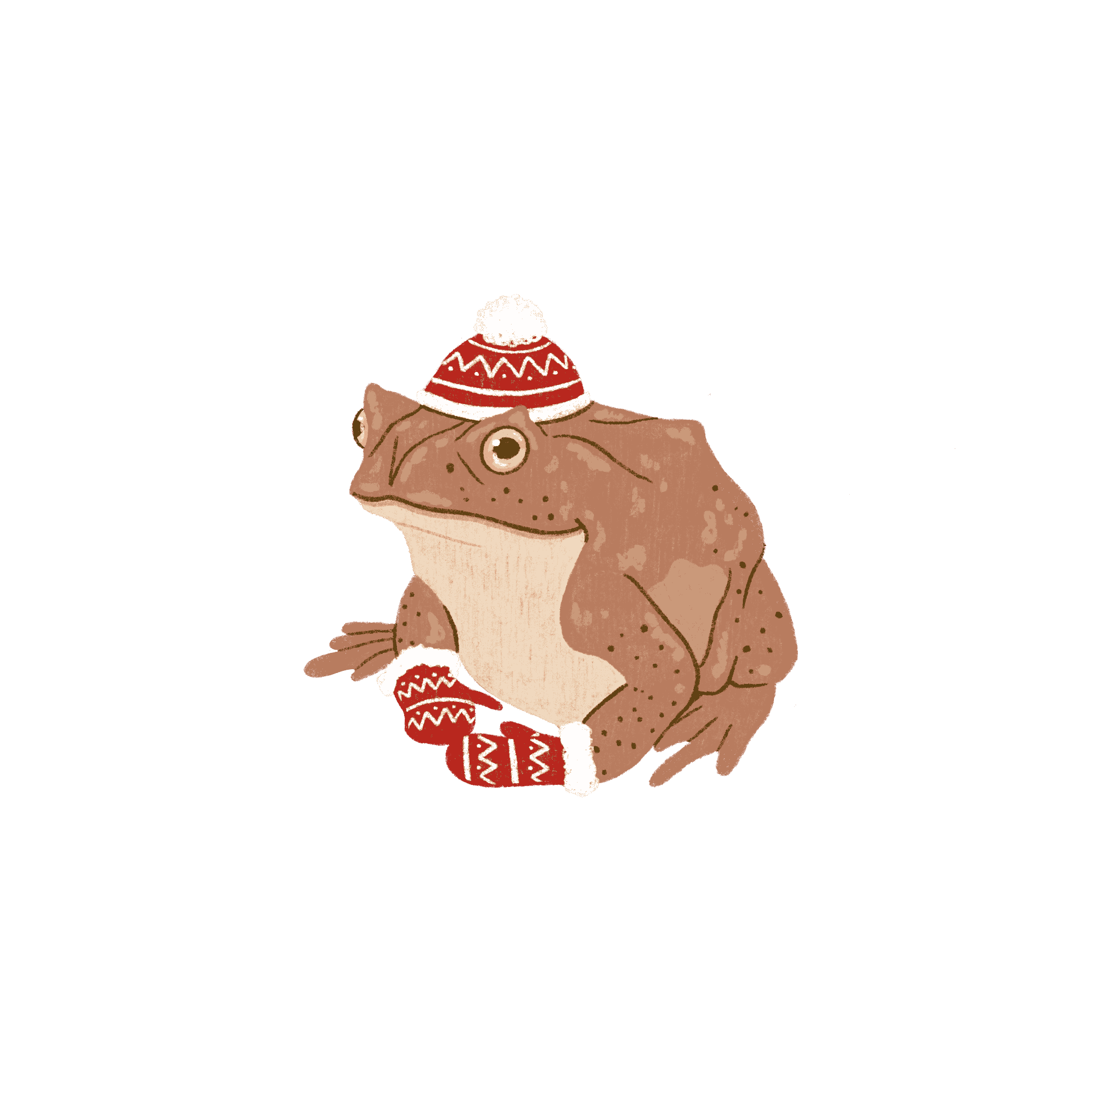
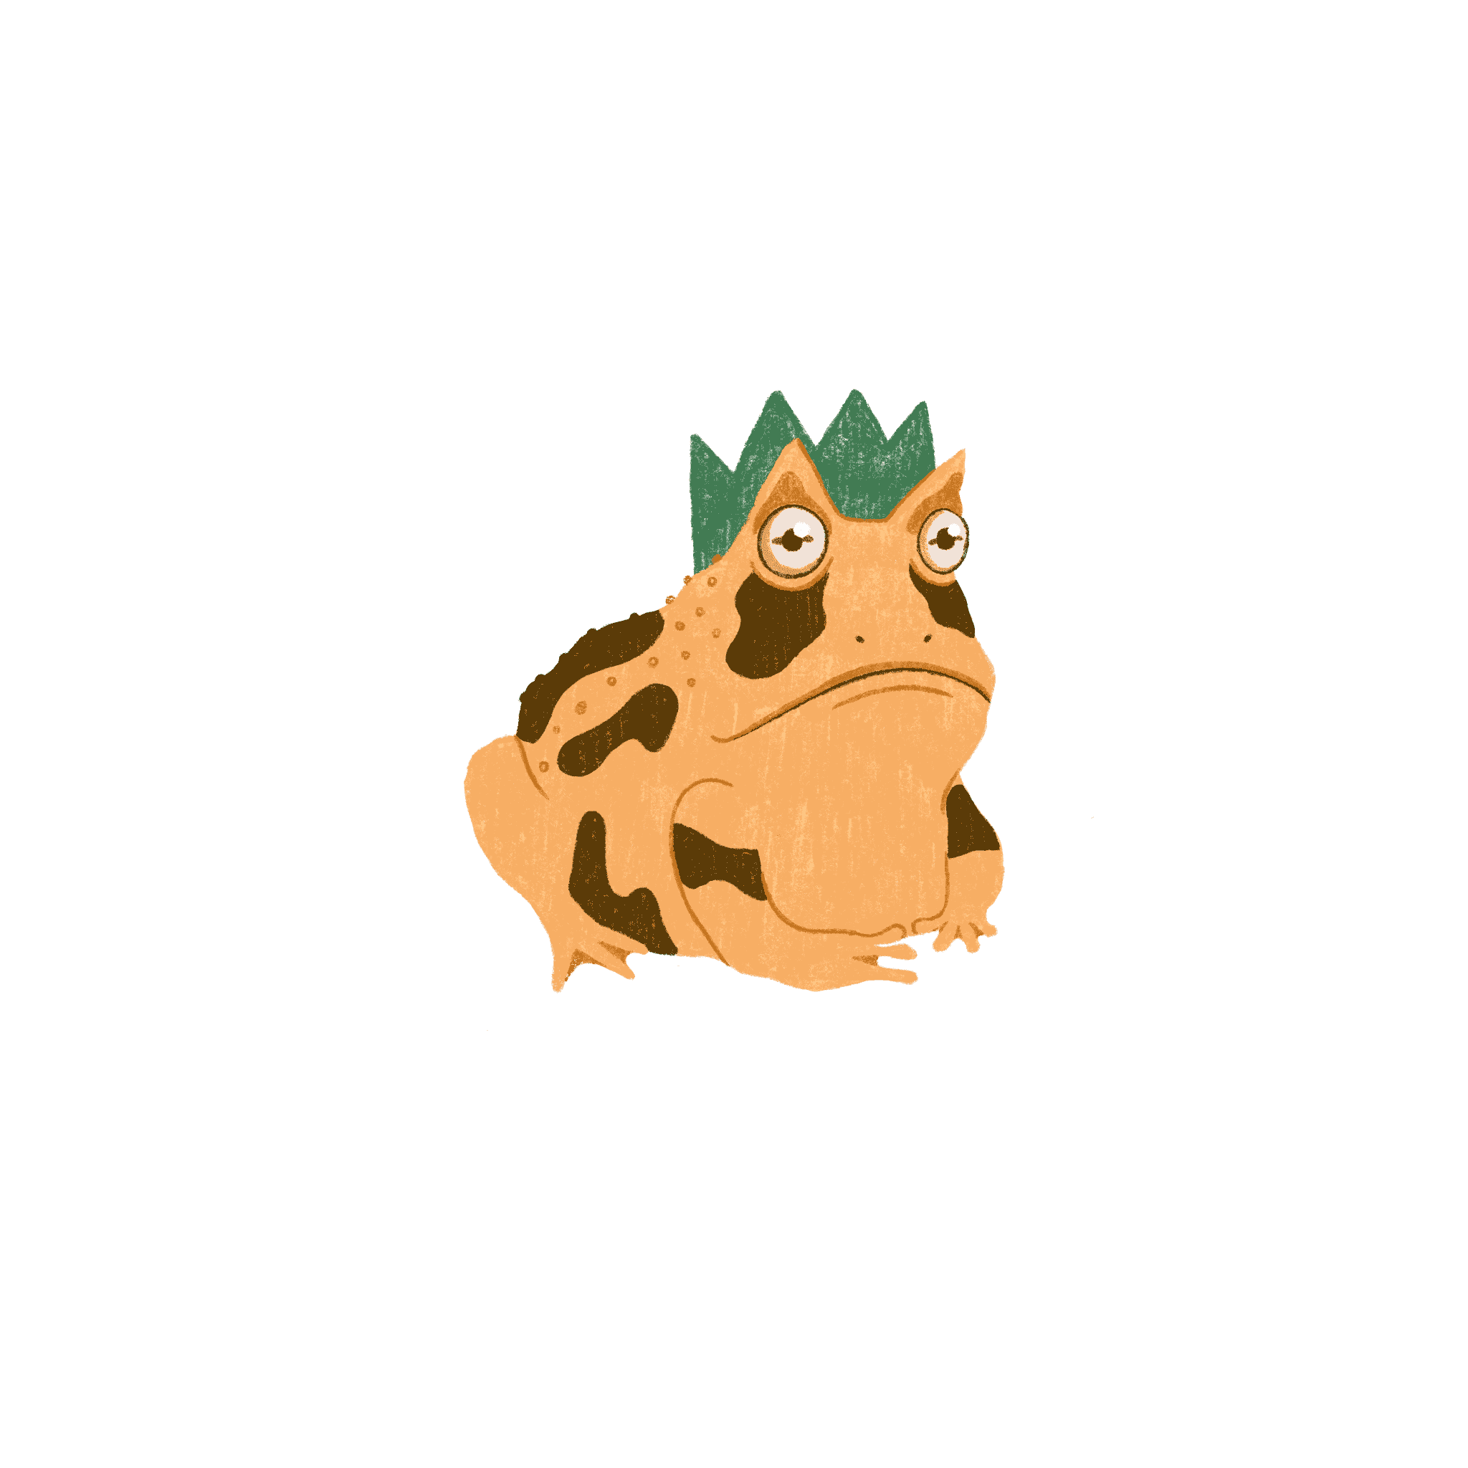
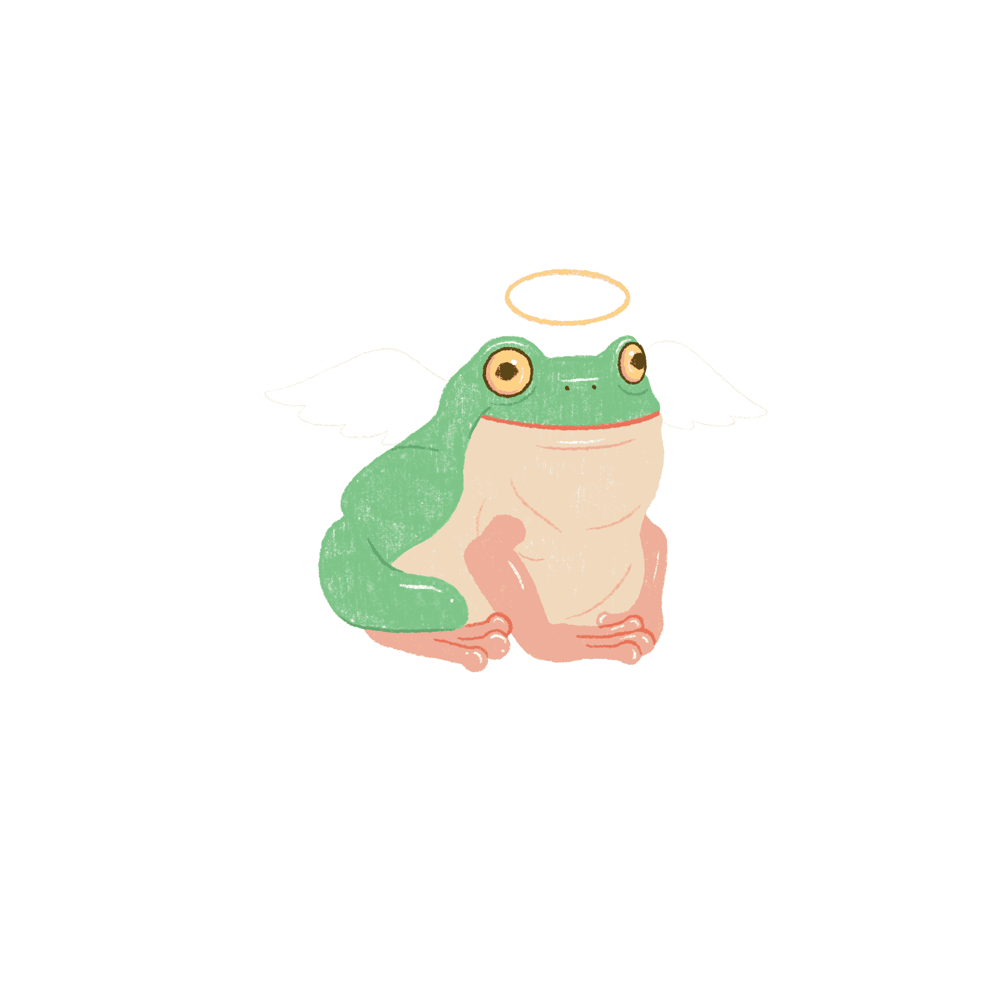
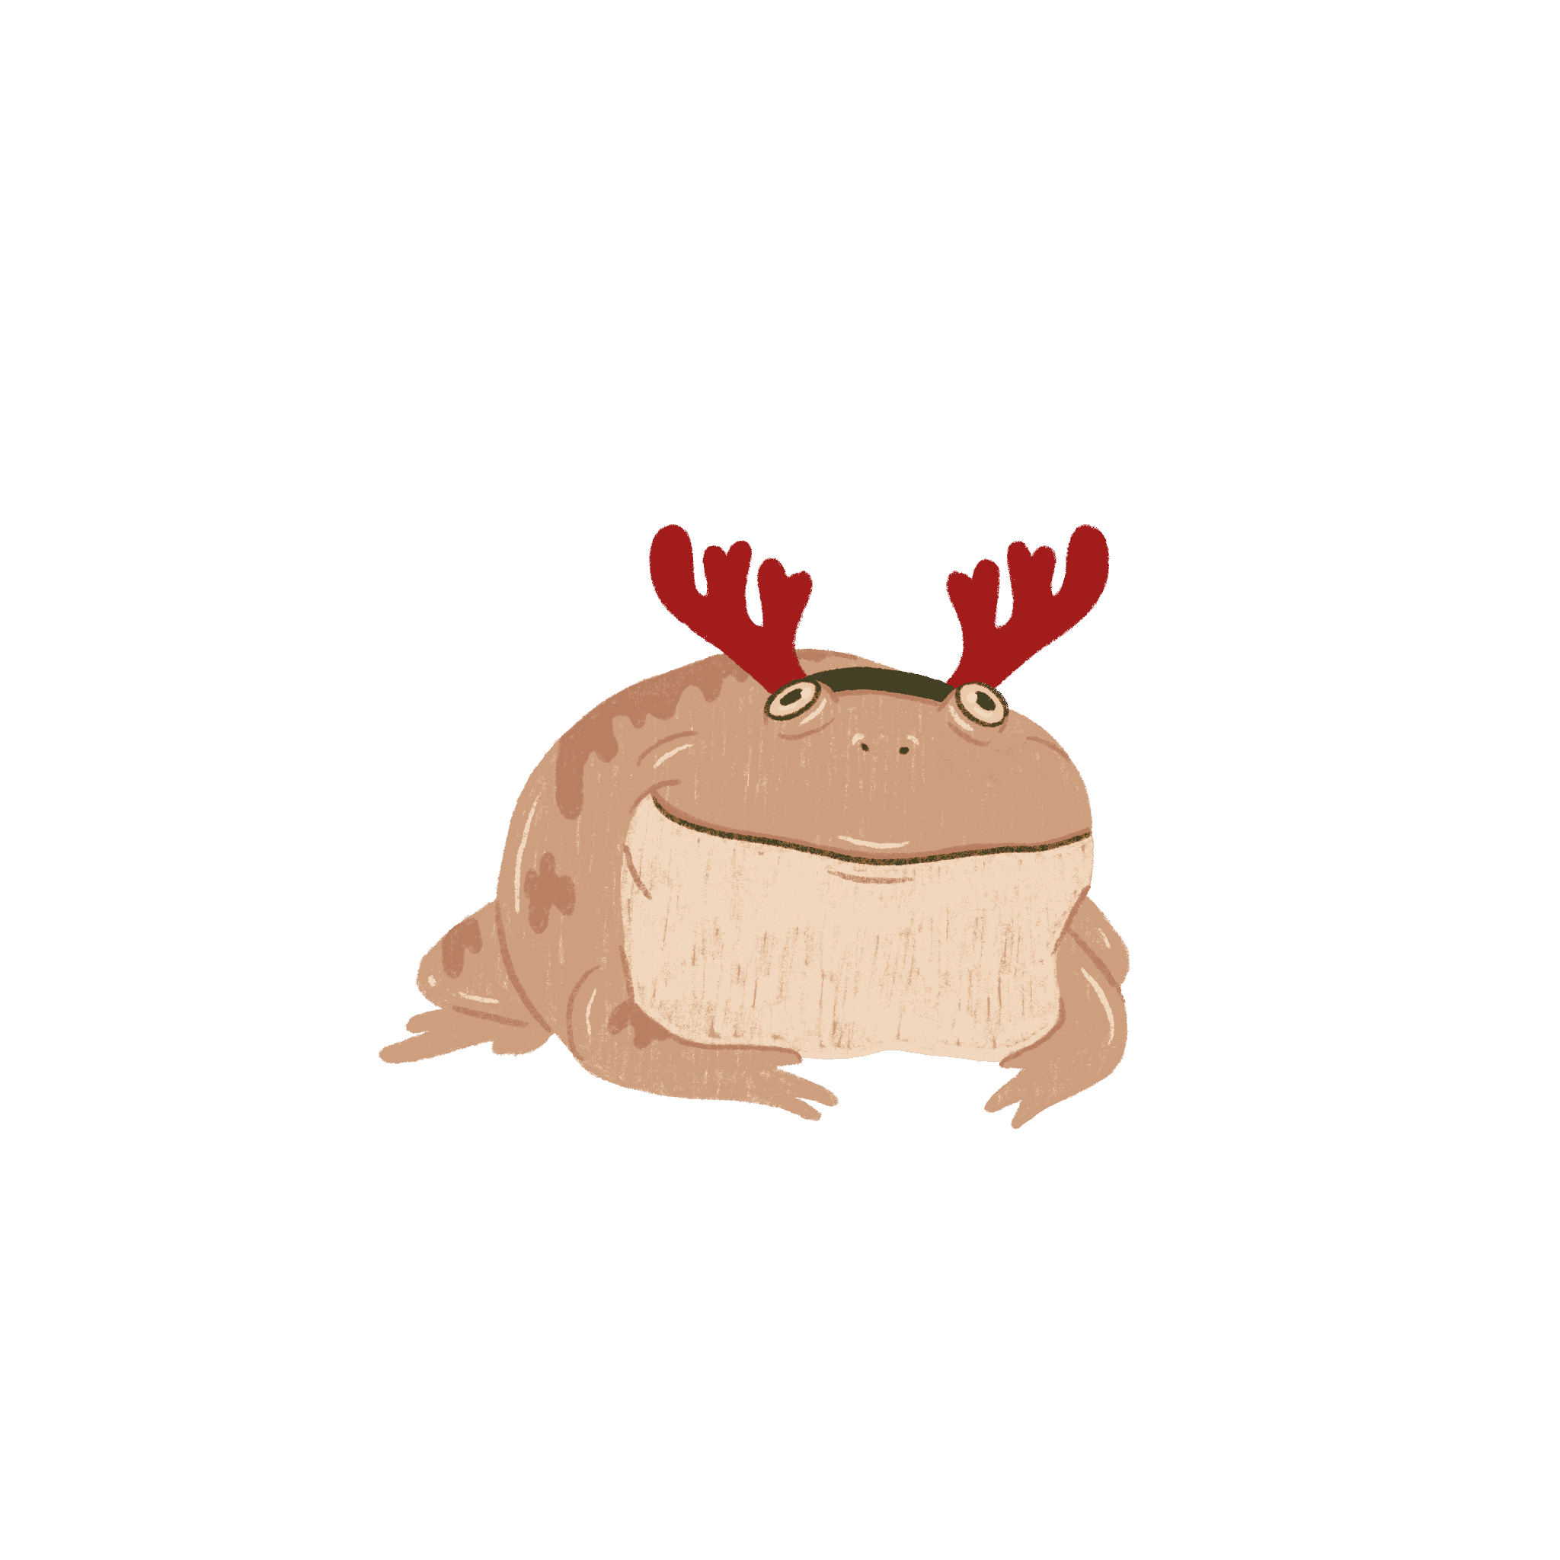
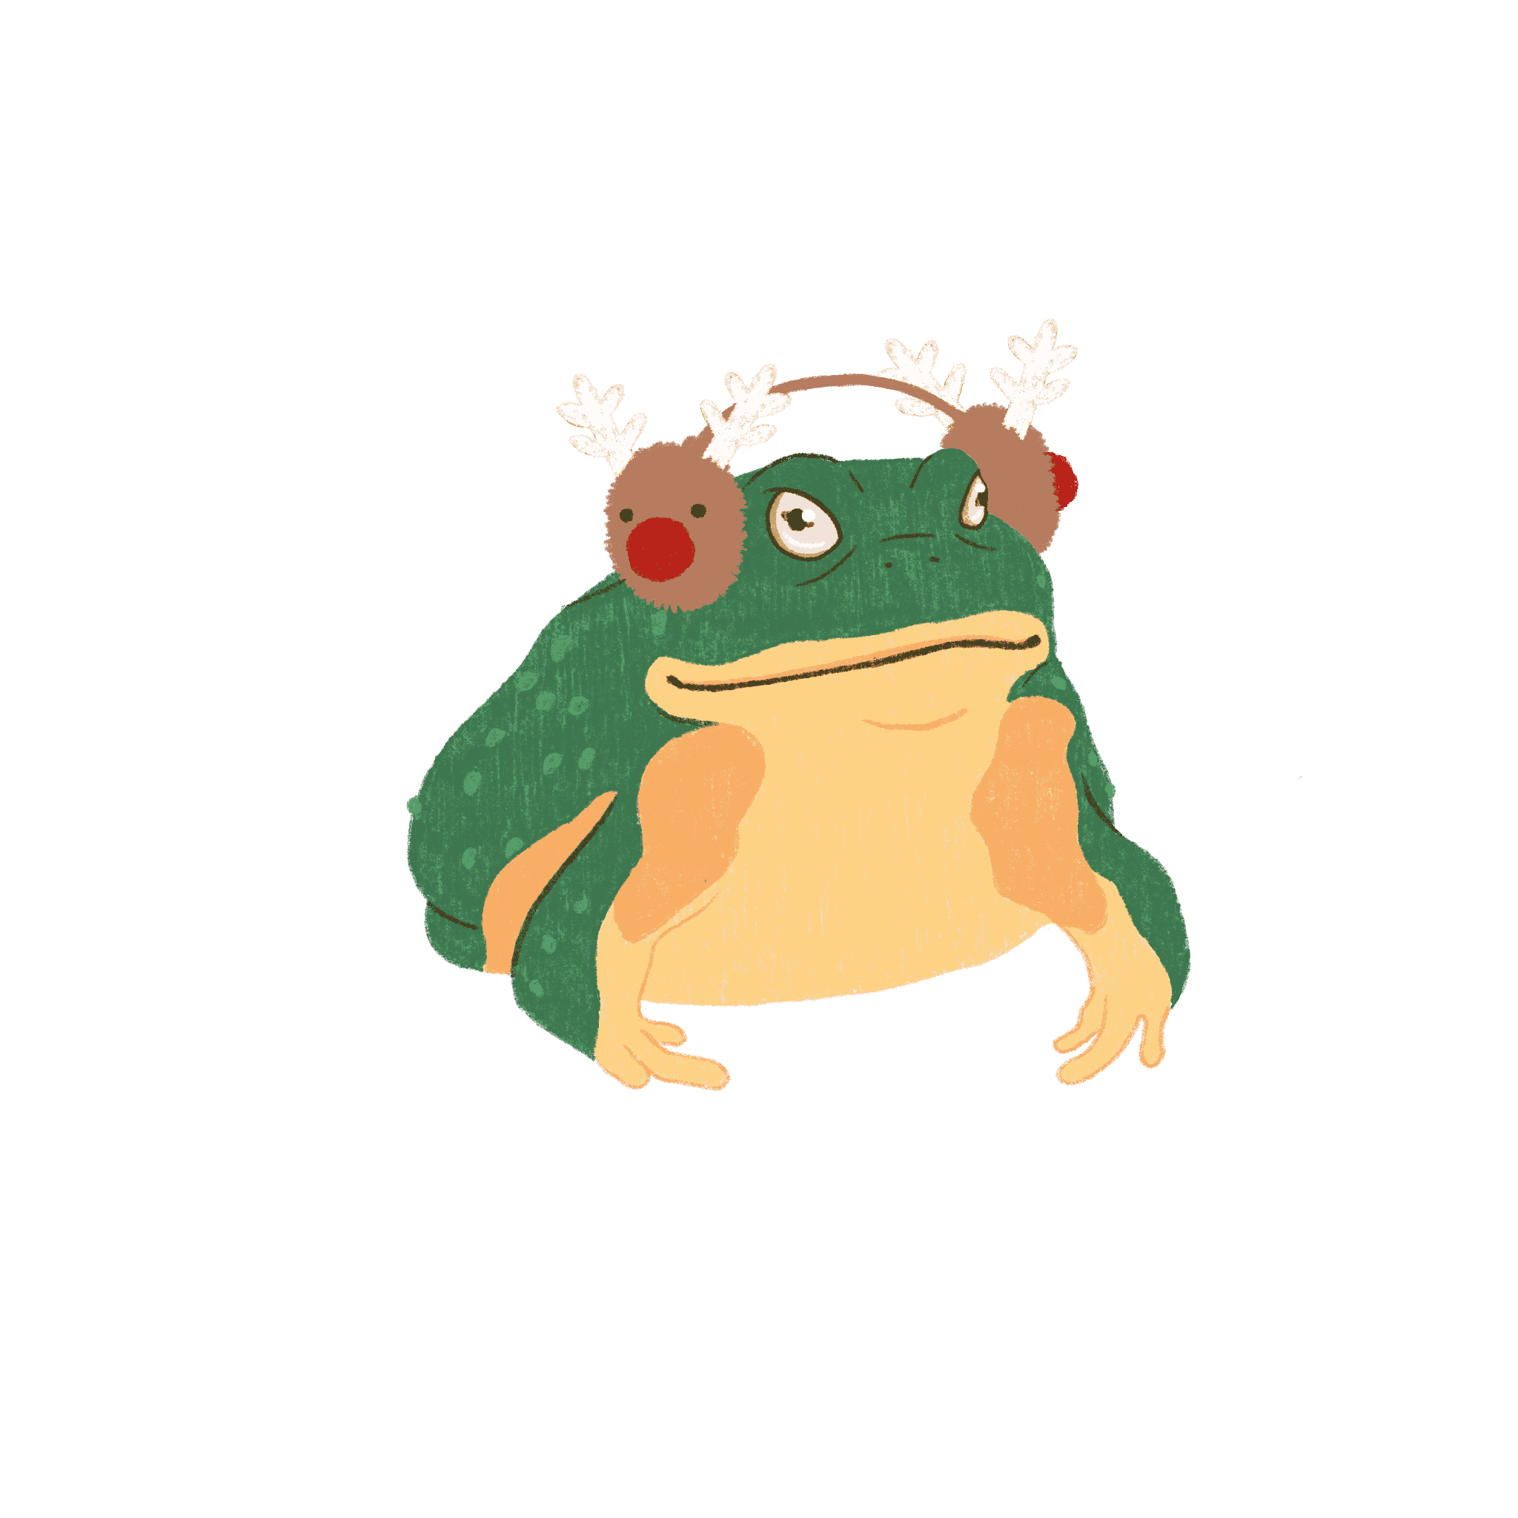
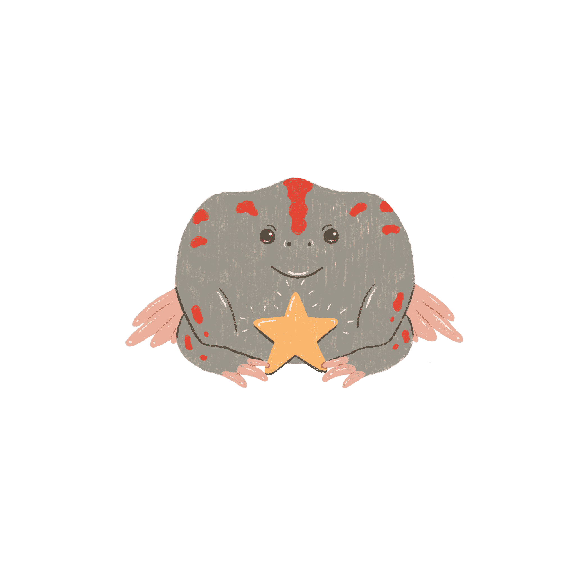
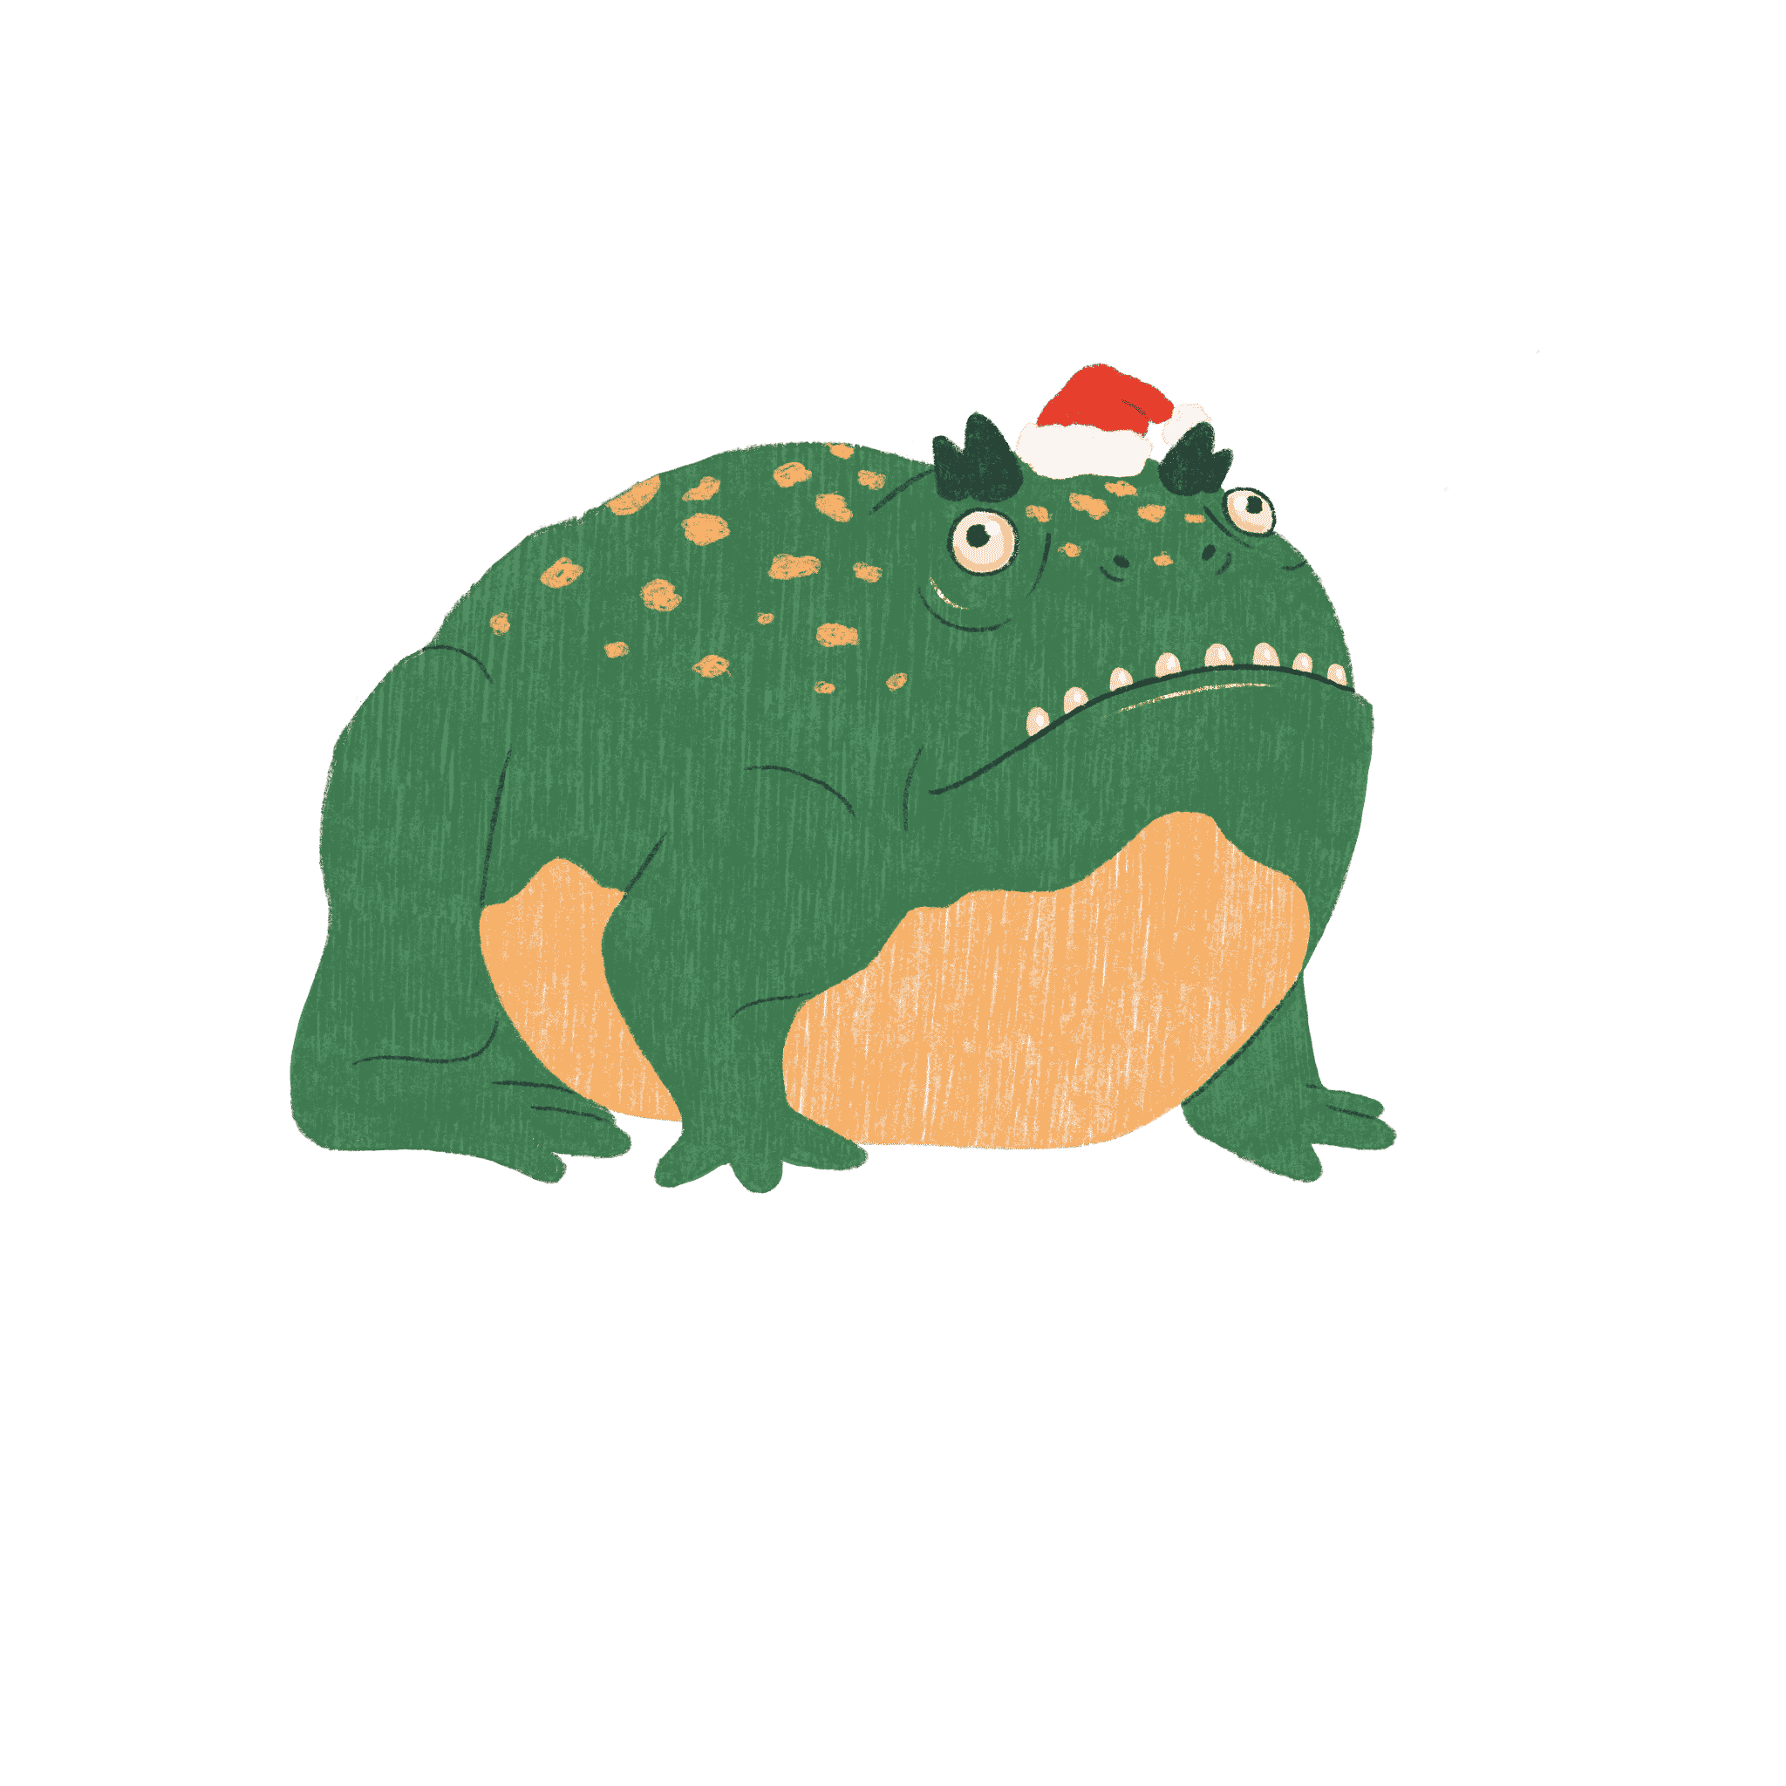
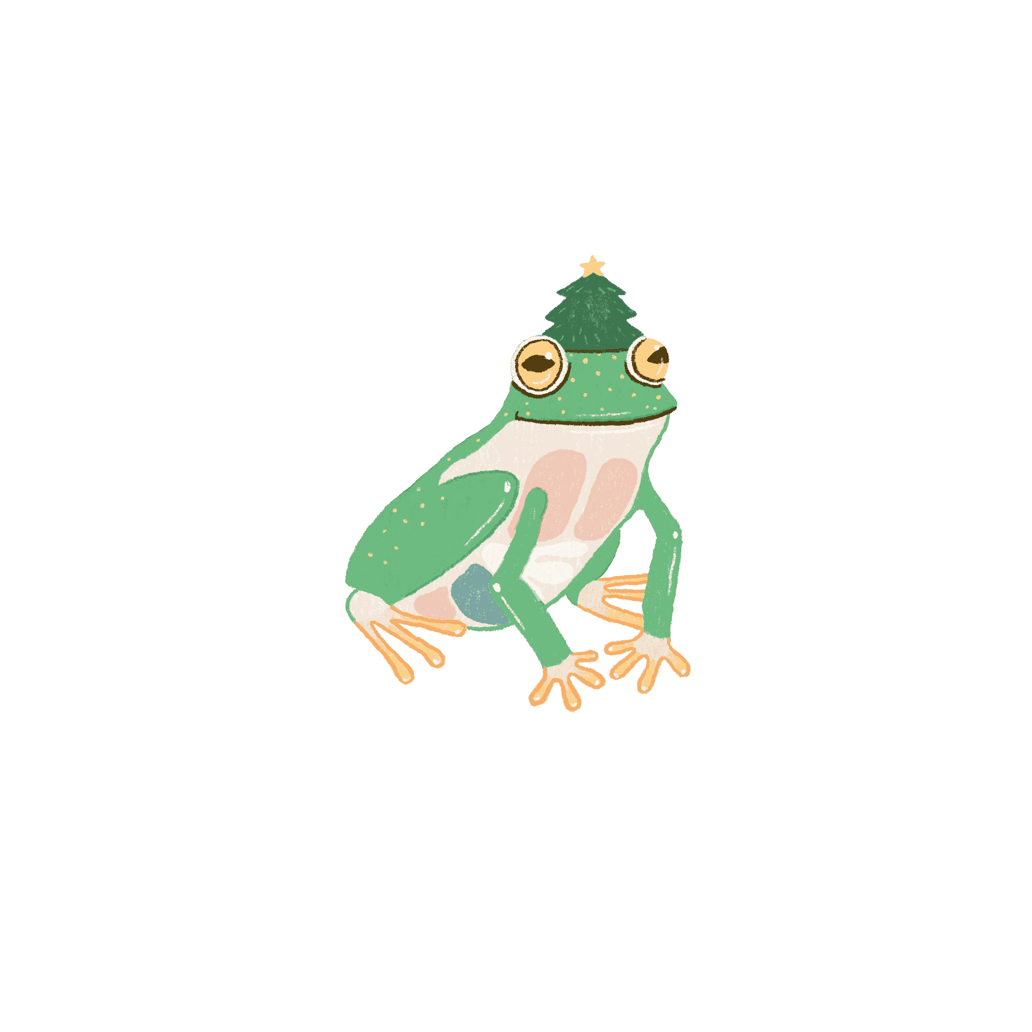
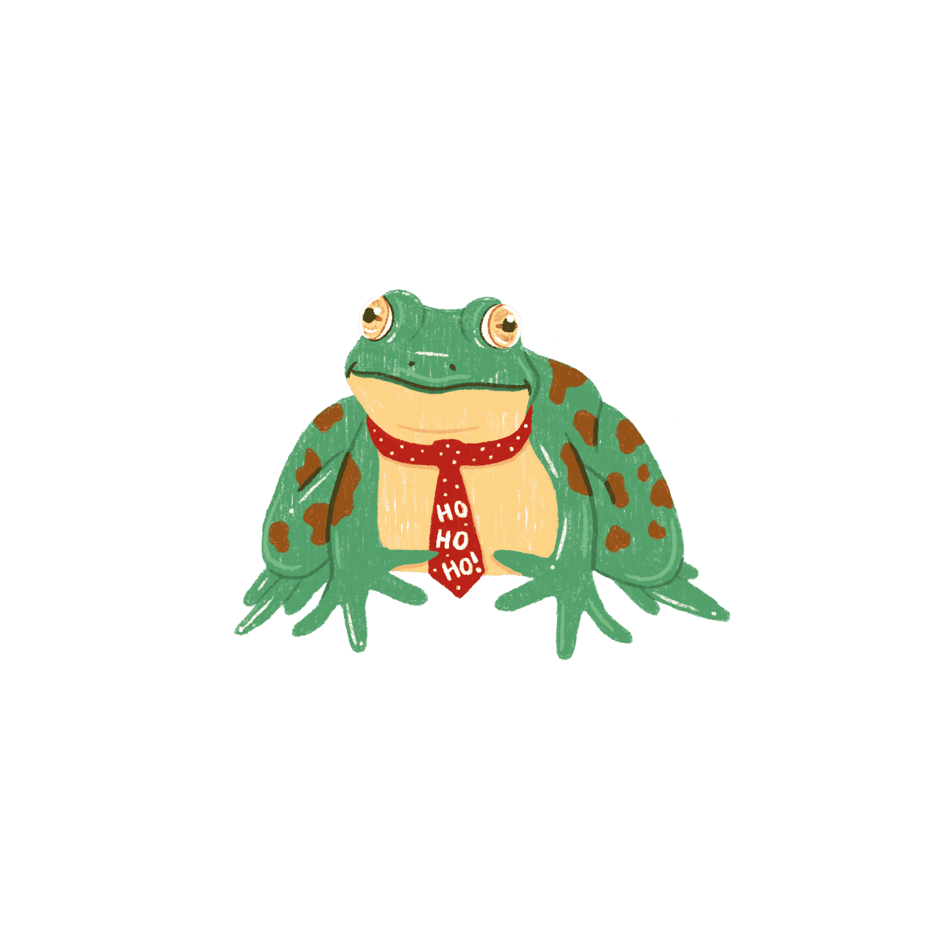
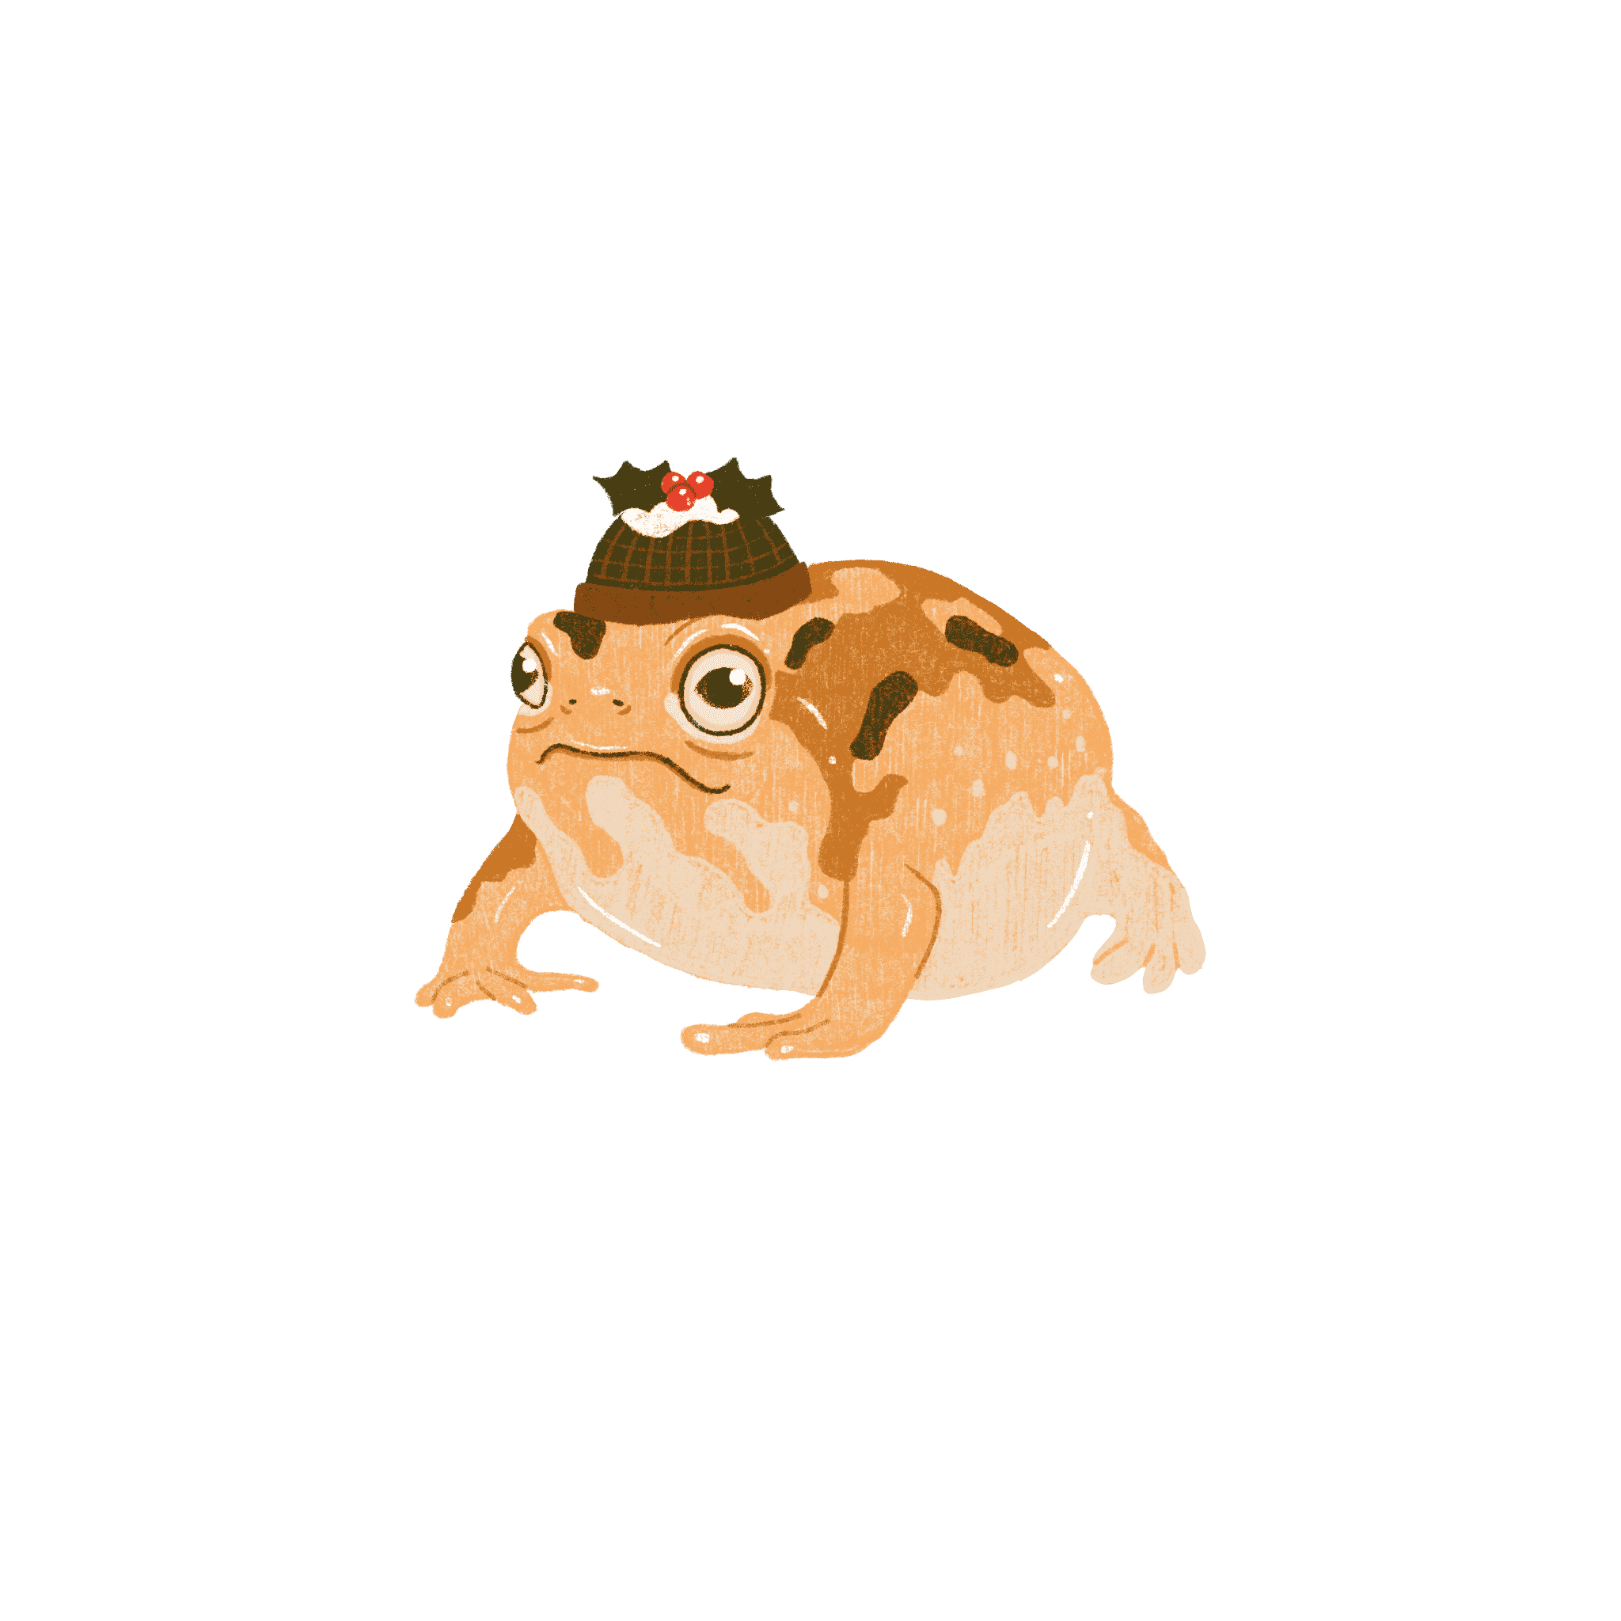
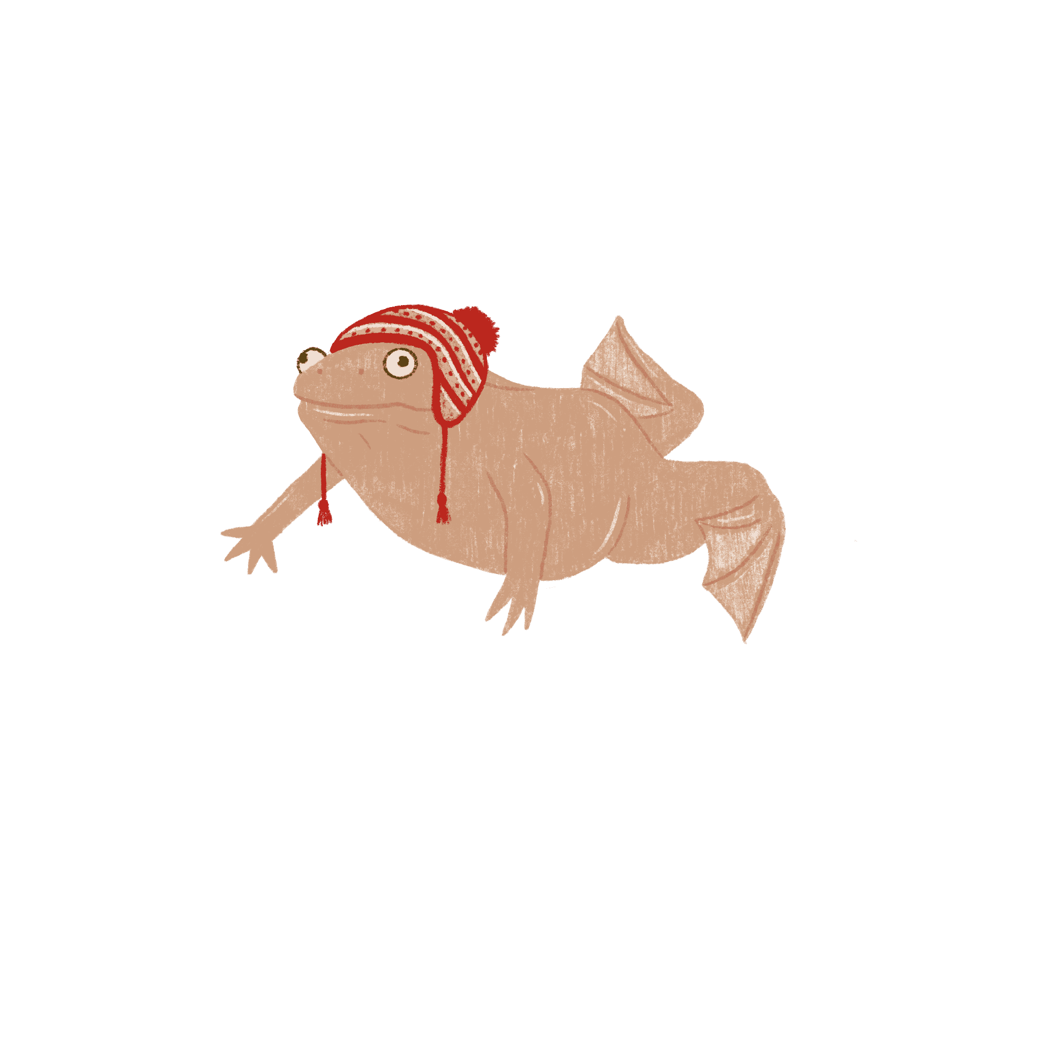
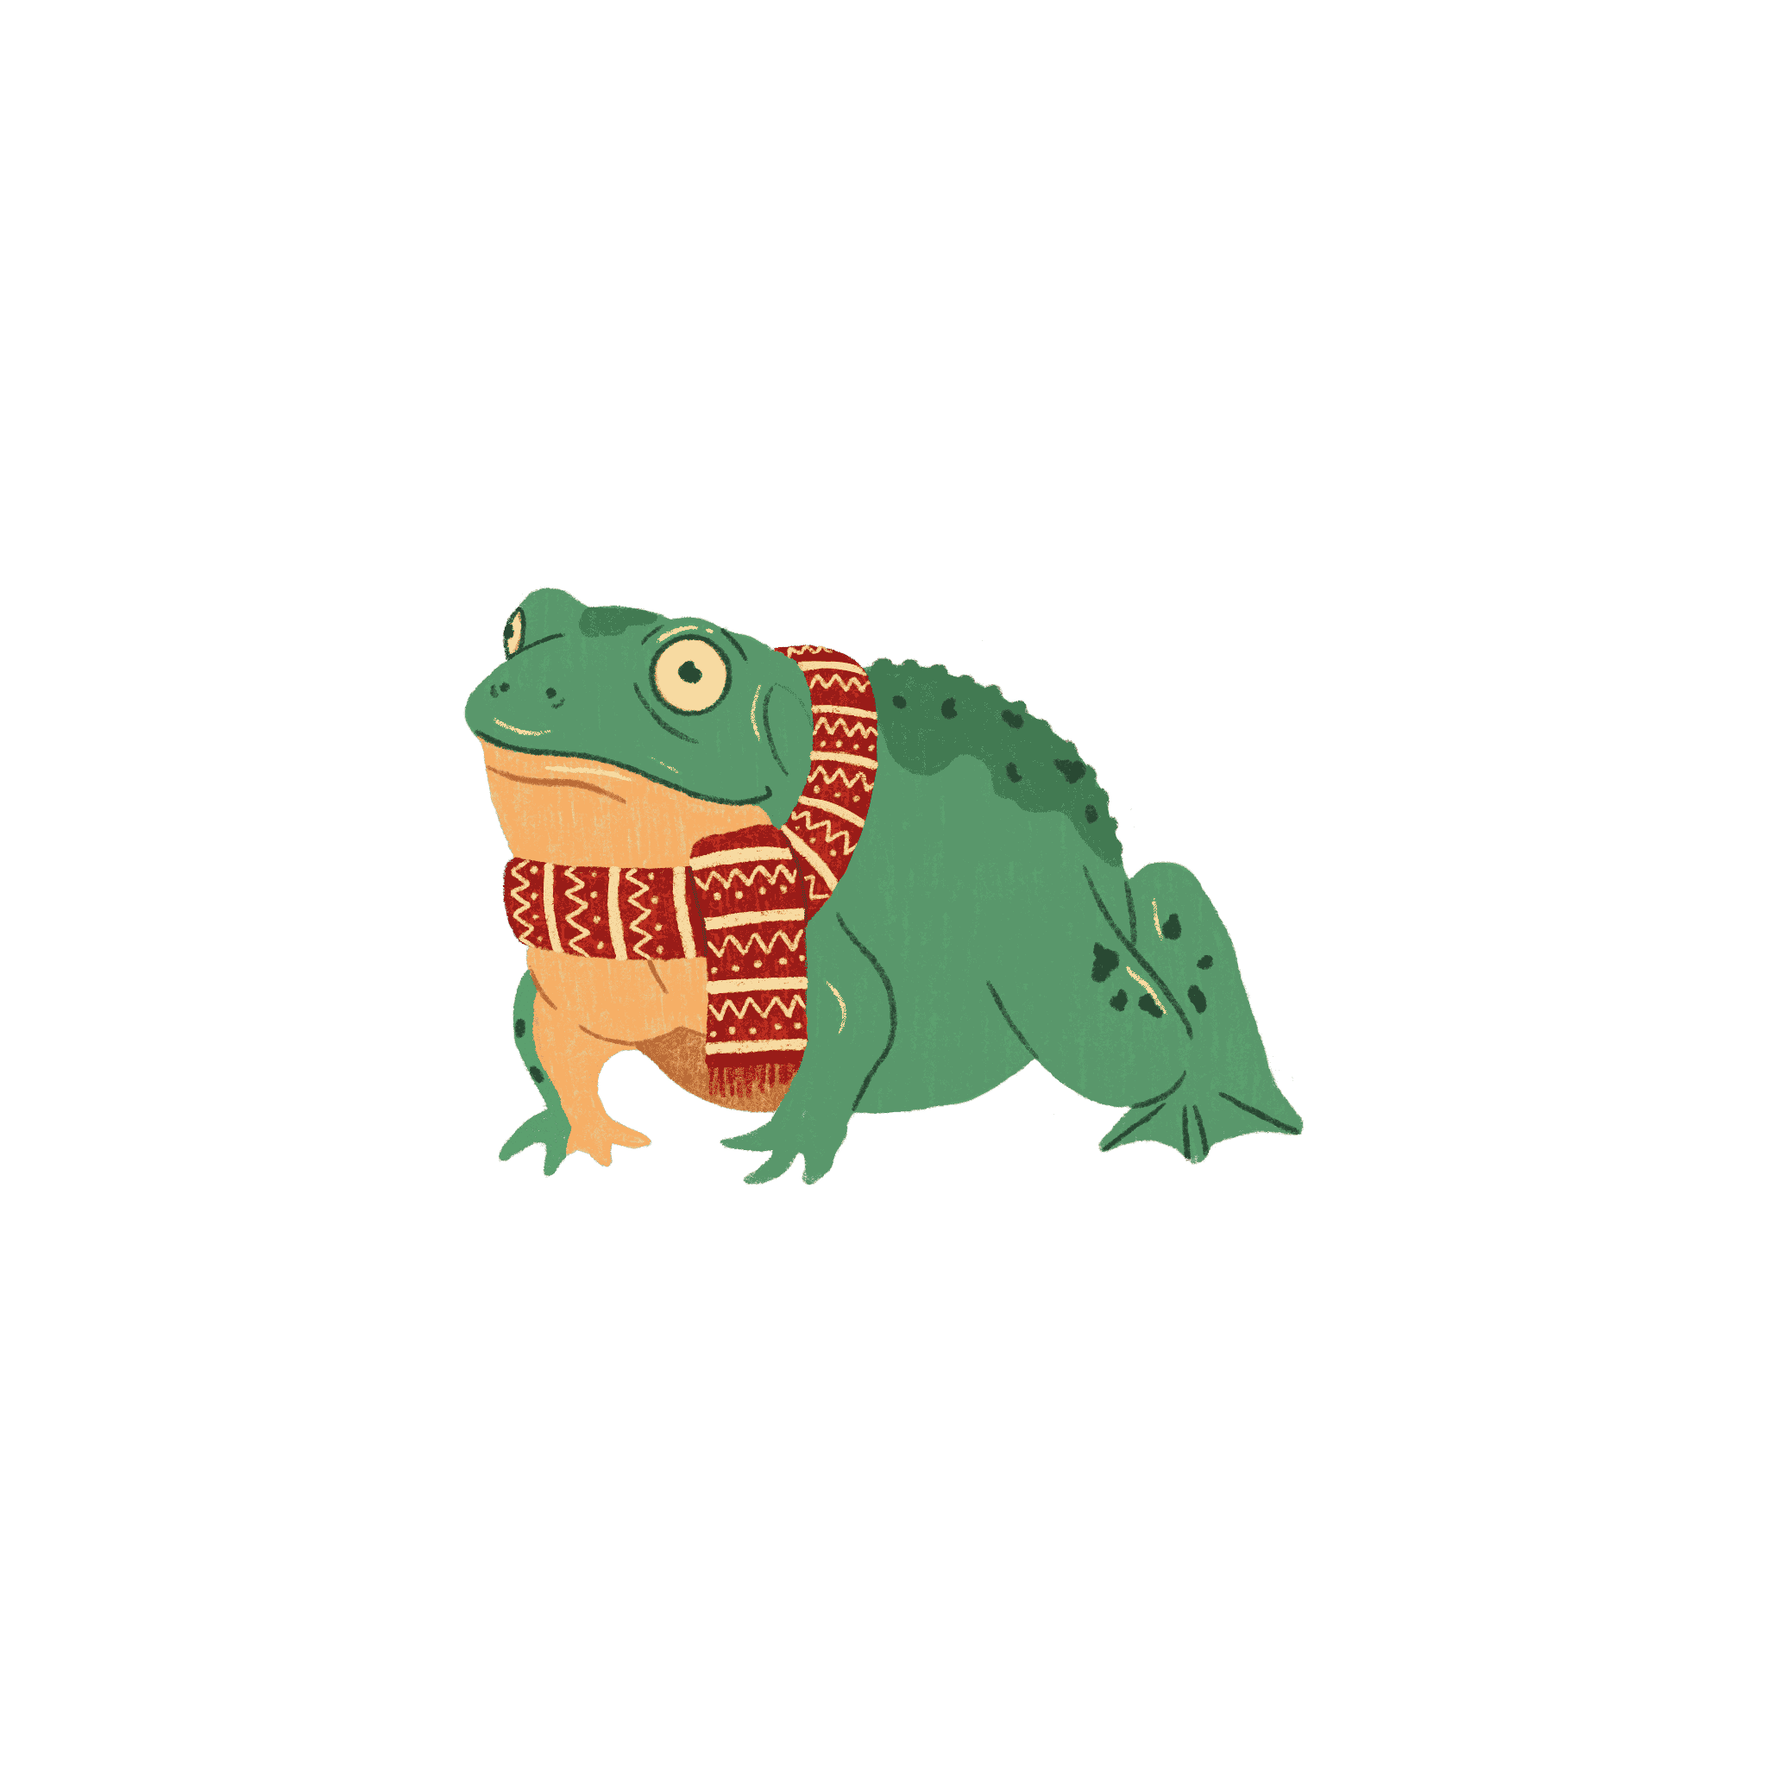
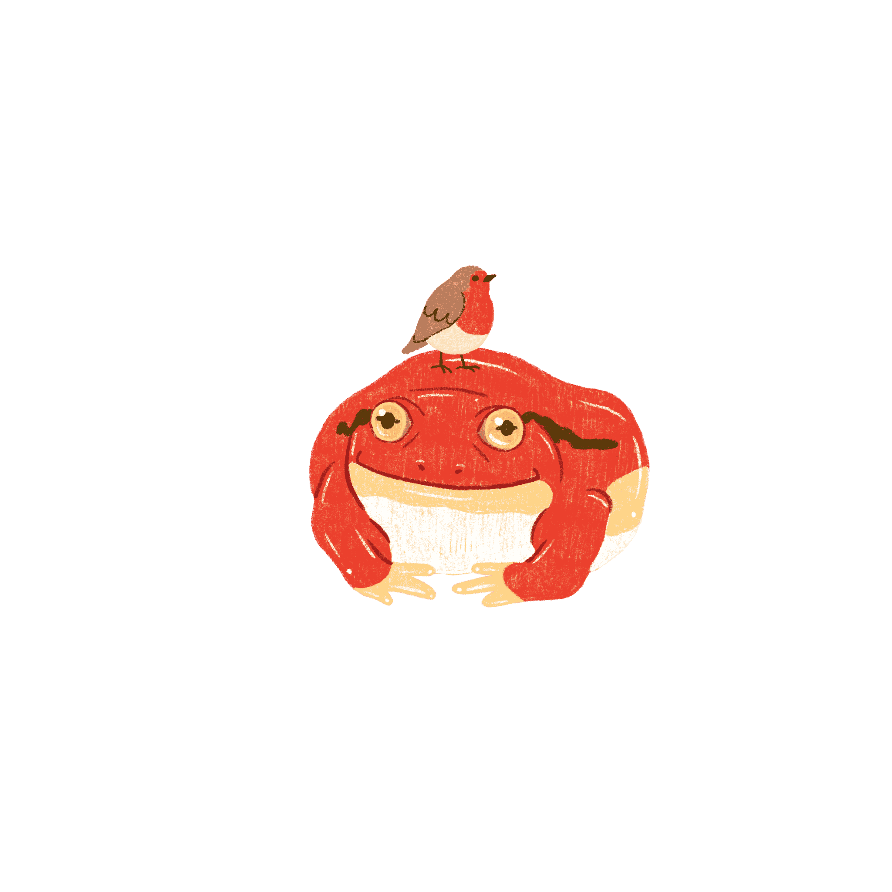
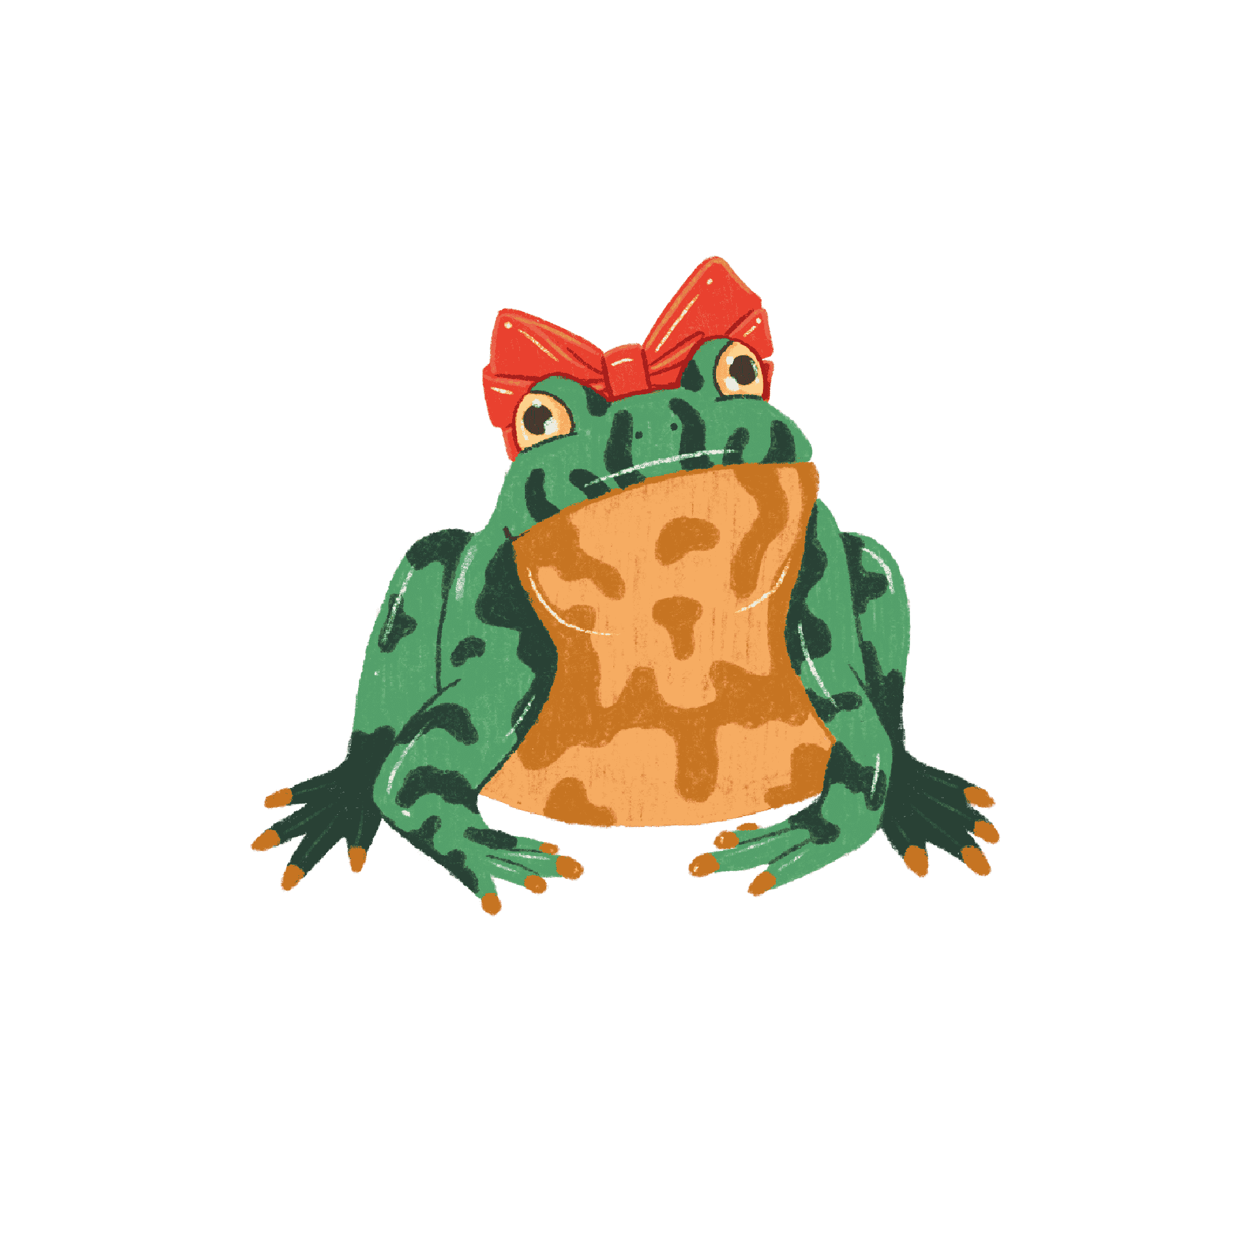
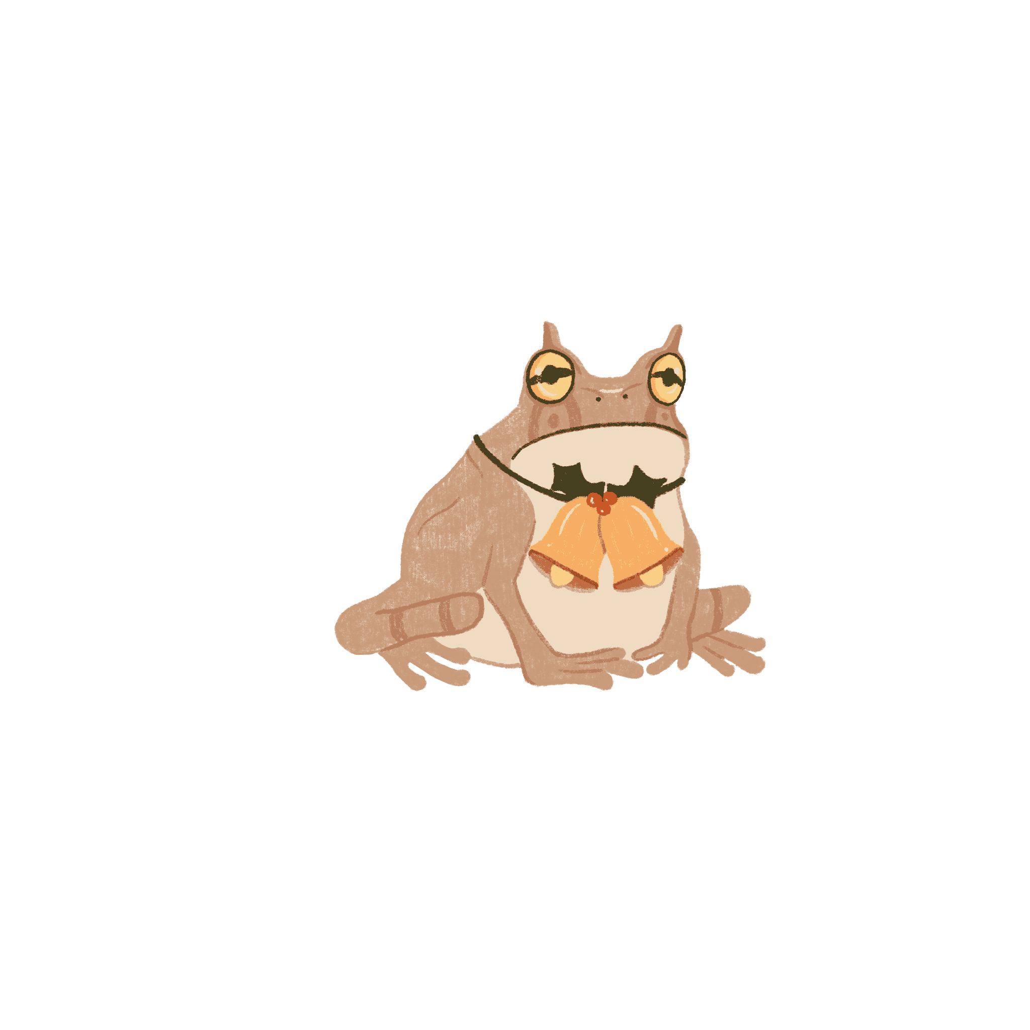
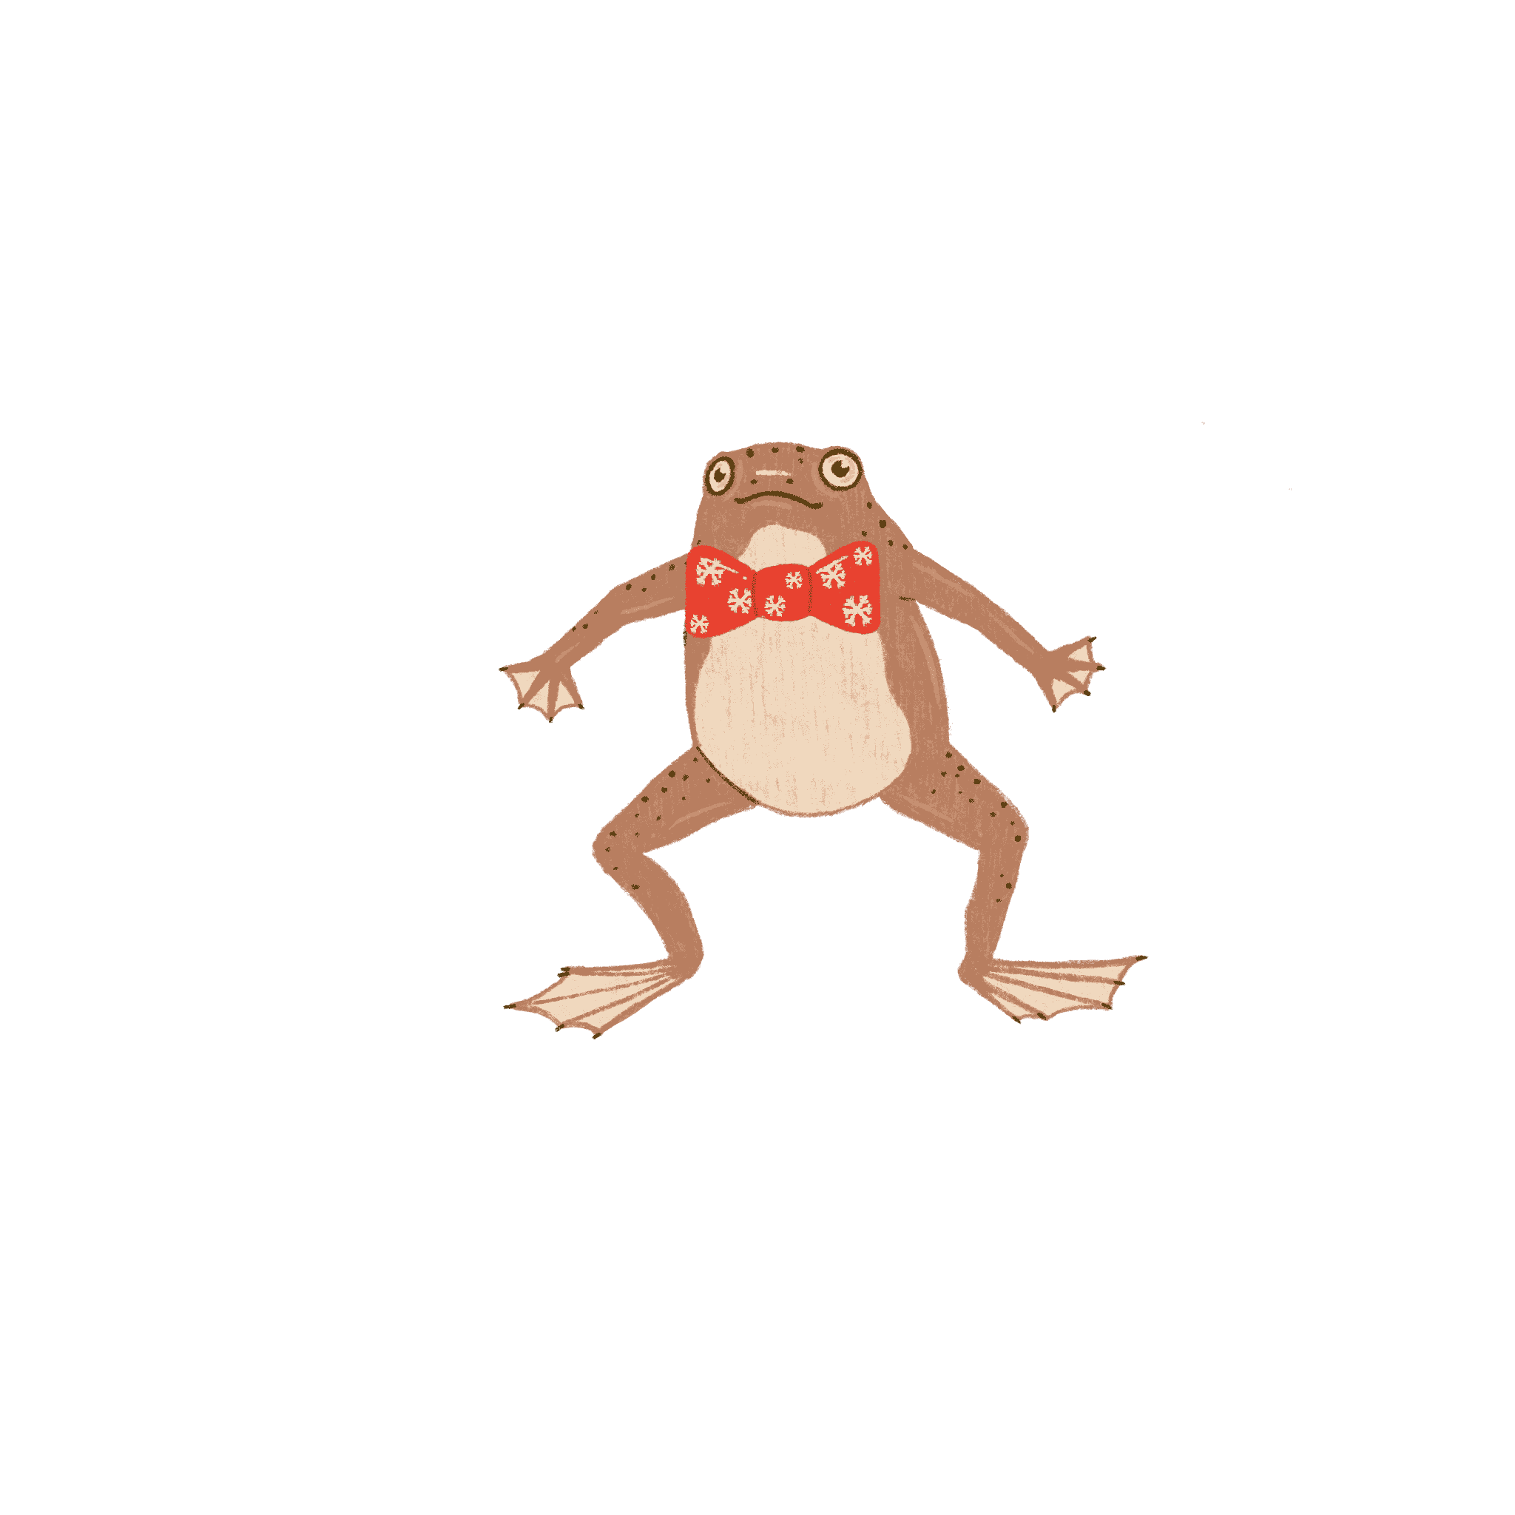
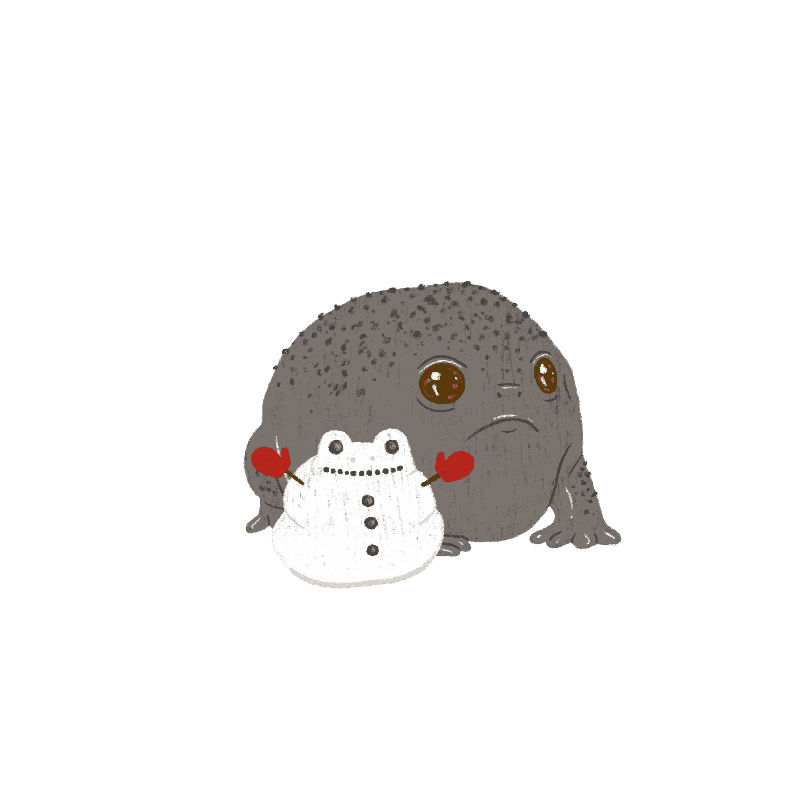
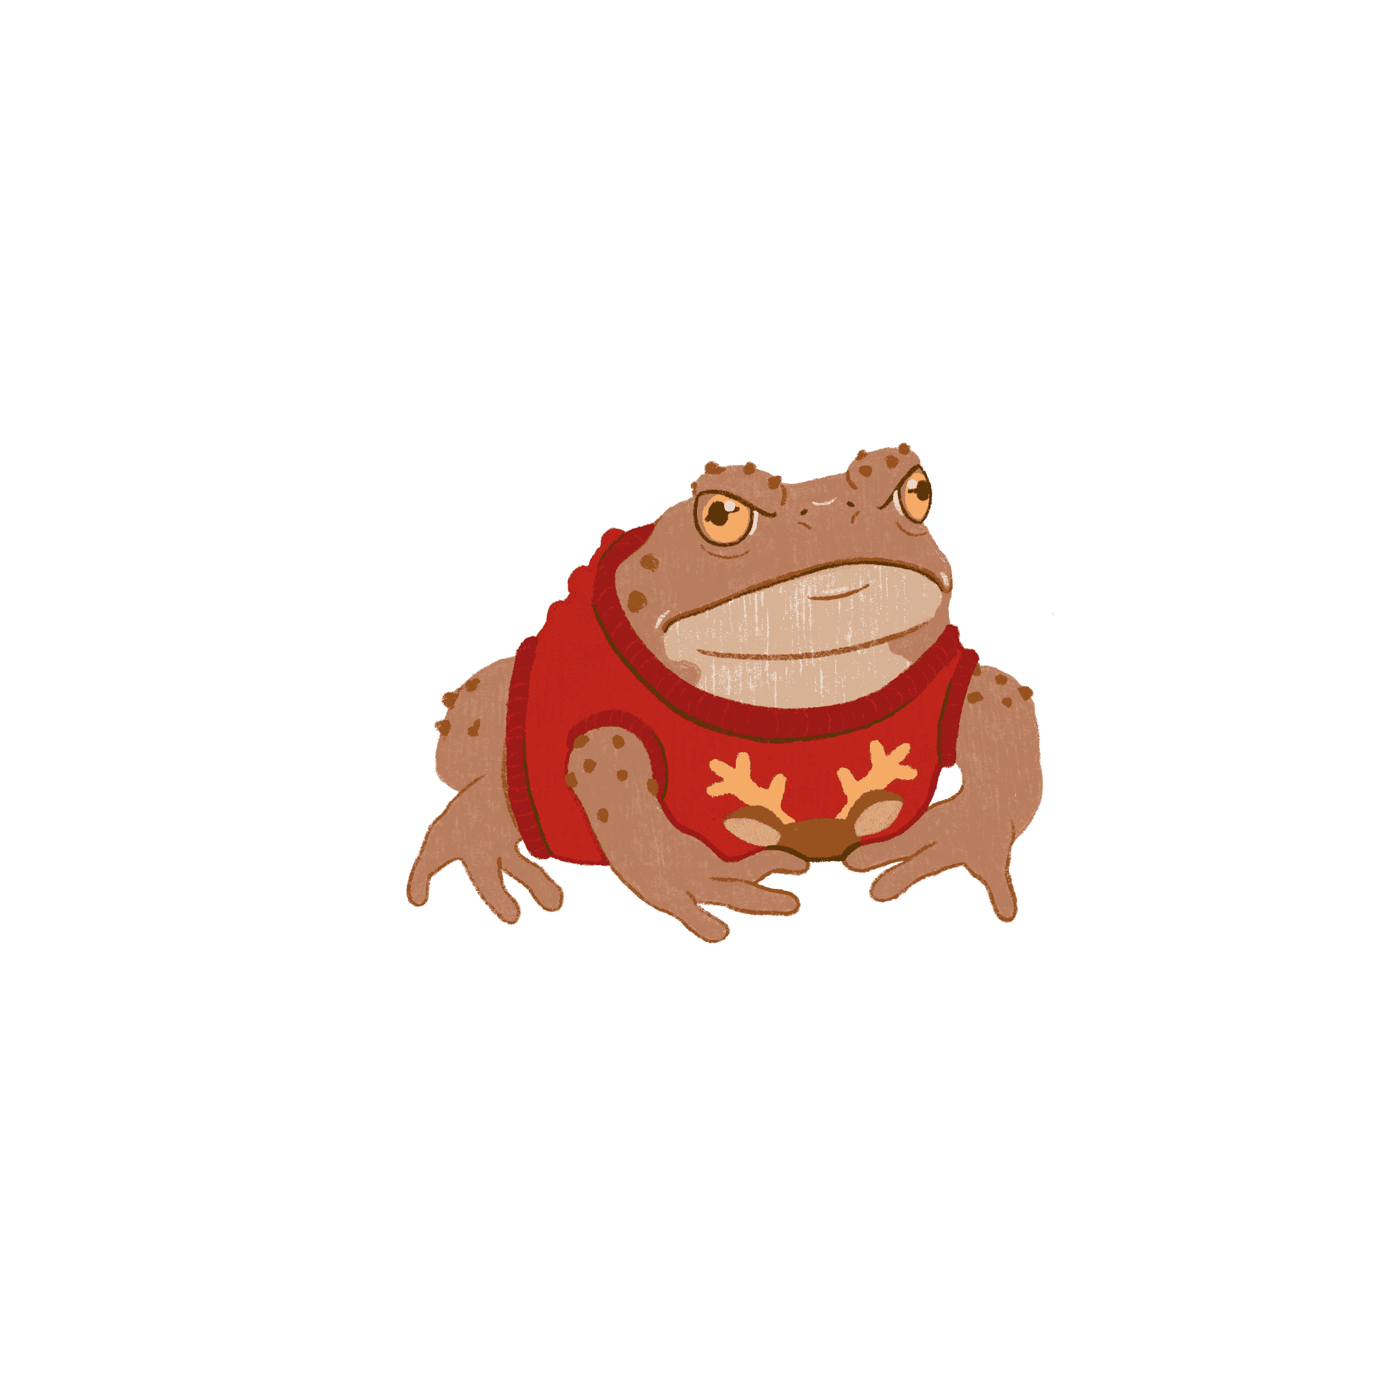
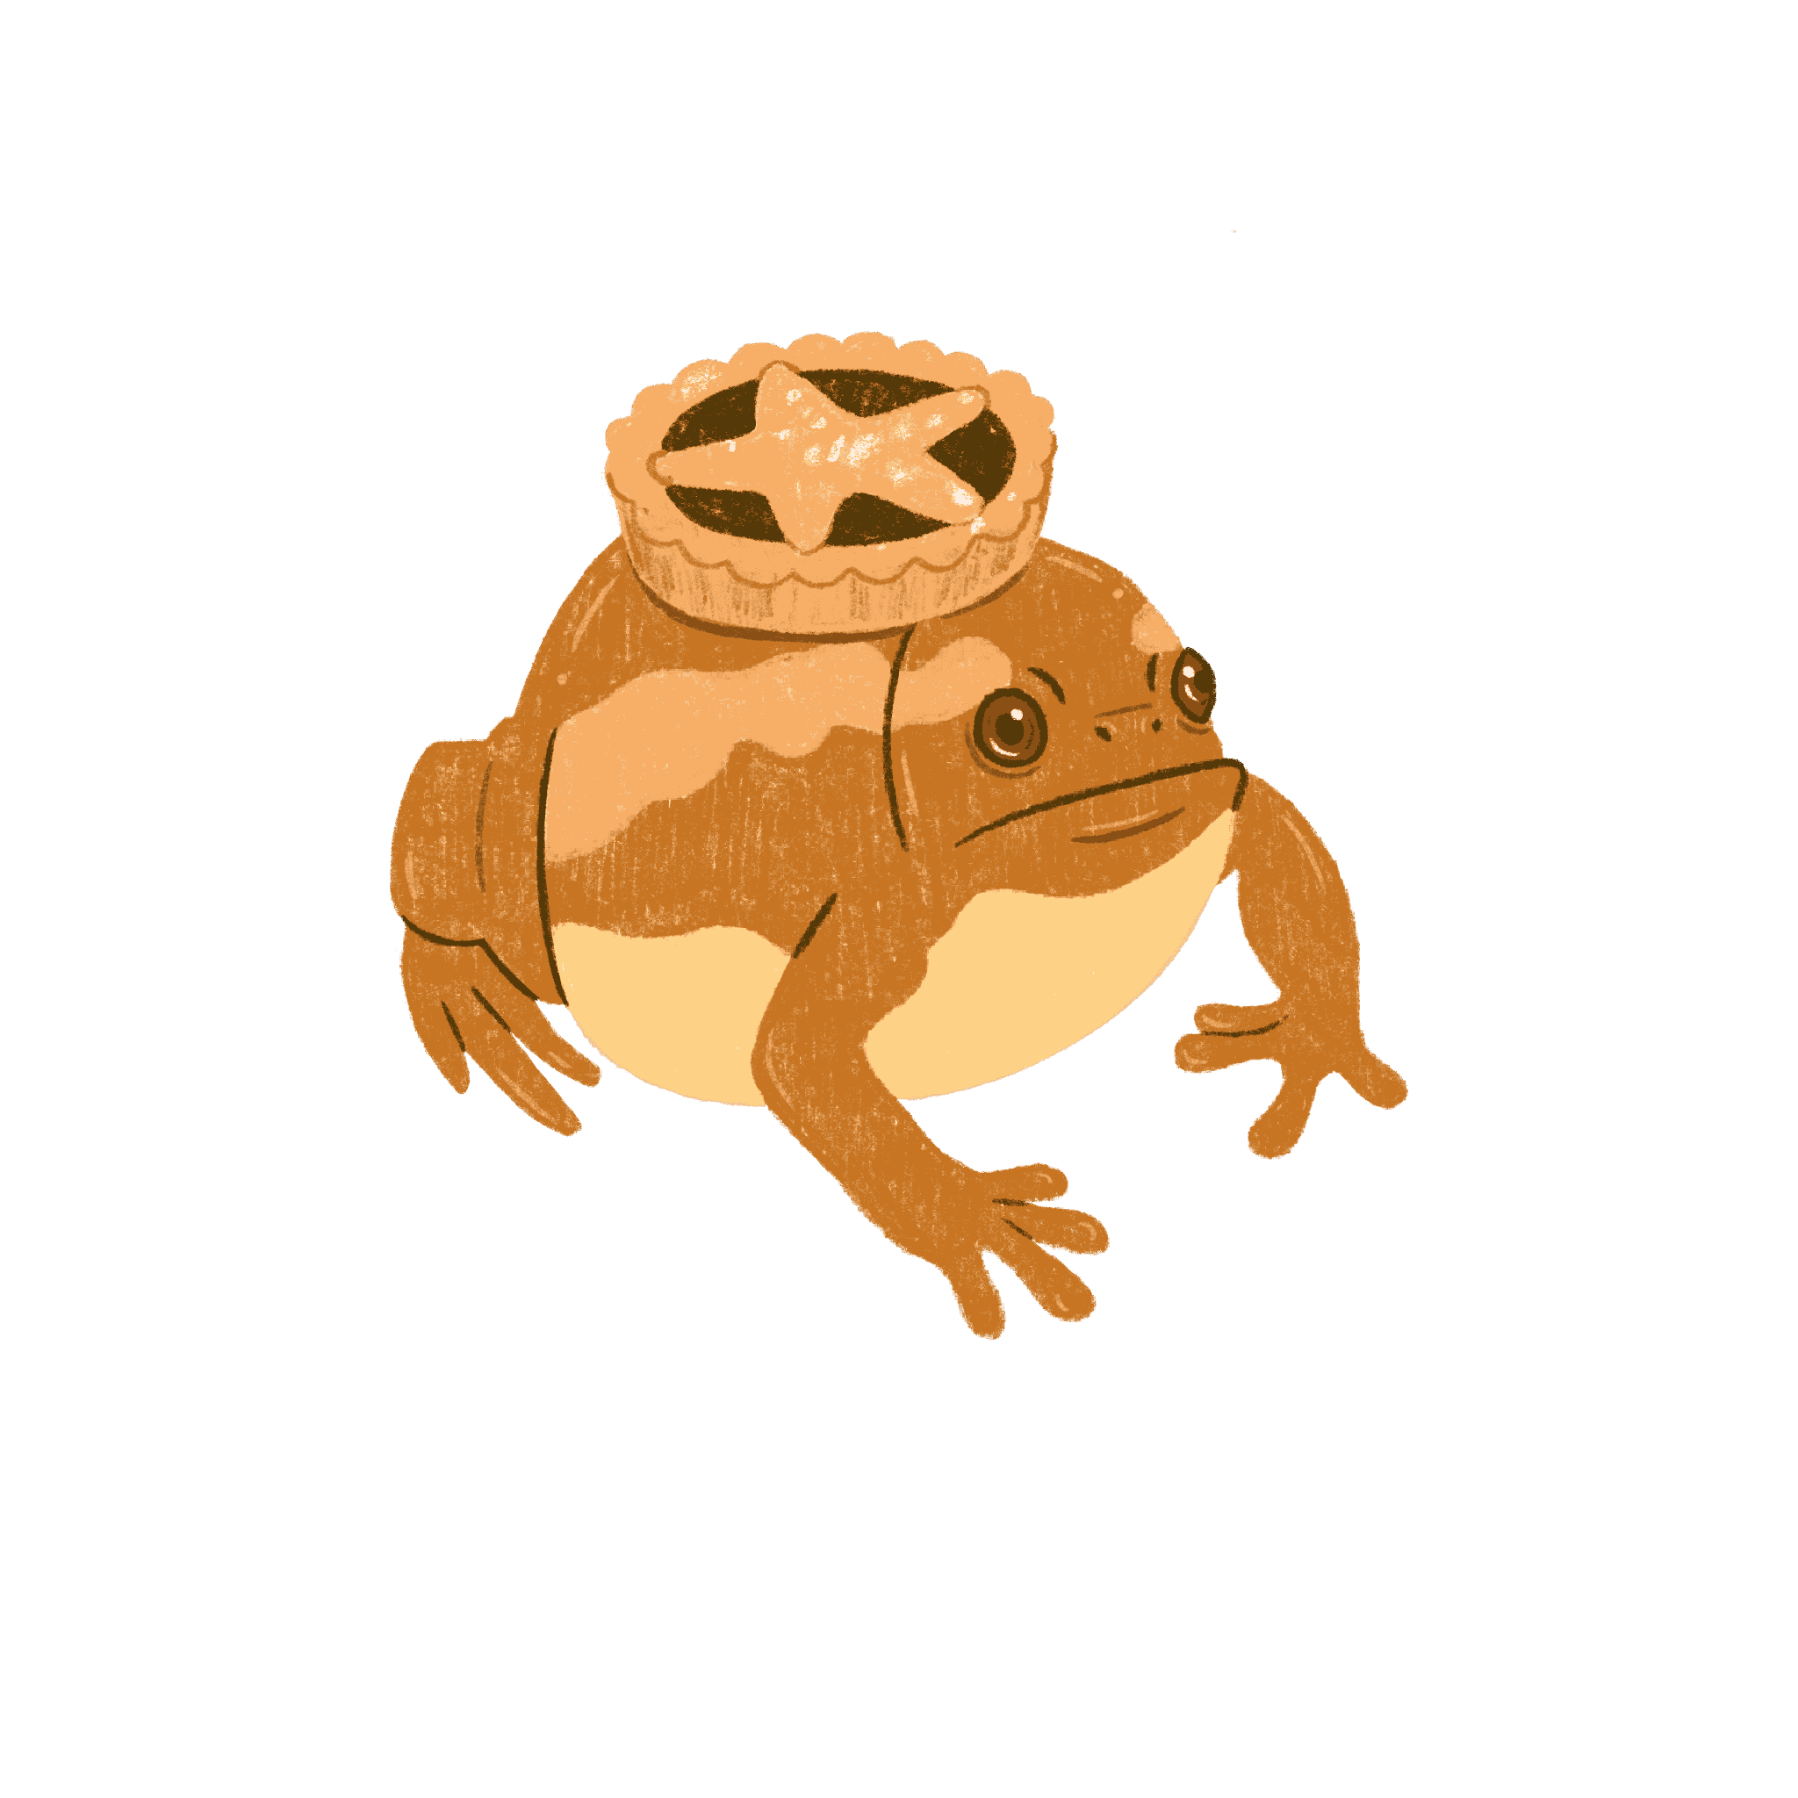
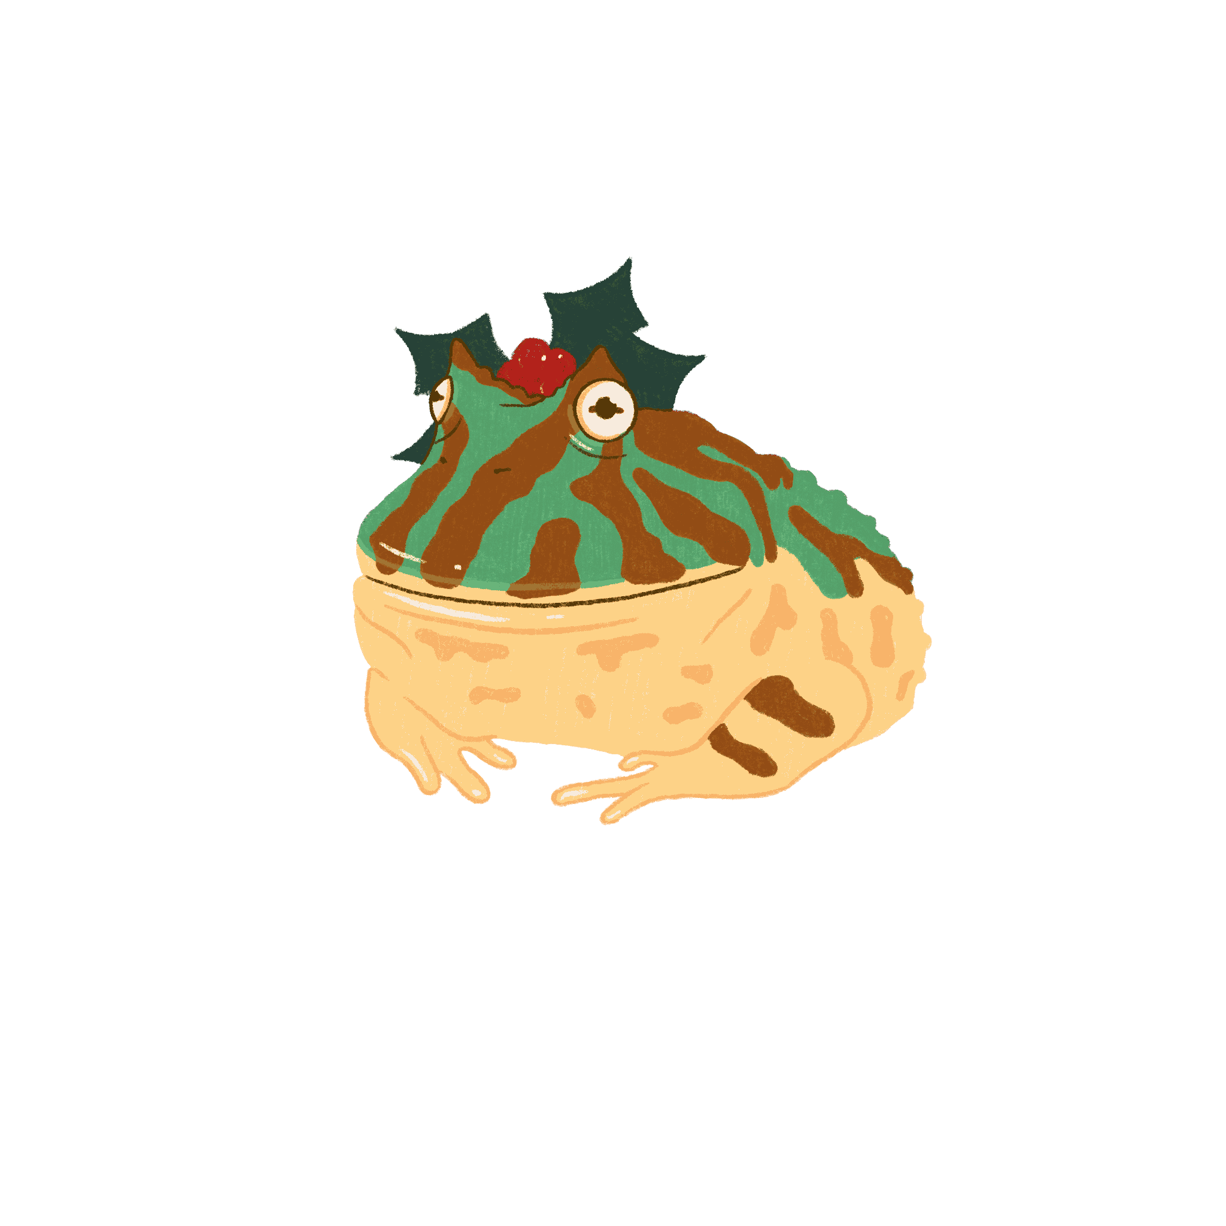
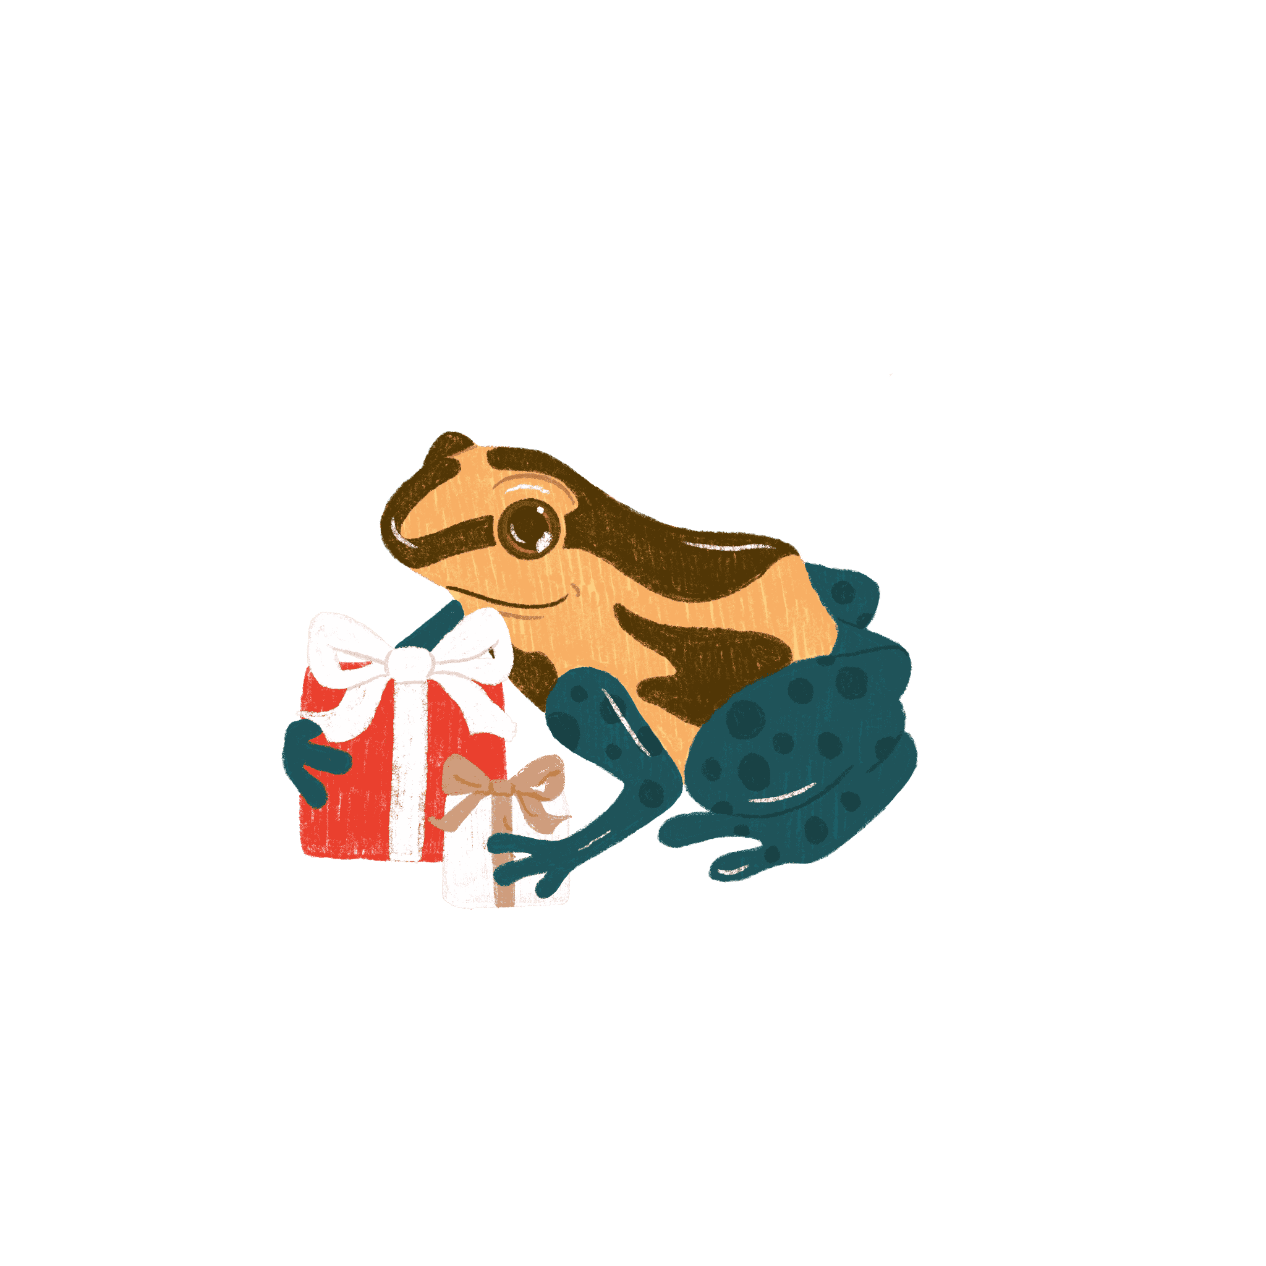
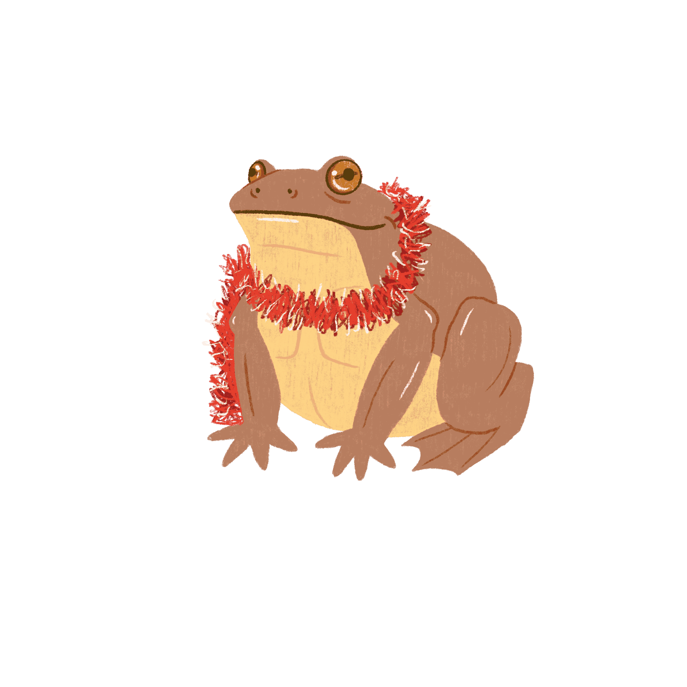
9
Back
to the garden
3
16
1
13
5
18
15
23
8
6
7
24
11
21
20
10
12
Click on
today’s date
to meet
today’s new
froggy friend
<3
19
17
2
22
14
4

Slide 3

SURINAM HORNED FROG
Ceratophrys cornuta
1
Back
to the garden
doing their best
20cm
category
emotionally fragile
absolute unit
chonker
frog-sized
burnt the
Christmas dinner
tiny guy

Slide 4

COMMON TOAD
Bufo bufo
2
Back
to the garden
bad-tempered
10cm
category
asleep by 5pm
absolute unit
chonker
frog-sized
grandad
tiny guy

Slide 5

RED-EYED TREE FROG
Agalychnis callidryas
3
Back
to the garden
has been bad
this year
6cm
category
sneaky
absolute unit
chonker
frog-sized
ate the last mince pie, denied it
tiny guy

Slide 6
BRAZILIAN HORNED FROG
Ceratophrys aurita
4
Back
to the garden
cheerful
20cm
category
actually likes Christmas music
absolute unit
chonker
frog-sized
won’t stop
eating tinsel
tiny guy

Slide 7

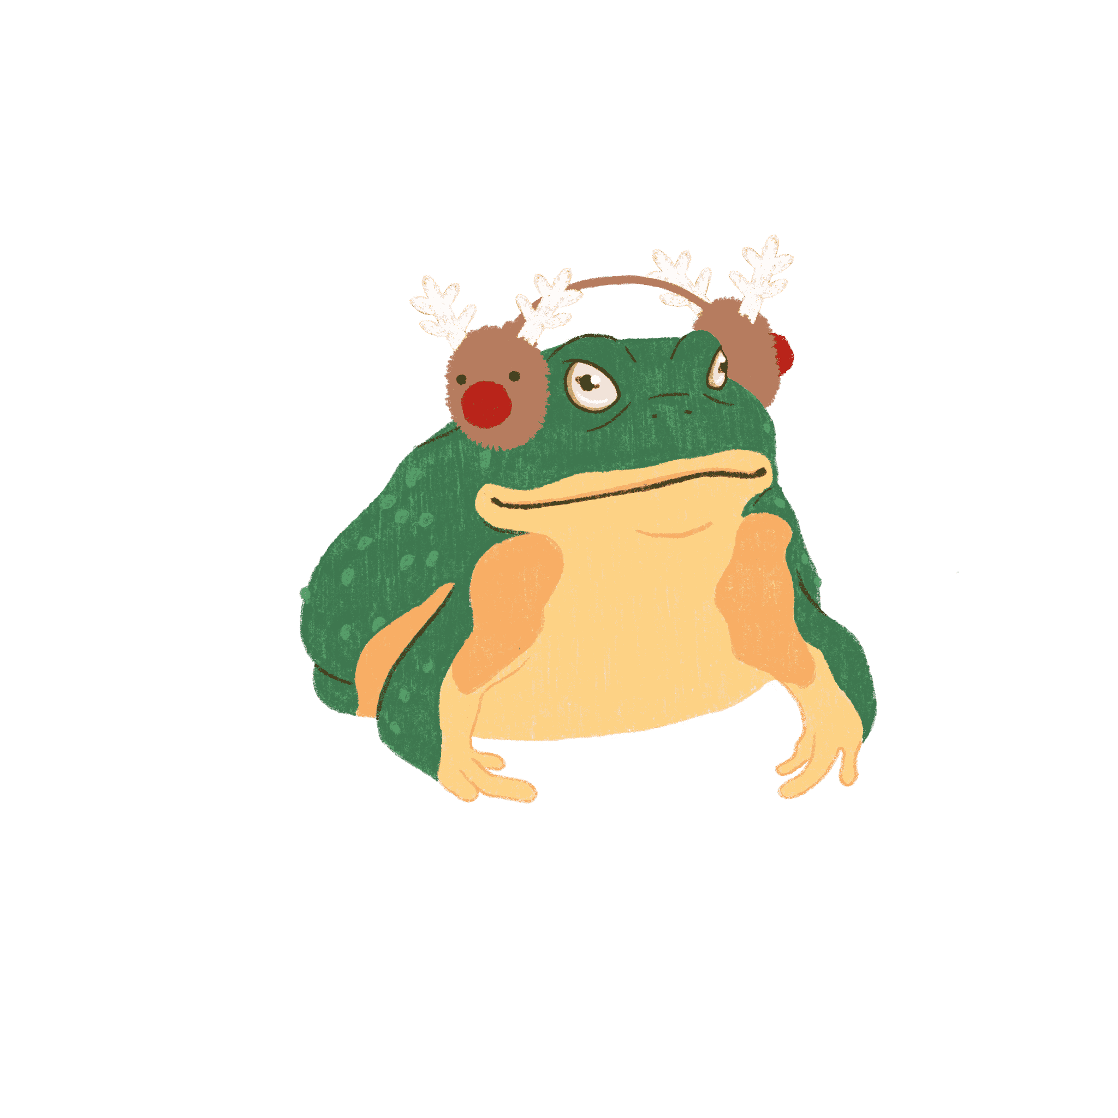
AFRICAN BULLFROG
Pyxicephalus adspersus
5
Back
to the garden
huggable
25cm
category
loves to sing carols
absolute unit
chonker
frog-sized
cannot and will not hear the haters
tiny guy

Slide 8

DESERT RAIN FROG
Breviceps macrops
6
Back
to the garden
little
4cm
category
squidgy
absolute unit
chonker
frog-sized
just wants to
be cosy
tiny guy

Slide 9

AFRICAN CLAWED FROG
Xenopus laevis
7
Back
to the garden
big feet
10cm
category
loves to dance, isn’t very good
absolute unit
chonker
frog-sized
silly
tiny guy

Slide 10

CASCADE GLASS FROG
Sachatamia albomaculata
8
Back
to the garden
a cool little guy
0.2cm
category
sarcastic
absolute unit
chonker
frog-sized
loves Bruce Willis
tiny guy

Slide 11
GOLDEN POISON FROG
Phyllobates terribilis
9
Back
to the garden
the rich
childless aunt
3cm
category
huge gossip
absolute unit
chonker
frog-sized
only eats mince pies from M&S
tiny guy

Slide 12

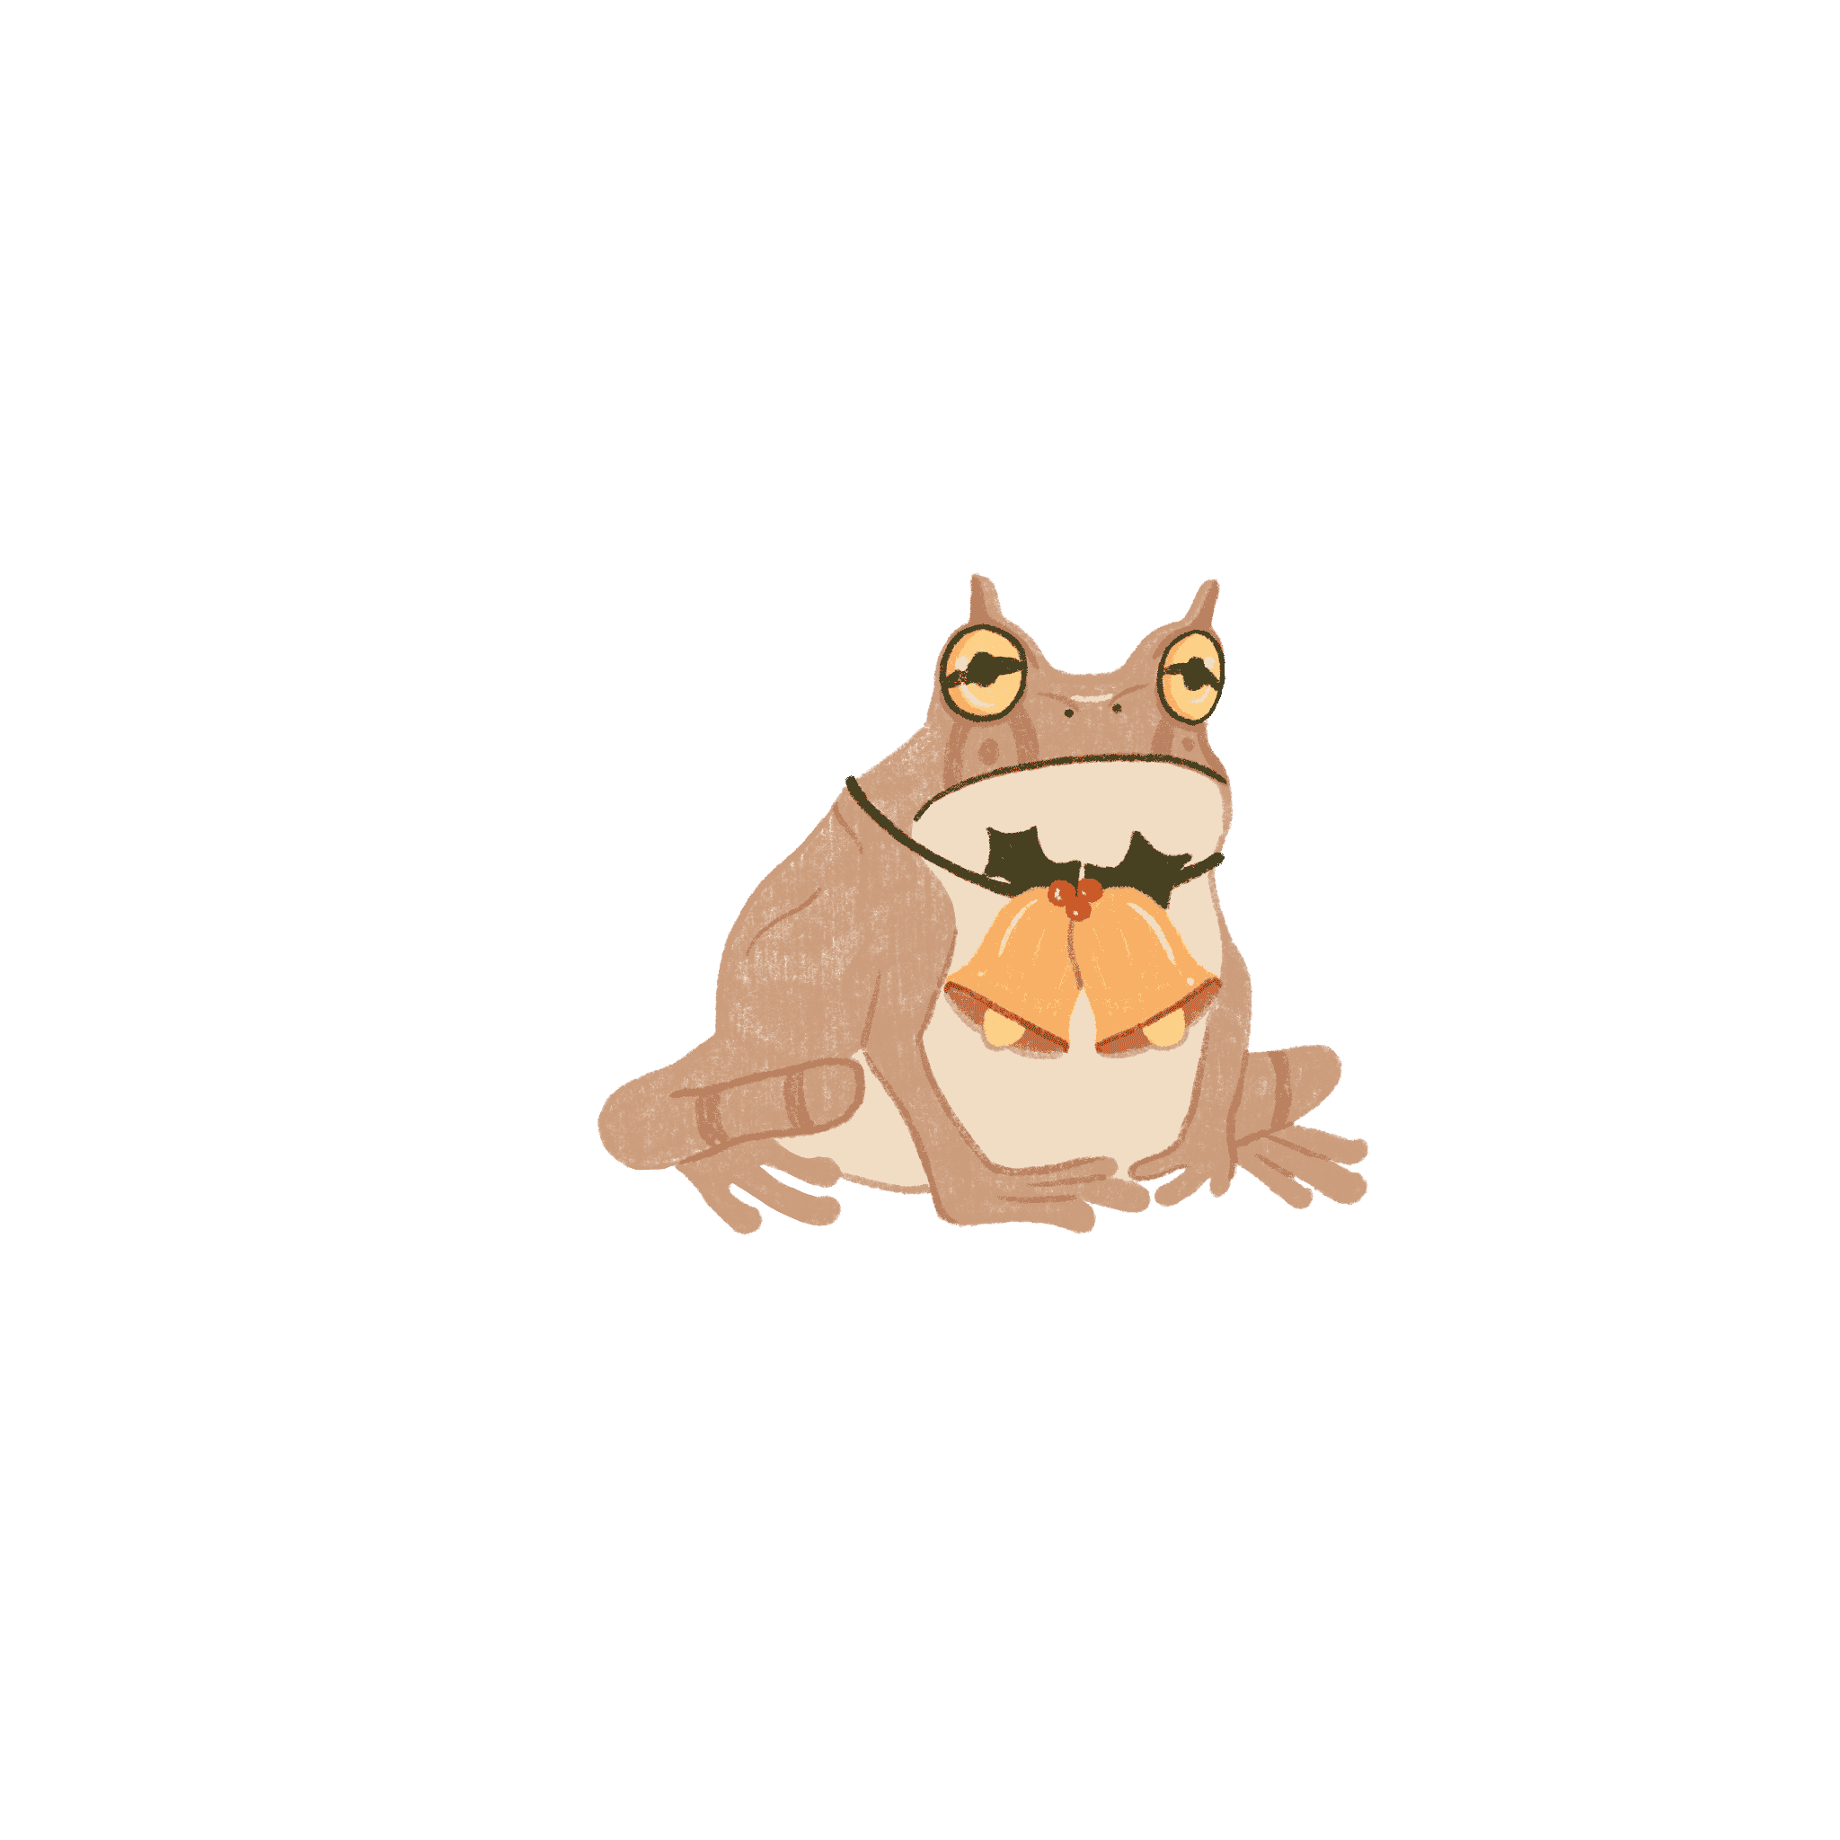
HORNED MARSUPIAL FROG
Gastrotheca cornuta
10
Back
to the garden
mild-mannered
6cm
category
everyone’s favourite
absolute unit
chonker
frog-sized
tastiest frog
tiny guy

Slide 13


AMERICAN BULLFROG
Lithobates catesbeianus
11
Back
to the garden
loud
20cm
category
loves parsnips
absolute unit
chonker
frog-sized
great at wrapping
tiny guy

Slide 14

AFRICAN DWARF FROG
Hymenochirus boettgeri
12
Back
to the garden
just a little guy
5cm
category
has a limp
absolute unit
chonker
frog-sized
all round good egg
tiny guy

Slide 15

WHITE’S TREE FROG
Litoria caerulea
13
Back
to the garden
prettiest in the pond
11cm
category
soft and dumpy
absolute unit
chonker
frog-sized
polite
tiny guy

Slide 16


GOLIATH FROG
Conraua goliath
14
Back
to the garden
very large
32cm
category
intimidating
absolute unit
chonker
frog-sized
ate the kid’s advent calendars
tiny guy

Slide 17
BUDGETT’S FROG
Lepidobatrachus laevis
15
Back
to the garden
flat
12cm
category
dim
absolute unit
chonker
frog-sized
happy-go-lucky
tiny guy

Slide 18

OAK TOAD
Anaxyrus quercicus
16
Back
to the garden
handsome
3cm
category
down to earth
absolute unit
chonker
frog-sized
the cool uncle
tiny guy

Slide 19


BANDED BULLFROG
Kaloula pulchra
17
Back
to the garden
rude
6cm
category
not taken seriously
absolute unit
chonker
frog-sized
big mince pie fan
tiny guy

Slide 20


MEXICAN BURROWING TOAD
Rhinophrynus dorsalis
18
Back
to the garden
the weird relative
8cm
category
humble
absolute unit
chonker
frog-sized
drink of choice
is gravy
tiny guy

Slide 21

BLACK RAIN FROG
Breviceps fuscus
19
Back
to the garden
grumpy
4cm
category
doesn’t like sprouts
absolute unit
chonker
frog-sized
wants a lie down
tiny guy

Slide 22


FIRE BELLIED TOAD
Bombina bombina
20
Back
to the garden
always ready
to party
5cm
category
too much
mulled wine
absolute unit
chonker
frog-sized
bad influence on the tadpoles
tiny guy

Slide 23

TOMATO FROG
Dyscophus antongilii
21
Back
to the garden
round
7cm
category
well behaved
absolute unit
chonker
frog-sized
only here for
the food
tiny guy

Slide 24

AMAZONIAN POISON FROG
Ranitomeya ventrimaculata
22
Back
to the garden
funky
0.2cm
category
dance machine
absolute unit
chonker
frog-sized
morally grey
tiny guy

Slide 25


MINK FROG
Lithobates septentrionalis
23
Back
to the garden
stinky
6cm
category
problematic
absolute unit
chonker
frog-sized
forgot the presents
tiny guy

Slide 26


BEEZLEBUFO
Beezlebufo ampinga
24
Back
to the garden
large and in charge
41cm
category
dresses as Santa for the tadpoles
absolute unit
chonker
frog-sized
keeps asking when dinner will be ready
tiny guy

