Slide 1
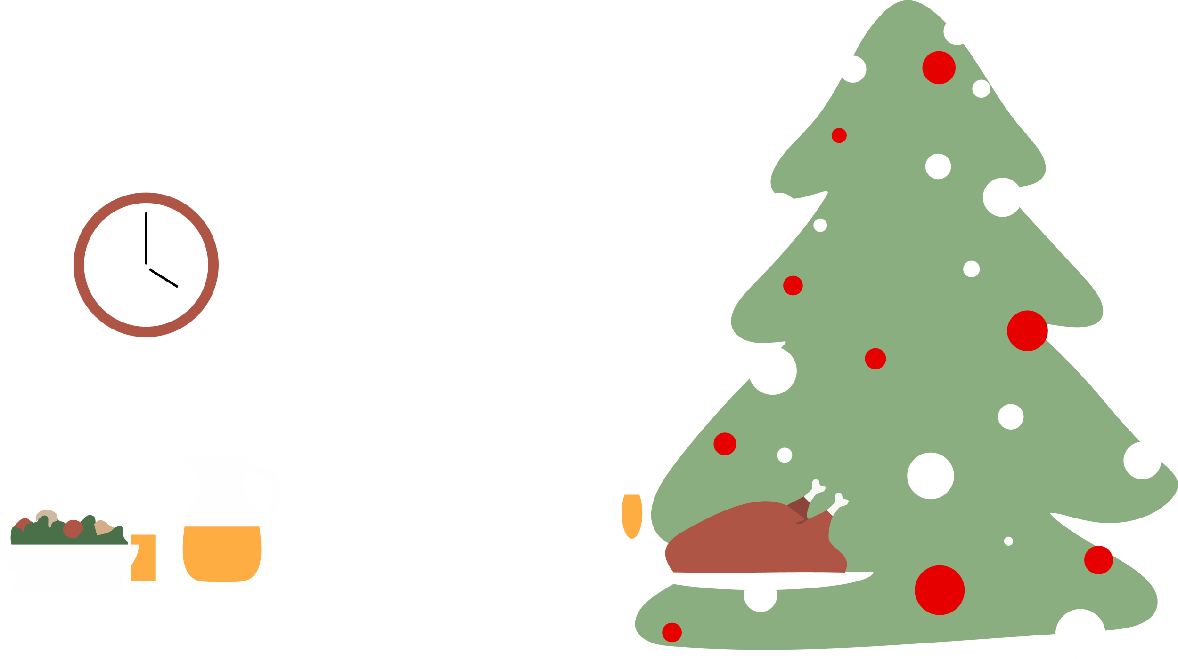
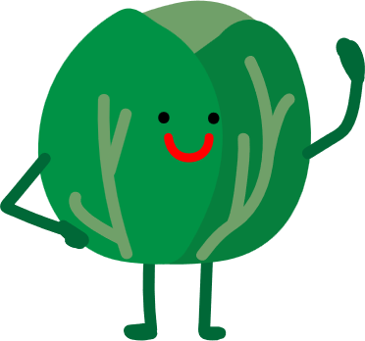



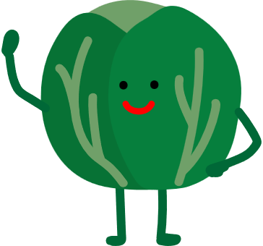
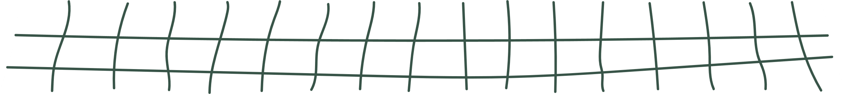

We all love sprouts at Christmas…
…Don’t we?
YES! I love ‘em
NO, absolutely not!

Slide 2







You’re right! It turns out, that we don’t!
Or at least, they’re not as popular as they would like
Favourite Christmas dishes in the UK

Slide 3
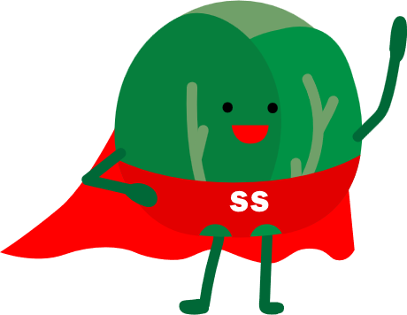

Sadly, not everyone loves sprouts
But they do have some super-powers!

Slide 4


Merry Christmas
from
And remember… sprouts can be eaten for comedy, as well as nutritional reasons!

