Slide 1




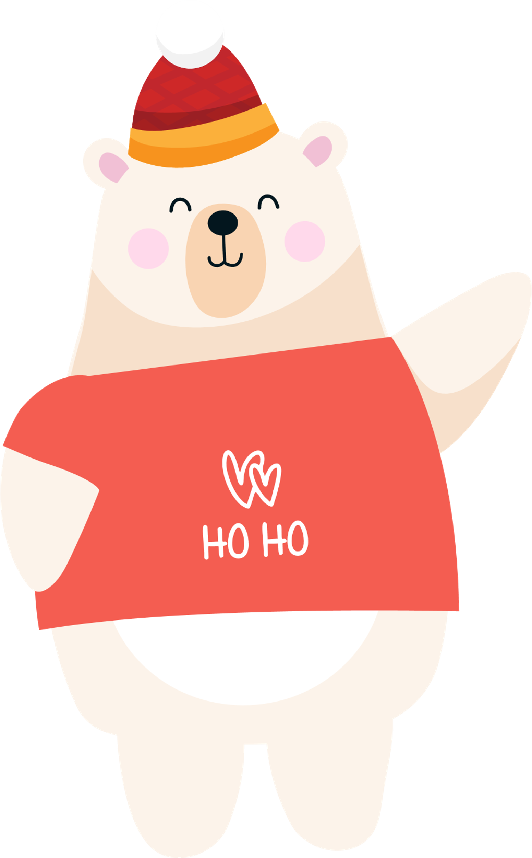

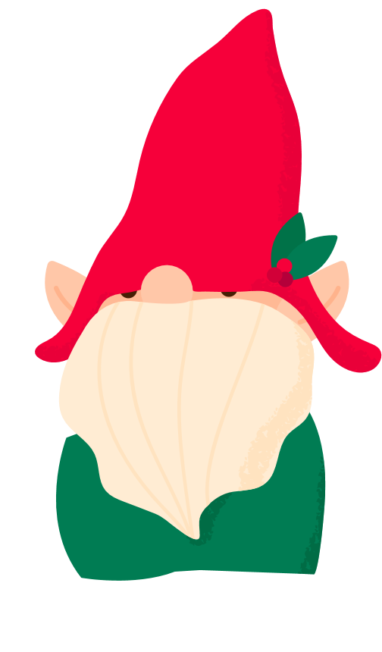












Slide 2


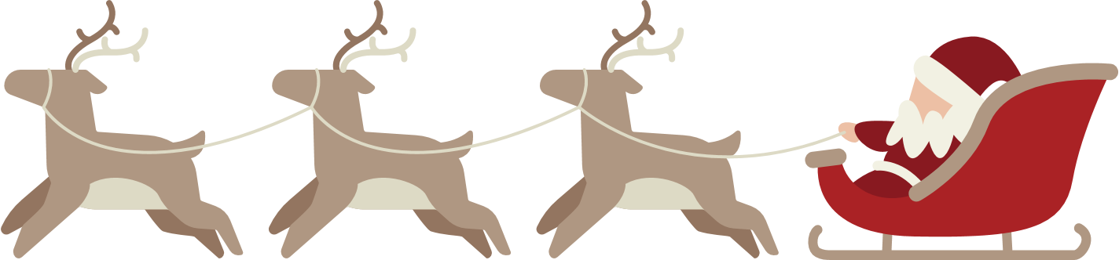


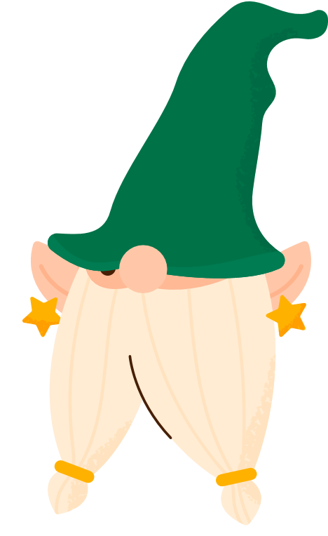
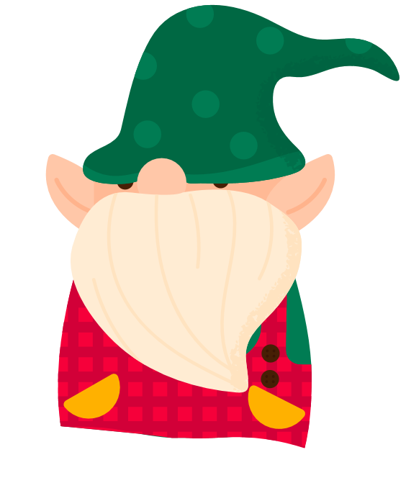
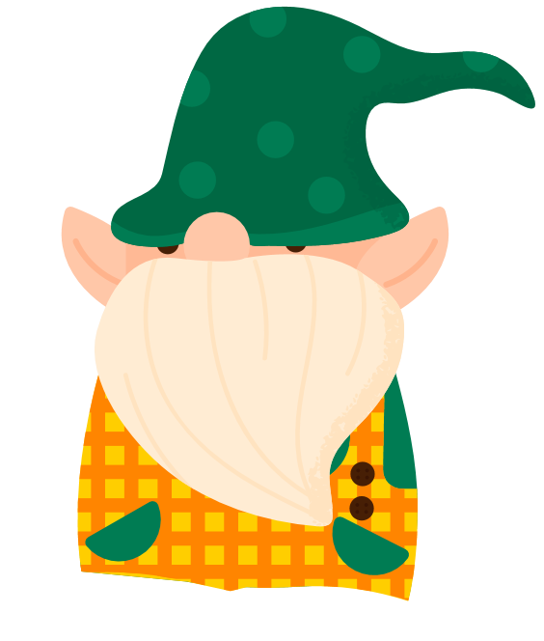


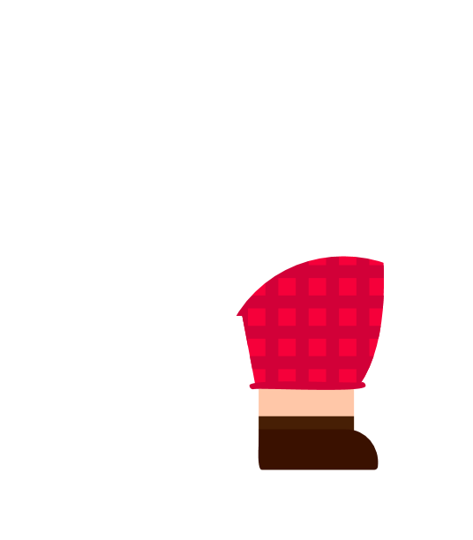
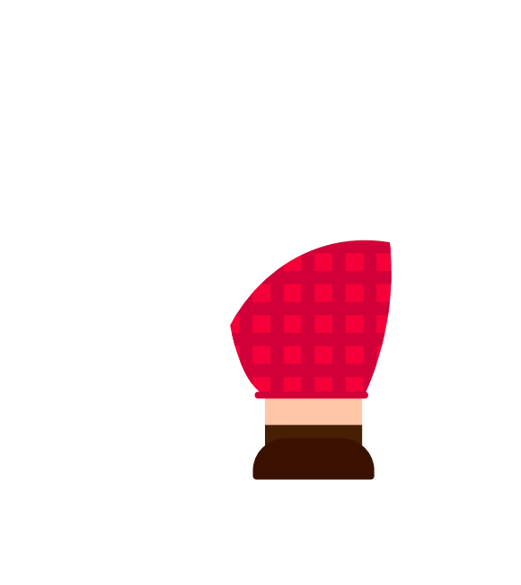
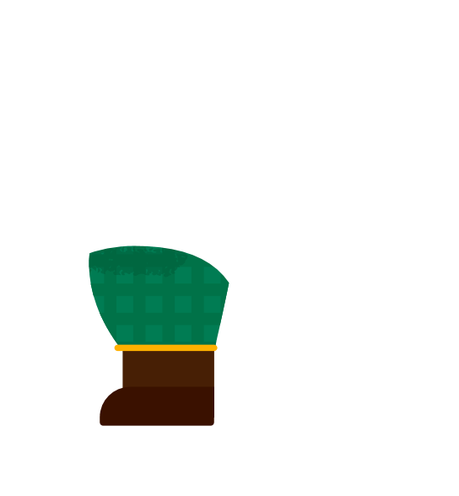
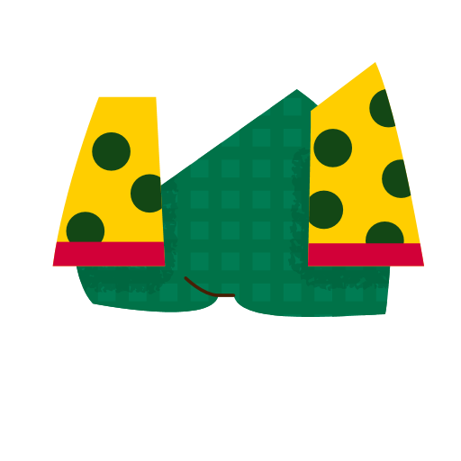


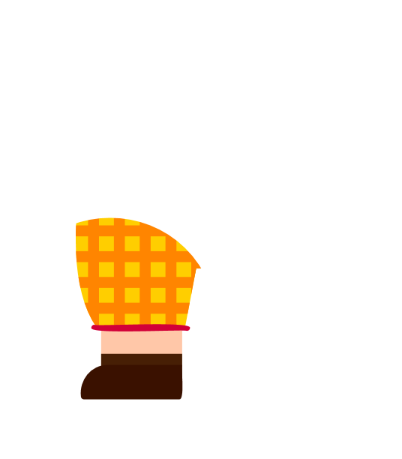



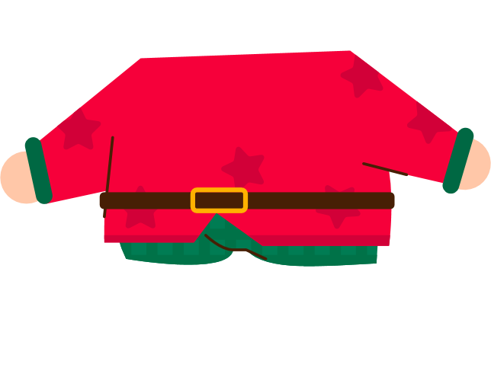



After a long-time preparing gifts, our hard-working elves trek back home.

Slide 3
Now is the part where they get all the credit

Slide 4



I think I’m getting repetitive strain injury from wrapping all those bows
At least we have the satisfaction of a job well done
Having put on the kettle, they start to wind down.
Knock! Knock!

Slide 5
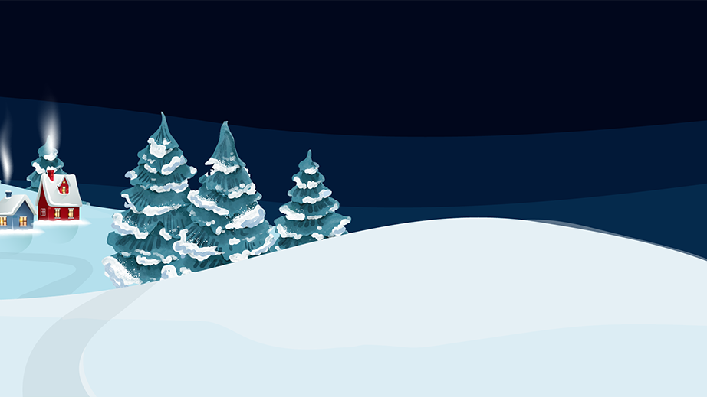








Looks a bit small for me…
Could a lonely bear get some hot cocoa!
Hello… I am Brian!
Give it the old heave-ho!
Like good Samaritans, the elves decided to invite Brian in the house…
A giant polar bear is standing at their door…
Helping Brian inside, some elves push while the others pull…

Slide 6




The elves push Brian through the door and …

Slide 7

Boom! *House rumbles and shakes*

Slide 8

Oh bother, that was something!
Thank you for the hospitality! I am actually here on behalf of Holiday Operations,
Helping Out!
and now I have something for you too...
You all work so hard to make every child’s Christmas wish come true…
The elves offer Brian some cookies and hot chocolate…

Slide 9

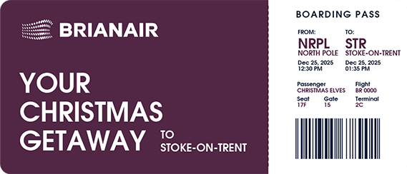

Worry not my
wondrous elves.
Don’t grumble or lament.
For all your hard work, you’ve earned a trip!
To sunny
Stoke-On-Trent. ☺

Slide 10

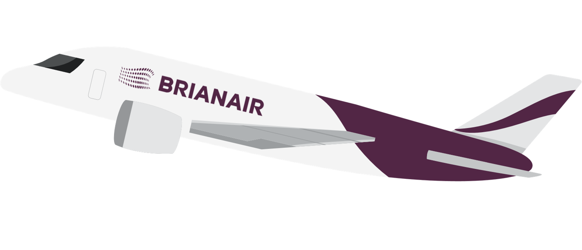


Brian waves the elves goodbye as they embark on an exciting vacation to Stoke-on-Trent…

Slide 11
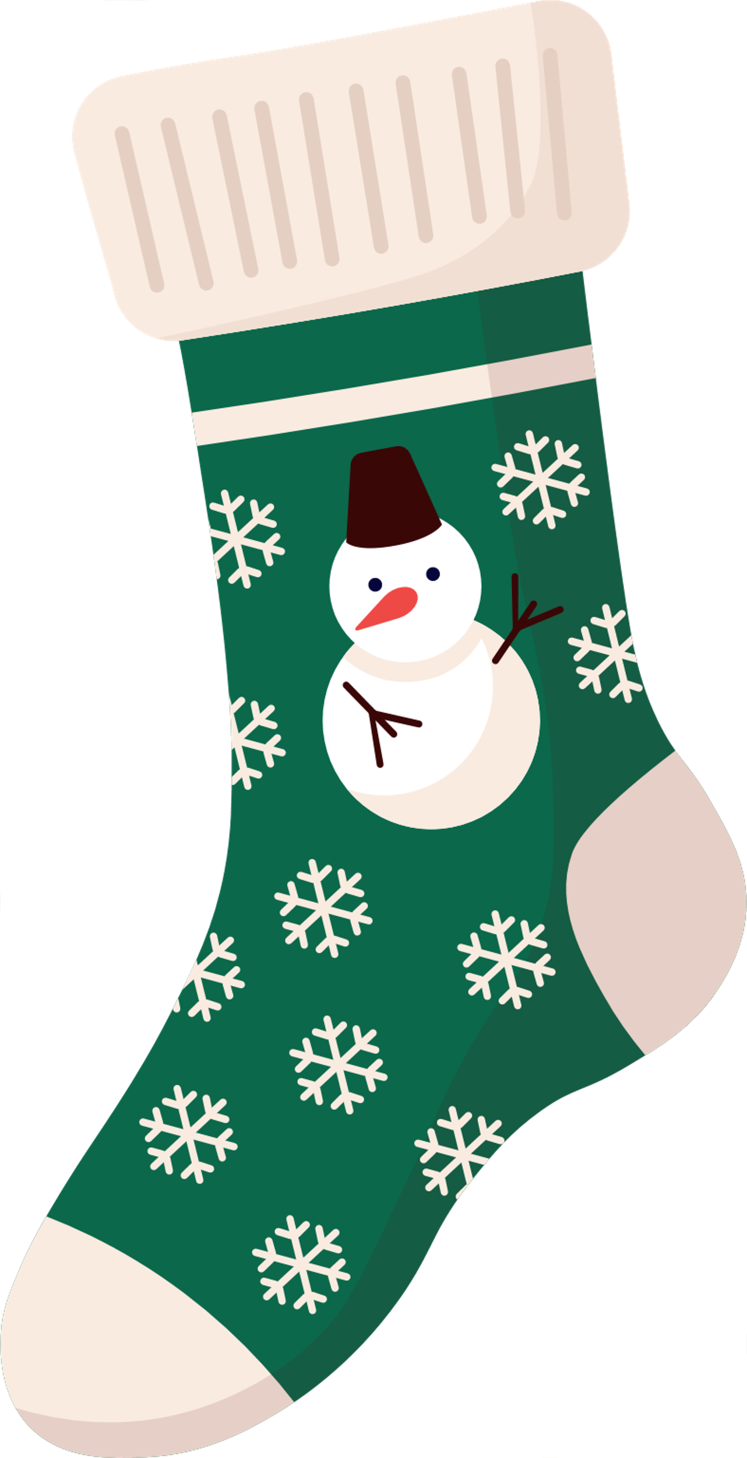
Spread the festive joy with a kind gesture –
small or large.
Happy holidays
from
BrightCarbon!
Ahh! Now even the elves get to enjoy Christmas!
Brian wriggles back into the house for another sip of cocoa.

