Slide 1


Have you been naughty or nice?

Slide 3



Slide 4


Slide 5


Slide 7


Slide 8


Slide 9


Slide 10


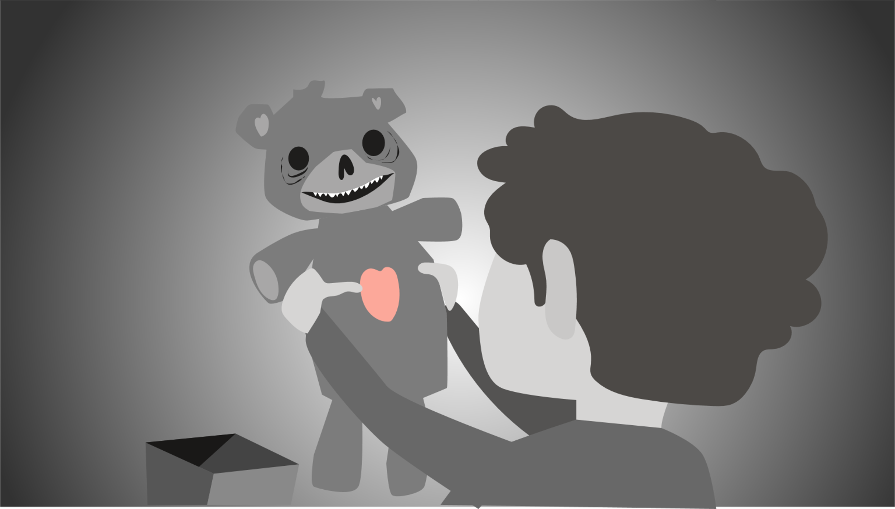
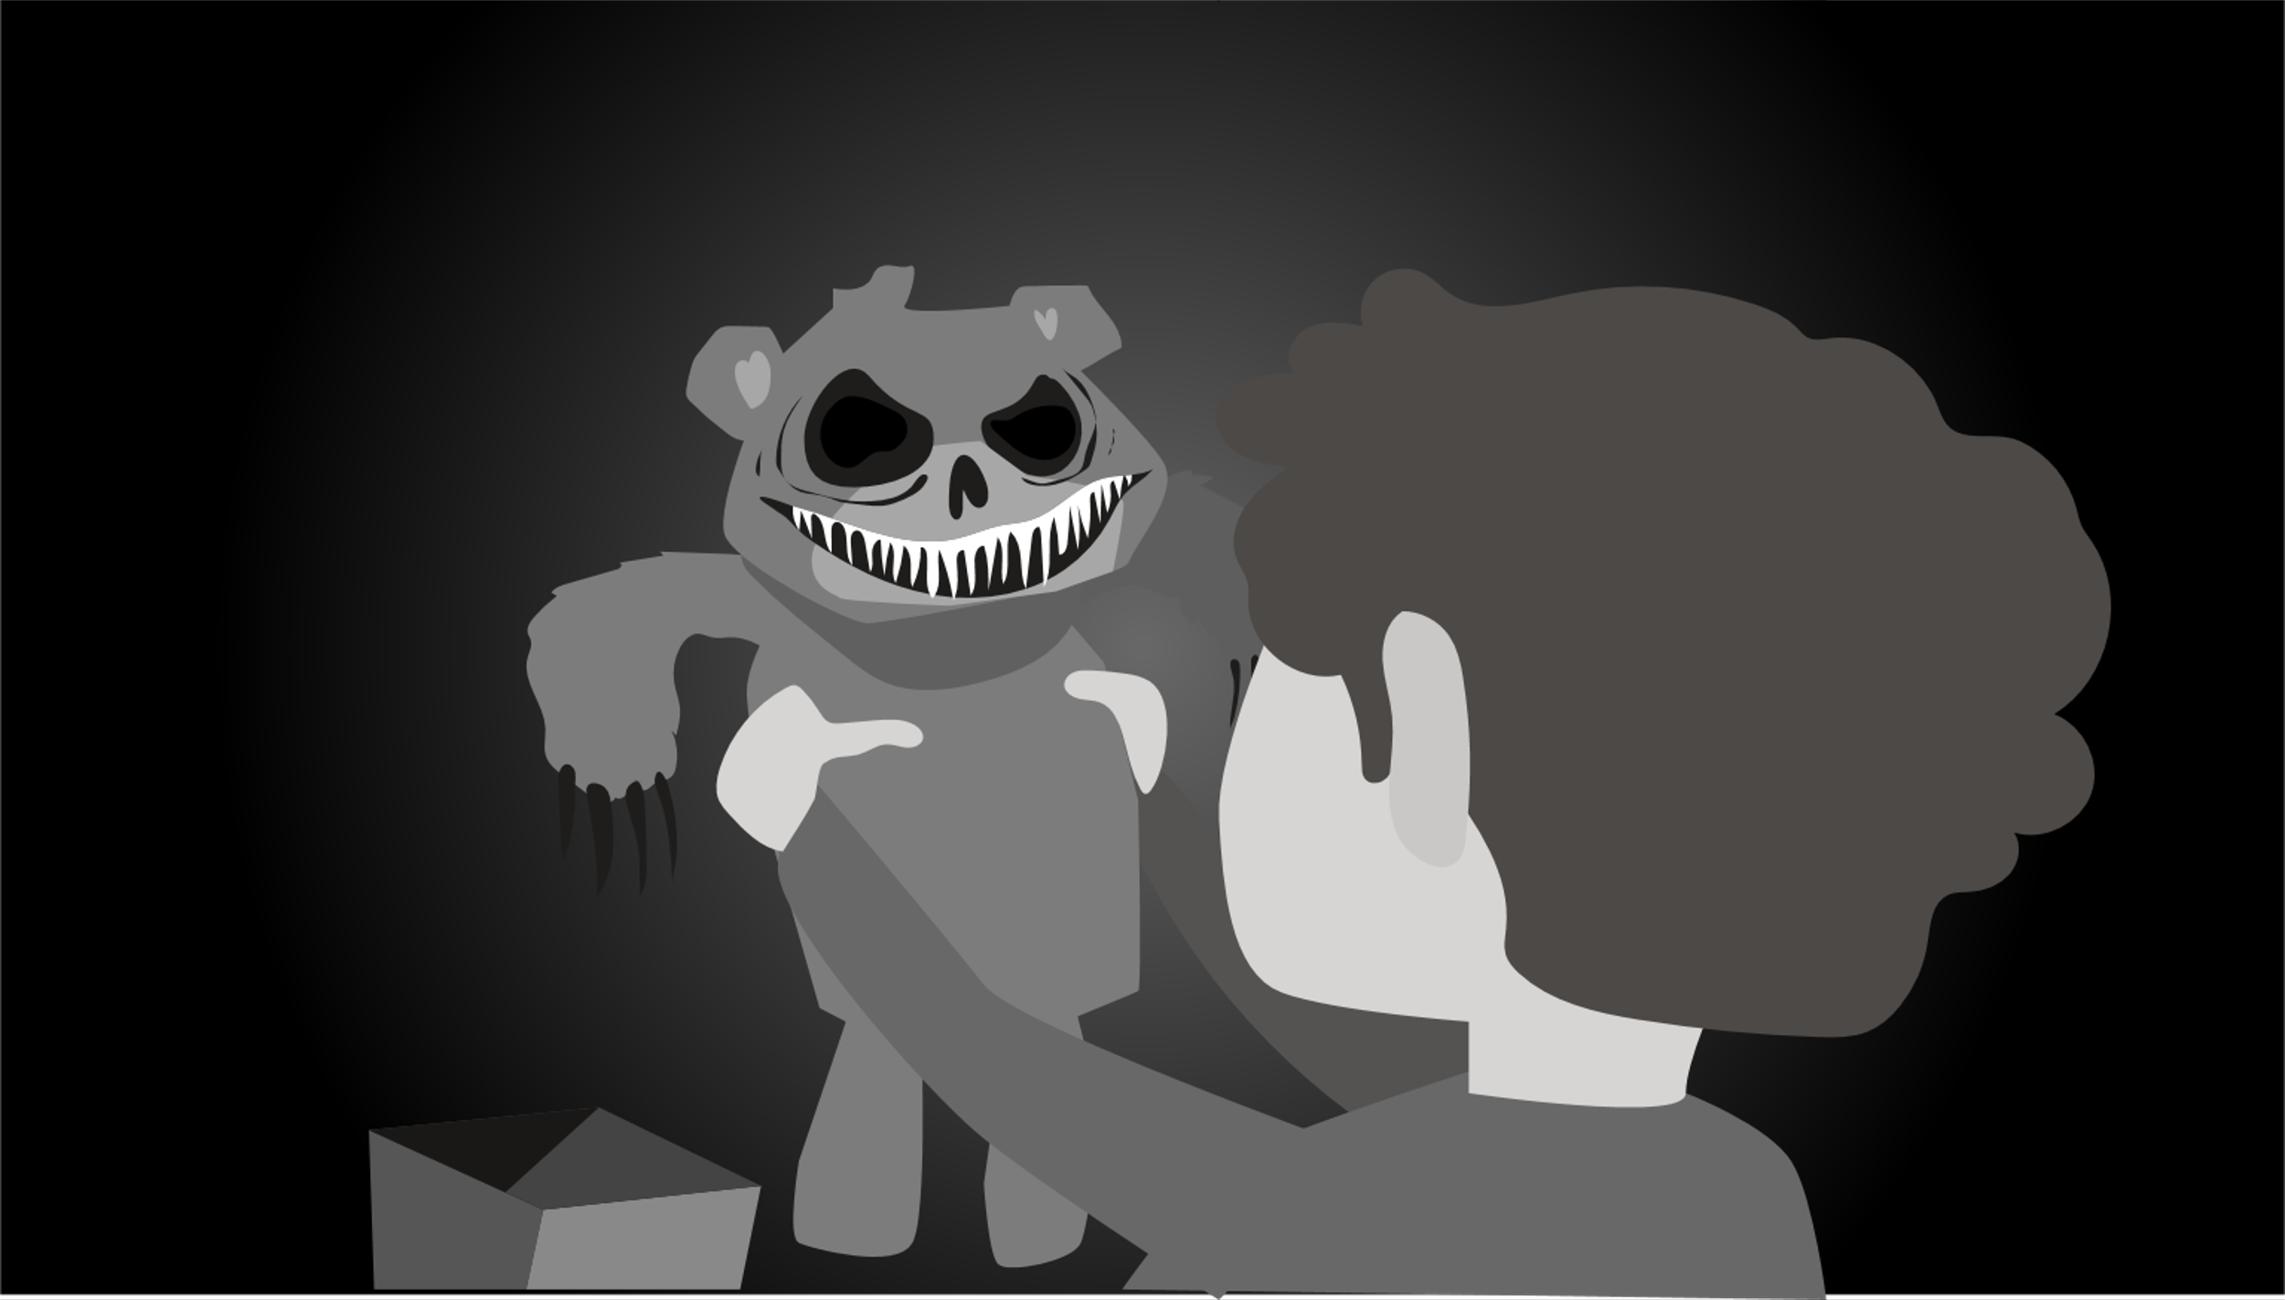

Slide 11



Slide 12



Slide 14

from
BrightCarbon
Sounds by xXSamilYTXx and Ulrich_Wehner

