Slide 1
Quiz-mas

Slide 2
Instructions
Happy Holidays! Or, if you don’t celebrate merry just-another-day-in-December.
This quiz consists of 6 Christmas-themed rounds, including 3 general knowledge rounds, 2 pictures rounds and 1 song round.
The answers are written with the speaker notes, so be sure you don’t share presenter view to
your audience!
We have many more resources on our blog and our free PowerPoint plugin, BrightSlide®, packed with tools to boost productivity. We offer professional services too, from creating your presentations, eLearning, and infographics, to running advanced PowerPoint and presentation training.
So, make great slides and be merry! All of us at BrightCarbon wish you a very happy holidays!

Slide 3
Christmas General Knowledge!
ROUND ONE

Slide 4
Christmas General Knowledge
ROUND ONE
1.
In the song "We Wish You a Merry Christmas," what is the first thing the singers ask for?
Notes:
Figgy pudding

Slide 5
Christmas General Knowledge
ROUND ONE
2.
Can you work out this equation?
The street on which a miracle happened
in a 1947 & 1994 movie + the number
of French Hens my true love gave to me
+ santa's reindeer = ?
Notes:
46 (34 + 3 + 9)

Slide 6
Christmas General Knowledge
ROUND ONE
3.
In ‘A Muppet Christmas Carol’ , which muppet character plays Bob Cratchit?
Notes:
Kermit the Frog

Slide 7
Christmas General Knowledge
ROUND ONE
4.
In Scrabble, how many points would XMAS* get?
13 points
15 points
*According to the Collins’ Scrabble dictionary, the word XMAS wouldn’t technically be allowed, but let’s pretend it is!
Notes:
13 (X-8, M-3, A-1, S-1)

Slide 8
Christmas General Knowledge
ROUND ONE
5.
Who plays workaholic Dad Howard Langston in the 1996 movie Jingle All the Way?
Notes:
Arnold Schwarzenegger

Slide 9
Picture Quiz!
ROUND TWO

Slide 10
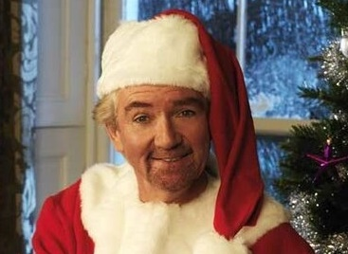
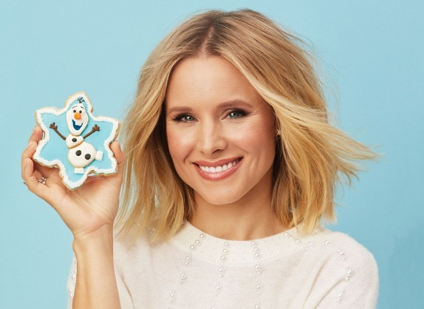
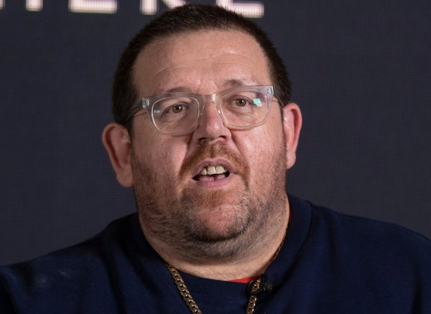
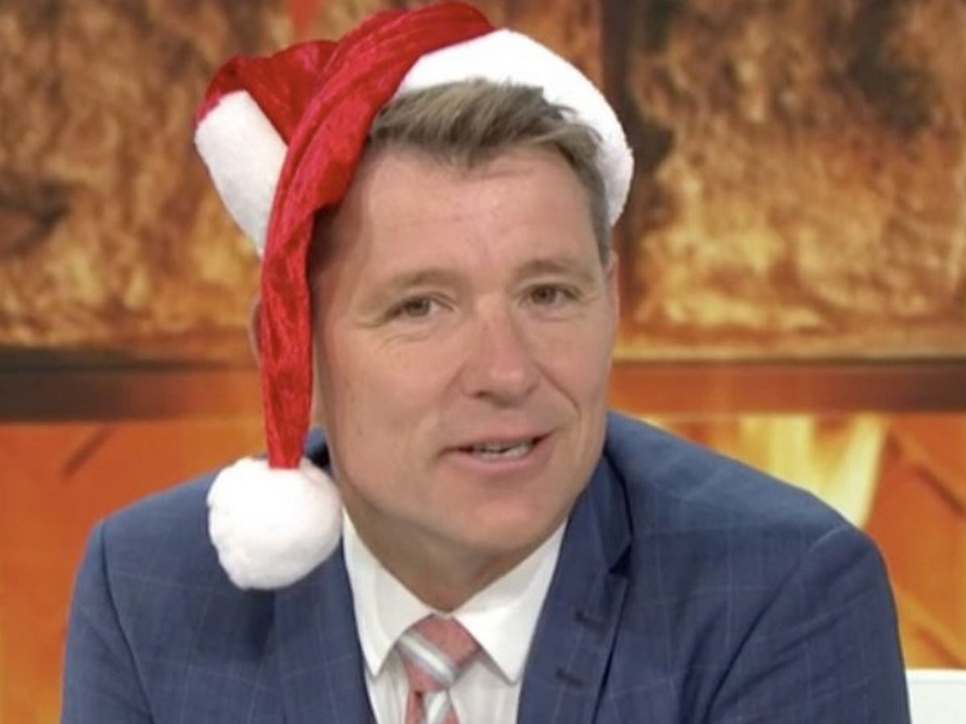
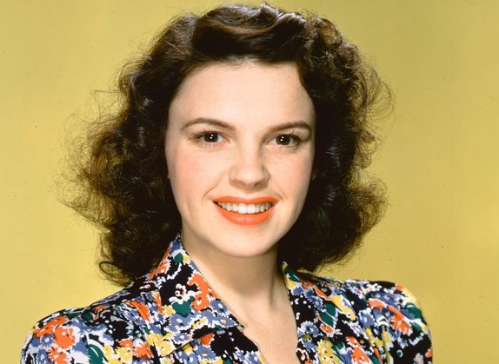

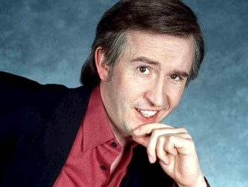
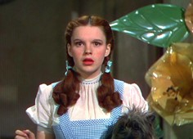
Picture Quiz!
ROUND TWO
People with Christmas themed names
Can you name them?
1
2
3
4
5
6
Notes:
NOEL Edmonds
Kristen BELL
Nick FROST
Ben SHEPHARD
Judy GARLAND
HOLLY Willoughby

Slide 11
More Christmas
General Knowledge!
ROUND THREE

Slide 12
More Christmas General Knowledge!
ROUND THREE
1.
What are the names of Santa’s
Reindeer beginning with D?
Notes:
Dasher, Dancer and Donner

Slide 13
More Christmas General Knowledge!
ROUND THREE
2.
Which music group had three consecutive Christmas number one songs in the 60s?
Notes:
The Beatles

Slide 14
More Christmas General Knowledge!
ROUND THREE
3.
In Yorkshire, people famously eat Christmas cake with what?
Cheese
Yorkshire pudding
Lemon curd
Notes:
Cheese

Slide 15
More Christmas General Knowledge!
ROUND THREE
4.
Which classic 1946 Christmas
movie tells the story of saving
George Bailey’s life?
Notes:
It’s a Wonderful Life

Slide 16
More Christmas General Knowledge!
ROUND THREE
5.
How many Christmas trees are harvested in Europe each year?
30-40 million
50-60 million
70-80 million
Notes:
50-60 million

Slide 17
Another
Picture Quiz!
ROUND FOUR

Slide 18
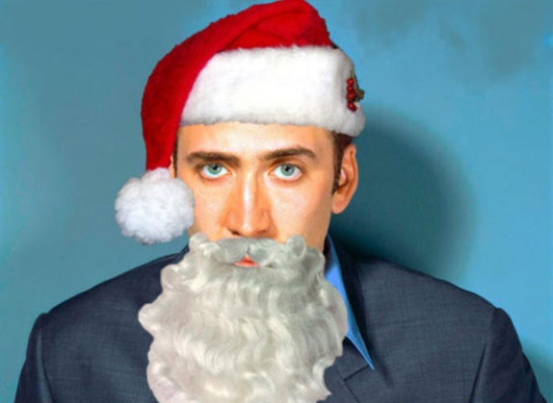
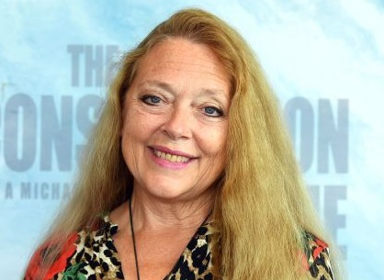

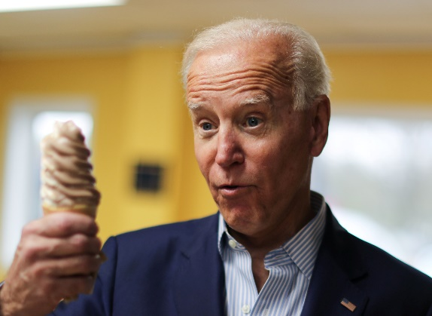
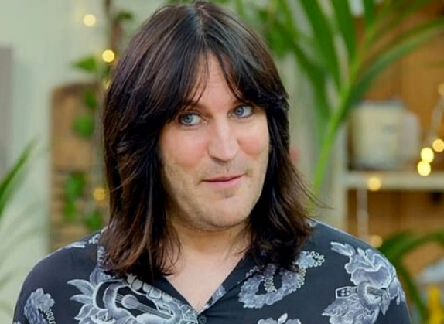
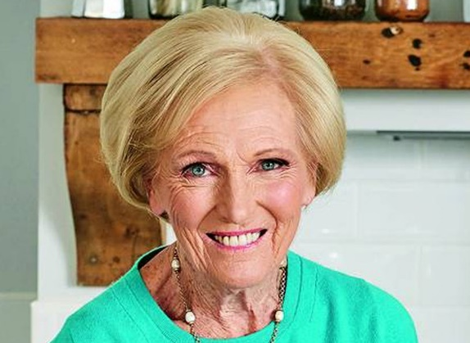
Picture Quiz!
ROUND TWO
People with Christmas themed names
Can you name them?
1
2
3
4
5
6
Notes:
NICOLAS Cage
CAROLe Baskin
ANGEL Strawbridge
JOSEPH Biden
NOEL Fielding
MARY Berry

Slide 19
Christmas Songs
& Carols!
ROUND FIVE

Slide 20
Christmas Songs & Carols!
ROUND FIVE
Which Christmas songs do the following initials represent?
SCICTT
DTH
HTHAS
FN
IWICBCE
Notes:
1. SCICTT... Santa Claus is Coming to Town
2. DTH... Deck The Halls
3. HTHAS... Hark The Herald Angels Sing
4. FN... Feliz Navidad
5. IWICBCE... I Wish It Could Be Christmas Everyday

Slide 21
Even More Christmas
General Knowledge!
ROUND SIX

Slide 22
Even More Christmas General Knowledge!
ROUND SIX
1.
Which popular Christmas beverage is also called 'milk punch'?
Notes:
Eggnog

Slide 23
Even More Christmas General Knowledge!
ROUND SIX
2.
What Hollywood actor played six different roles in the 2004 animated film, The Polar Express?
Notes:
Tom Hanks

Slide 24
Even More Christmas General Knowledge!
ROUND SIX
3.
What country has the
most reindeer?
Notes:
Norway

Slide 25
Even More Christmas General Knowledge!
ROUND SIX
4.
How many mince pies are eaten in the UK every year?
700 million
750 million
800 million
Notes:
800 million

Slide 26
Even More Christmas General Knowledge!
ROUND SIX
5.
Who was driving home
for Christmas?
Notes:
Chris Rea

