Slide 1

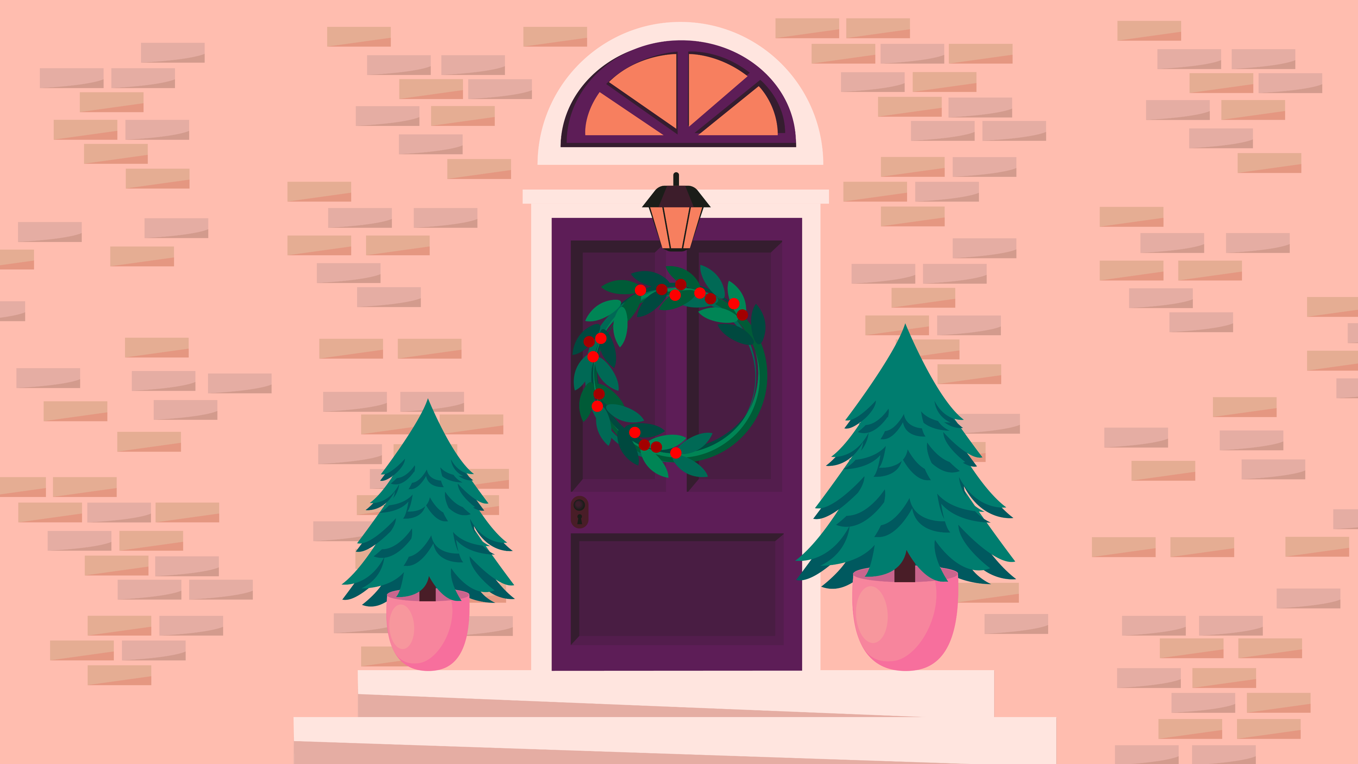



Click on the decorations to knock them down for the robin!
Quick! Click to follow them!

Slide 2
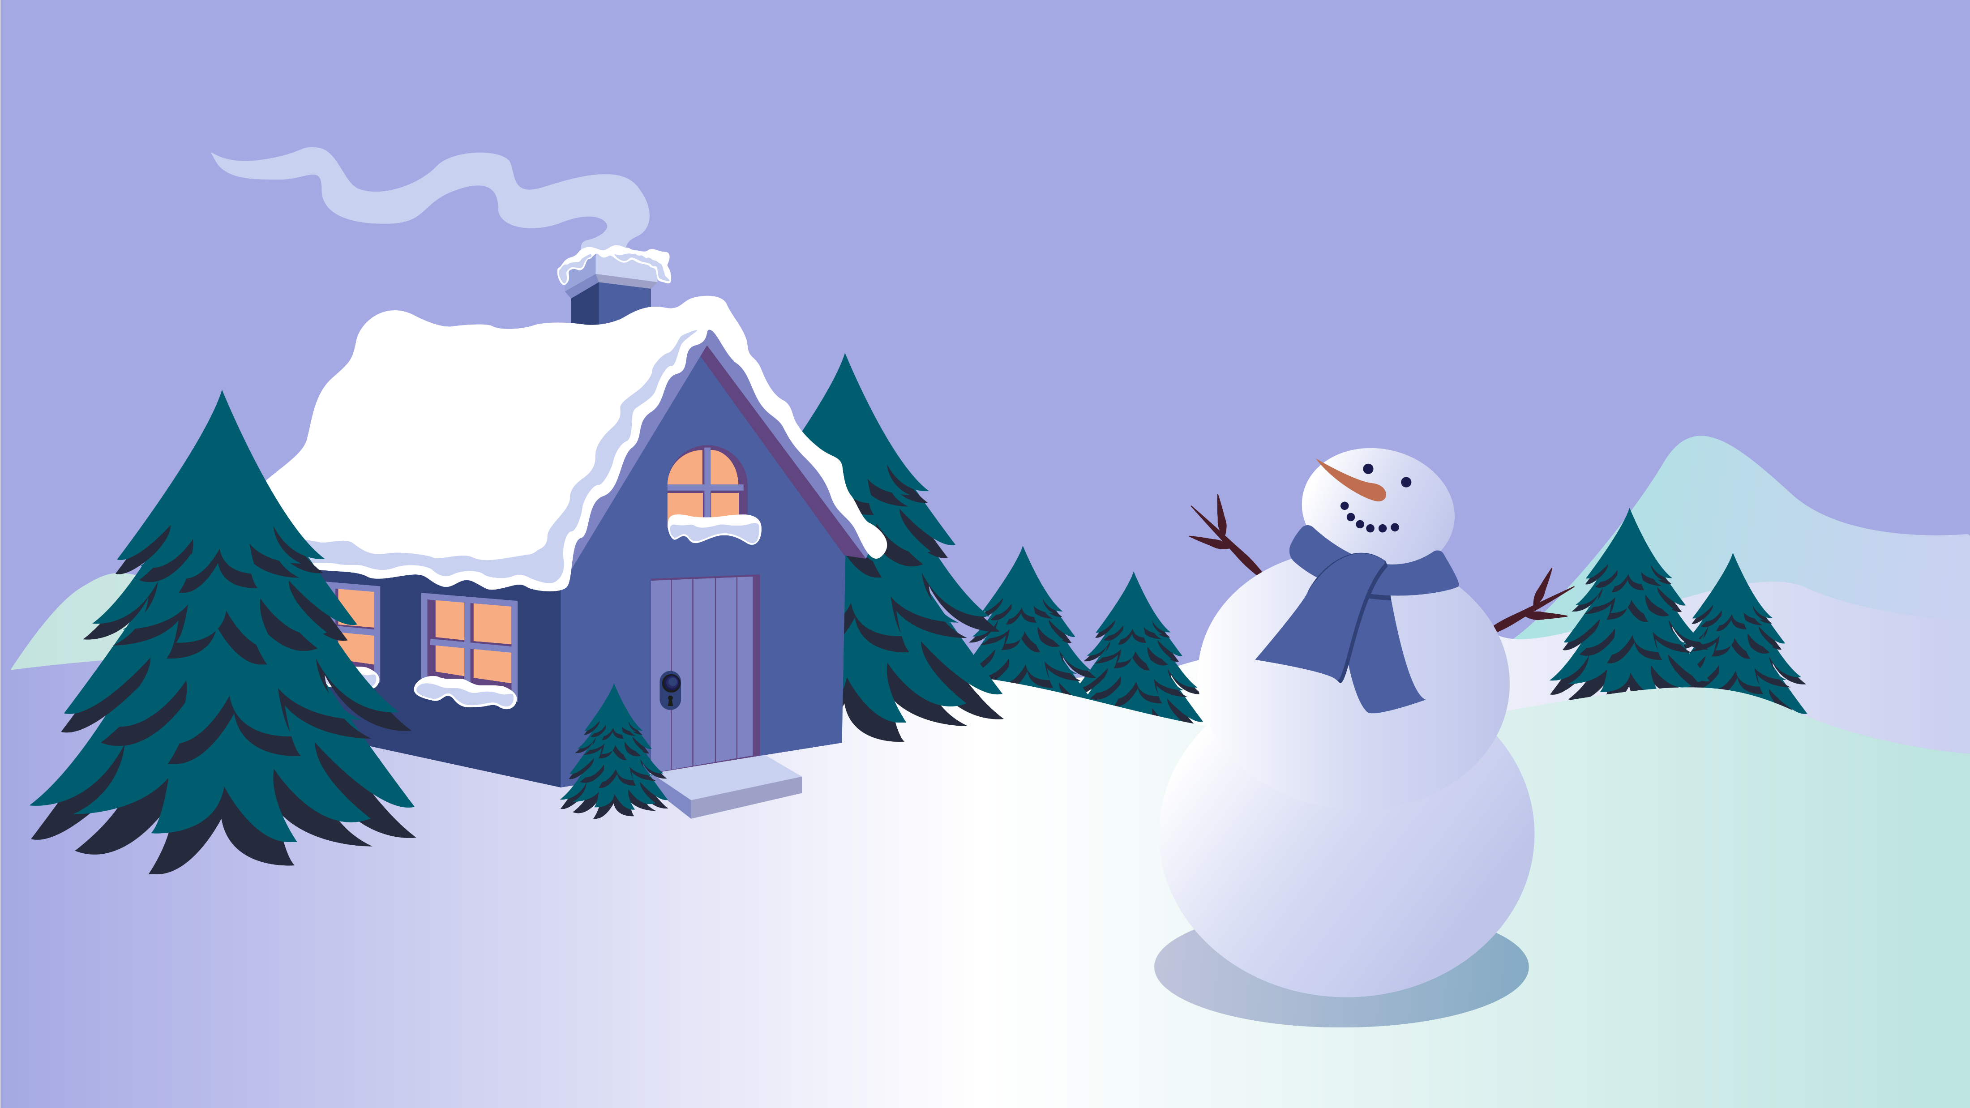
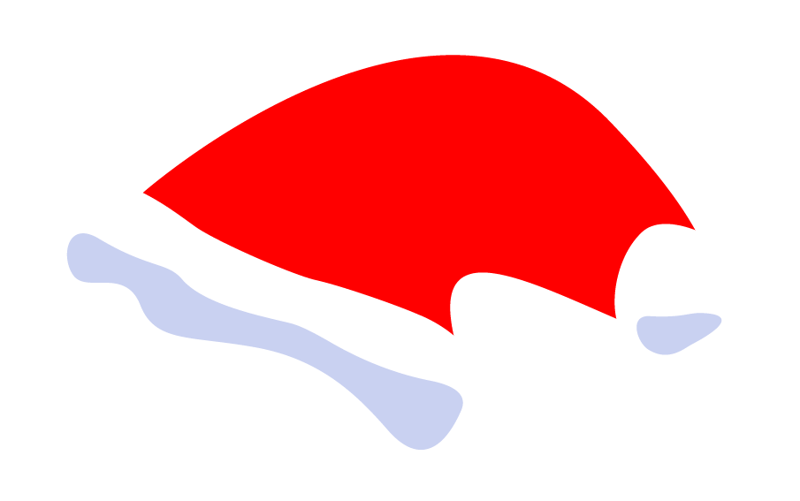
Click to try and catch up!

Slide 3

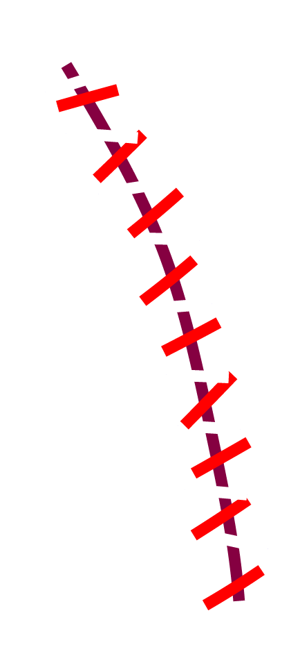
Almost there, one more click!

Slide 4
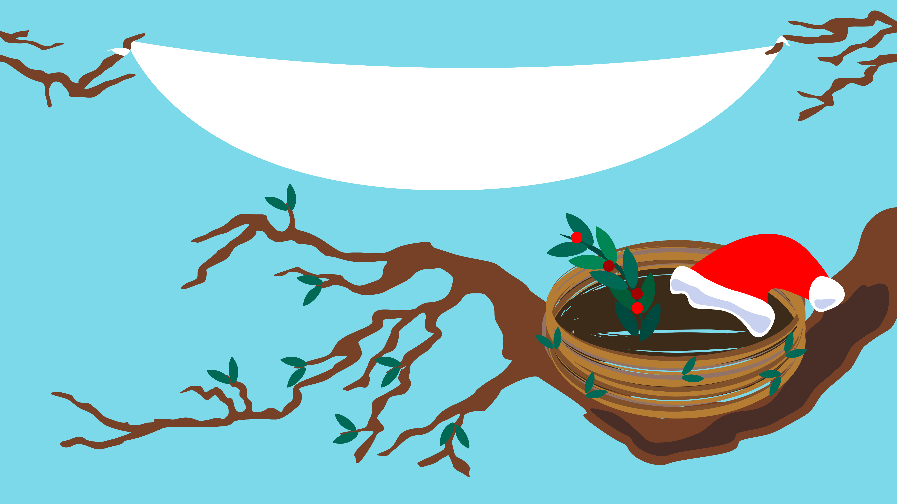


Happy Holidays!
It’s about the personal touch

