Slide 1



THE

Slide 2
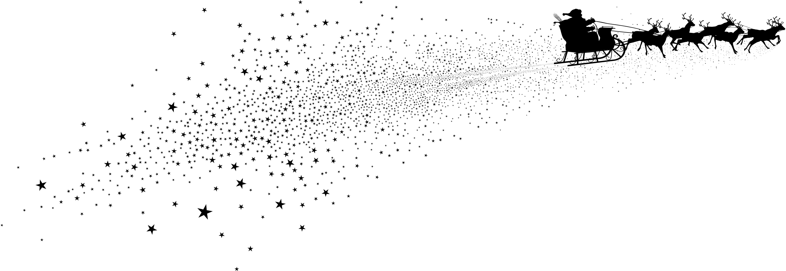


Slide 3



I did see it….
And his nose did glow…

Slide 4
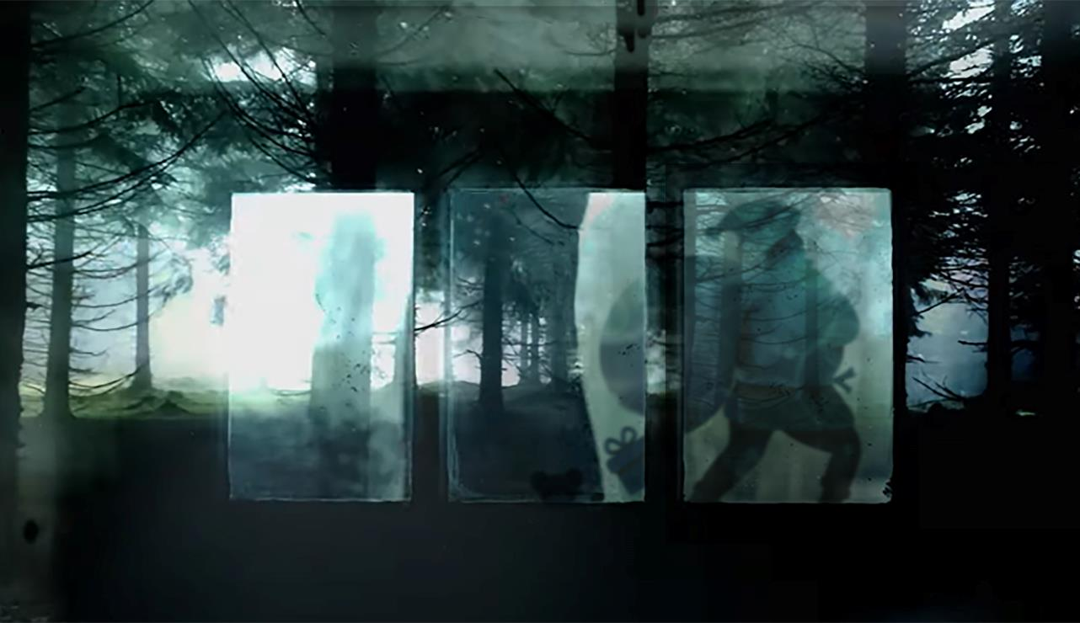

Slide 5
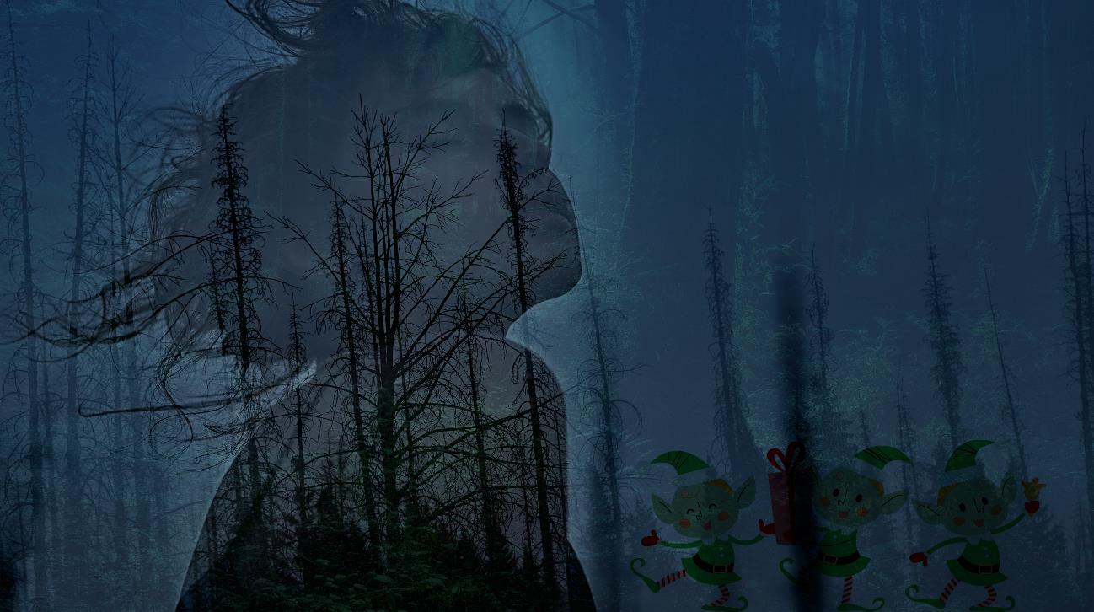
I know what I saw….
LITTLE GREEN MEN!
I know what I saw… LITTLE GREEN MEN

Slide 6
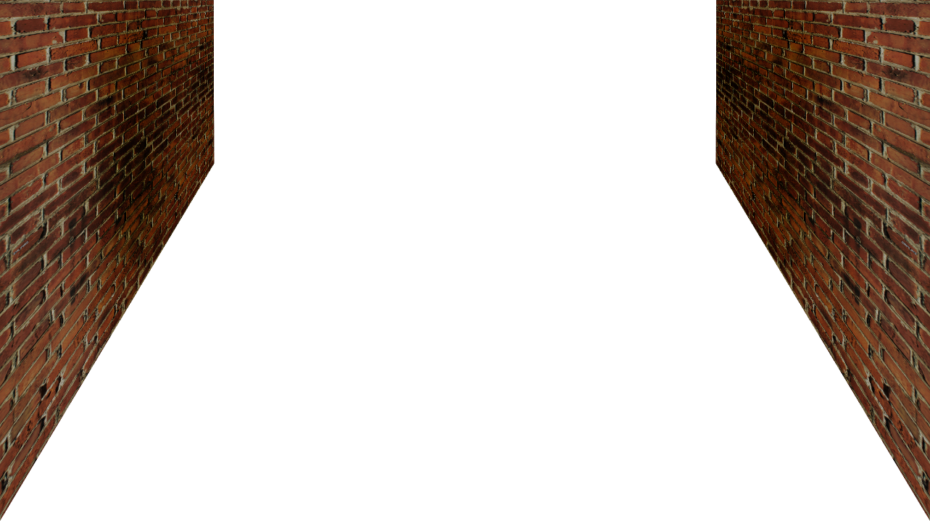
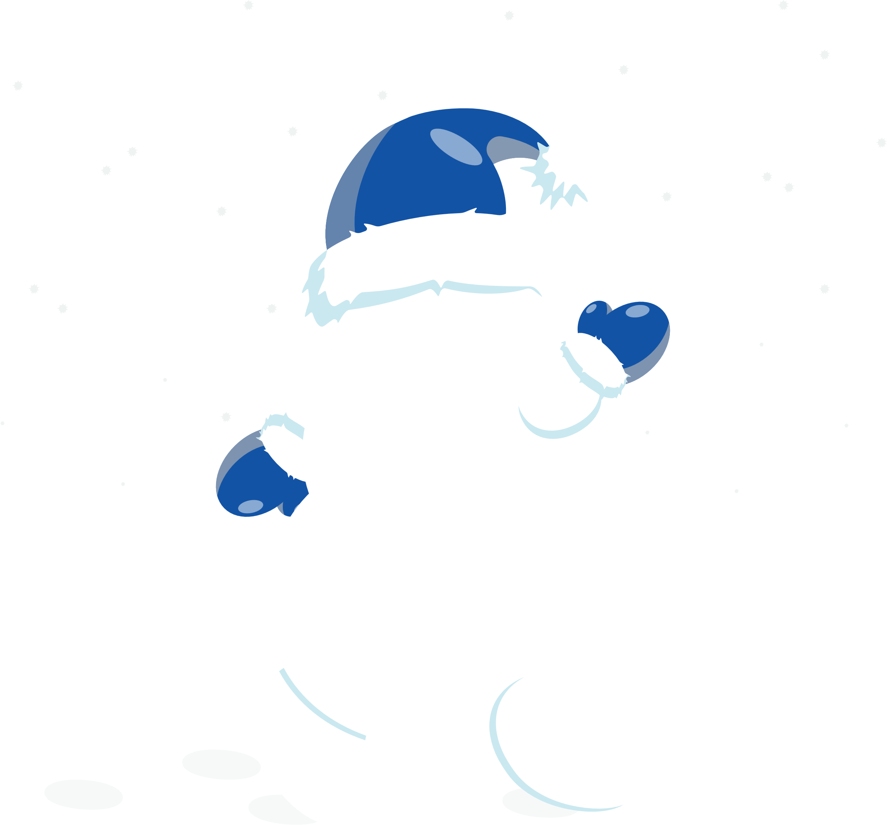

REC
00:59:11:24
12-25-22

Slide 7

REC
00:59:13:14
12-25-22

Slide 8
REC
12:59:16:54
12-25-22

Slide 9

The truth is out there…
he is REAL

Slide 10

The truth is out there…
he is REAL

Slide 11

The truth is out there…
he is REAL

Slide 12
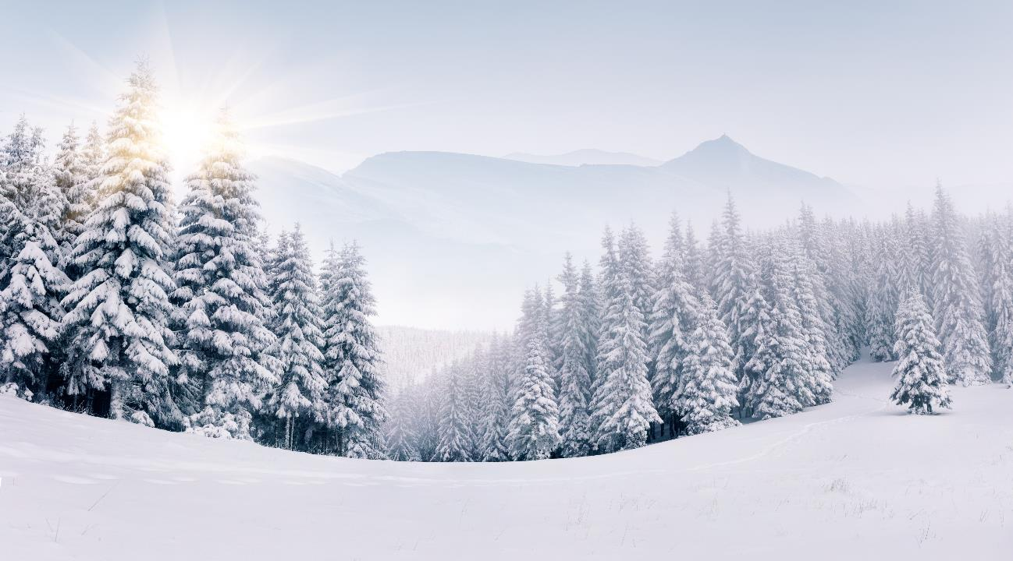
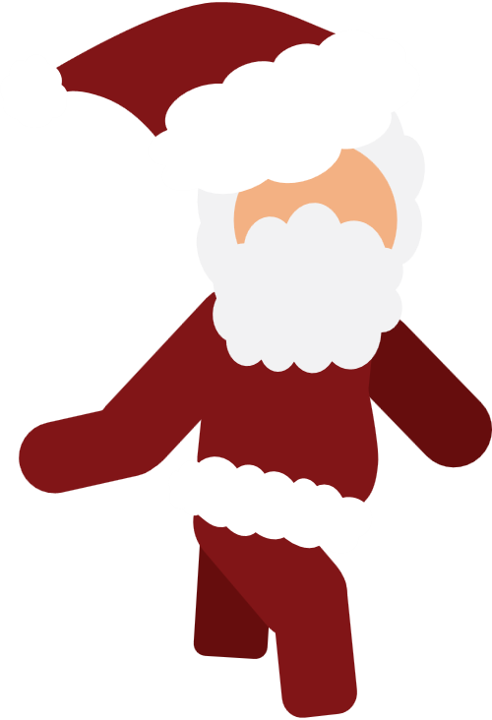
MERRY CHRISTMAS
from everyone at BrightCarbon

