Slide 1

Ye Olde Gift Shoppe

Slide 2
Ye Olde Gift Shoppe

Slide 3
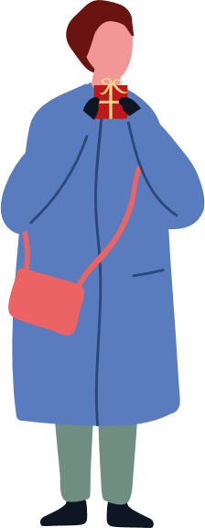

Ye Olde Gift Shoppe
That’s presents sorted!

Slide 4


Slide 5

There goes the present!

Slide 6


Move (click) the snow to find the present!

Slide 7


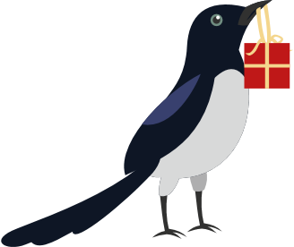

Oh no!
A mischievous magpie has taken the present.
Where will they take it?

Slide 8
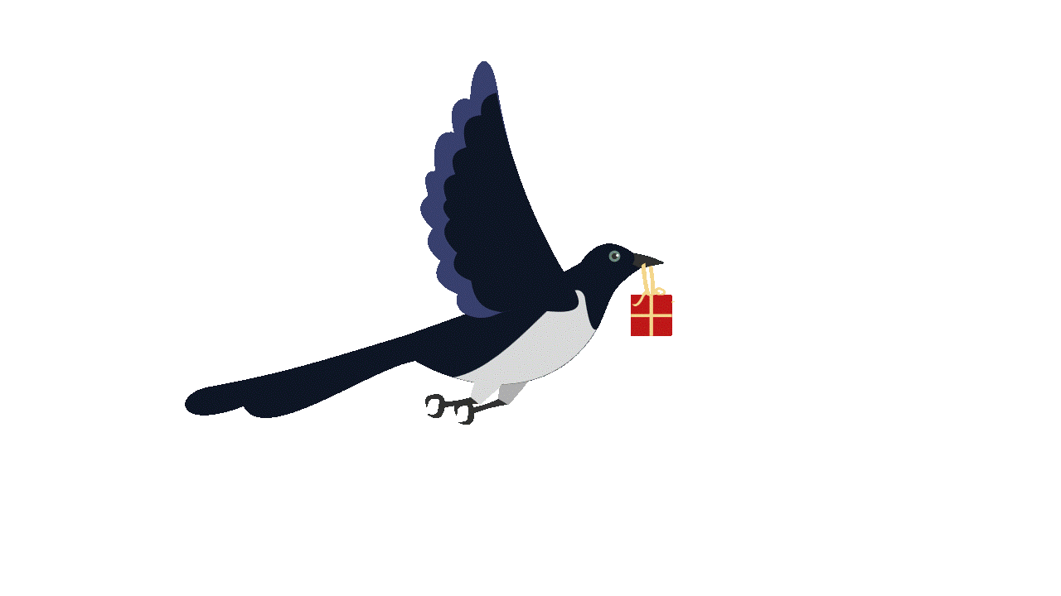

Slide 9
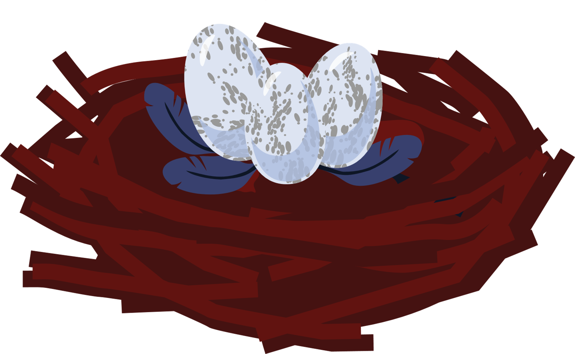
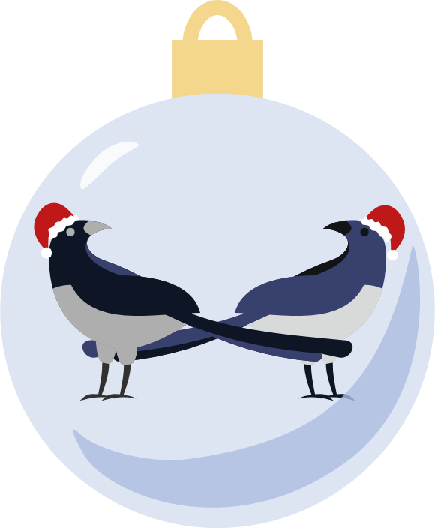


Click the present to unwrap it!
It looks like it might have been for our magpie friend after all!

Slide 10
Merry Christmas
[Name],
From [Name]

Slide 11
Sometimes it’s the thought that counts.
May you have a mischief-free festive season!
Card by BrightCarbon

