Slide 1
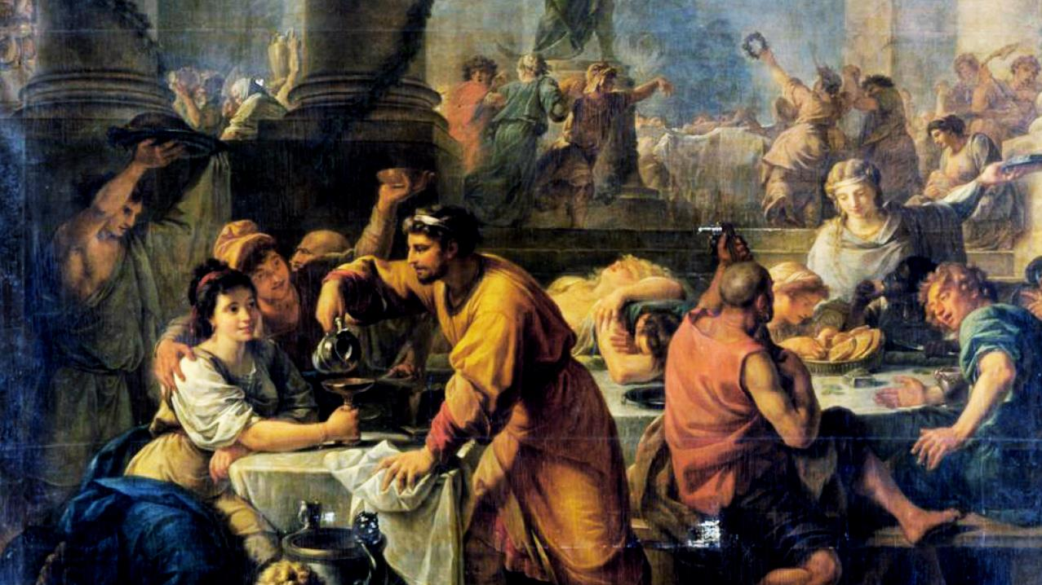
A merry
saturnalia

Slide 2
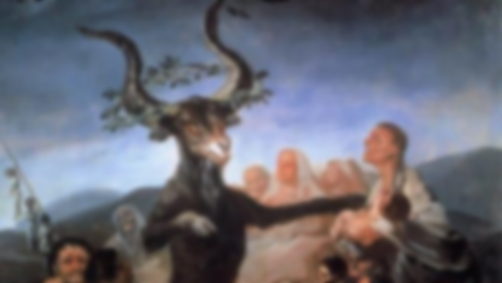
A merry
saturnalia

Slide 3

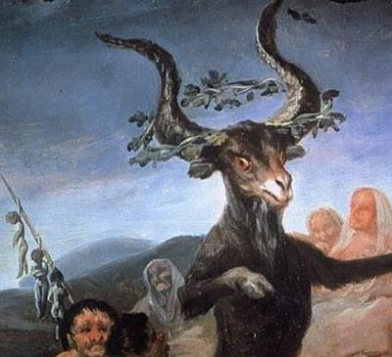
A bright
solstice

Slide 4
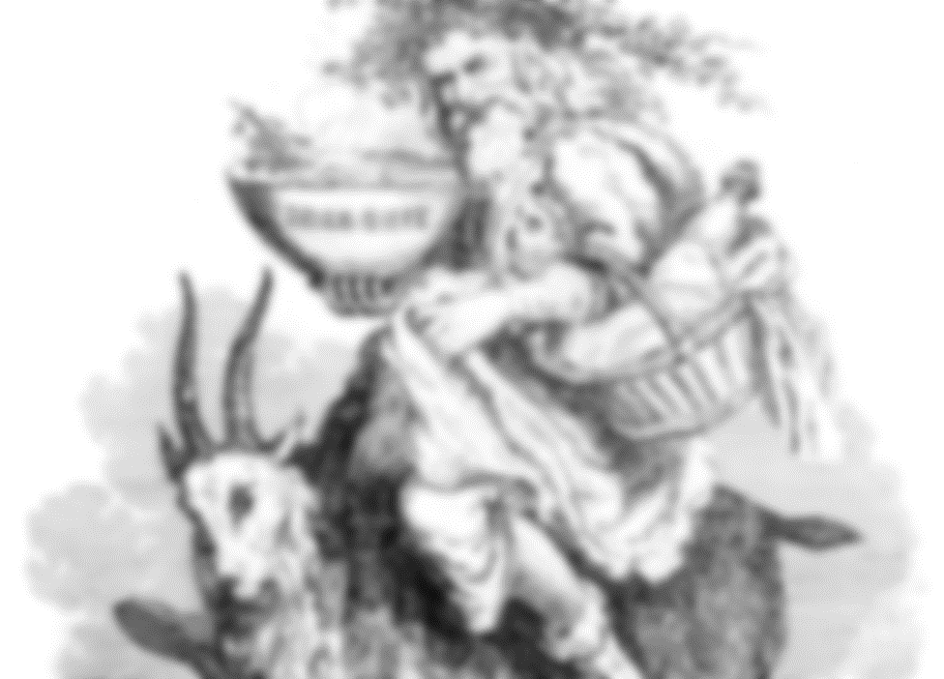
A bright
solstice

Slide 5
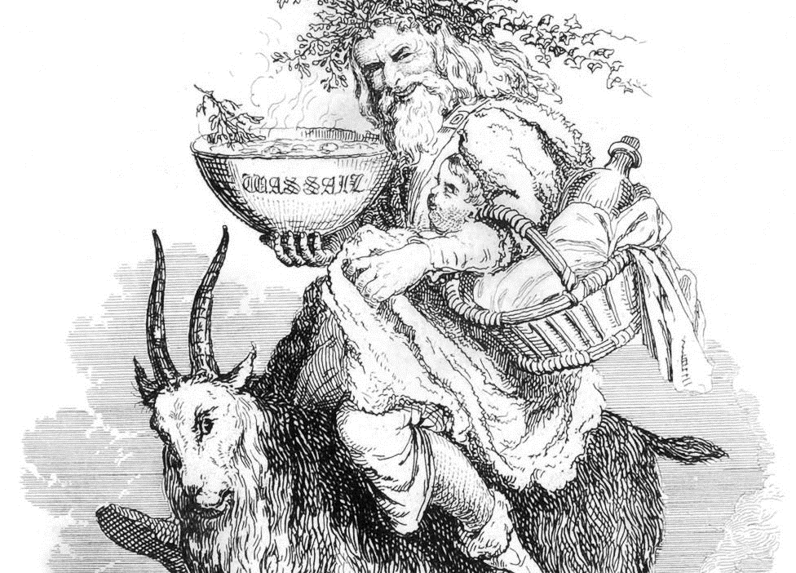
A fruitful
yule

Slide 6
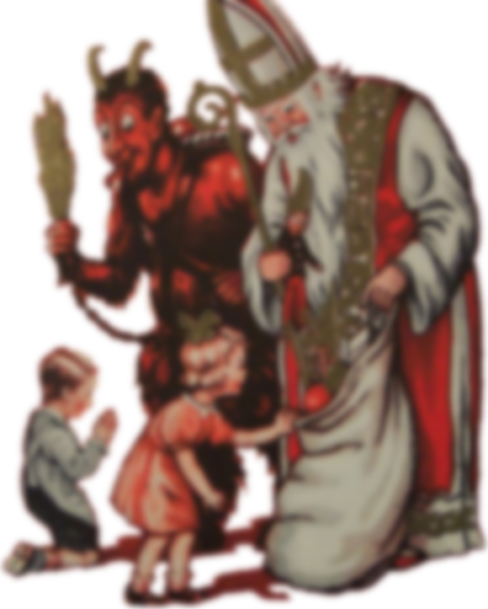
A fruitful
yule
A wicked
christmas

Slide 7
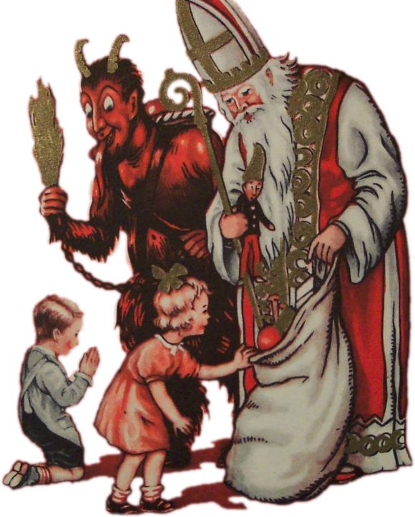
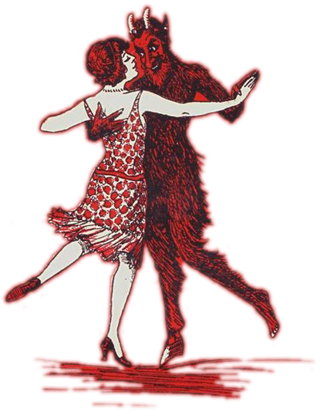
Whatever you
celebrate
A wicked
Make it
christmas
legendary

Slide 8
A wicked
Whatever you
celebrate
Make it
legendary
christmas
Season’s
greetings
From brightcarbon

Slide 9
Whatever you
celebrate
Make it
legendary
Season’s
greetings
From brightcarbon

