Slide 1
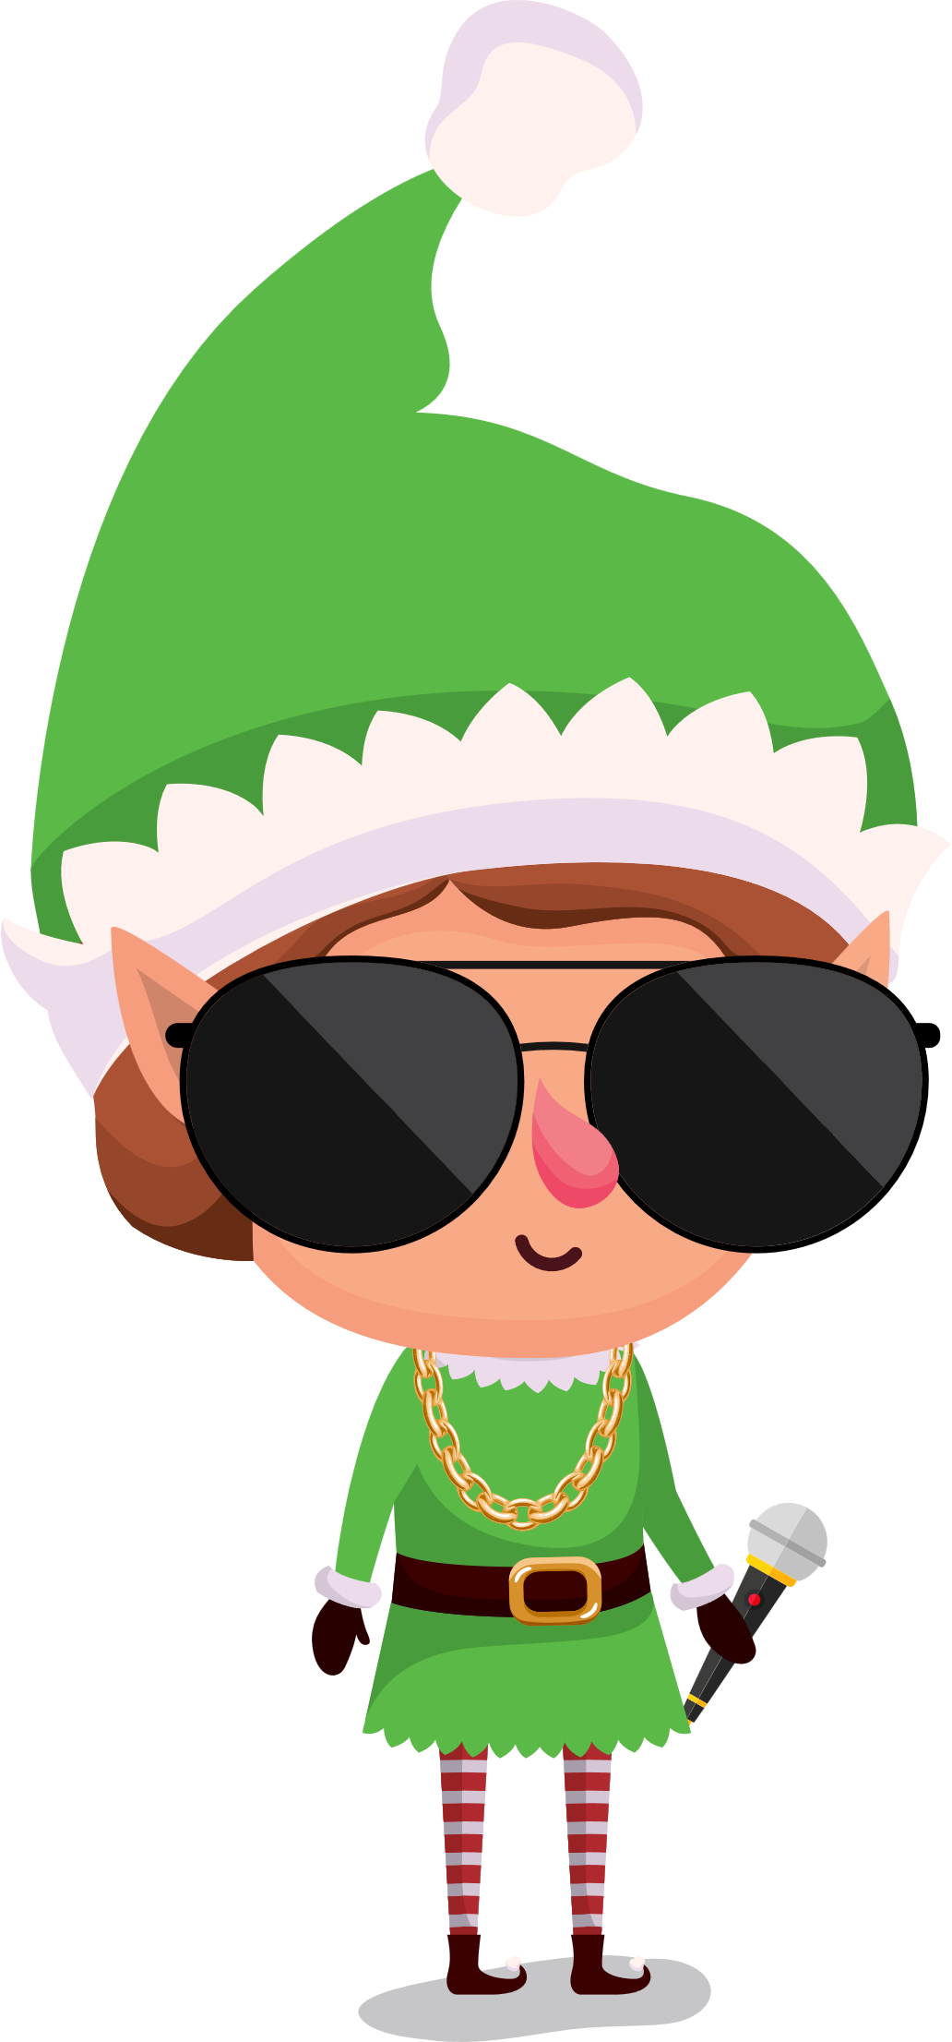


Once in a land…
Far from gloom…
The tale of
M
C Jingle
BELLS

Slide 2
An Elf danced spritely
in his room…

Slide 3

When an email arrived
A chance to shine?

Slide 4

A school for rapping!
How divine…

Slide 5
With heart aflutter, he set out to partake,
Ready to rap, no time to forsake.

Slide 6
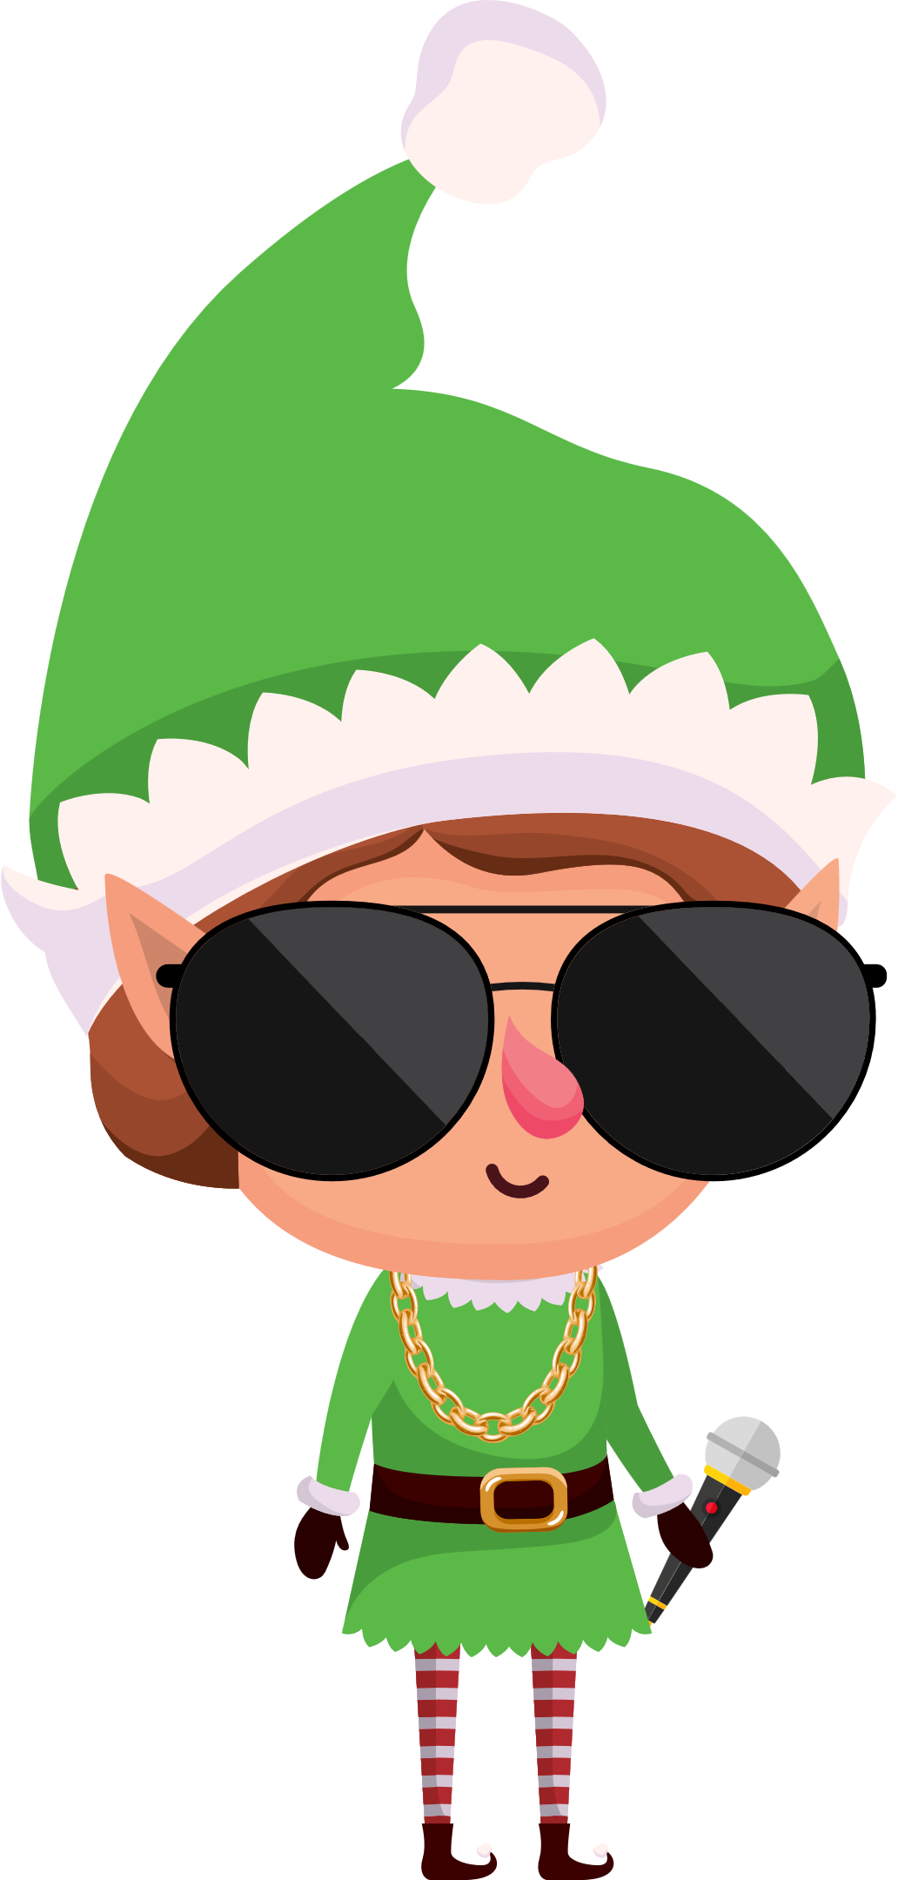
He entered the store
‘Rap Outfits Galore’
And snagged himself an outfit no one could ignore

Slide 7
With an outfit prepared, the elf was not scared
A school for rapping? He was more than prepared!

Slide 8

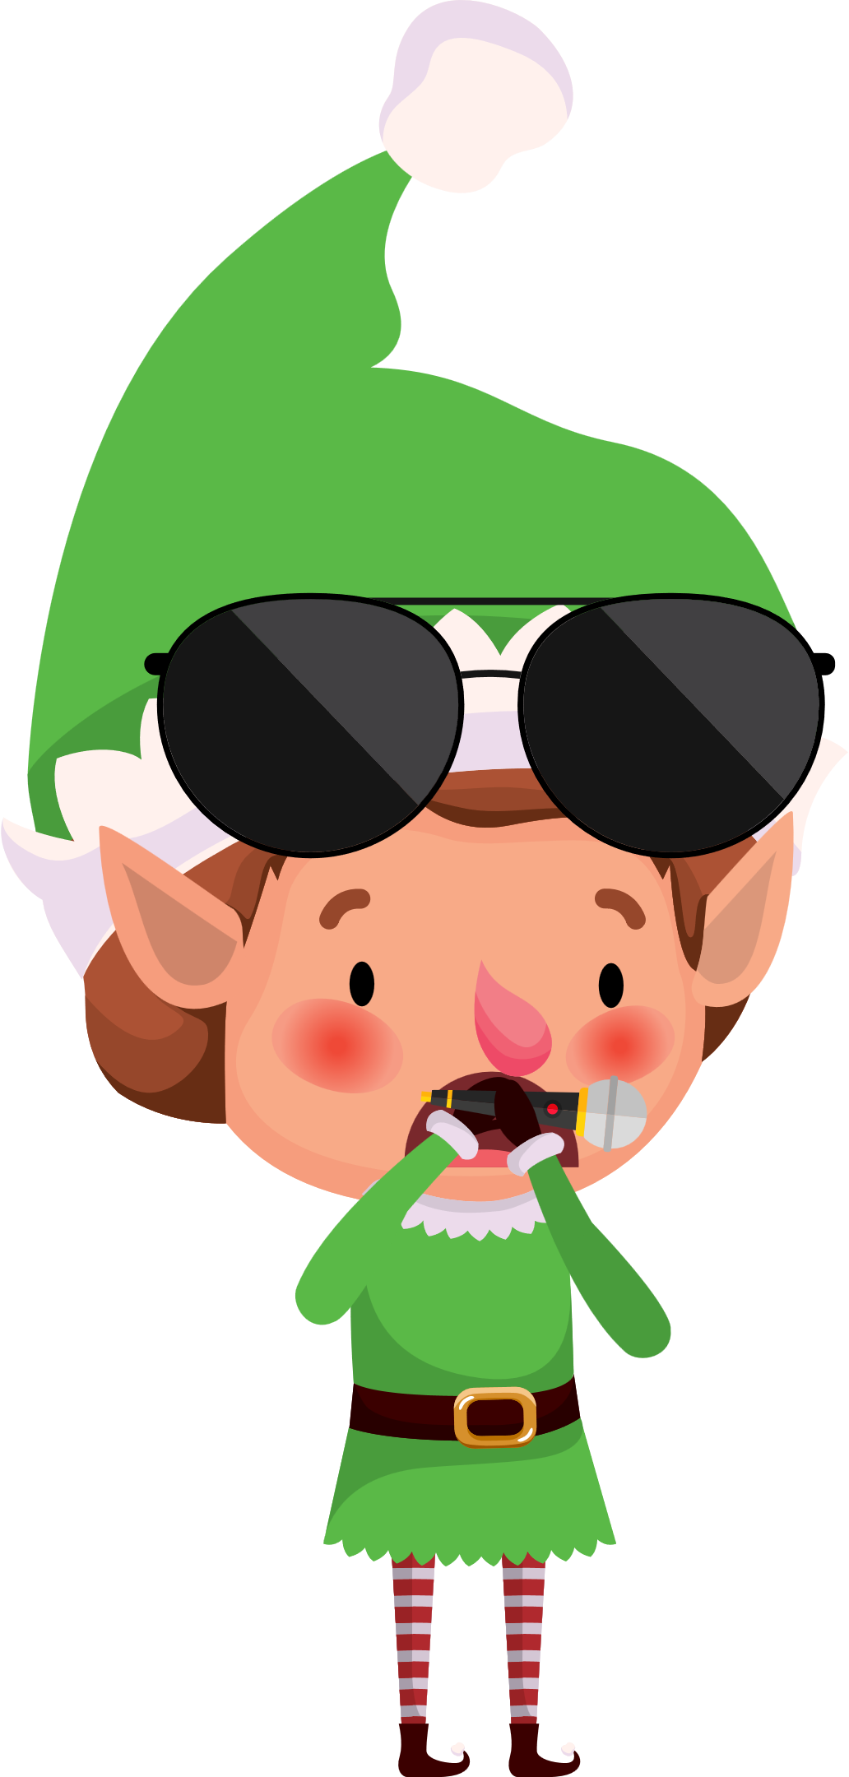
But as he arrived, it soon became clear
His elfish heart began to sink, for words misread brought him
to think
A school for Wrapping, not Rapping oh dear!

Slide 9
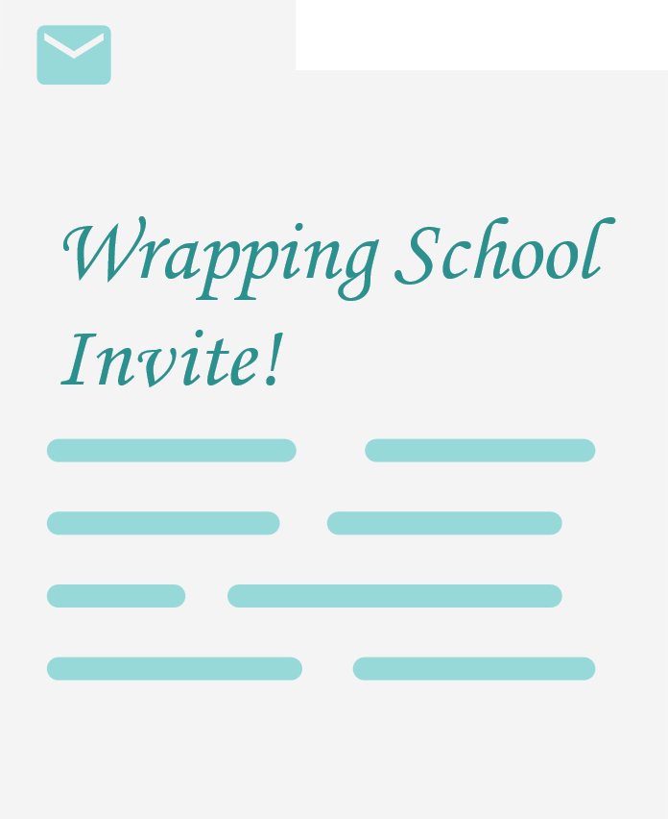
An overlooked email
A comedy grand
Rapping versus Wrapping
A tale unplanned

Slide 10
Lessons learned;
messages set sail
Slow down with emails, avoid that fail!

Slide 11

How to add your own logo!
Right click the BrightCarbon logo
Scroll down to ‘Change graphic’
Chose location as ‘My Device’
Locate your own logo, click insert
Done!
Happy Christmas from
Hear our cheer!
May your days be merry,
And your emails clear!

