Slide 1

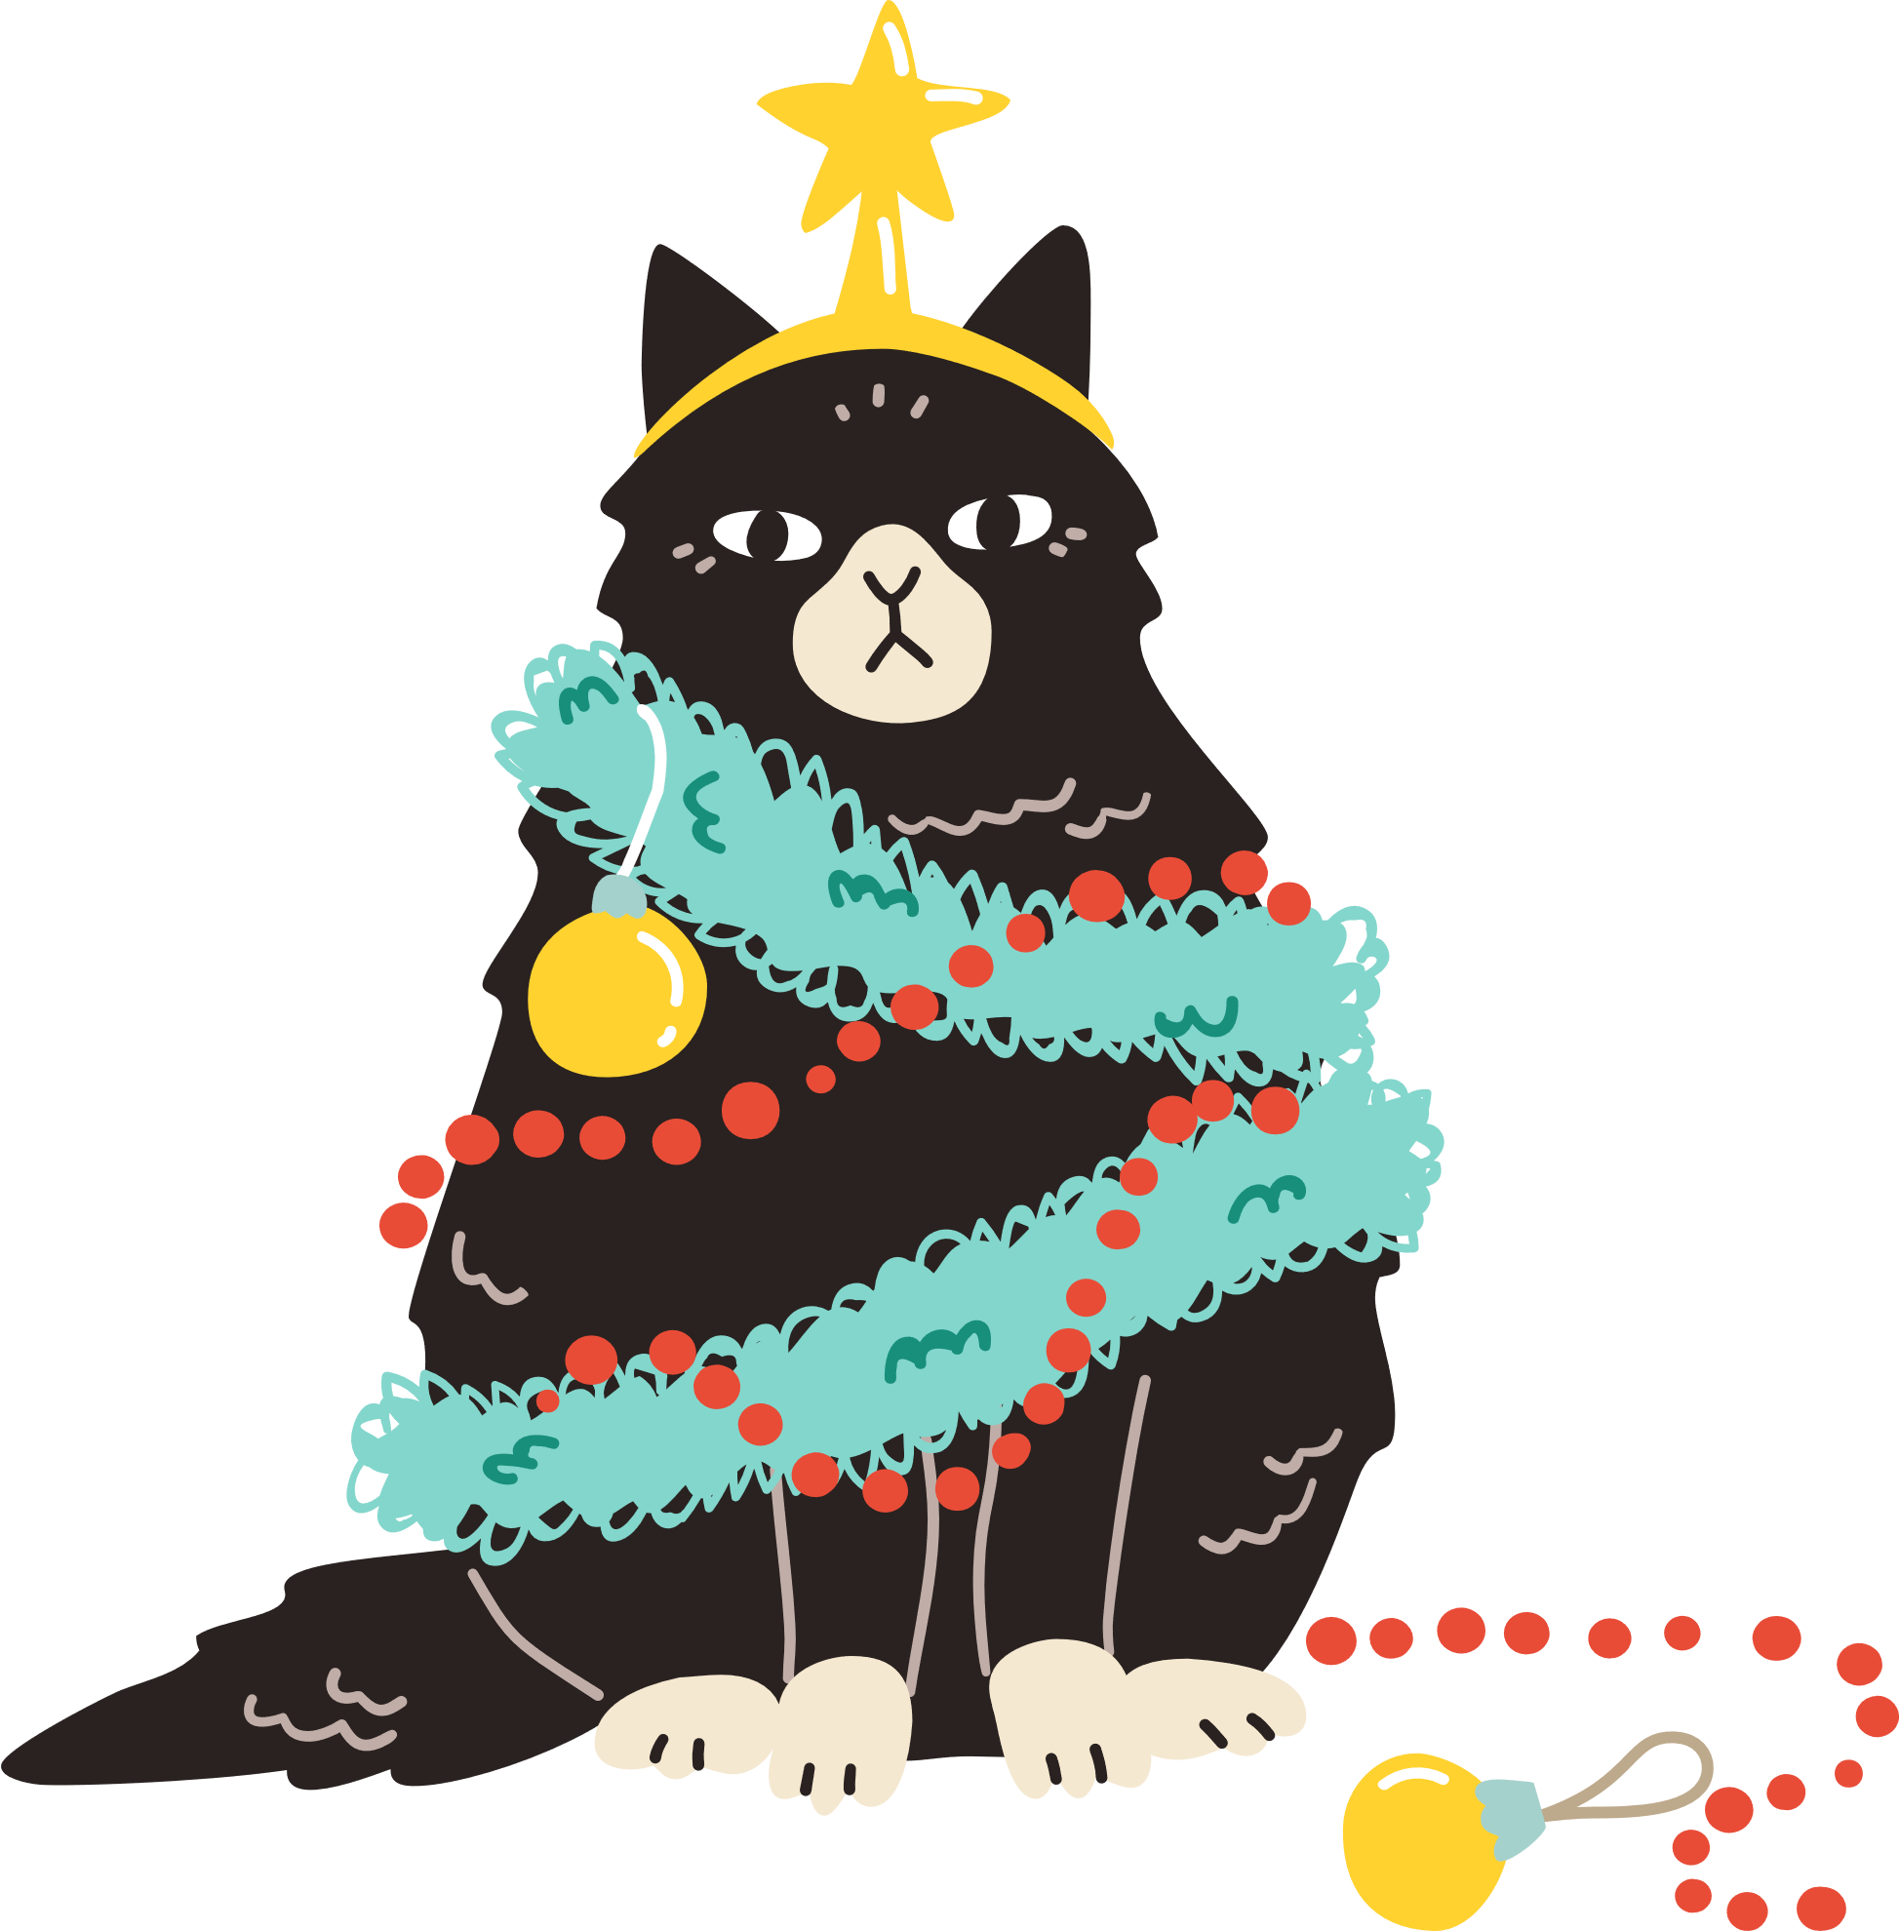

Slide 2
Oh no! What happened
to the Christmas tree?

Slide 3

Merry
Christmas
Ah, I think Barry
knows the answer...
From BrightCarbon
Notes:
Music credit: Up on a Housetop by Kevin MacLeod (incompetech.com)

