Slide 1



A Very
CAPY
Christmas

Slide 2
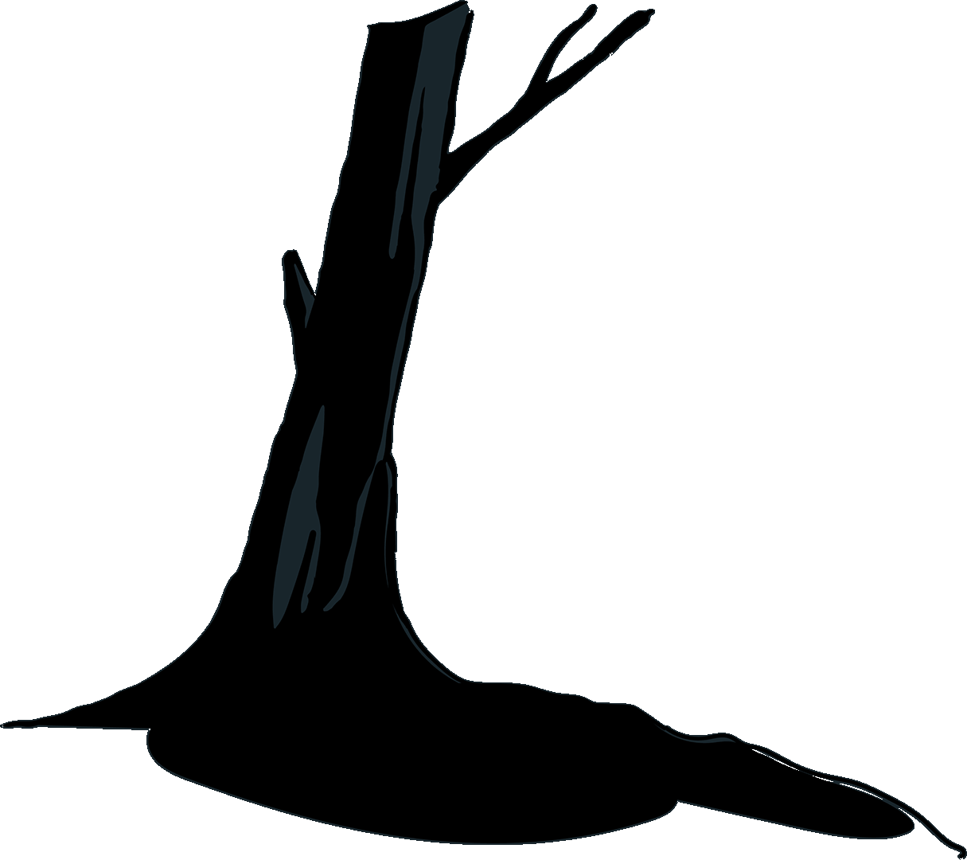
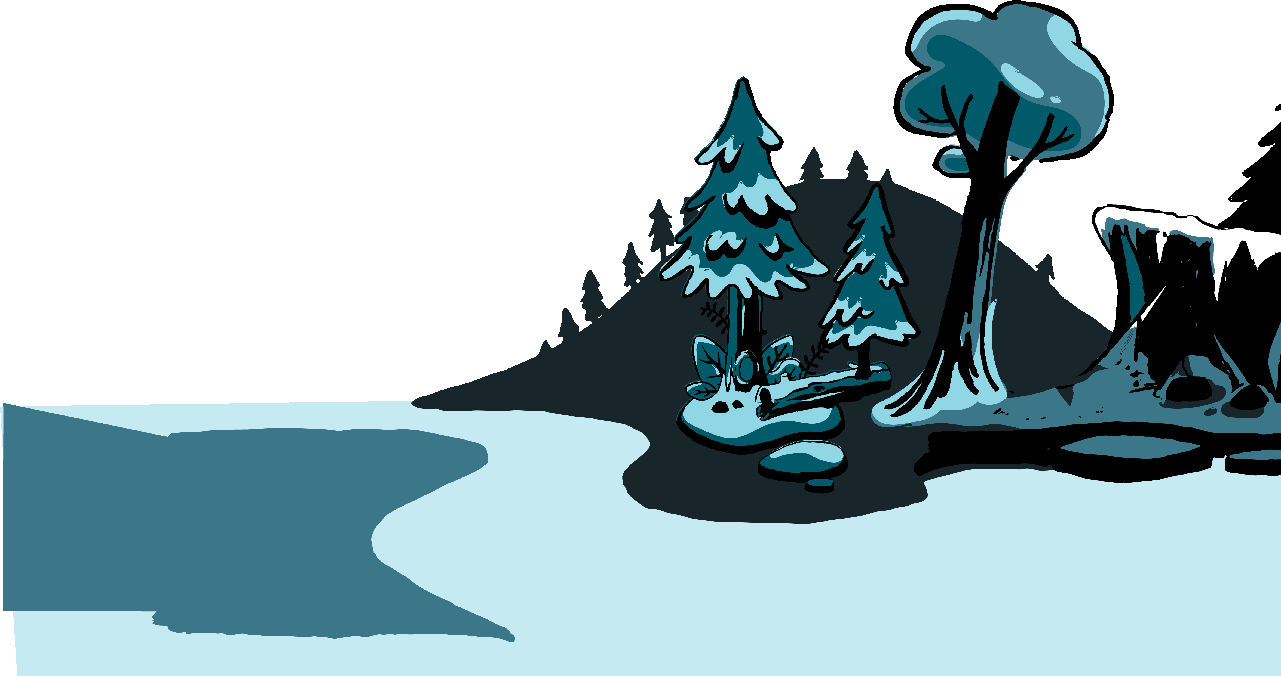





Slide 3
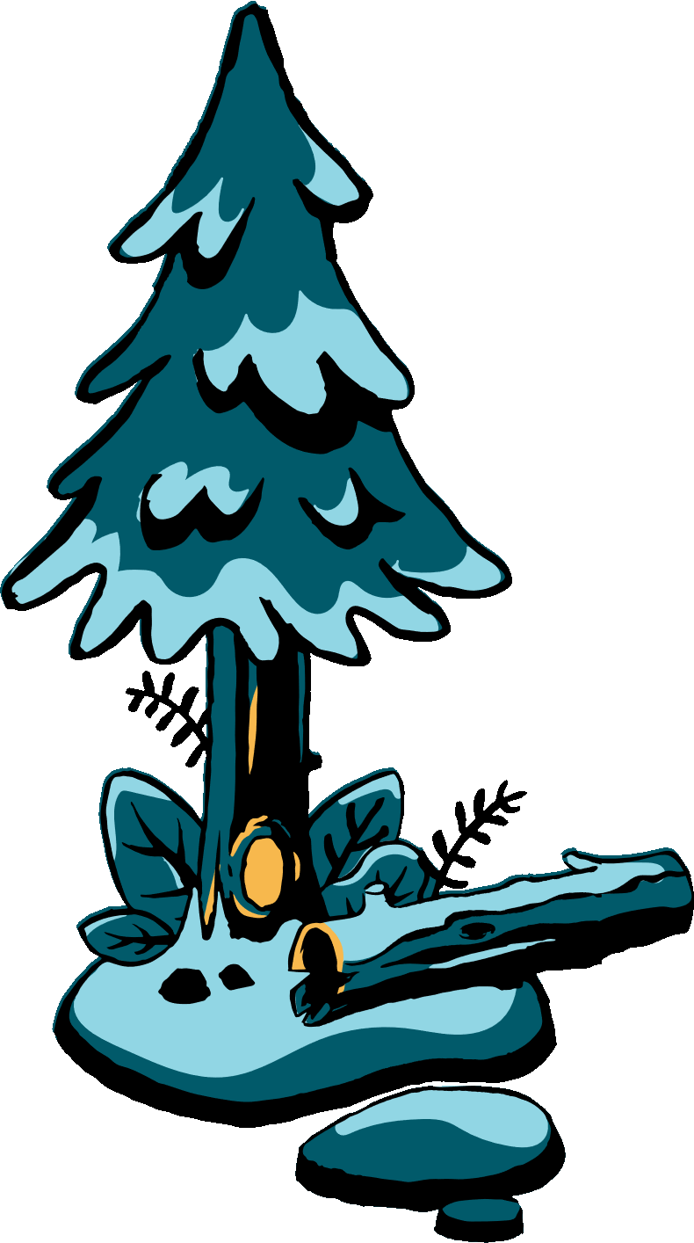
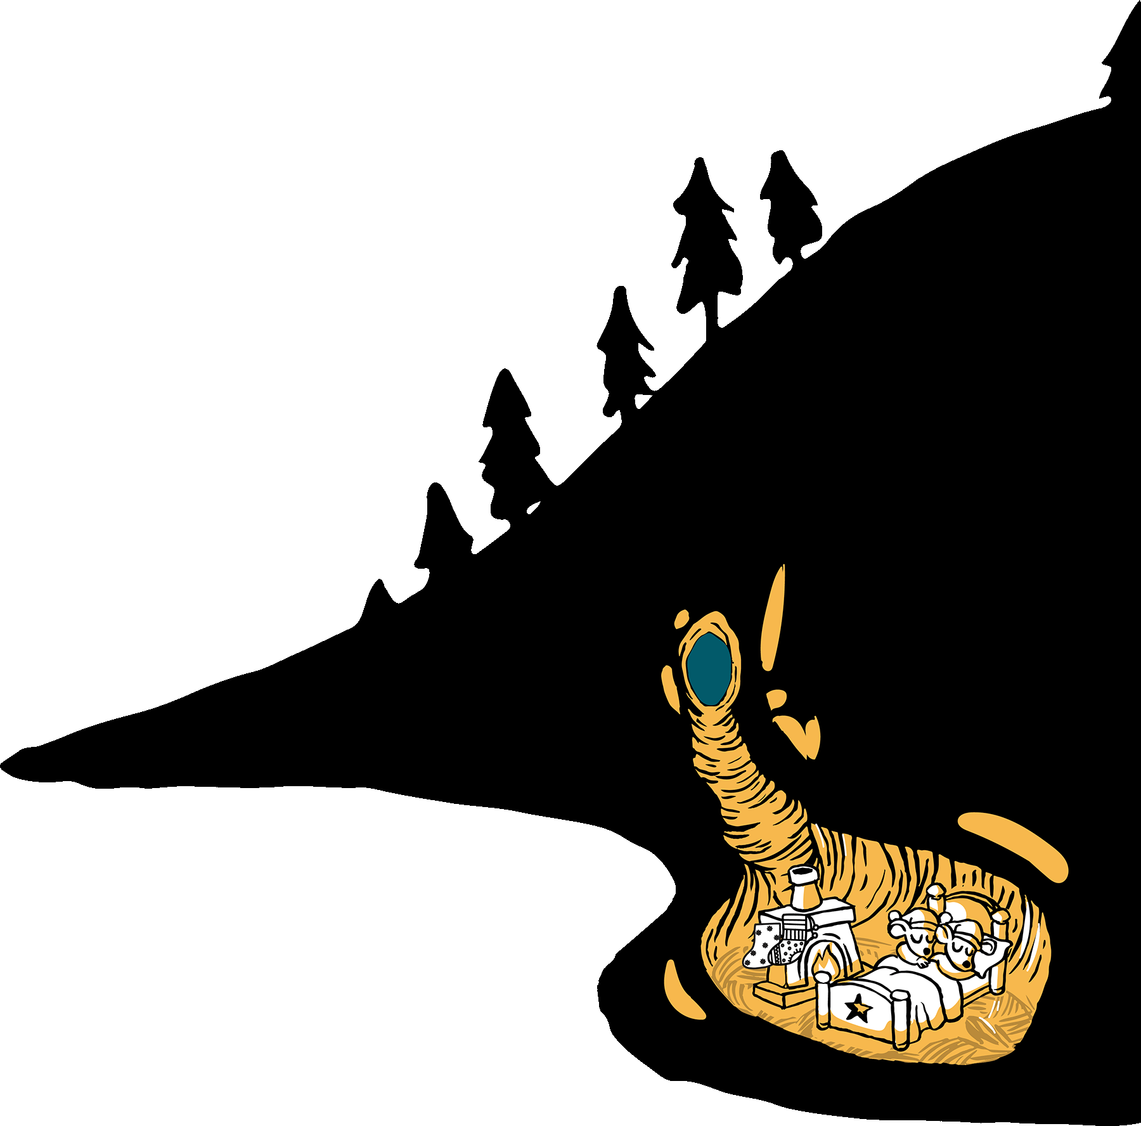


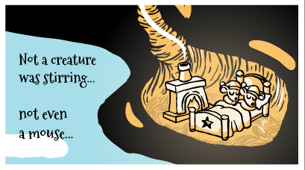
‘Twas
the
night
before
Not
a
creature
Christmas,
and
all
was
stirring,
through
the
marsh…

Slide 4
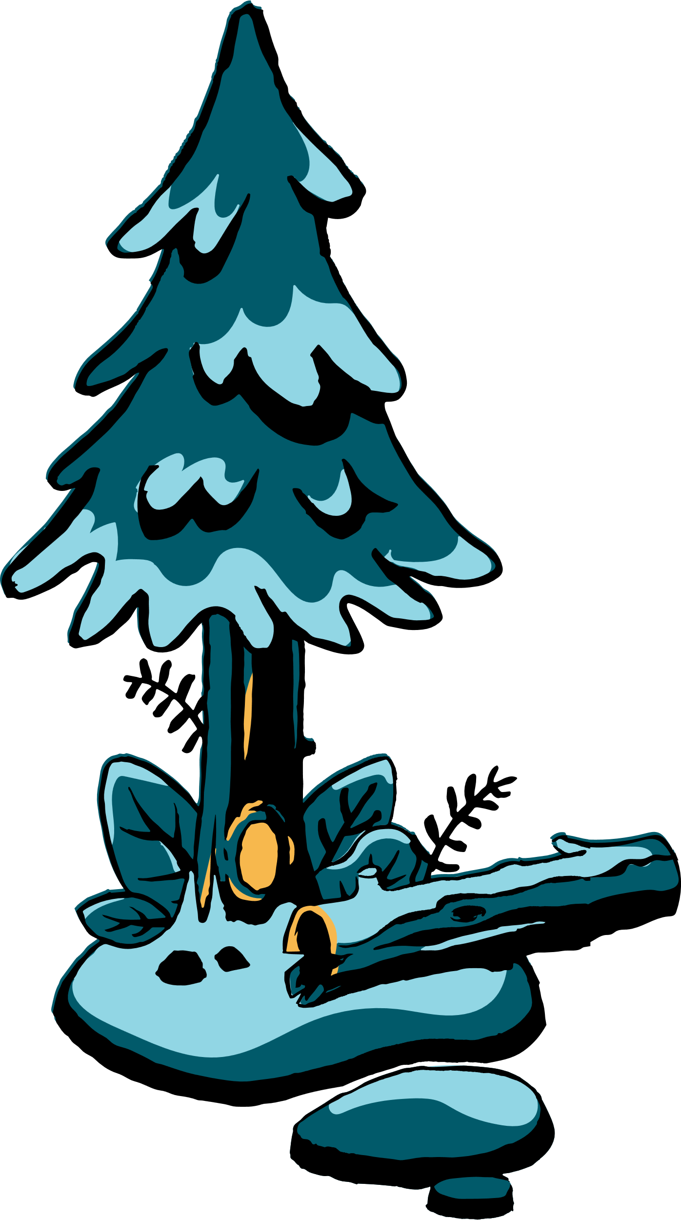
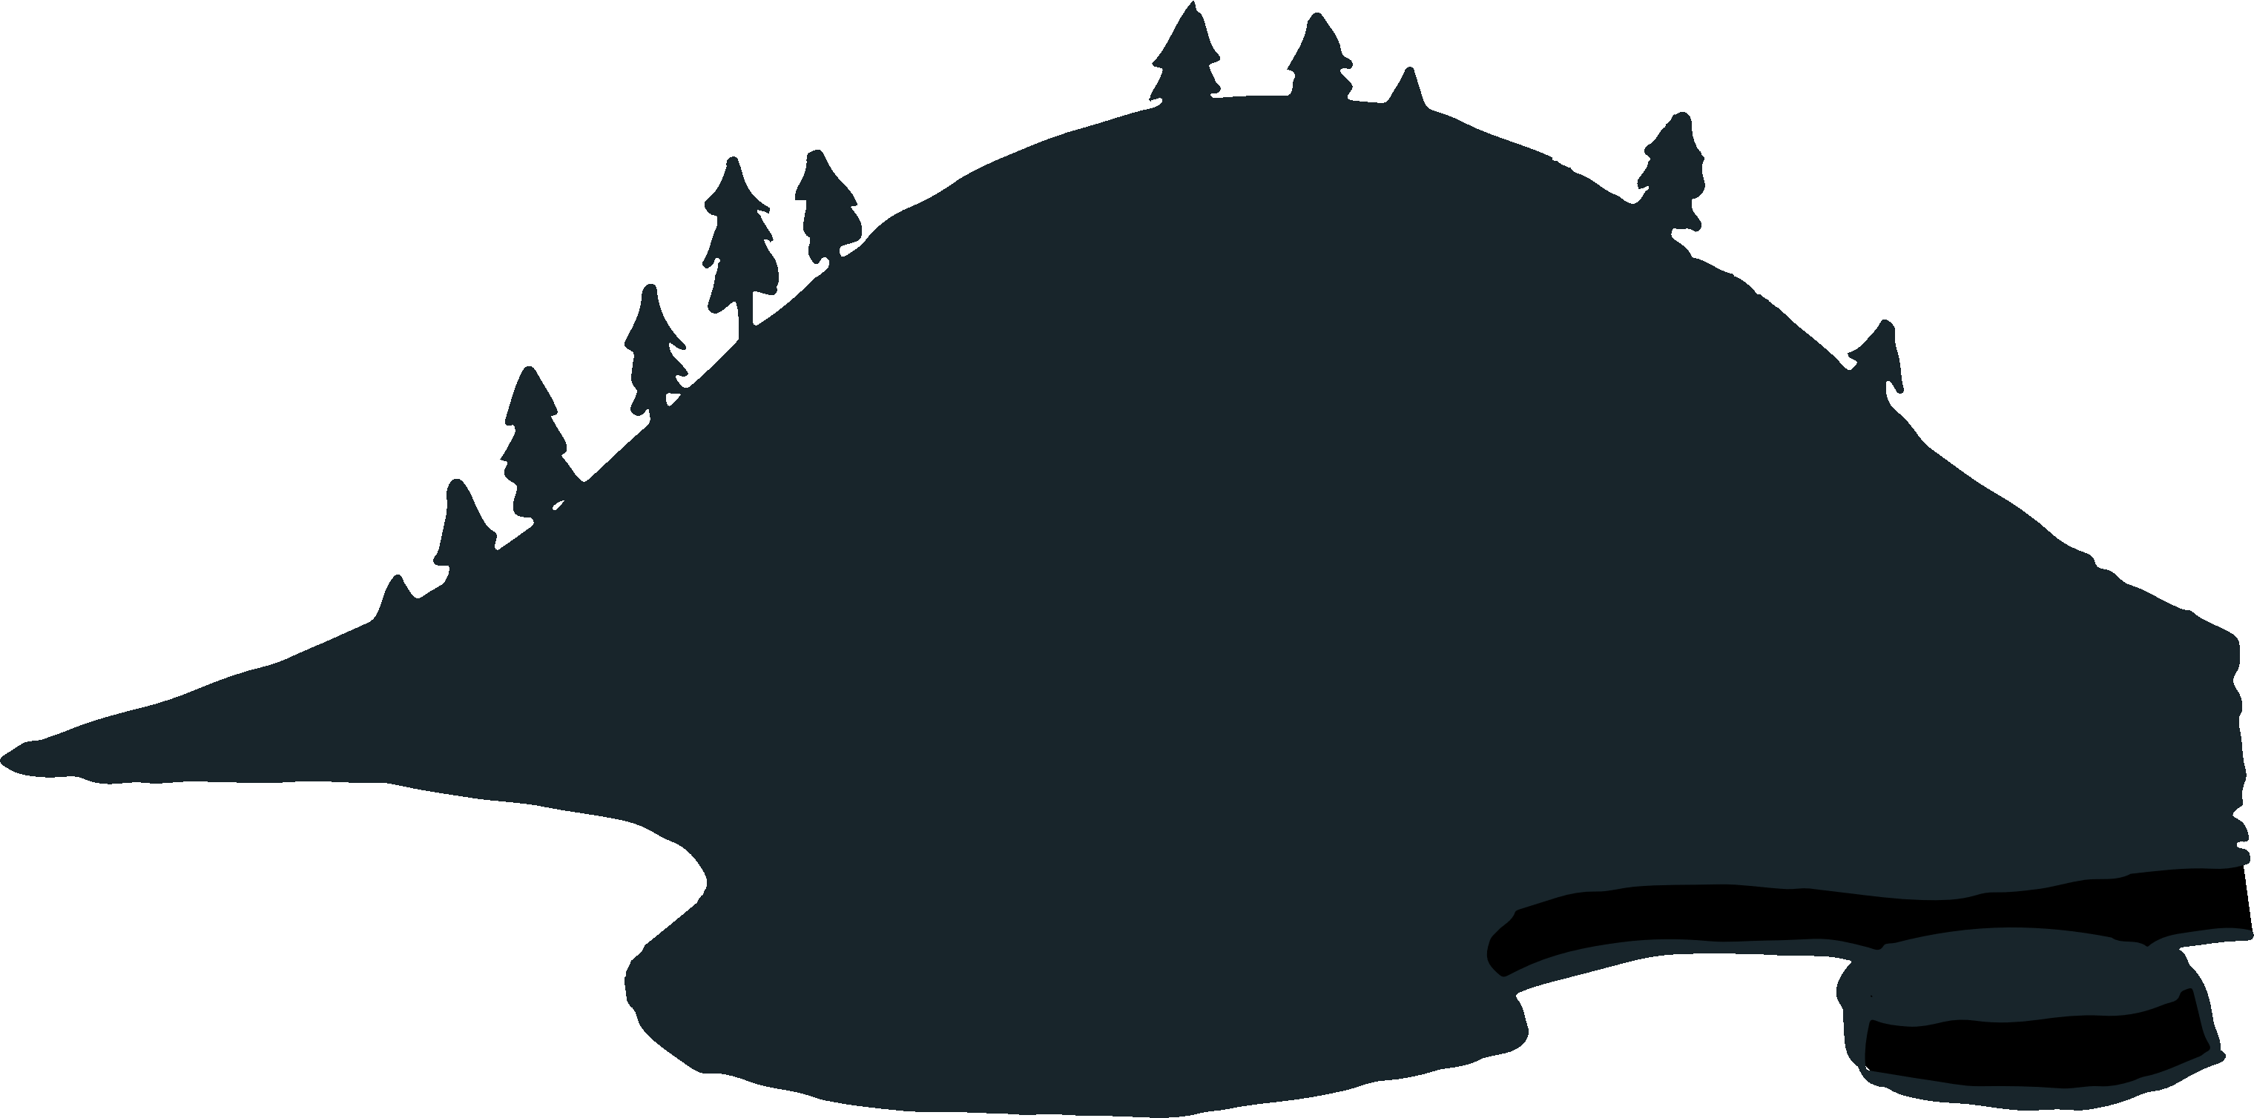

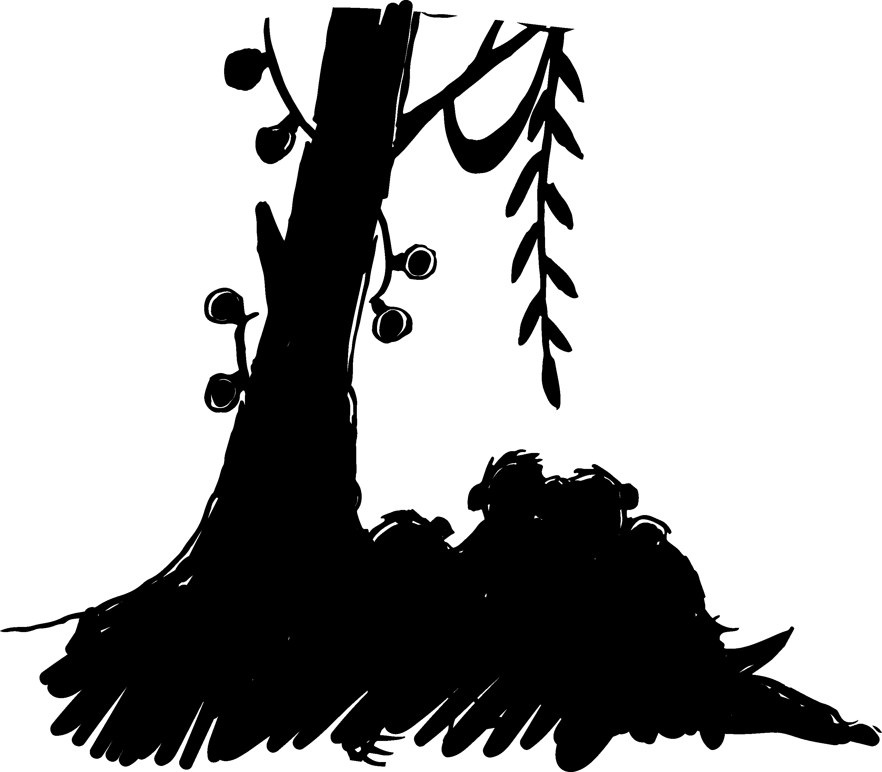

not
even
a
mouse!

Slide 5
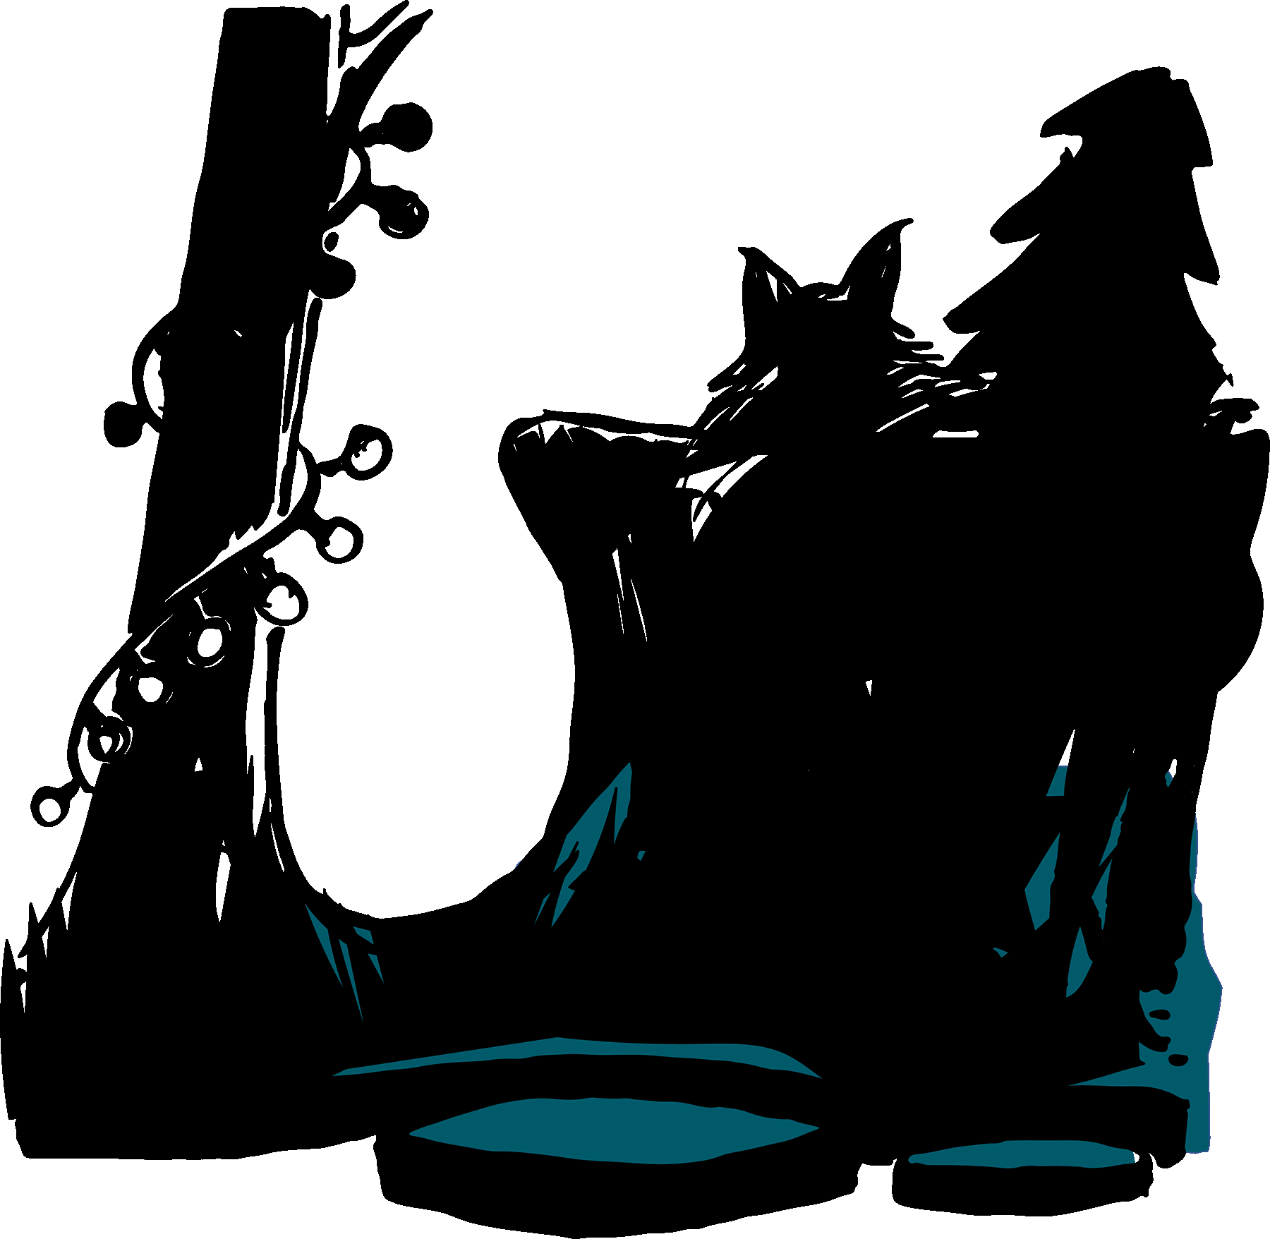
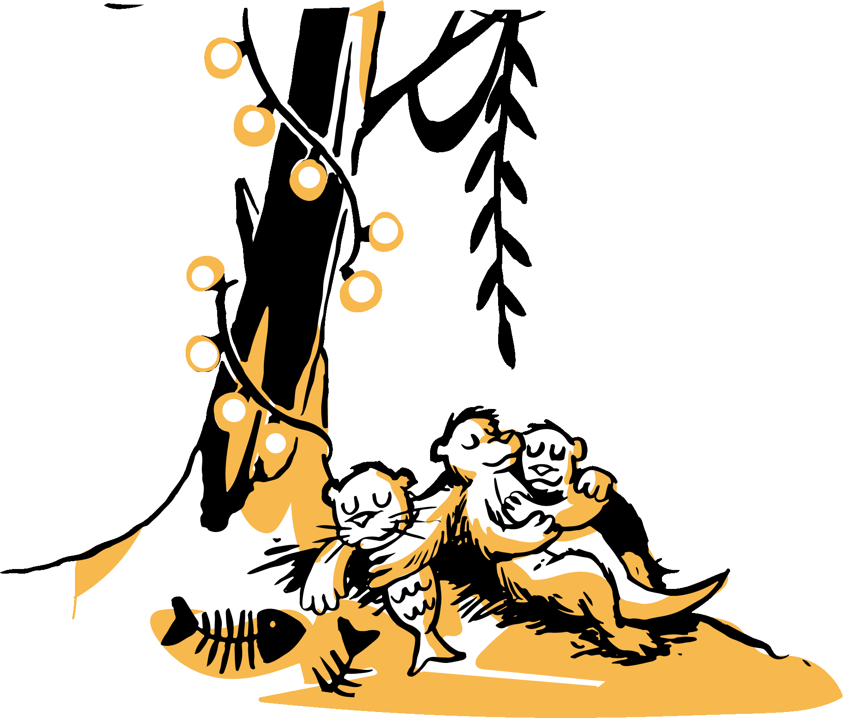
With
visions
of
rivers
The
otters
were
nestled
dammed
up
in
their
heads!
all
snug
in
their
beds,

Slide 6
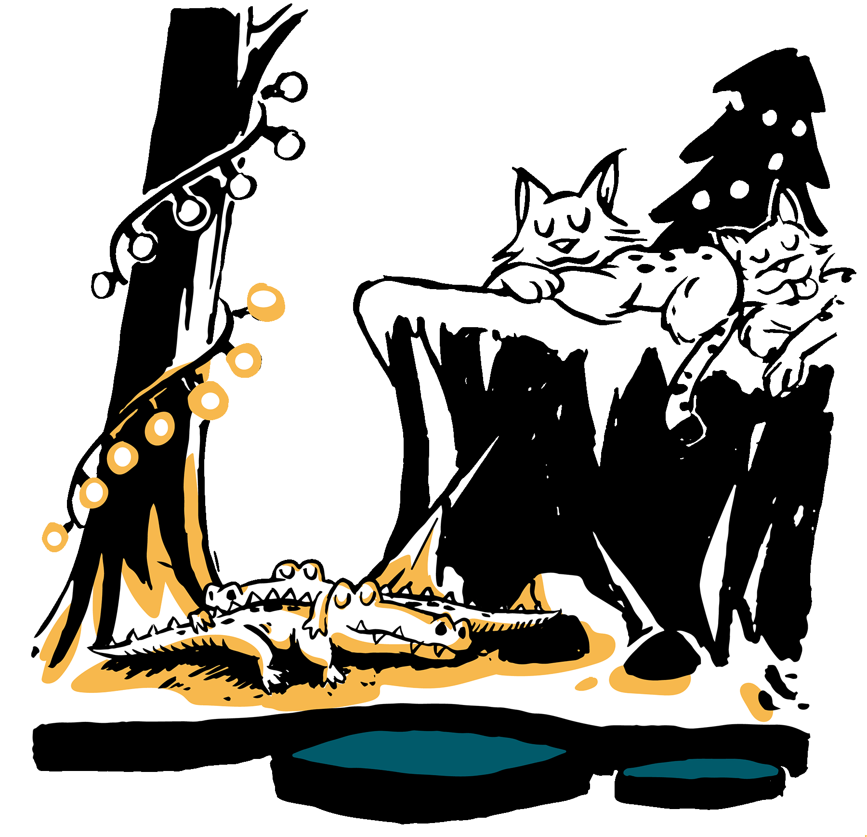
The
alligators
were
resting…

Slide 7
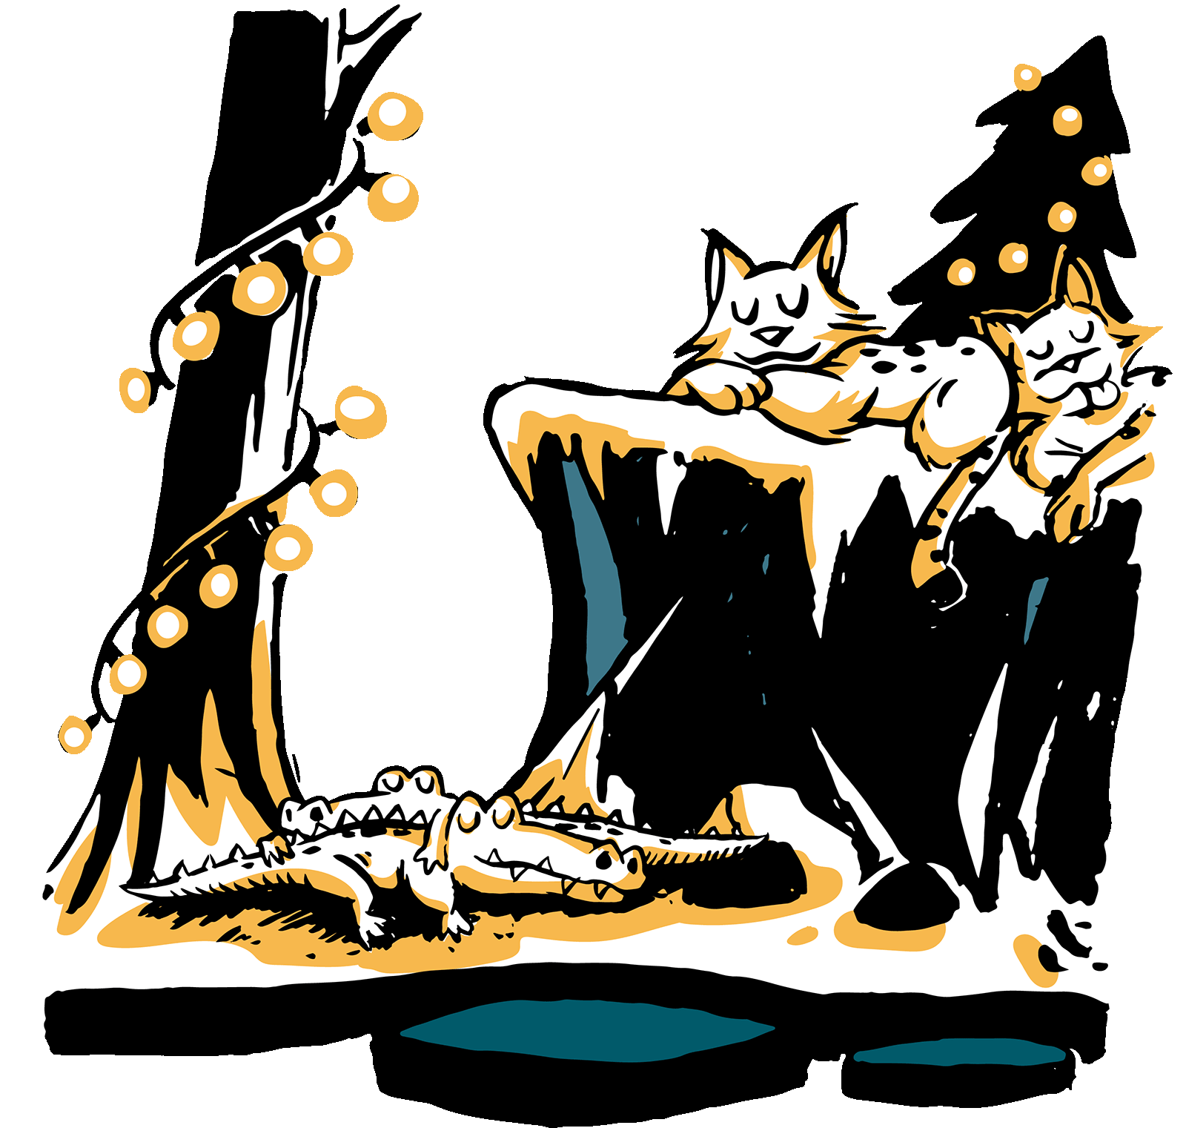

The
bobcats
did
doze…

Slide 8
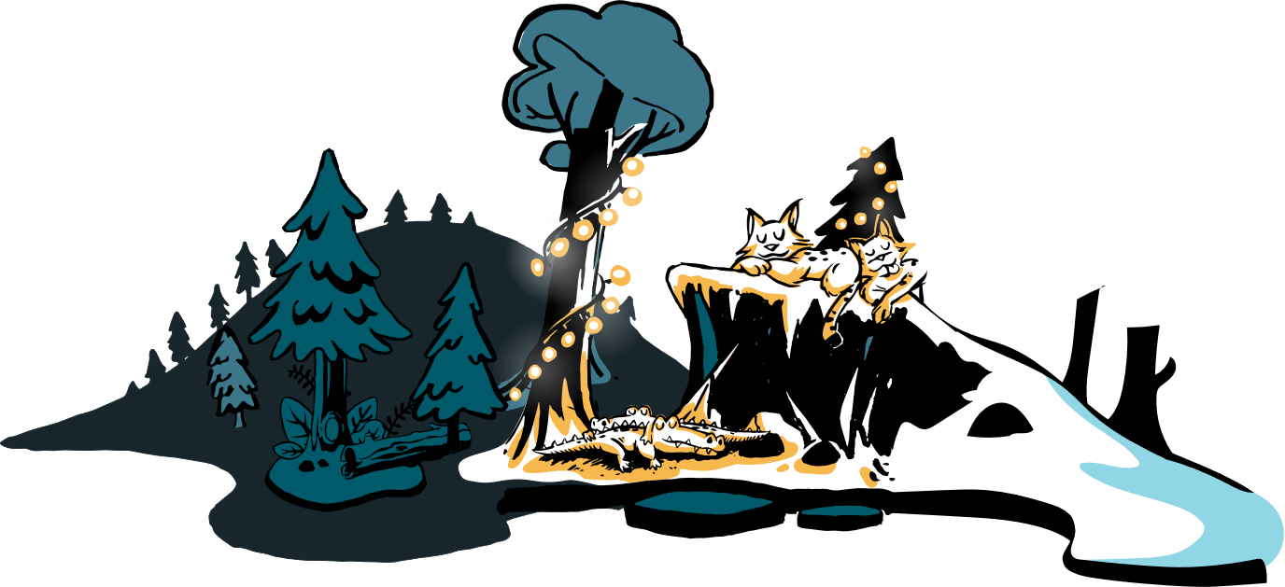
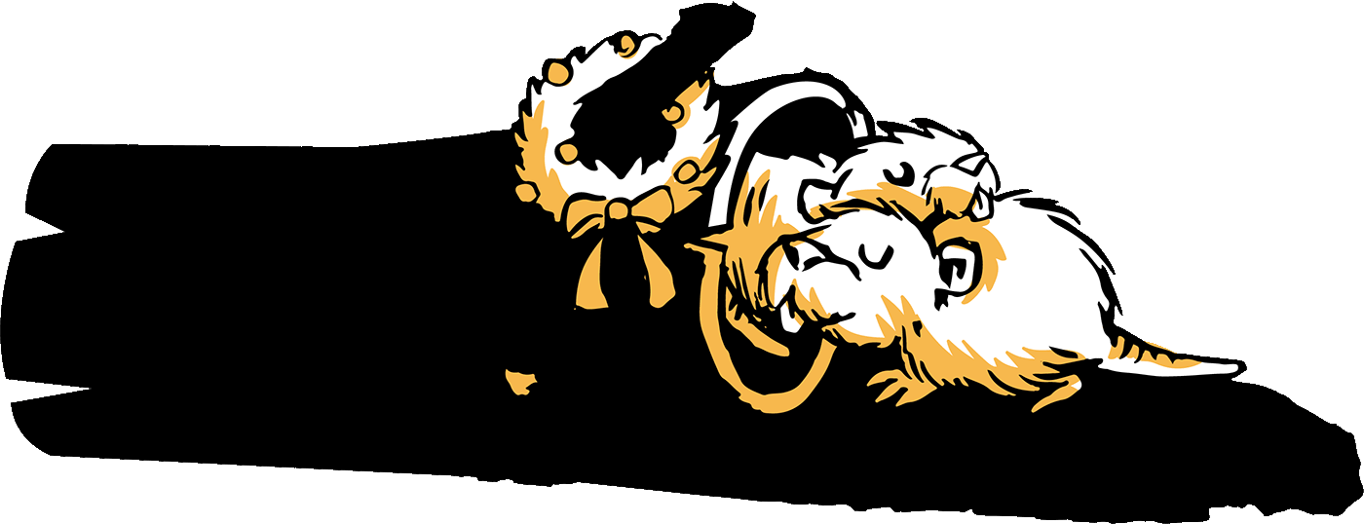
Even the muskrats were safe in their homes!

Slide 9
When all of a sudden,
from up in the sky….
Even the muskrats were safe in their homes!
Even the muskrats were safe in their homes!

Slide 10

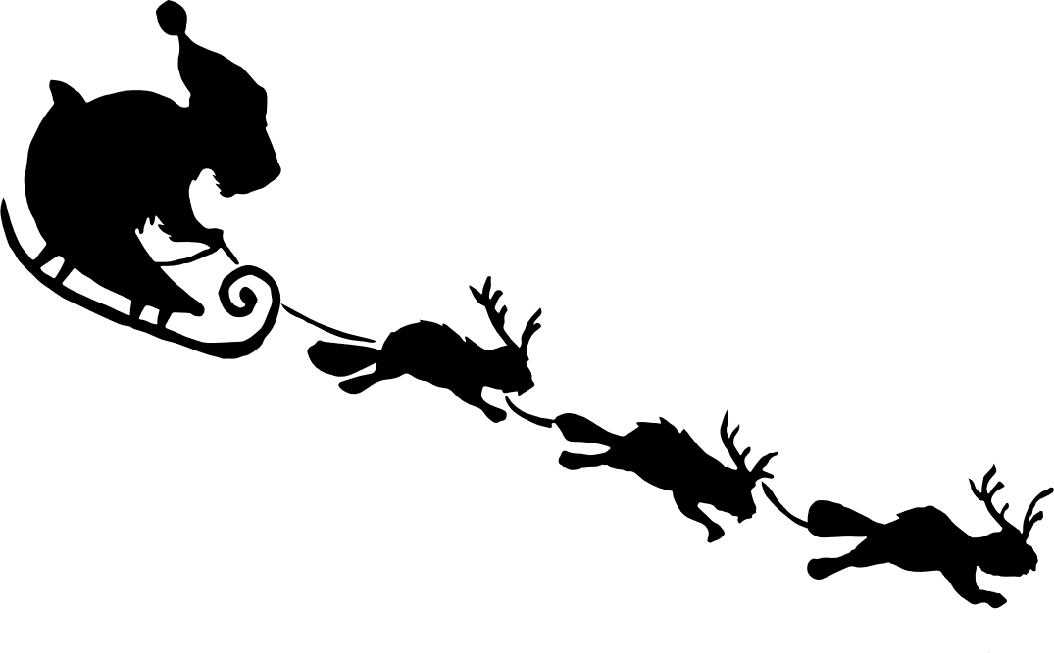
The biggest of rodents came down with a cry!

Slide 11


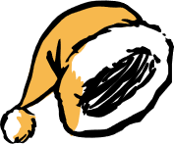
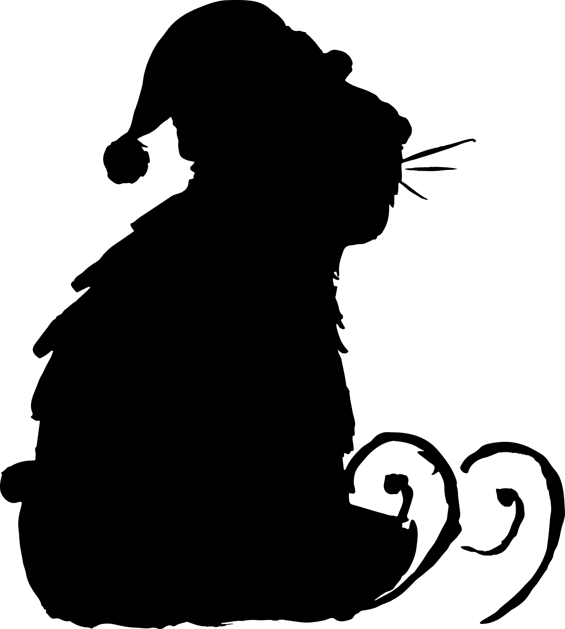
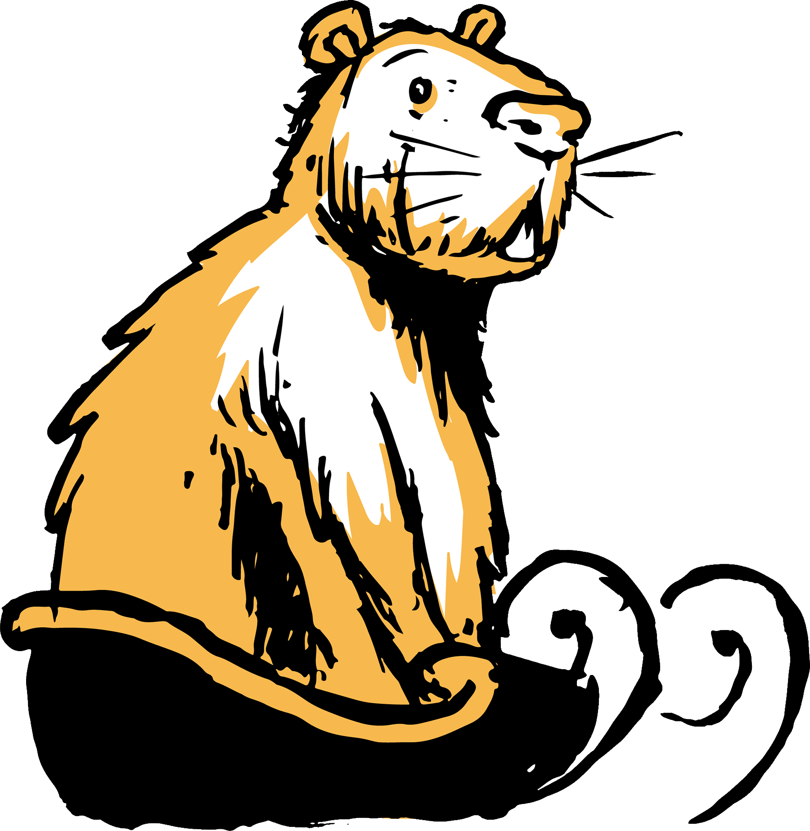

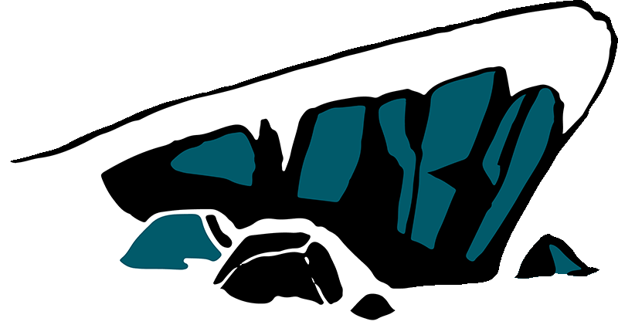
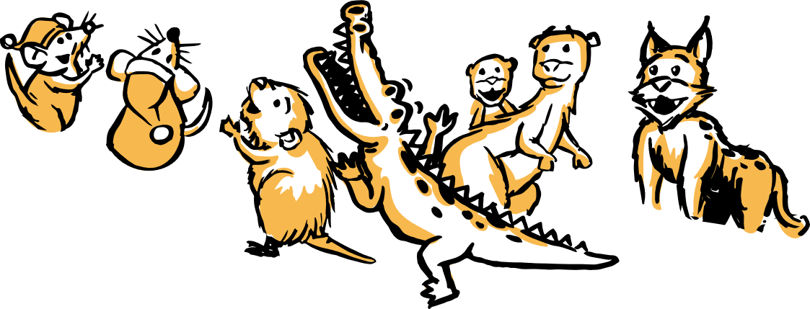
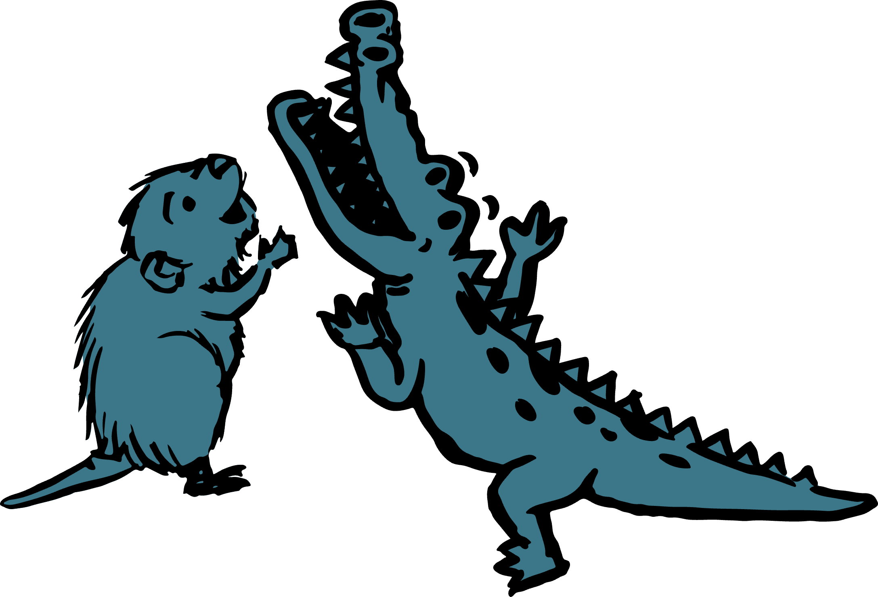
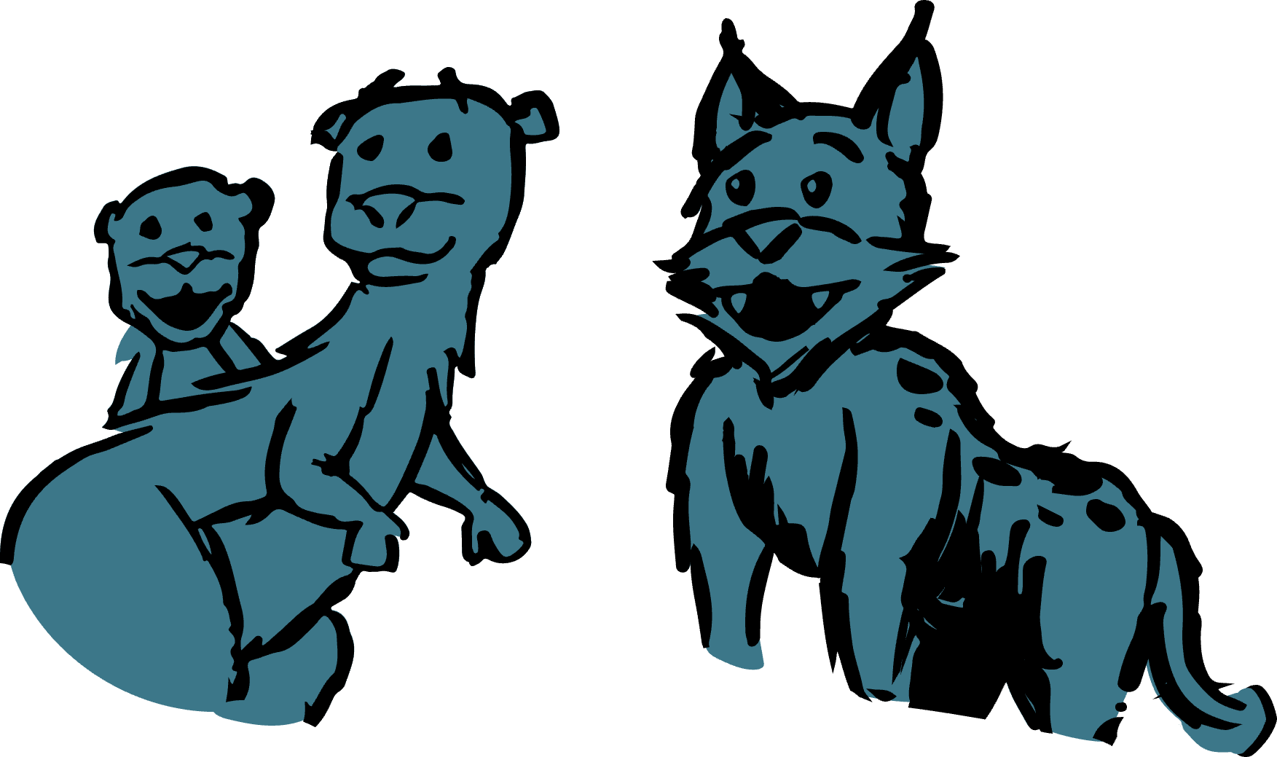
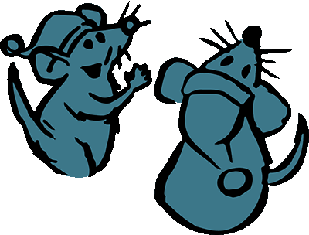
‘twas the old capybara, with a message
of love,
(much more seasonal than that of a dove…)

Slide 12


He was cheery and round, with
Yuzu on his noggin,

Slide 13
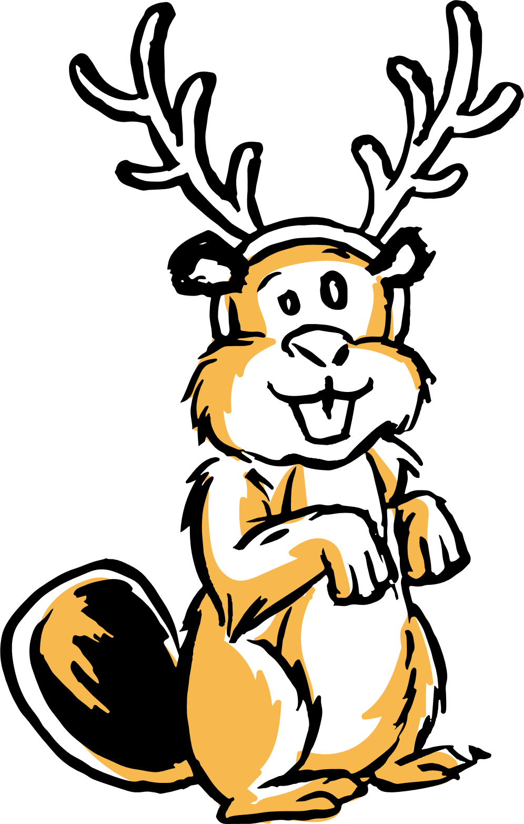
Being pulled by his beavers atop a toboggan!

Slide 14
But what did
he say? Well he squeaked far
and wide…

Slide 15

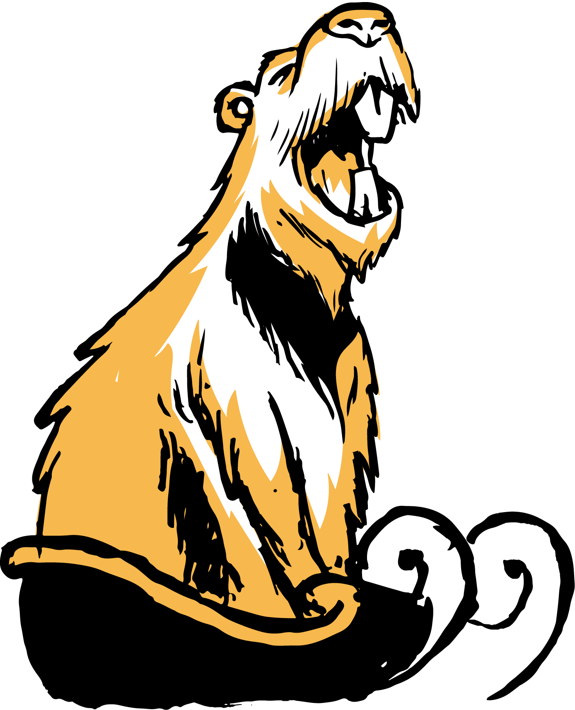
A Very Capy Christmas!
To yours and
to mine!

Slide 16
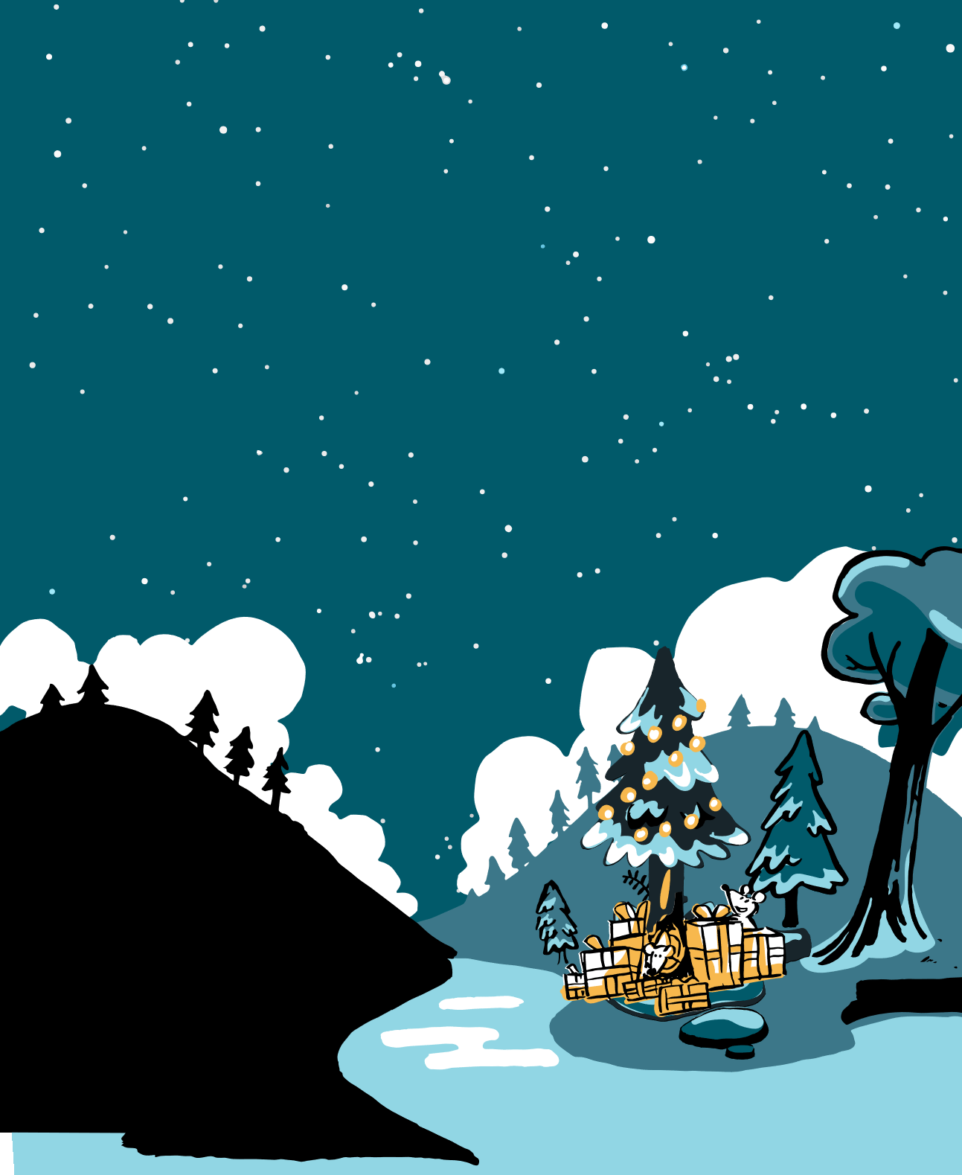
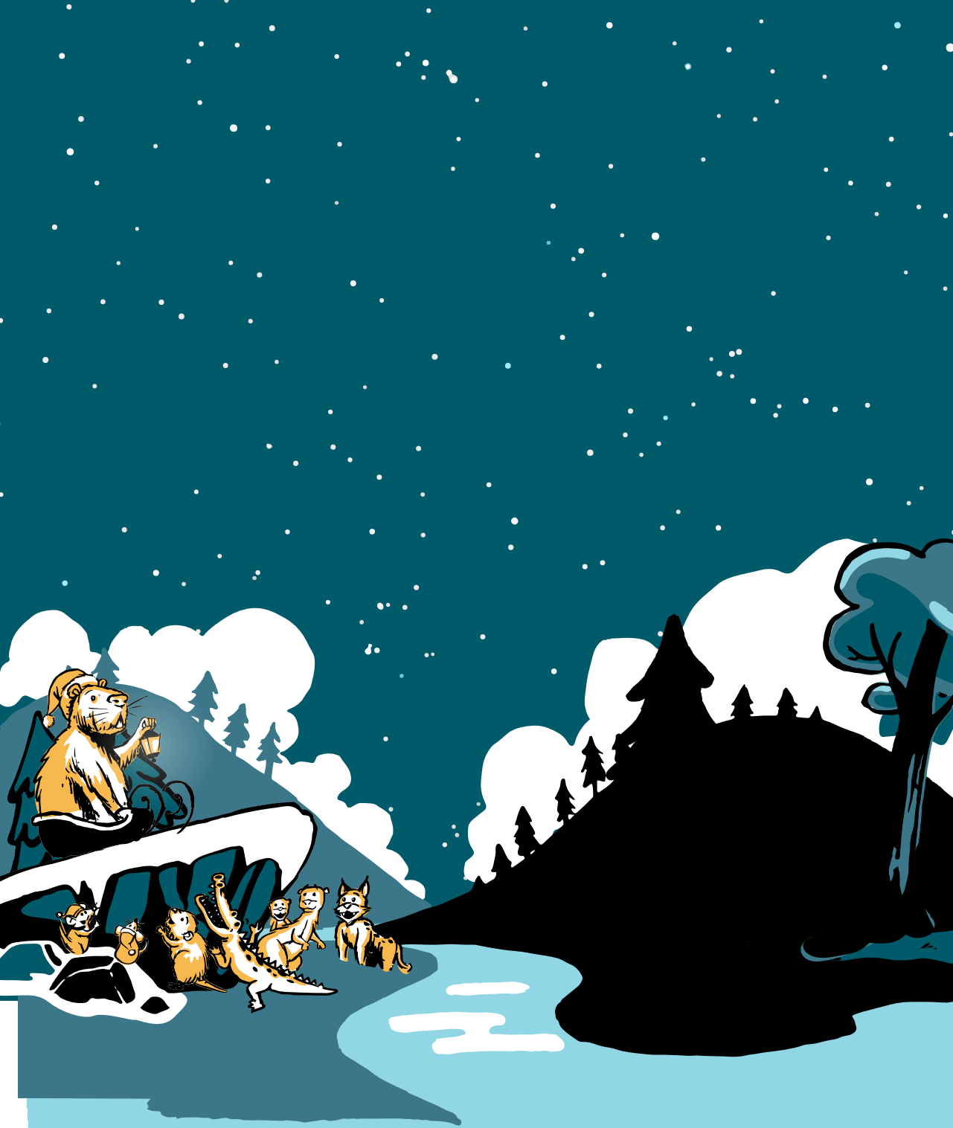
And with that
he vanished, as quick as he came
Leaving lovely presents for all knowing his name!

Slide 17
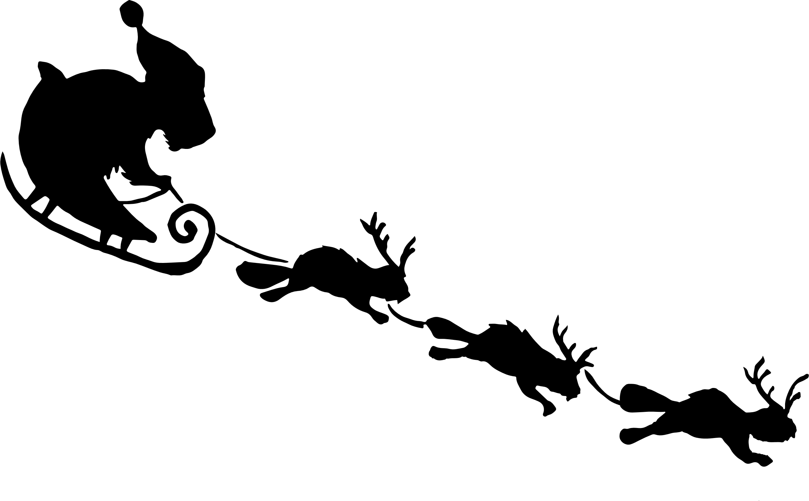
Wishing you a VERY CAPY CHRISTMAS!
from
BrightCarbon

