Slide 1
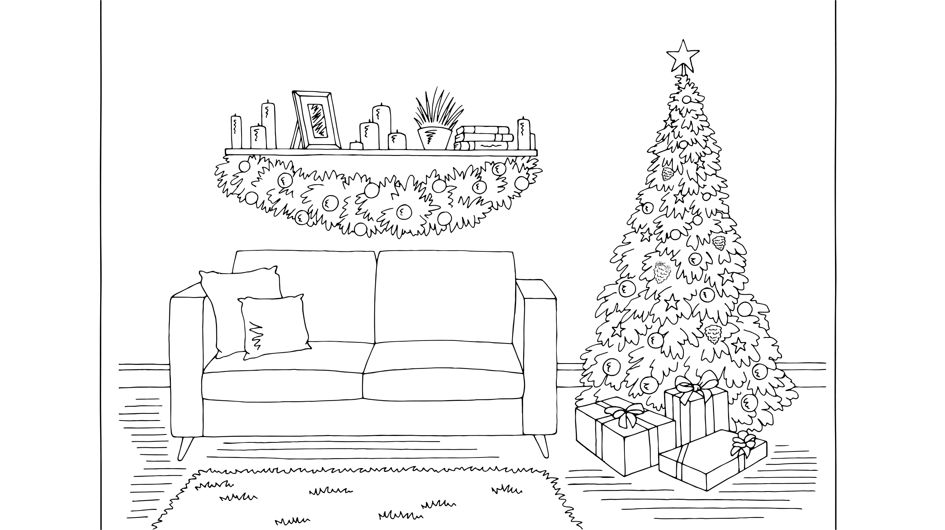

Beetle
Christmas

Slide 2
Beetle
Christmas

Slide 3
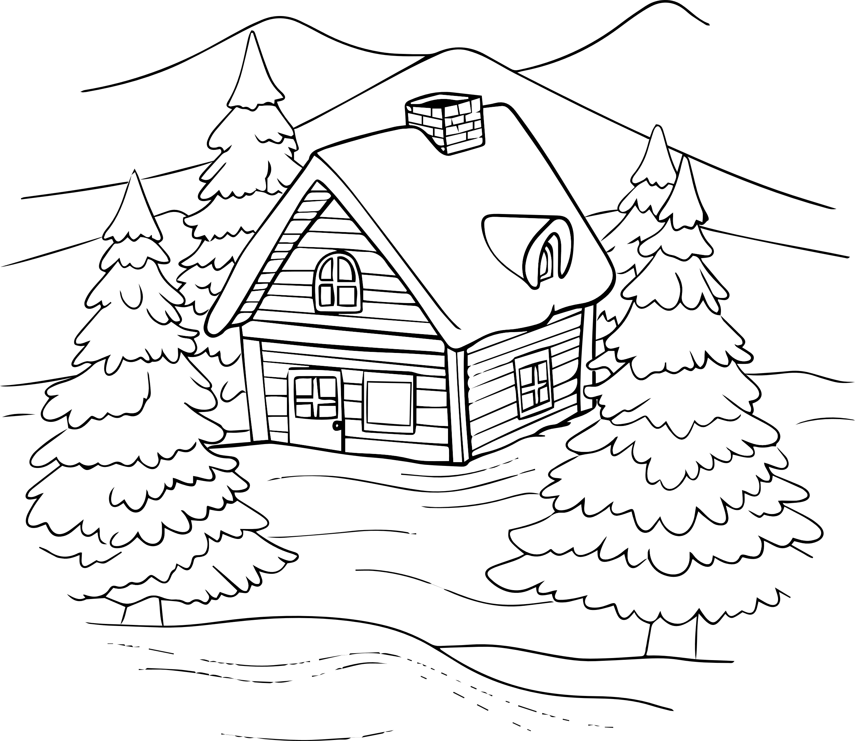

Slide 5







Slide 7
Merry
Christmas!
From
BrightCarbon

