Slide 1

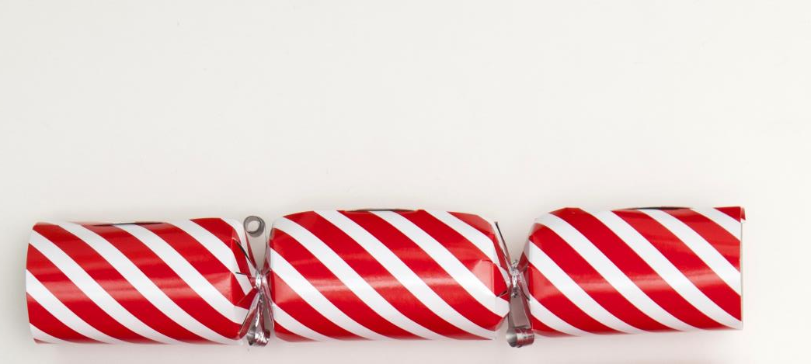

Punny
Christmas Crackers
A festive burst of great PowerPoint and
even better cracker jokes

Slide 2
What do you call a bunch of chess players bragging about their games in a hotel lobby?

Slide 3

Chess nuts boasting in an open foyer!

Slide 4
How does
Darth Vader
enjoy his
Christmas Turkey?

Slide 5
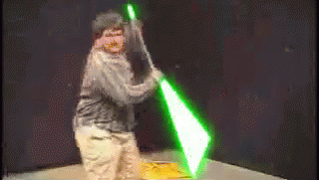
_{On the}
_{dark side!}

Slide 6
What does
Miley Cyrus
have at Christmas?

Slide 7
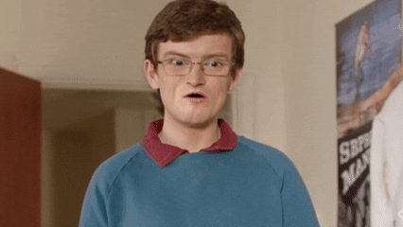
TWERKY

Slide 8
Knock knock.
Who's there?
Murray.
Murray Who?

Slide 9
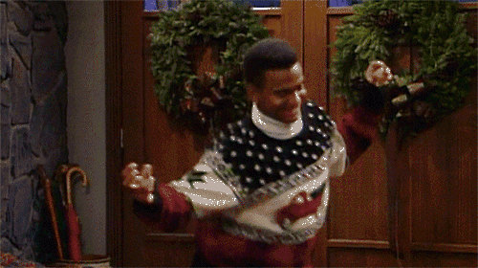
Murray Christmas
to all and to all a good night.
Happy XMAS from
everyone at BrightCarbon

