Slide 1

PREHISTORIC
CHRISTMAS
CLICK TO START
or choose a time period
Notes:
SOUND FX –
Swamp sounds by flood-mix - https://freesound.org/people/flood-mix/sounds/413343/
Christmas music by lena_orsa - https://freesound.org/people/lena_orsa/sounds/442791/

Slide 2
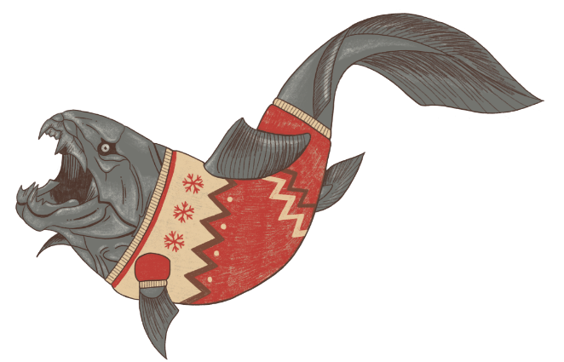
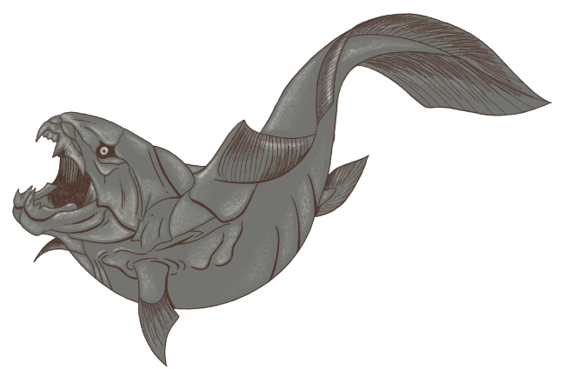



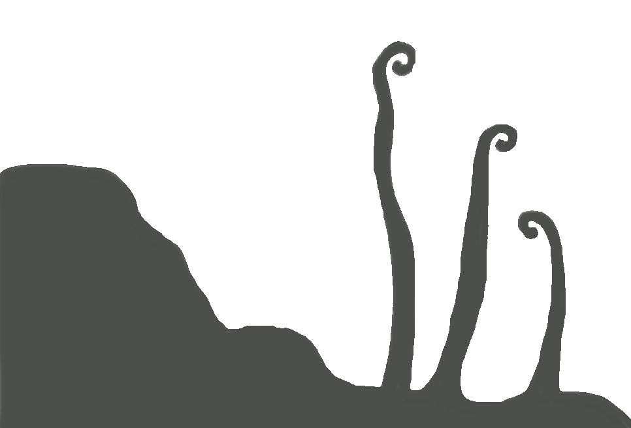
DEVONIAN
(419 million years ago)
DUNKLEOSTEUS
Dunkleosteus terrelli
30ft long
Armour-plated killing machine
On Santa’s
Good Boy list

Slide 3
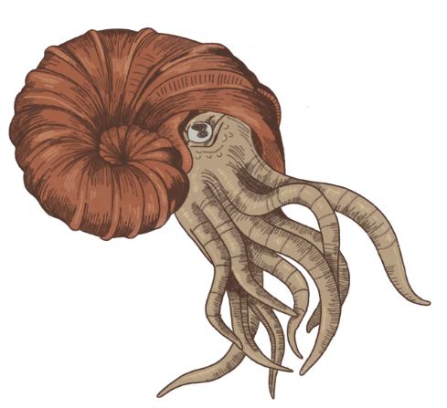




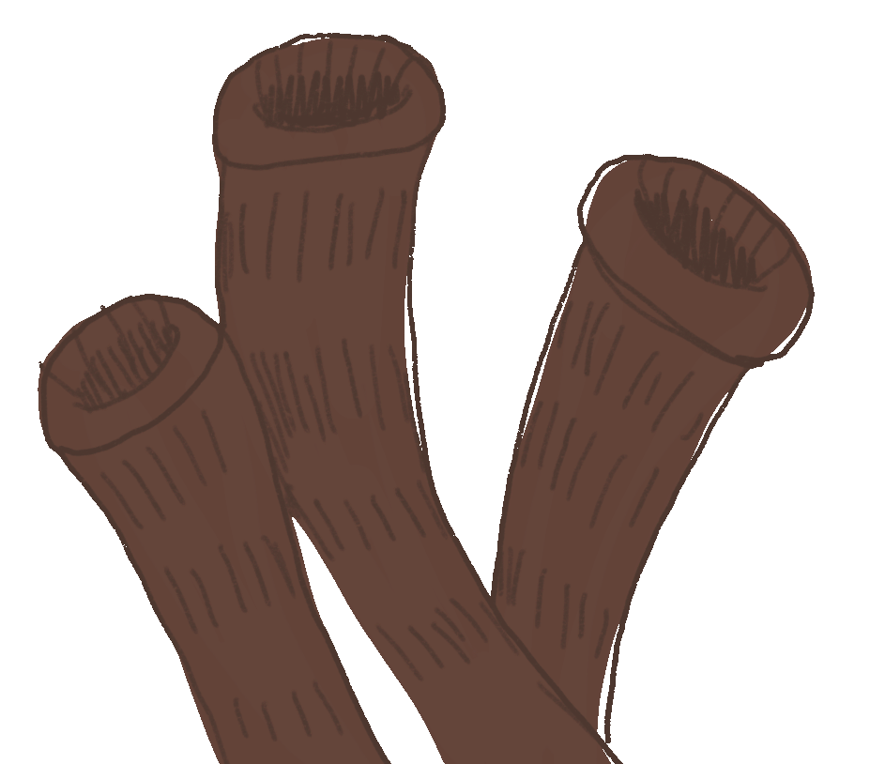
PERMIAN
(299 million years ago)
AMMONITE
Parapuzosia seppenradensis
Distant ancestor of the squid
Could grow up to 6ft
Every tentacle can hold a mince pie

Slide 4

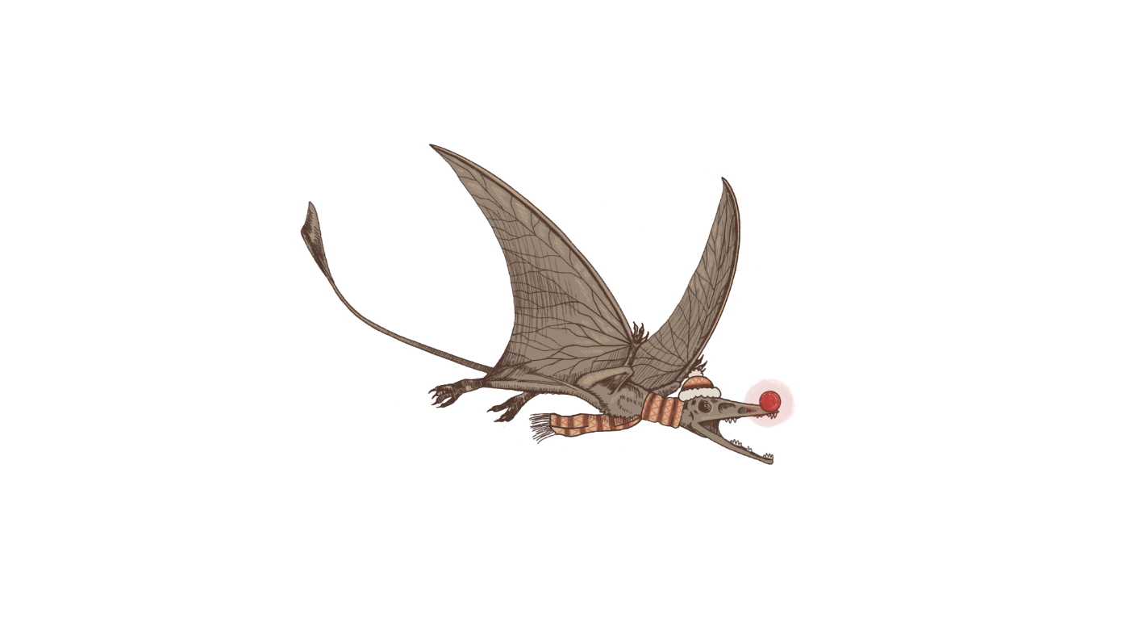
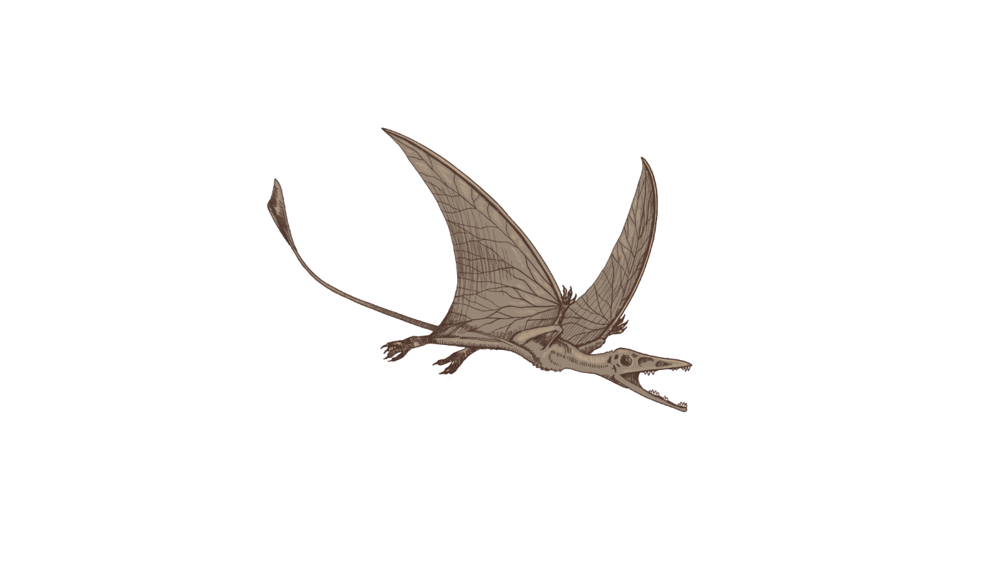

TRIASSIC
(252 million years ago)
PREONDACTYLUS
Preondactylus buffarinii
First known pterosaur
Just 30cm long
Possibly early,
tiny flying reindeer

Slide 5

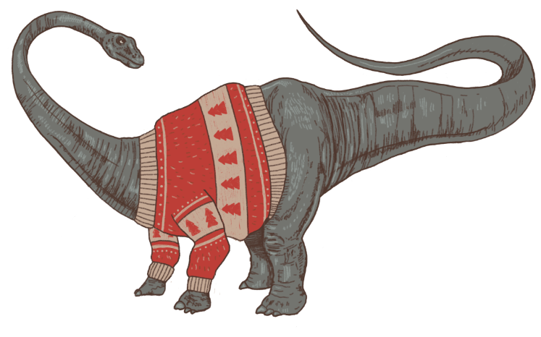
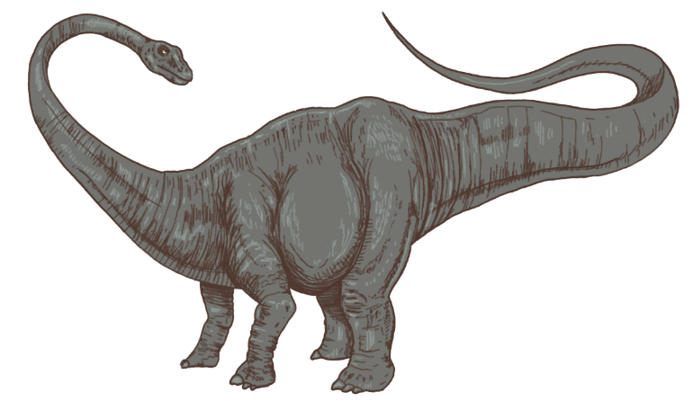




JURASSIC
(201 million years ago)
DIPLODOCUS
Diplodocus carnegii
80ft long
Weighs more than 5 elephants
Needed an extremely
large Christmas jumper

Slide 6
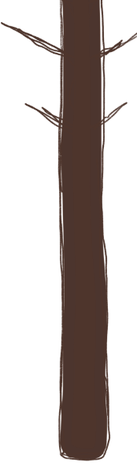
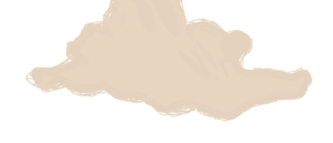
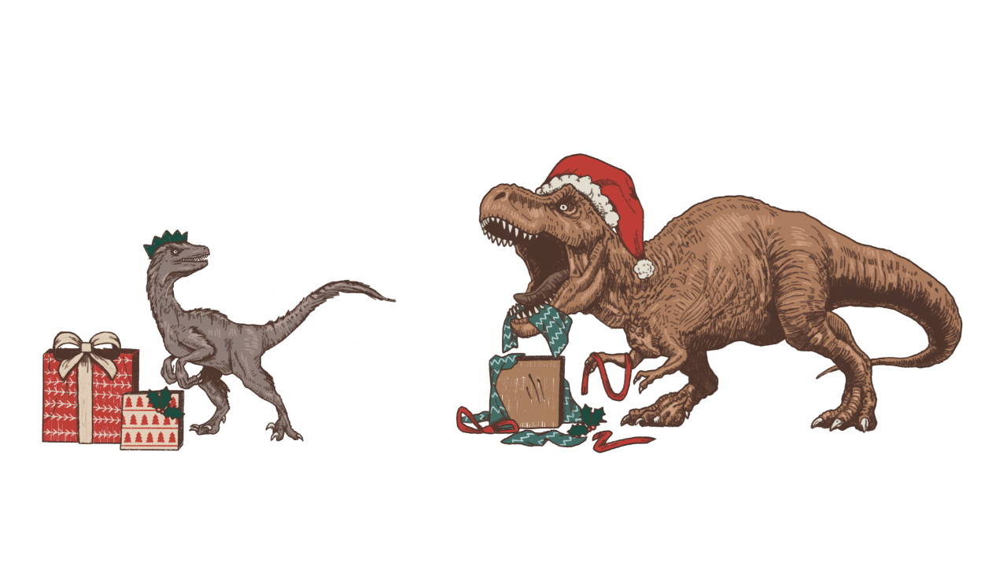
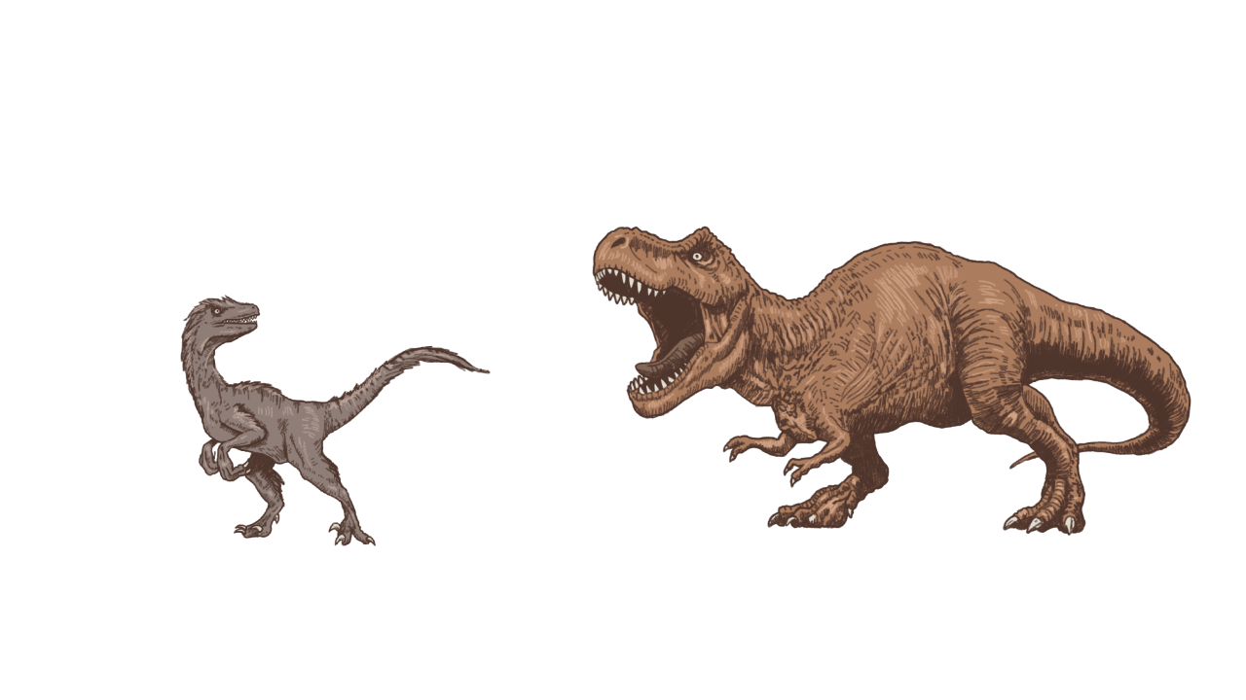

CRETACEOUS
TYRANNOSAURUS
Tyrannosaurus rex
Name means ‘king of the terrible lizards’
Terrible at wrapping
VELOCIRAPTOR
Velociraptor mongoliensis
Name means ‘speedy thief’
Intelligent and dexterous
Excellent at wrapping
(145 million years ago)

Slide 7
WISHING YOU A CHRISTMAS THAT IS SO AMAZING,
IT GOES DOWN IN HISTORY
MERRY CHRISTMAS FROM BRIGHTCARBON
Swamp sounds by flood-mix - https://freesound.org/people/flood-mix/sounds/413343/
Christmas music by lena_orsa - https://freesound.org/people/lena_orsa/sounds/442791/

