Slide 1



















Click to enter
the carnival and
AVO good Christmas!
Roll up, roll up!
Welcome to the
2020 funfair

Slide 2





This year has been a unique
one so I thought it would be
nice to have a bit of fun!
Please choose a game
you’d like to play
Sanitizer
push
Toilet
roll search
Facemask application

Slide 3
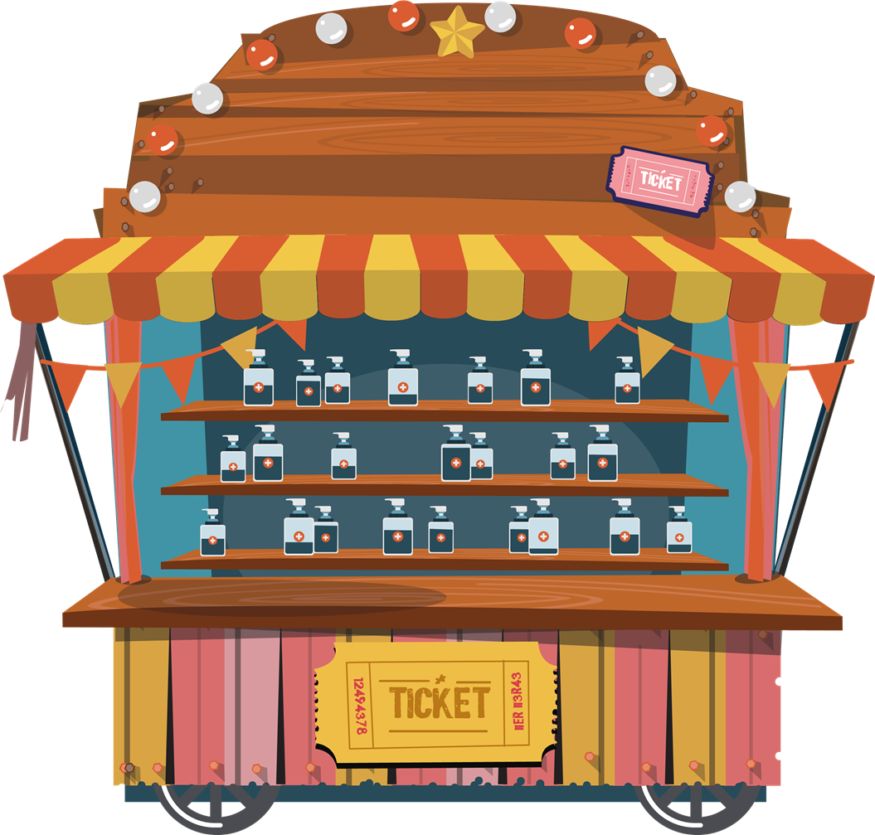



Can you knock all the
hand sanitizers off
the shelf in 8 seconds?
Go!

Slide 4
Ready?!

Slide 5





8
7
6
5
4
3
2
1

Slide 6


Times up!
Avo’nother
go!
Another game
I give up!

Slide 7

































Can you find the toilet roll within 10 seconds?
Go!

Slide 8

10
9
8
7
6
5
4
3
2
1

Slide 9
Times up!
Try
again
Another game
I give up!

Slide 10

Smashed it!
Well
done
Another game
I’m done!

Slide 11





Can you mask the
avo using the slingshot?
Fire
Go!

Slide 12
Fire

Slide 13

Bad luck!
Try again
Fire
Fire
Another game
I give up!

Slide 14
Bad luck!
Try
again
Fire
Fire
Another game
I give up!

Slide 15
Bad luck!
Try
again
Fire
Fire
Another game
I give up!

Slide 16
Bad luck!
Try
again
Fire
Fire
Another game
I give up!

Slide 17
Bad luck!
Try
again
Fire
Fire
Another game
I give up!

Slide 18
Bad luck!
Try
again
Fire
Fire
Another game
I give up!

Slide 19
Bad luck!
Try
again
Fire
Fire
Another game
I give up!

Slide 20
Bravocado!
Fire
Well
done
Fire
Another game
I’m done!

Slide 21
Bad luck!
Try
again
Fire
Fire
Another game
I give up!

Slide 22
Merry Christmas!
Hope you AVO lovely festive time
From, BrightCarbon

