Slide 1

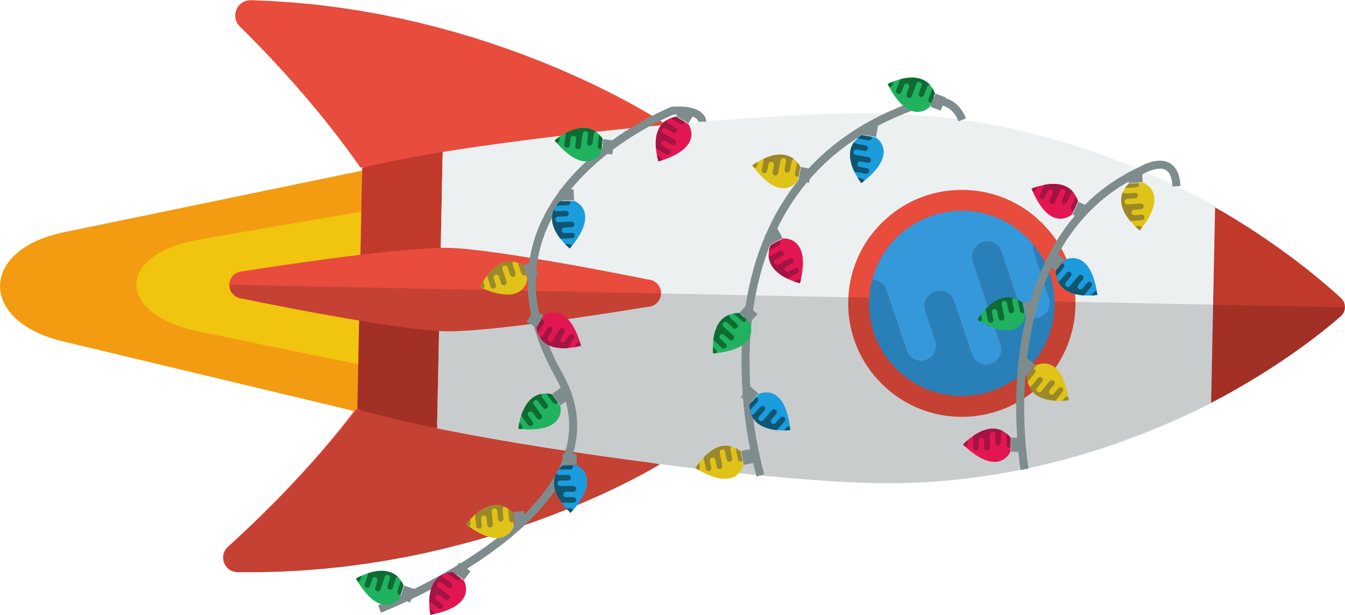
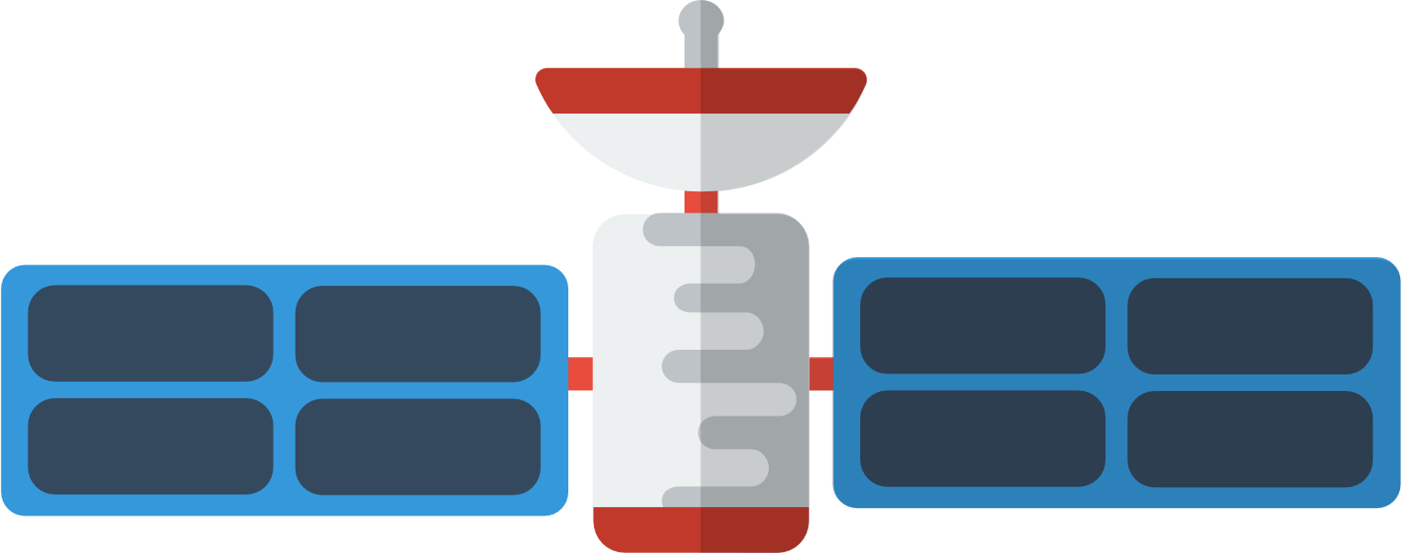
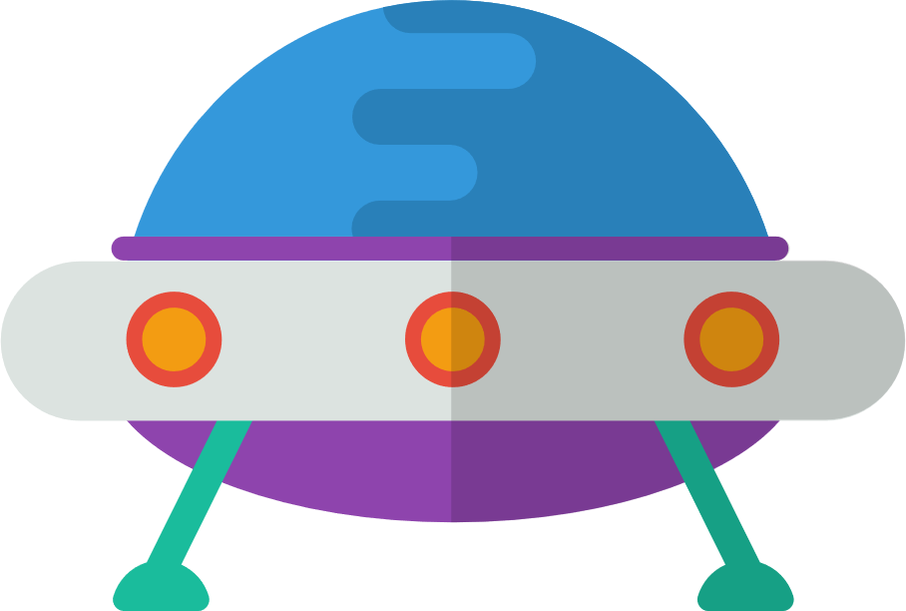
It’s nearly Christmas, all throughout space
And your little rocket is setting quite a pace,
Rushing to get home for the holidays,
But maybe you’ll have time for a few, short delays.
There’s so many planets to explore,
So earth can wait a little more.
Notes:
It’s nearly Christmas, all throughout space
And your little rocket is setting quite a pace,
Rushing to get home for the holidays,
But maybe you’ll have time for a few, short, delays.
There’s so many planets to explore,
So earth can wait a little more.

Slide 2
Click on a planet to explore more

Slide 3




On Neptune, the fish people rejoice,
Belting out carols in one slimy voice,
The sound mingles and mixes with the wind and the waves,
A holiday harmony that vibrates for days.
Click to
go back
Notes:
Neptune:
On Neptune, the fish people rejoice,
Belting out carols in one slimy voice,
The sound mingles and mixes with the wind and the waves,
A holiday harmony that vibrates for days.

Slide 4


On icy cold Uranus,
The polar bears shiver,
Warm Christmas jumpers,
you’ll kindly deliver.
Click to
go back
Notes:
Uranus:
On icy cold Uranus,
The polar bears shiver,
A warm, Christmas feast,
you’ll kindly deliver.

Slide 5






At the rings of Saturn you get quite a fright,
The rocks are now baubles that glimmer starlight,
Around these adornments your ship wiggles and weaves,
Like glam Christmas dodgeball on a giant wreathe.
Click to
go back
Notes:
Saturn:
At the rings of Saturn you get quite a fright,
The rocks are now baubles that glimmer starlight.
Around these adornments your ship wiggles and weaves,
Like glam Christmas dodgeball on a giant wreathe.

Slide 6
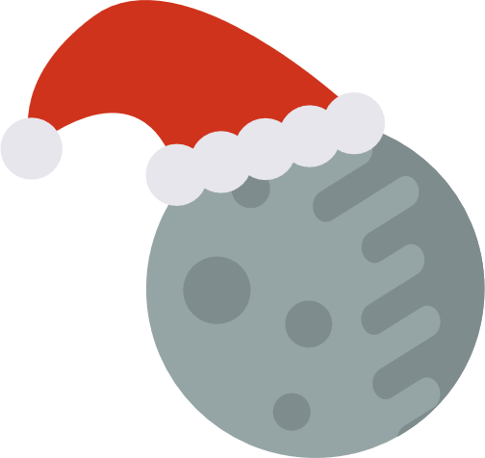
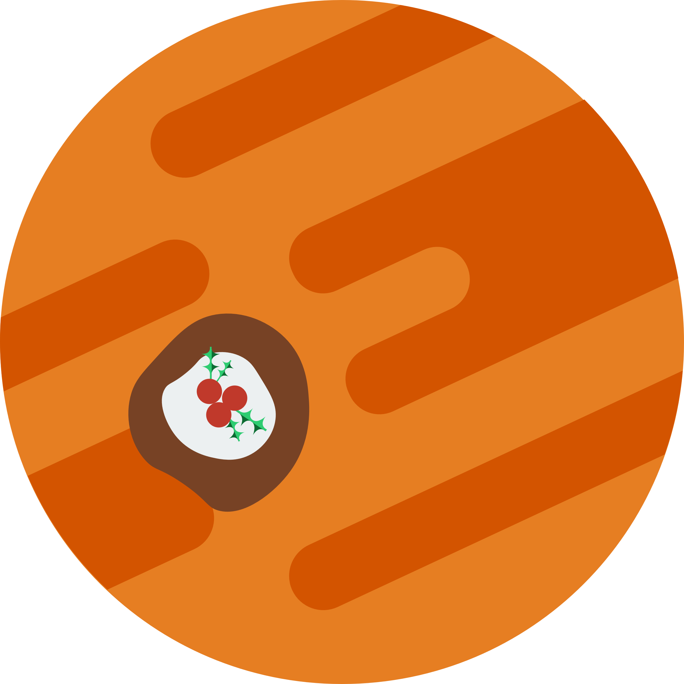
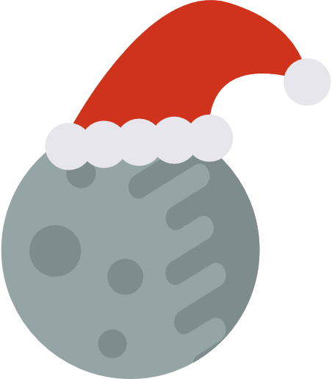
In the clouds of Jupiter the red spot is rocking,
For the holidays it’s been decorated in a way that seems shocking,
A huge Christmas pudding moving at a pace,
Enough for a galaxy to stuff its face.
Click to
go back
Notes:
Jupiter:
In the clouds of Jupiter the red spot is rocking,
For the holiday’s it’s been decorated in a way that seems shocking,
A huge Christmas pudding moving at a pace,
Enough for a galaxy to stuff its face.

Slide 7


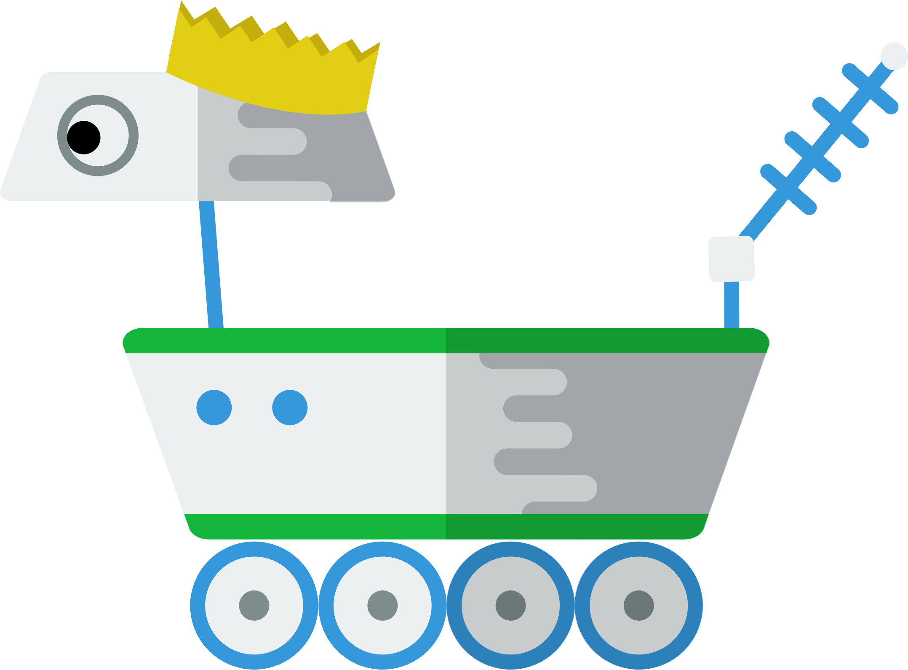



On dusty red mars the rover is sad,
No friends to celebrate with, it feels really bad,
But today you’ll show up with a gift and a smile,
Pull Christmas crackers and stay for a while.
Click to
go back
Notes:
Mars:
On dusty red mars the rover is sad,
No friends to celebrate with, it feels really bad,
But today you’ll show up with a gift and a smile,
pull Christmas crackers and stay for a while.

Slide 8


In the smog of Venus it’s time for some snacking,
The incredible heat means the turkey’s always crackling,
The astronauts share the food around and about,
And of course, there’s always time for some sprouts.
Click to
go back
Notes:
Venus:
In the smog of Venus its time for some snacking,
The incredible heat means the turkey’s always crackling,
The astronauts share the food around and about,
And of course, there’s always time for some sprouts.

Slide 9


On Mercury there’s no fun to be had,
The lack of atmosphere makes their parties bad.
Click to
go back
Notes:
Mercury:
On Mercury there’s no fun to be had,
The lack of atmosphere makes their parties bad.

Slide 10
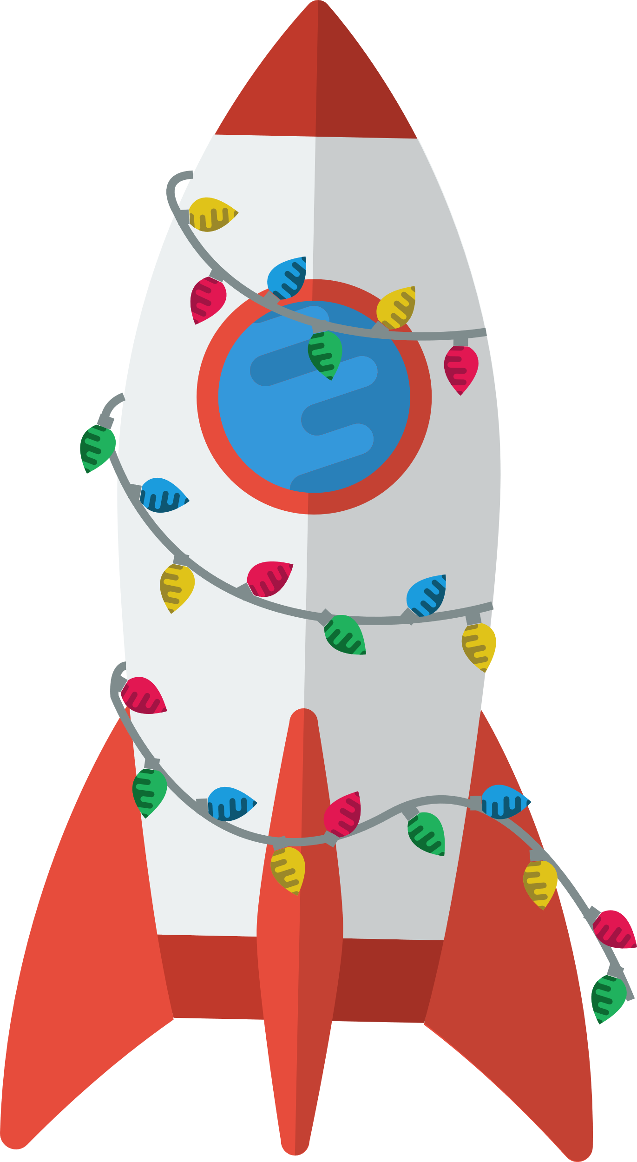

Well your journey is over, you’ve landed on earth,
And look who’s here to greet you with joy and mirth,
It’s your family and friends and your loyal dog, Roger,
But wait, who’s that with them? Who’s this old codger?
(Gasp) It’s Santa himself, with his sack and his sleigh,
You shake his hand and you ask him to stay,
What a wonderful end to a solar Christmas day.
Notes:
Earth:

Slide 11
Wishing you a Merry Christmas
from all of us at [BrightCarbon]
Notes:
Earth:

