Slide 1

MISSION CODENAME -

Slide 2


DECEMBER 24, 23:50
30,000 FEET ABOVE GUILDFORD

Slide 3



Special Agent K.R.I.N.G.L.E
Your mission is to spread
festive cheer to all.
…no matter how grumpy.
Agent J.I.N.G.L.E

Slide 5


CAMERA 06 – 23 LITTLE TODDING ROAD

Slide 6



CAMERA 07 – LIVING ROOM

Slide 7



CAMERA 08 – BATHROOM DOOR

Slide 8


CAMERA 07 – LIVING ROOM

Slide 9
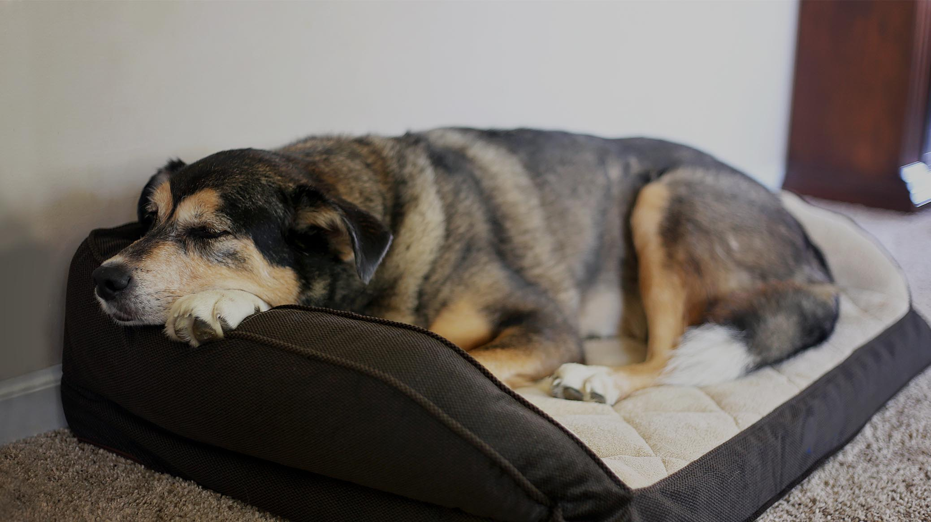

CAMERA 02 – MERLIN’S BED

Slide 10

CAMERA 12 – CORRIDOR

Slide 11
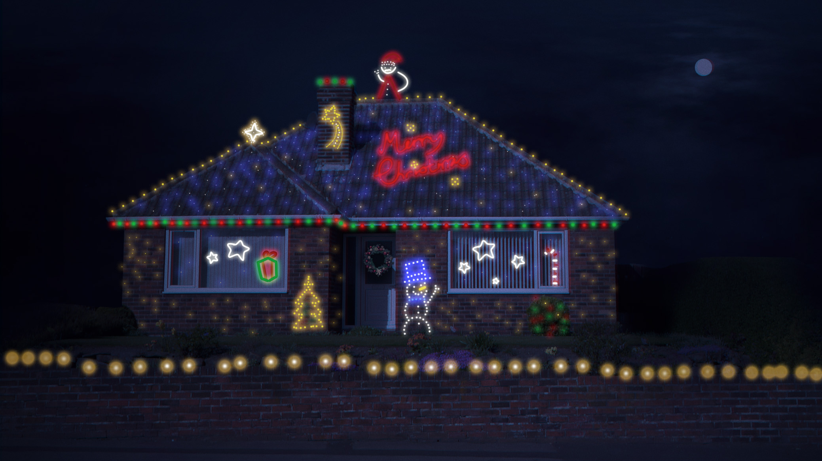
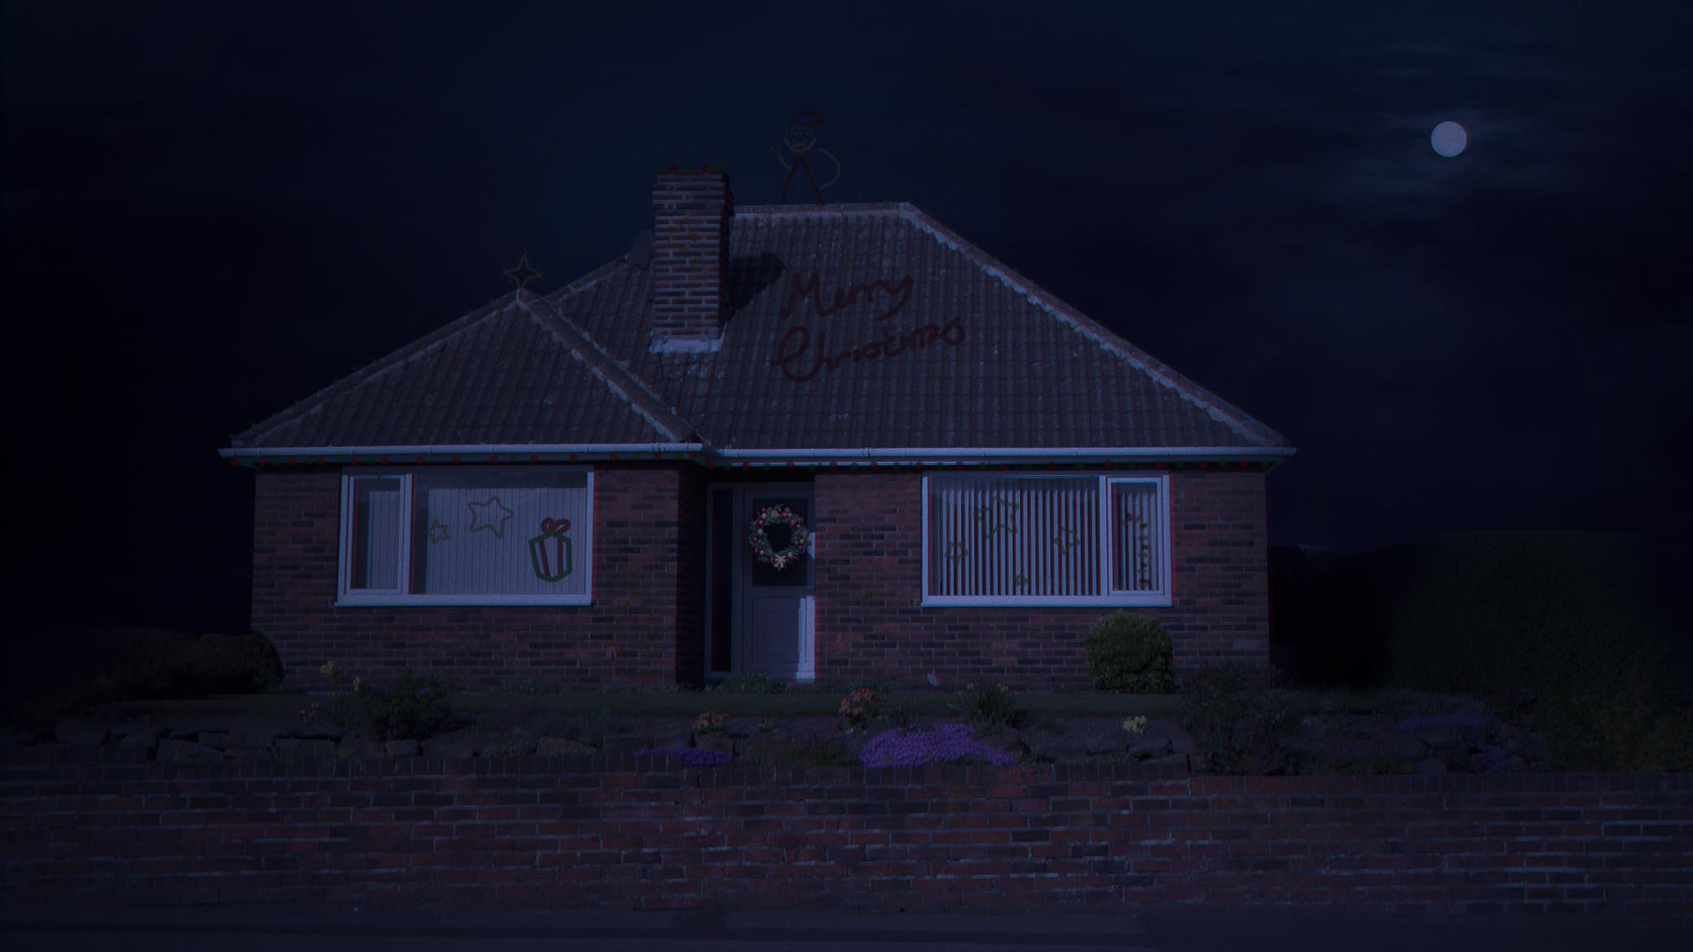


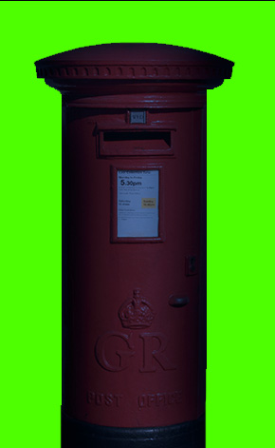
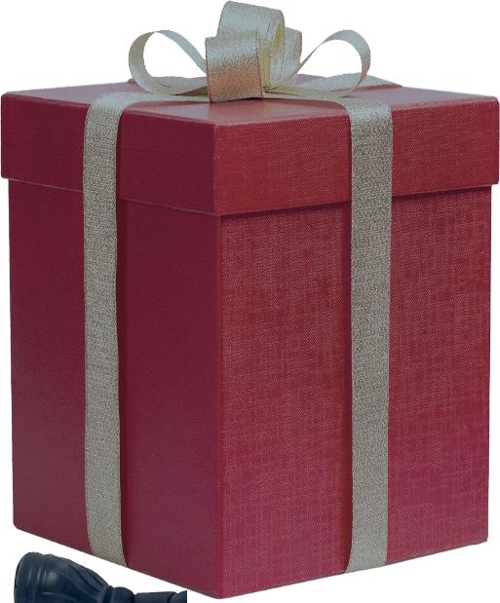
TO “ADD NAME HERE”
FROM “ADD NAME HERE”

