Slide 1

Which iconic Christmas character are you?
As the winter nights get colder, it’s time to snuggle up by the fire with your loved ones and figure out once and for all which notable Christmas figure you are.
BEGIN

Slide 2
01 Mince Pies
THE BELLY
MINCE PIES ARE FOR
THE BIN

Slide 3
02 Haiku
…NEXT TO DRUNK RUDOLPH”
COMPLETE THE HAIKU:
“Festive wintry cheer
A merry Santa dances…
…WITH THE TIRED ELVES”

Slide 4
03 Snow party
YOU’RE OFF TO A PARTY BUT THE SNOW SHOWS NO SIGN OF STOPPING. DO YOU…?
BAIL, STAY HOME AND DRINK HALF A BOTTLE OF RED?
SET OFF EARLY AND DO A BIT OF CAROLLING ALONG THE WAY?

Slide 5
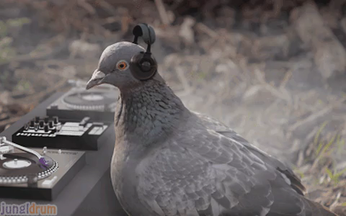
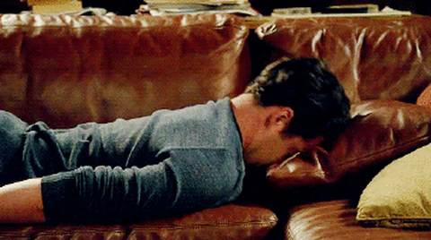
04 Christmas music GIF
WHICH GIF BEST DESCRIBES YOUR REACTION TO CHRISTMAS MUSIC?

Slide 6
05 Would you rather
COVERED IN GREEN FUR
WOULD YOU RATHER BE…
A FROG

Slide 7
06 Cold
THE BADDIES
YOU’VE GOT
A COLD.
WHO DID YOU CATCH IT FROM?
THE OTHER ELVES

Slide 8
07 Festive costume
SEXY
MRS. SANTA
PICK A FESTIVE COSTUME
UGLY CHRISTMAS SWEATER

Slide 9
08 Your perfect Christmas present
CANDY CANES
YOUR PERFECT CHRISTMAS GIFT?
I DON’T REALLY ~DO~ GIFTS

Slide 10
09 Time of year
HOLIDAY?
IS THIS TIME
OF YEAR…
CHRISTMAS?

Slide 11
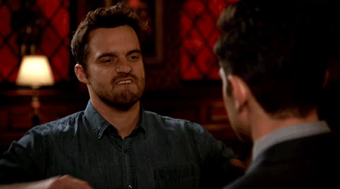
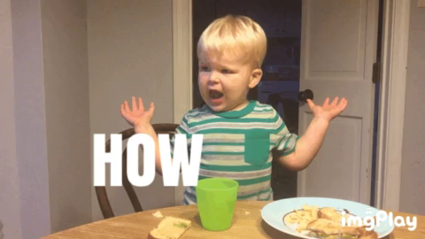
10 Christmas dinner GIF
YOUR MUM ASKS YOU TO HELP WITH CHRISTMAS DINNER. HOW DO YOU RESPOND?

Slide 12
18 Scone
SCONE
PICK THE CORRECT PRONUNCIATION
SCONE

Slide 13
11 Christmas vibe
ANYTHING SPARKLY
PICK A CHRISTMAS VIBE
DANISH HYGGE

Slide 14
12 Revenge
PLOT FOR YEARS
YOU WERE ON THE NAUGHTY LIST IN 1998. YOU WANT REVENGE. DO YOU…
THINK ON YOUR FEET

Slide 15
13 Santa’s arrival
SET UP AN ELABORATE HOME SECURITY SYSTEM TO KEEP HIM OUT
IT’S CHRISTMAS EVE. SANTA IS DUE ANY MINUTE. DO YOU…
WELCOME HIM
IN FOR A HEARTY MEAL WITH YOUR ENTIRE EXTENDED FAMILY

Slide 16
14 All I want for Christmas
I DON’T WANT A
LOT FOR CHRISTMAS
ALL I WANT FOR CHRISTMAS IS…
YOUR MOM’S CHEST HAIR

Slide 17
15 Christmas wish
BAN TINSEL
YOU HAVE
ONE CHRISTMAS WISH. YOU USE
IT TO…
GIVE EVERYONE FREE HEALTH CARE

Slide 18
16 Bridget Jones
AN ARROGANT PRICK
YOU’RE
INTRODUCED TO BRIDGET JONES AT A PARTY. SHE THINKS YOU’RE…
A PARANOID CHILD

Slide 19
17 Christmas motto
“SANTA!!!
I KNOW HIM!!!”
WHAT’S YOUR CHRISTMAS MOTTO?
“AND GOD BLESS US,
EVERY ONE!”

Slide 20
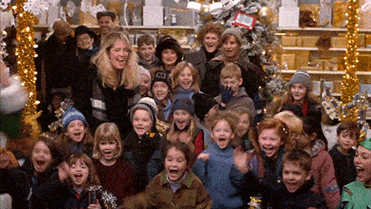
G Elf
You got ELF!
You firmly believe that the best way to spread Christmas cheer is by singing loud for all to hear! You’ve got an unhealthy disposition for wearing Christmas paraphernalia, and you’re always first to raid the Quality Street tin.
REDO QUIZ

Slide 21
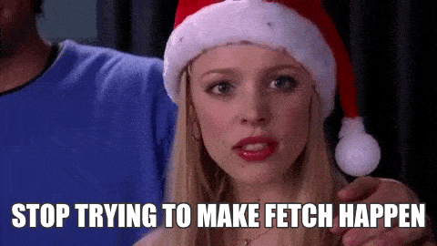
A Regina George
You got REGINA GEORGE!
Get in loser, we’re going shopping! You’re ready to hit the Christmas markets like mulled wine is going out of style. And you’re not worried about the themed Xmas party coming up, because you’ve been planning your outfit since Halloween.
REDO QUIZ

Slide 22
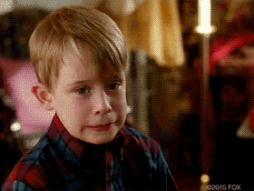
E Kid from Home Alone
You got THE KID FROM HOME ALONE!
Merry Christmas, ya filthy animal! You’re the most likely to crack out the Lego whilst everyone else is sleeping post Xmas-dinner.
REDO QUIZ

Slide 23
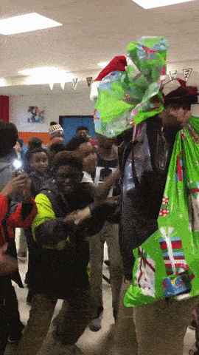
D Obama
You got OBAMA IN A SANTA HAT!
You look great in a Santa hat, which is just as well, because you spend so much time giving to good causes at Christmas that you may as well be Santa.
REDO QUIZ

Slide 24
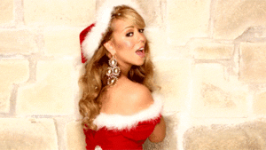
B Mariah Carey
You got MARIAH CAREY!
You’ve got nothing sorted gift-wise, because all you want for Christmas is a little mistletoe magic…
REDO QUIZ

Slide 25
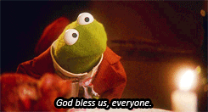
H Tiny Tim
You got TINY TIM!
You say you prefer giving gifts
to receiving them, but no one
believes you.
REDO QUIZ

Slide 26
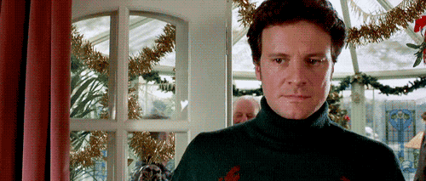
F Mr Darcy
You got MR. DARCY!
You might wear the ugliest sweaters, but you’re someone’s Mr Right!
REDO QUIZ

Slide 27
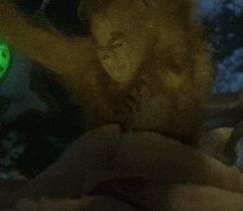
C The Grinch
You got THE GRINCH!
You’re a mean one with a secret
heart of gold. But you should probably take a shower before joining the festivities.
REDO QUIZ

