Slide 1
BrightCarbon Studios
Presents
“
The Good,
The Bad
& The Festive
“
In Glorious Technicolor
Notes:
Christmas western – genre-bending epic

Slide 2


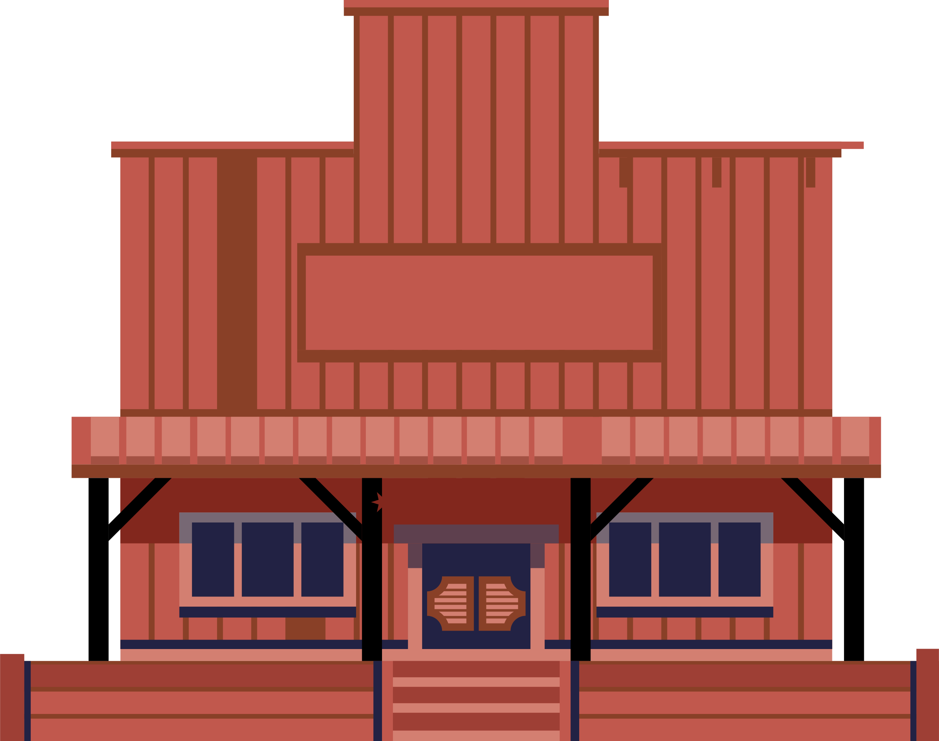



WADE’S
WATERIN’ HOLE
Somewhere in the American west…

Slide 3


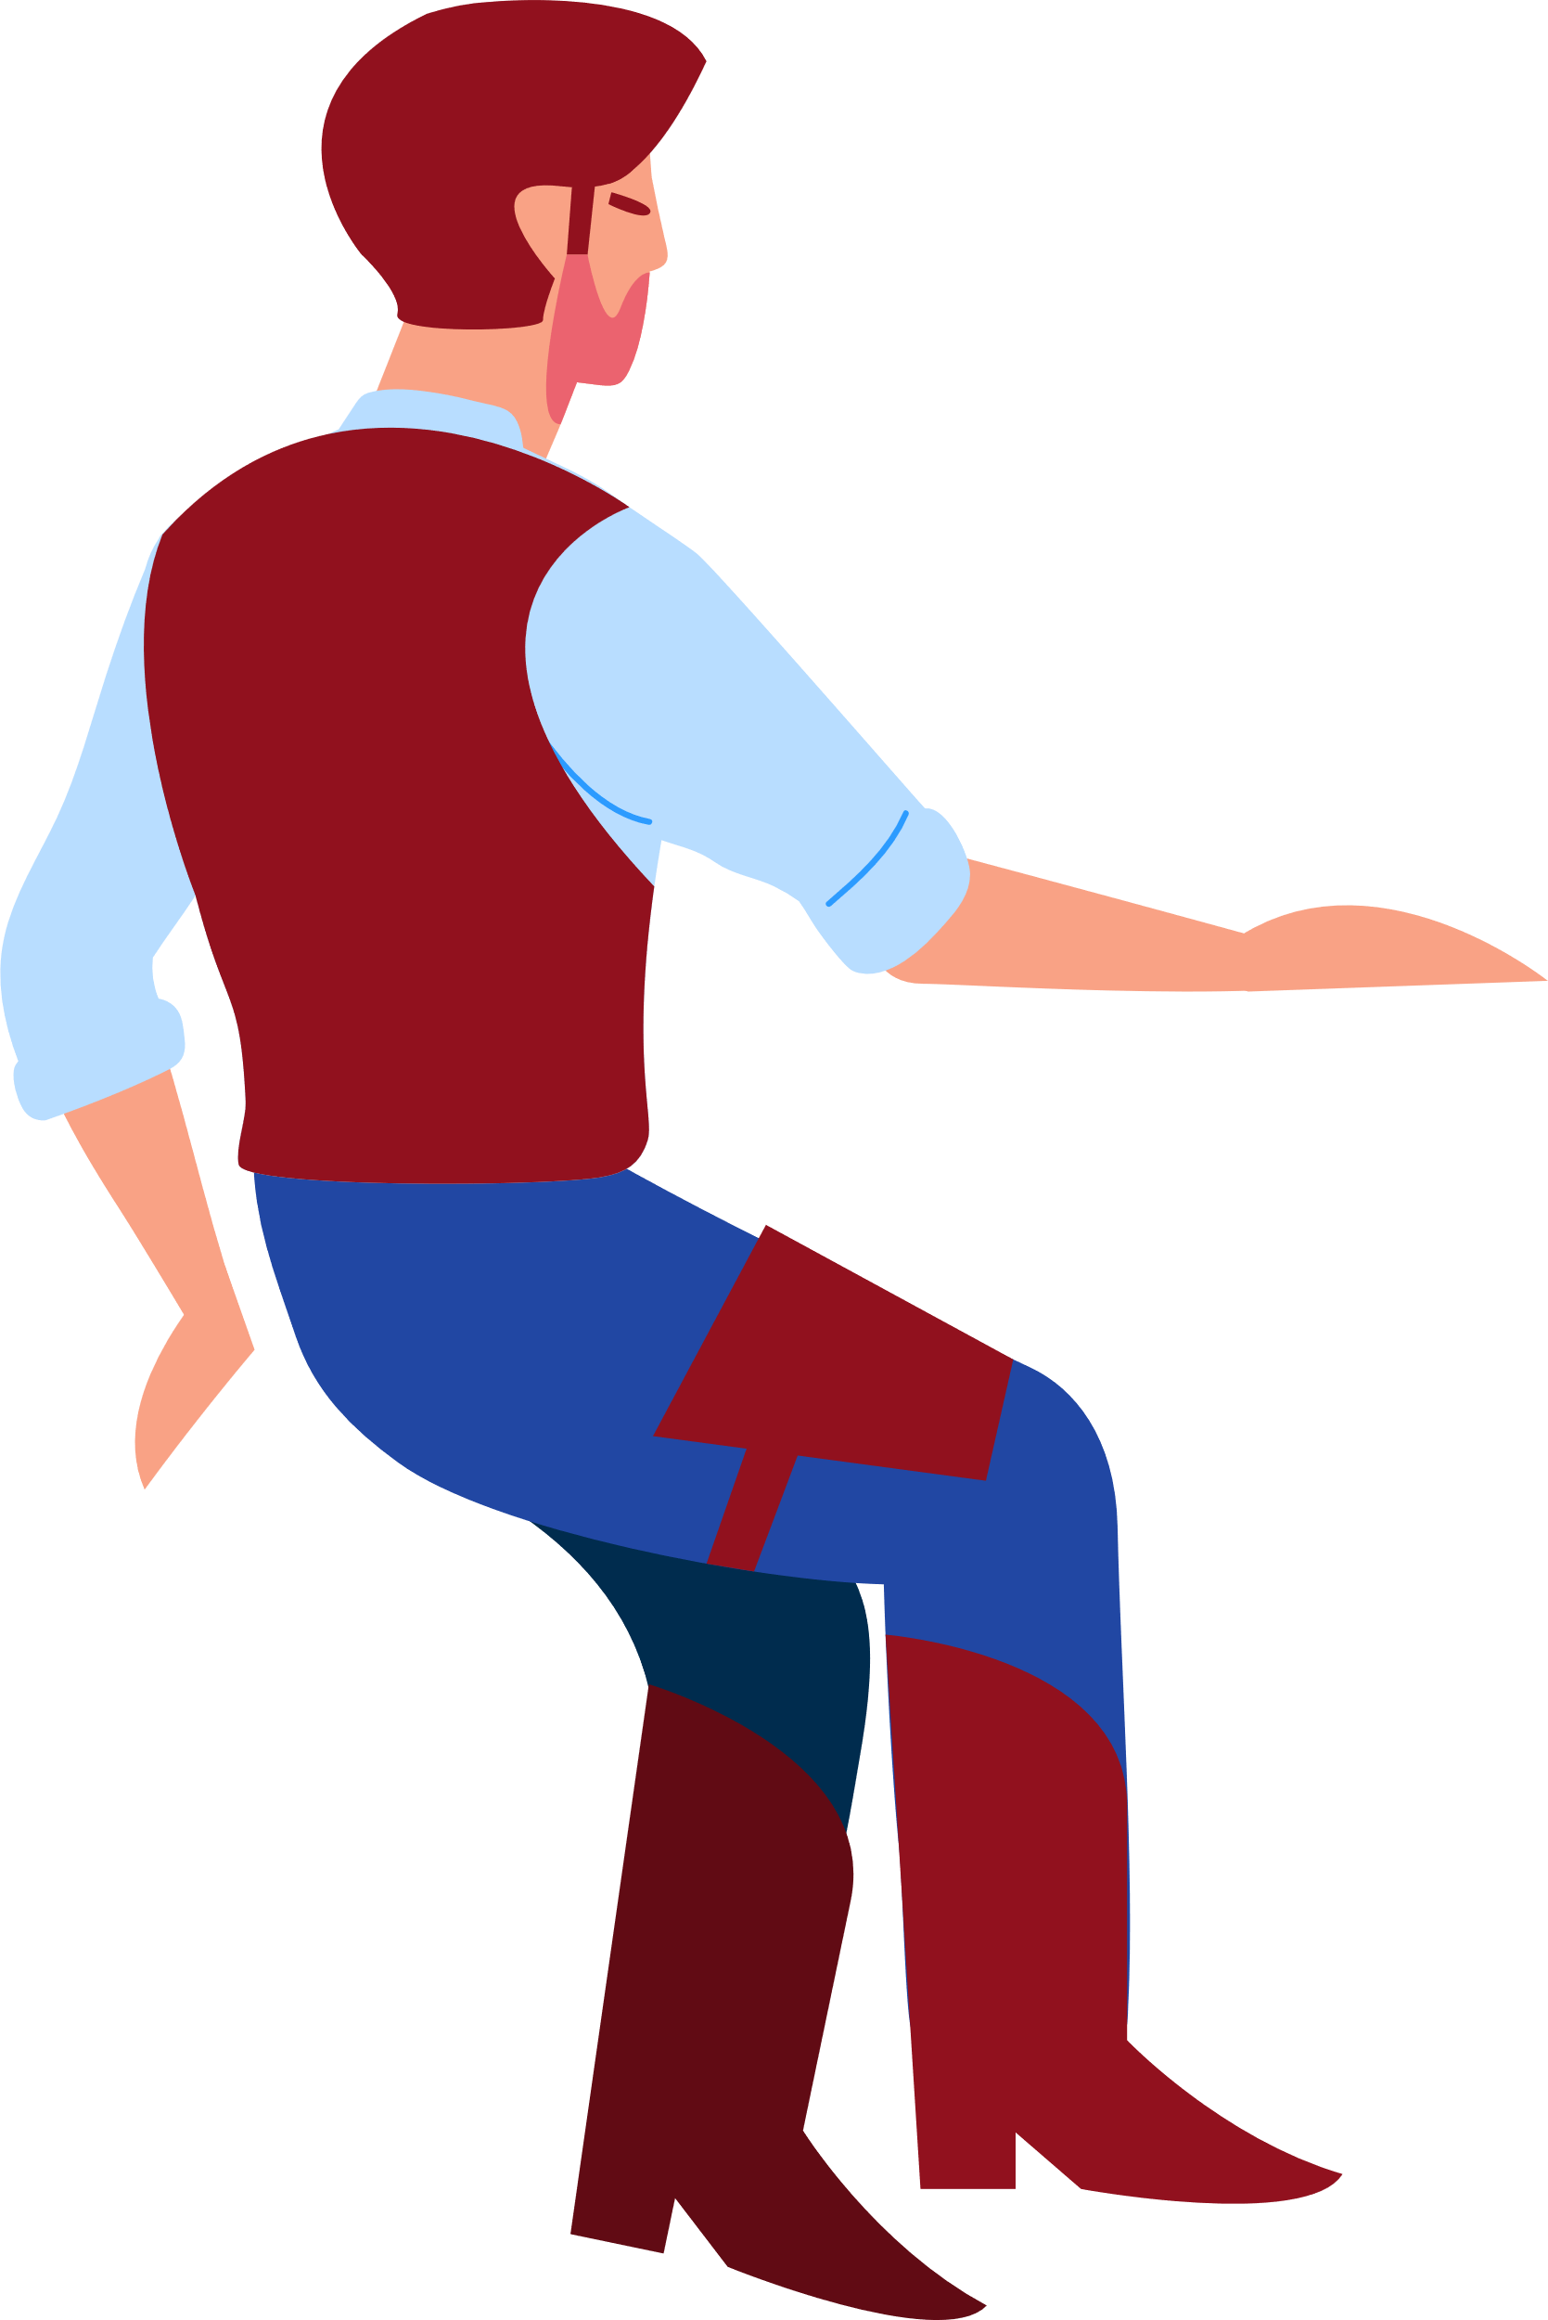
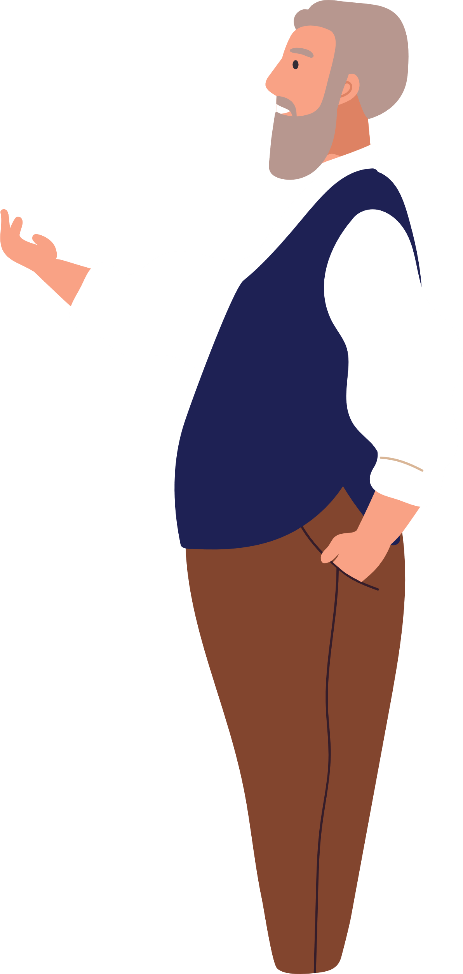



Celebrating? I haven’t
celebrated Christmas in
25 years. Not since…
Another drink Jimmy?
It’s Christmas Eve, you should be celebrating!
Not for
me Wade.

Slide 4


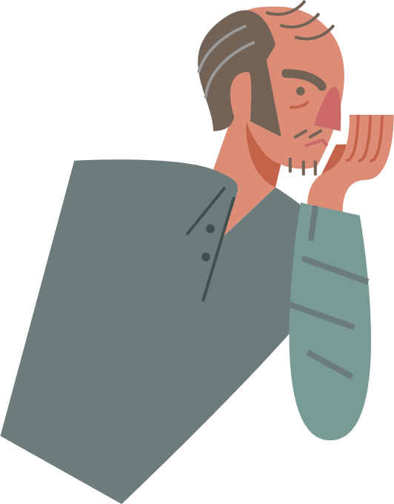


Jimmy, Jimmy! There’s a fella outside says he’s come to settle some business with you! Calls himself Chester Graves.

Slide 5
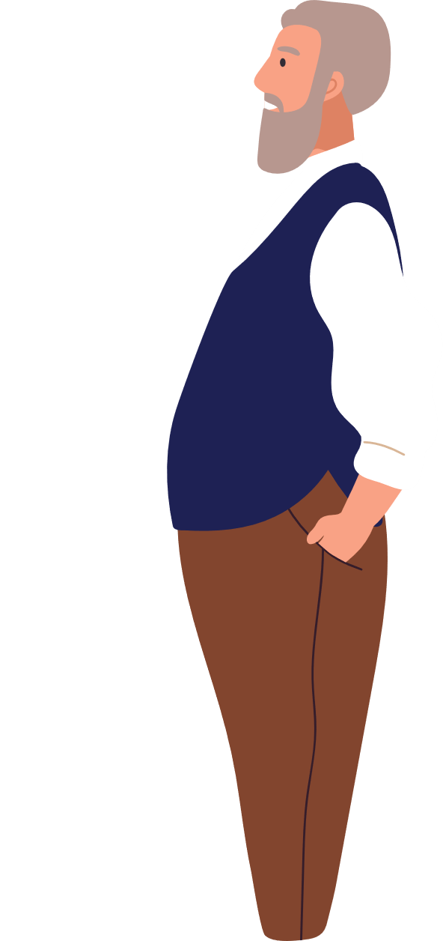
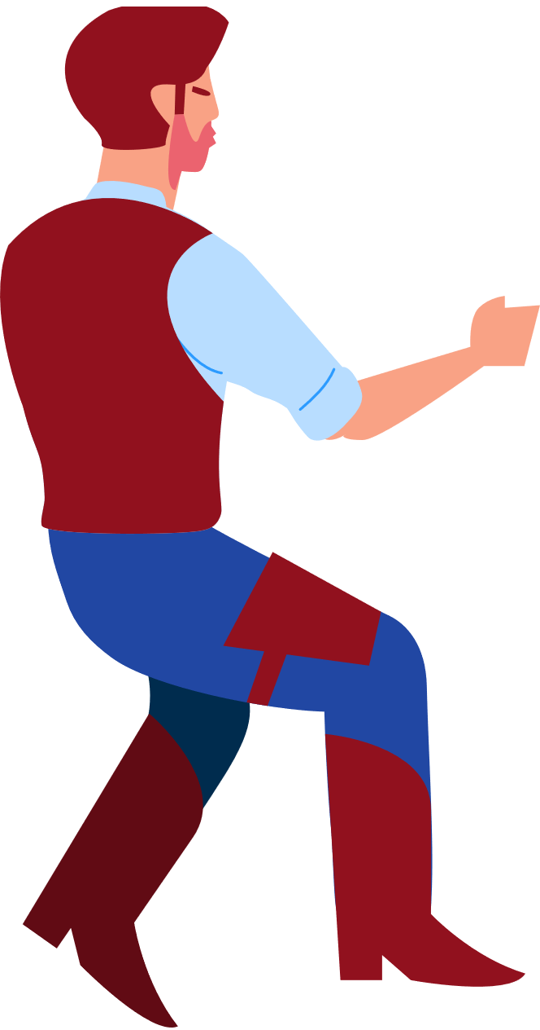
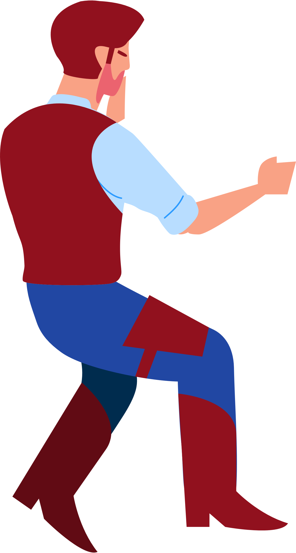


I can’t wear a Santa hat!
Say, any of you fellas got
a proper cowboy hat?
Fetch me my hat.
Chester Graves? Now that’s a name I never thought I’d hear again.
You know him Jimmy?
You weren’t wearing a hat Jimmy.
Here take this!
Damn, must’ve misplaced it.

Slide 6
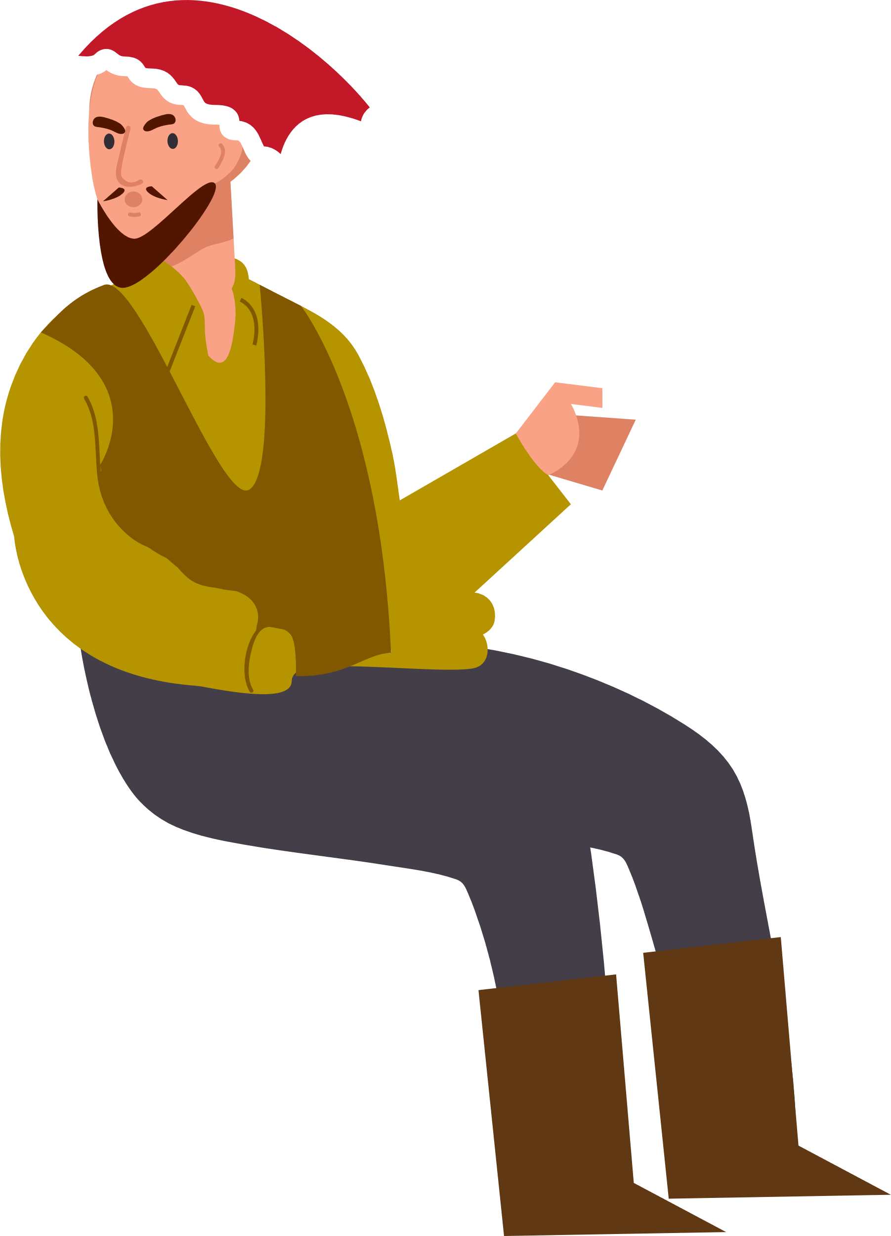
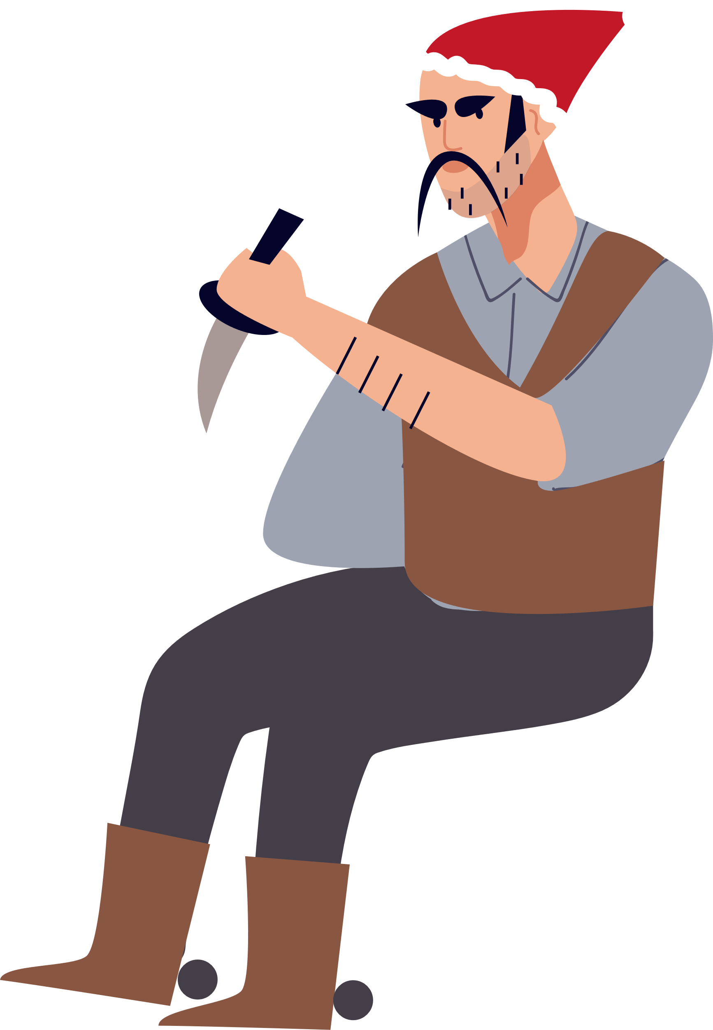


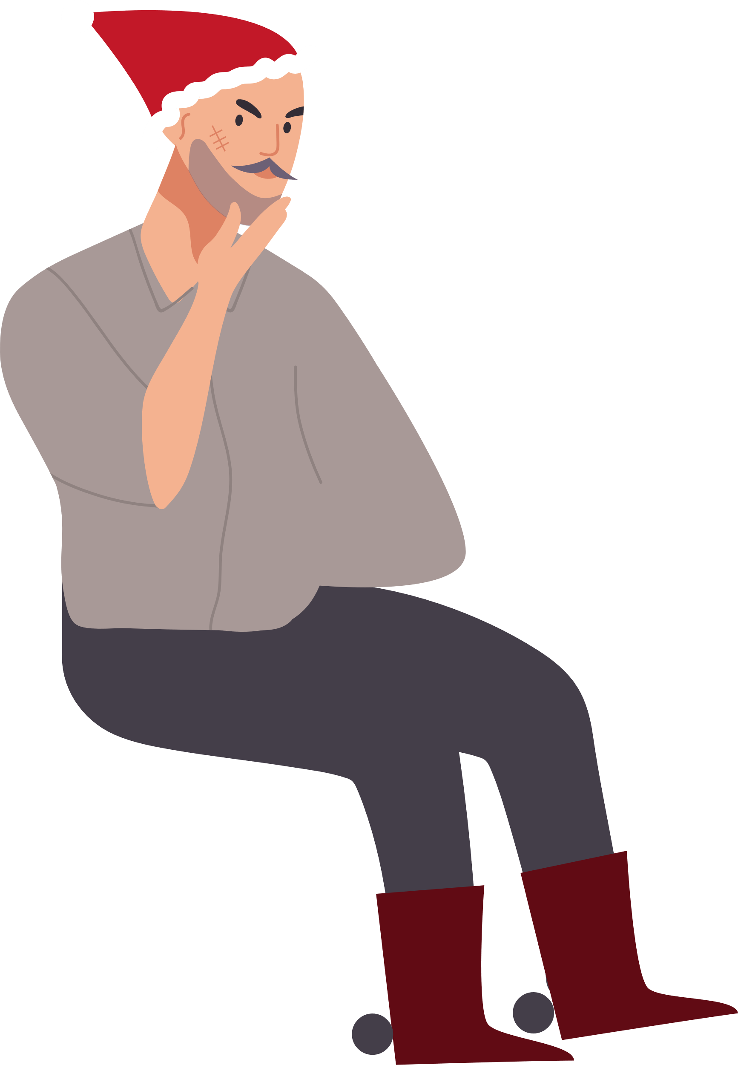

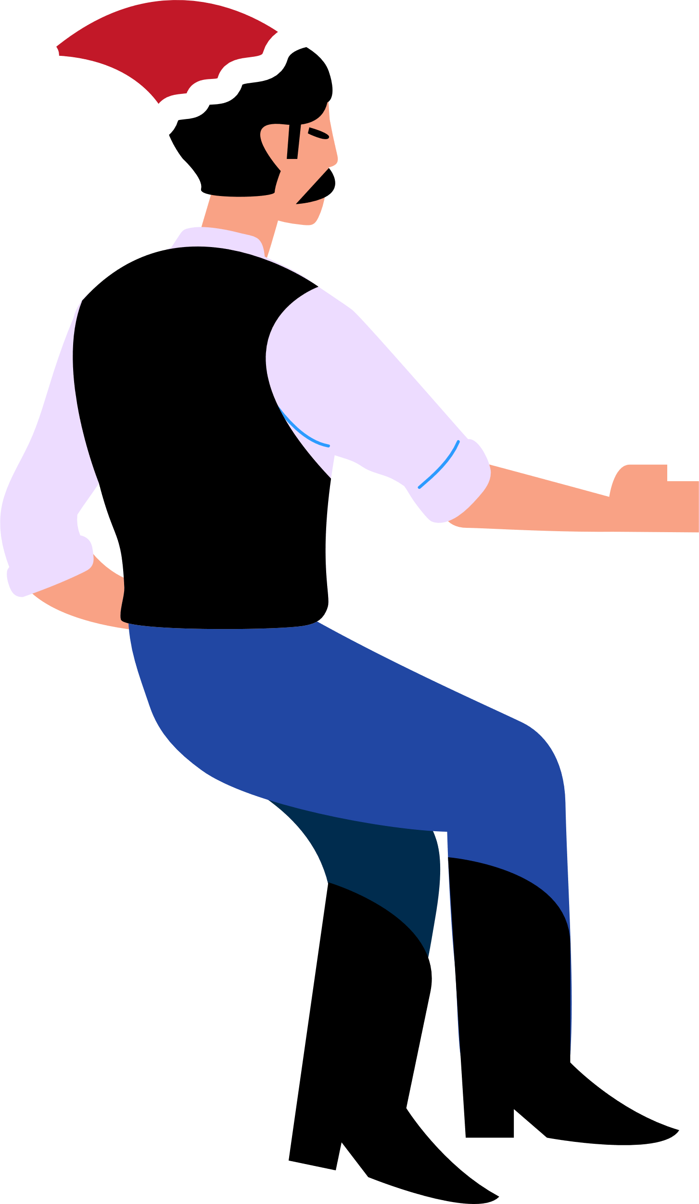
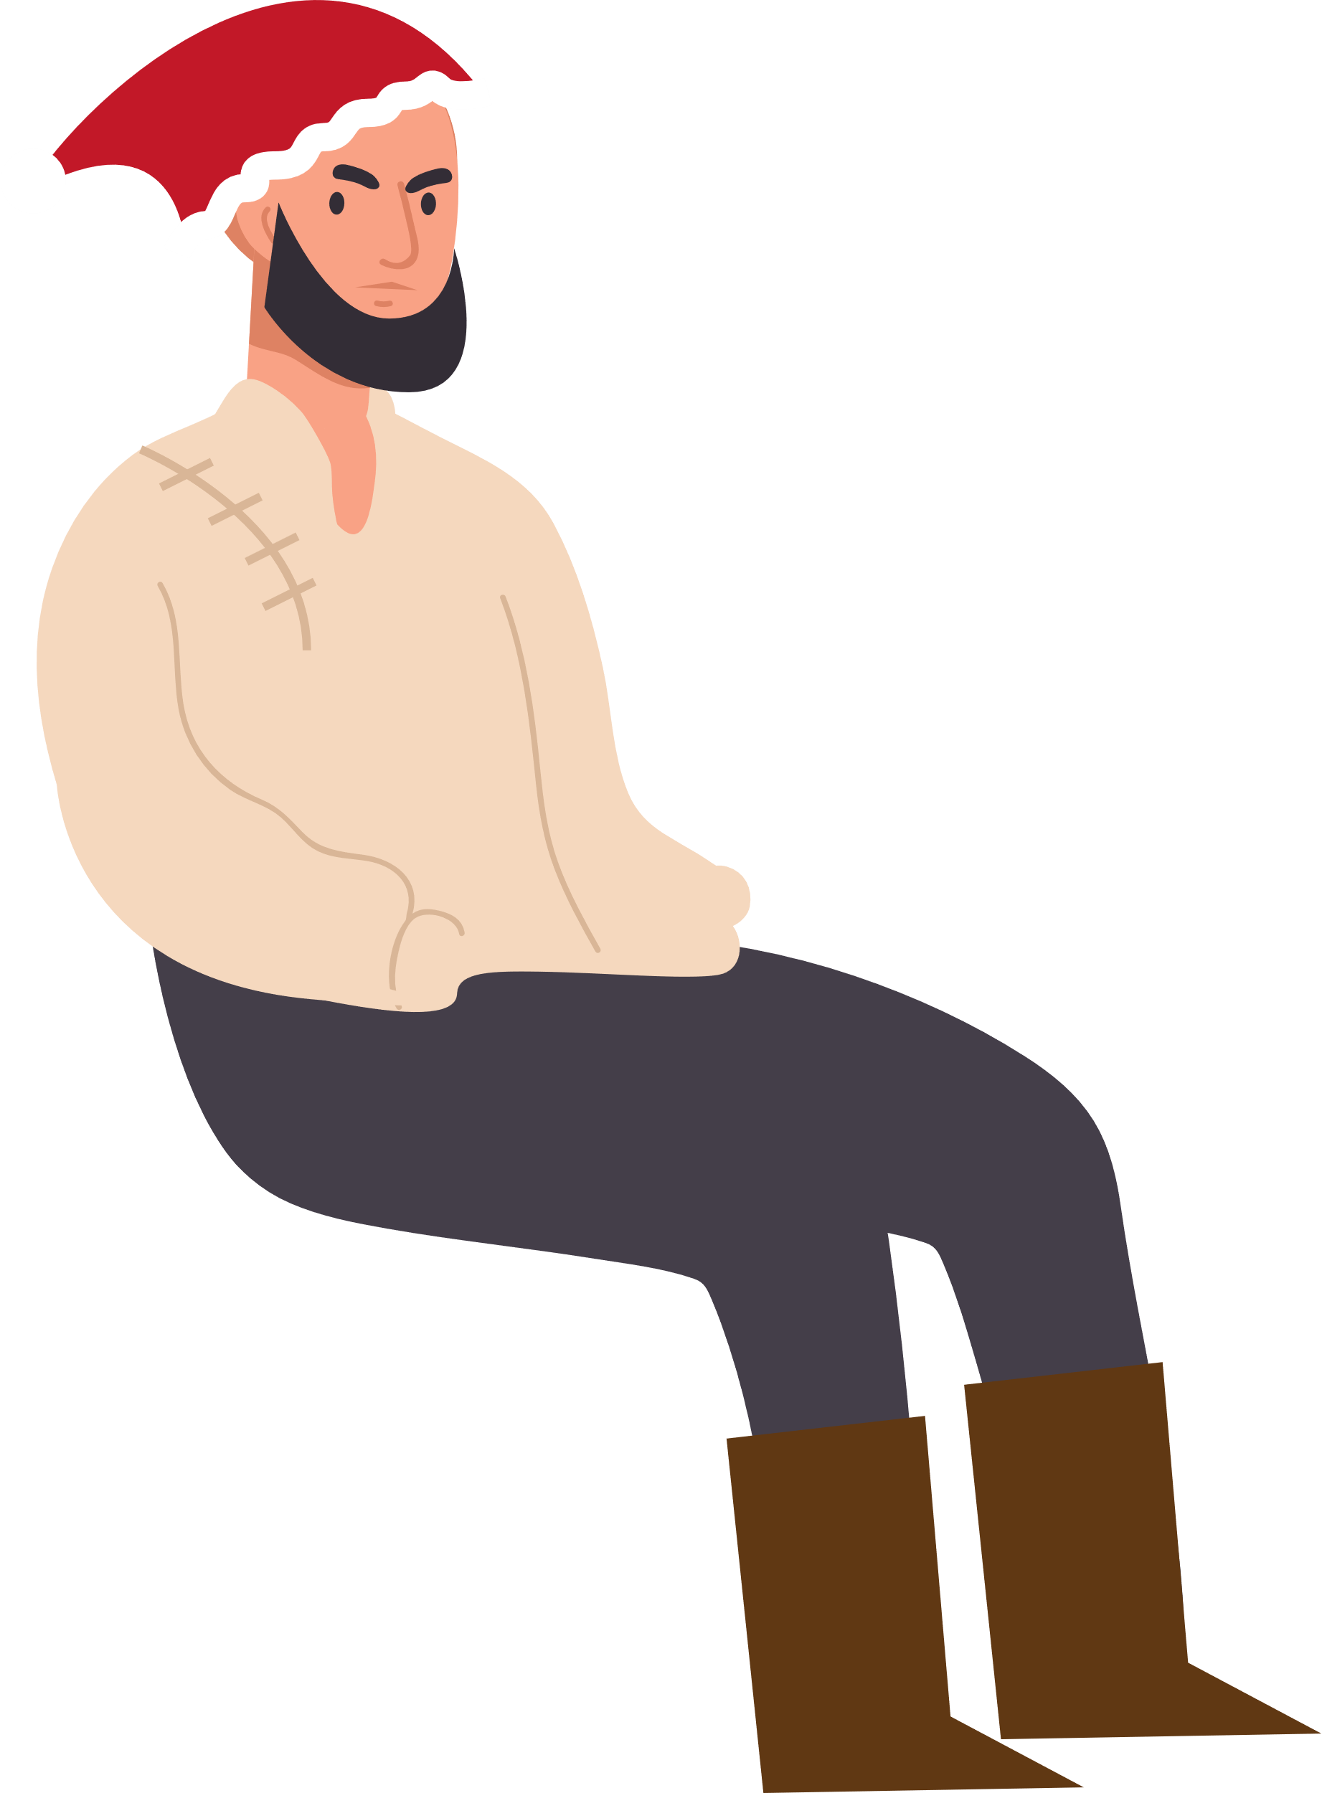
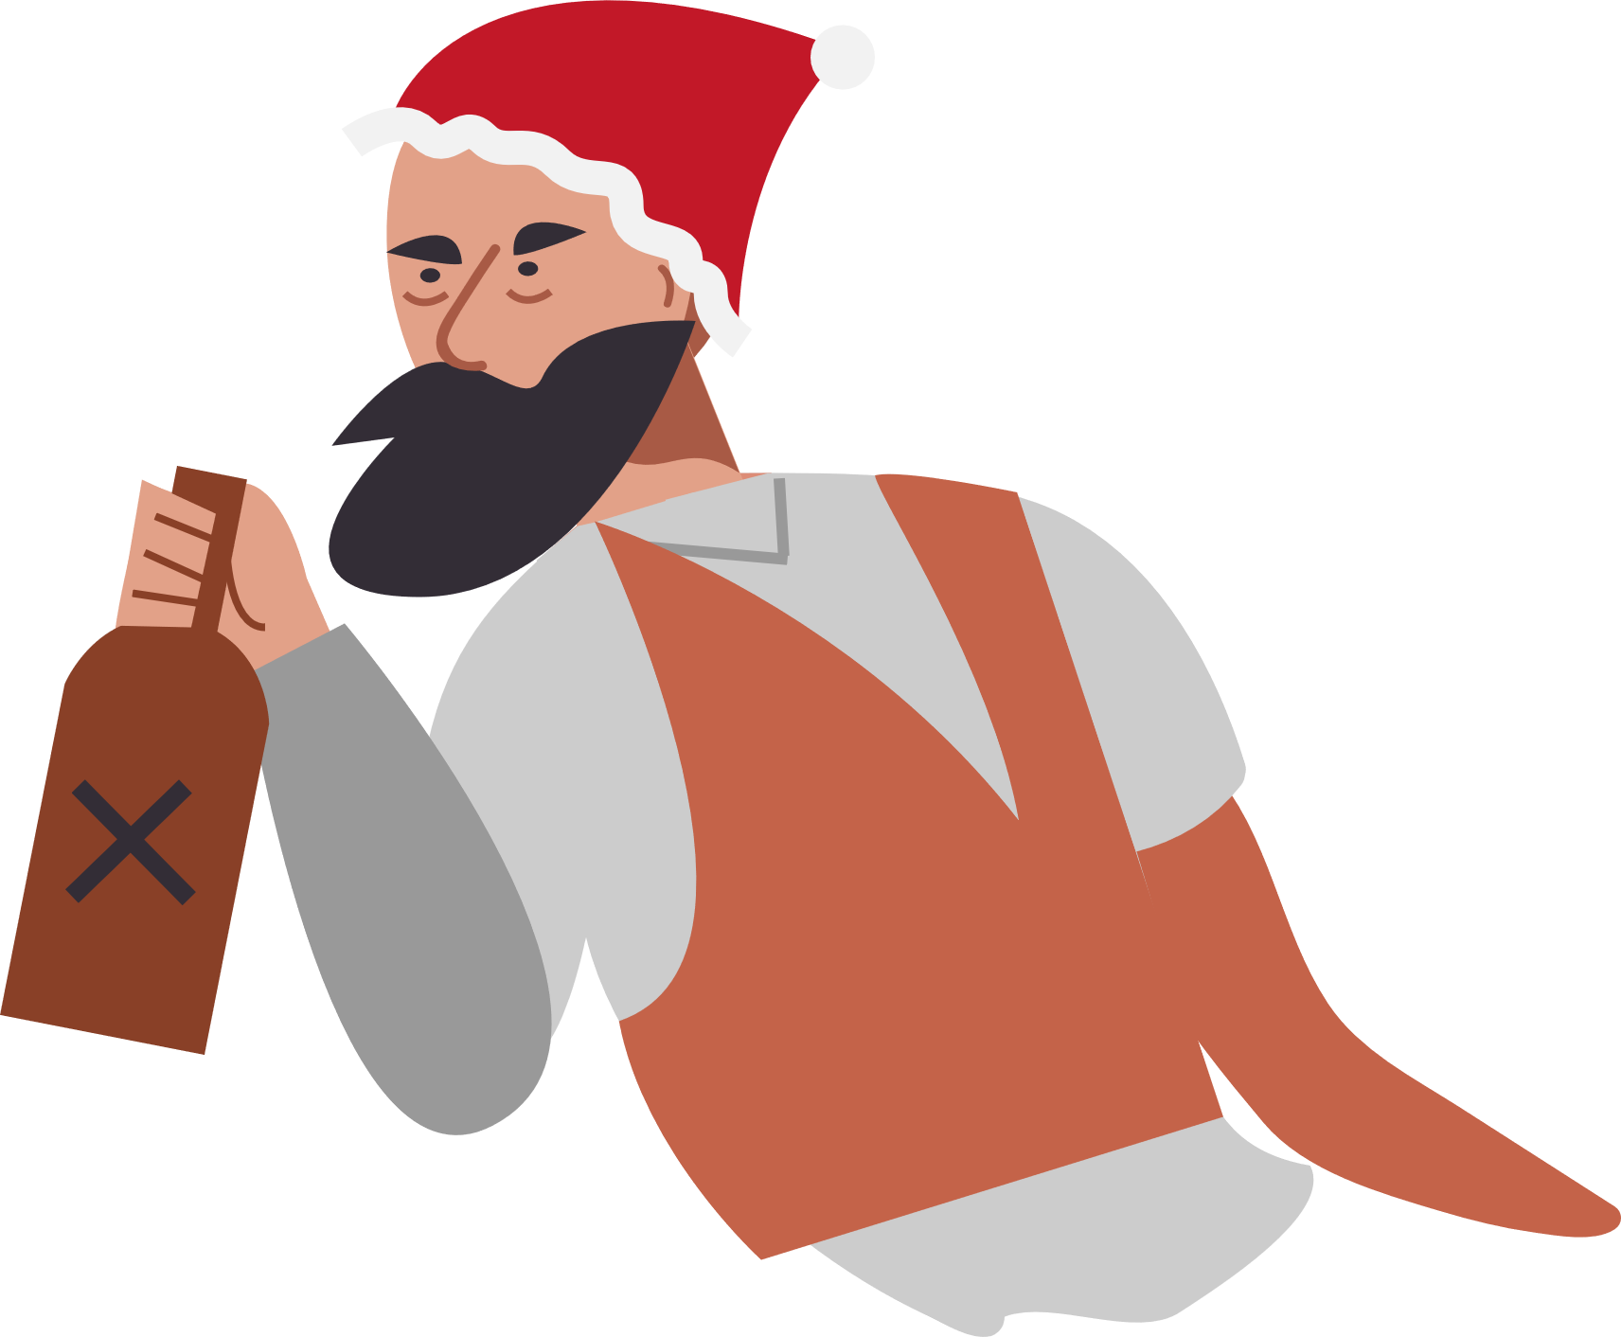





Slide 7




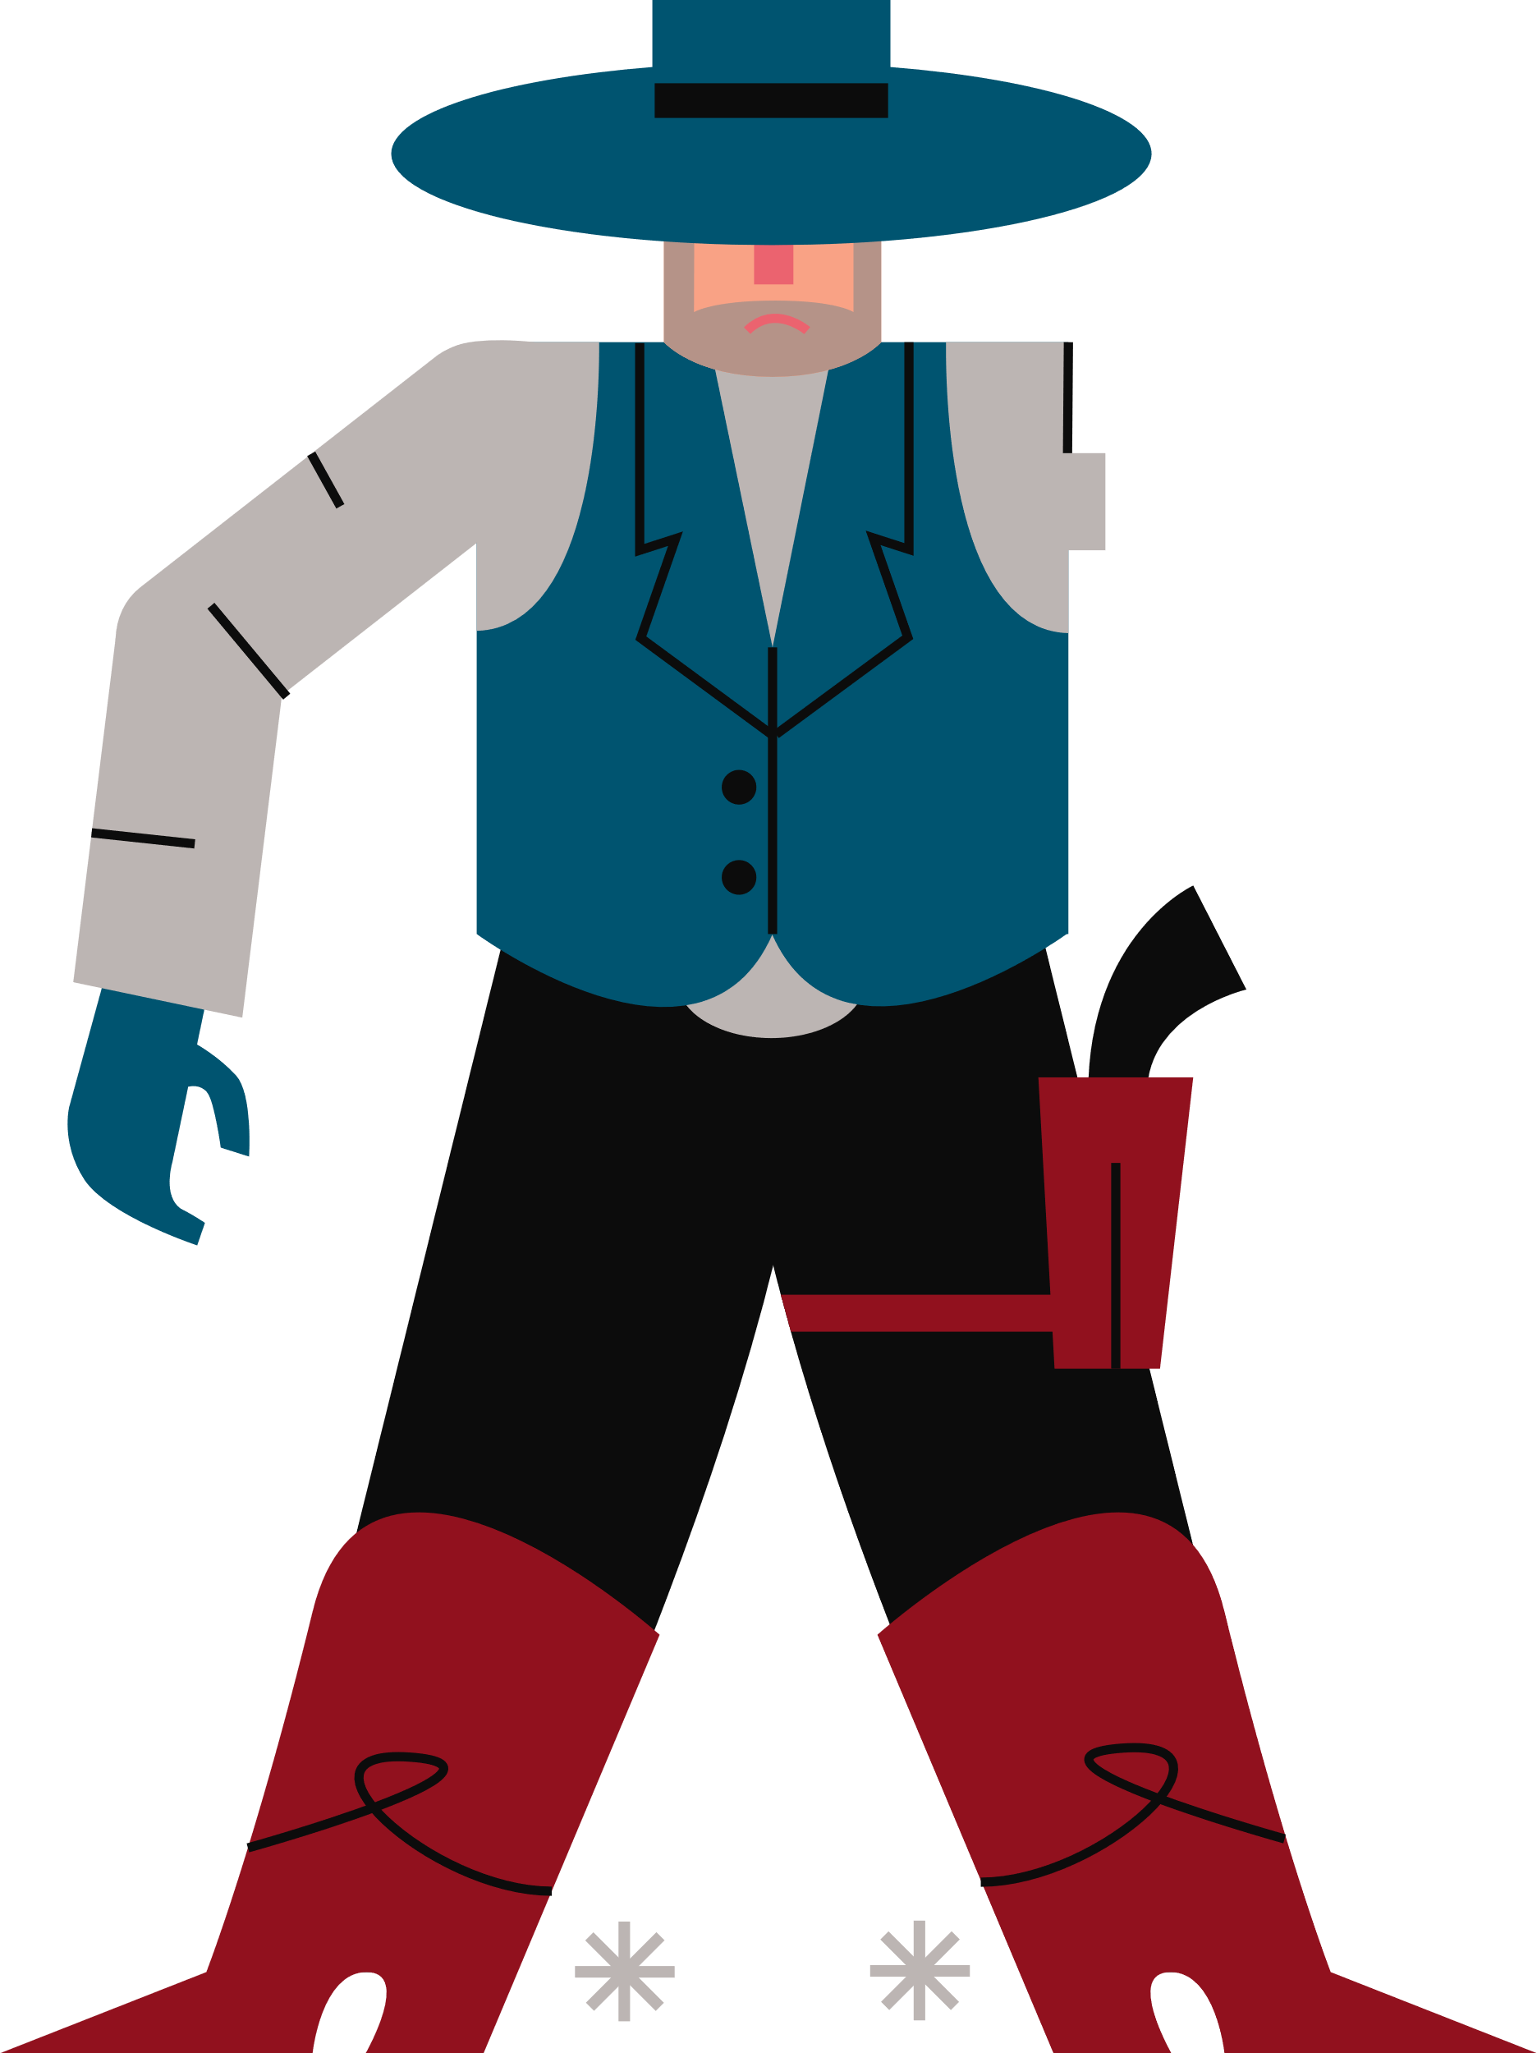
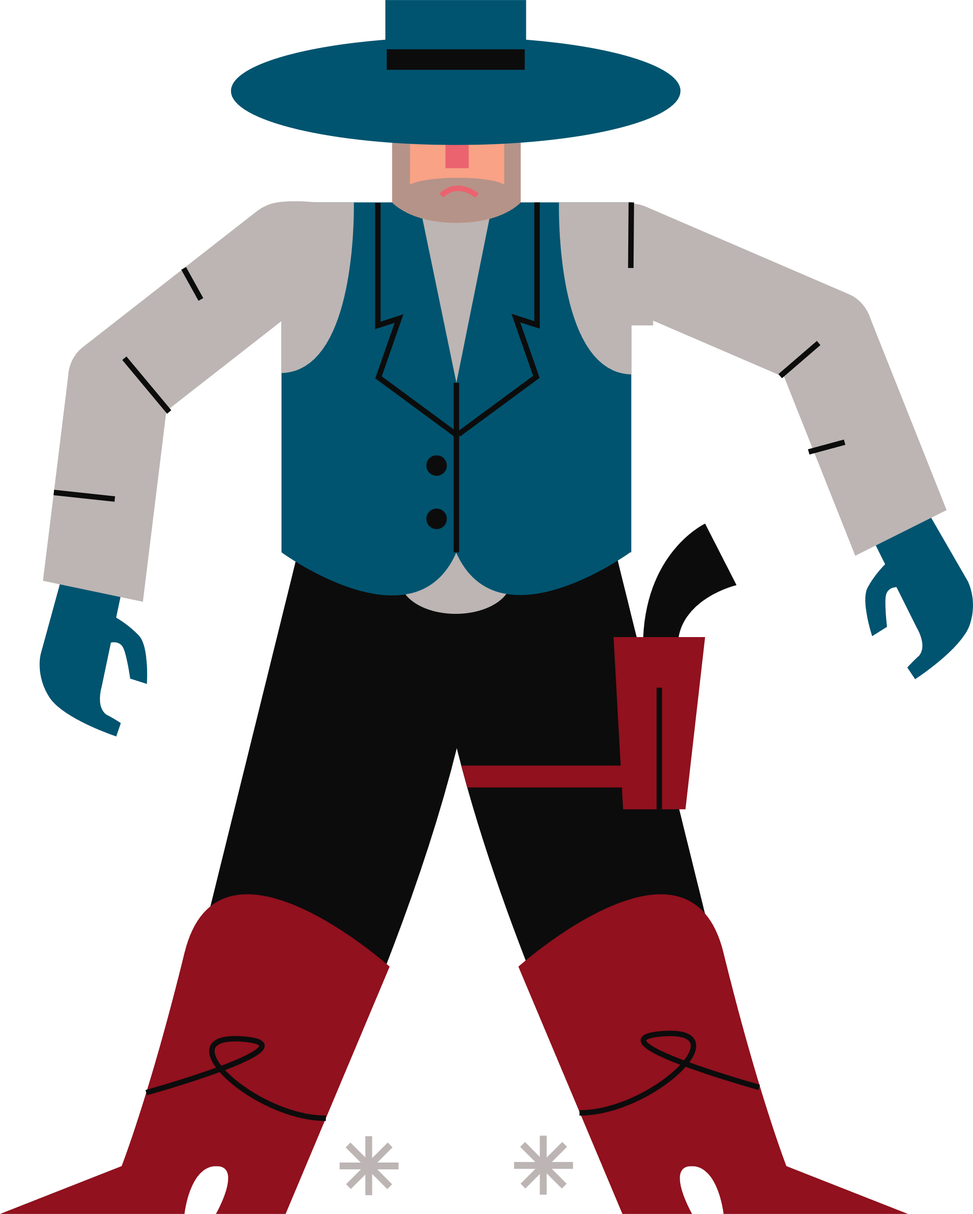


A present? That’s real nice of you Chester. I might have a little gift for you myself.
Don’t make it your last Chester.
Merry Christmas Jimmy. Nice hat.
I’ve got a present for you Jimmy.

Slide 8



*CLICK*
*CLICK*

Slide 9
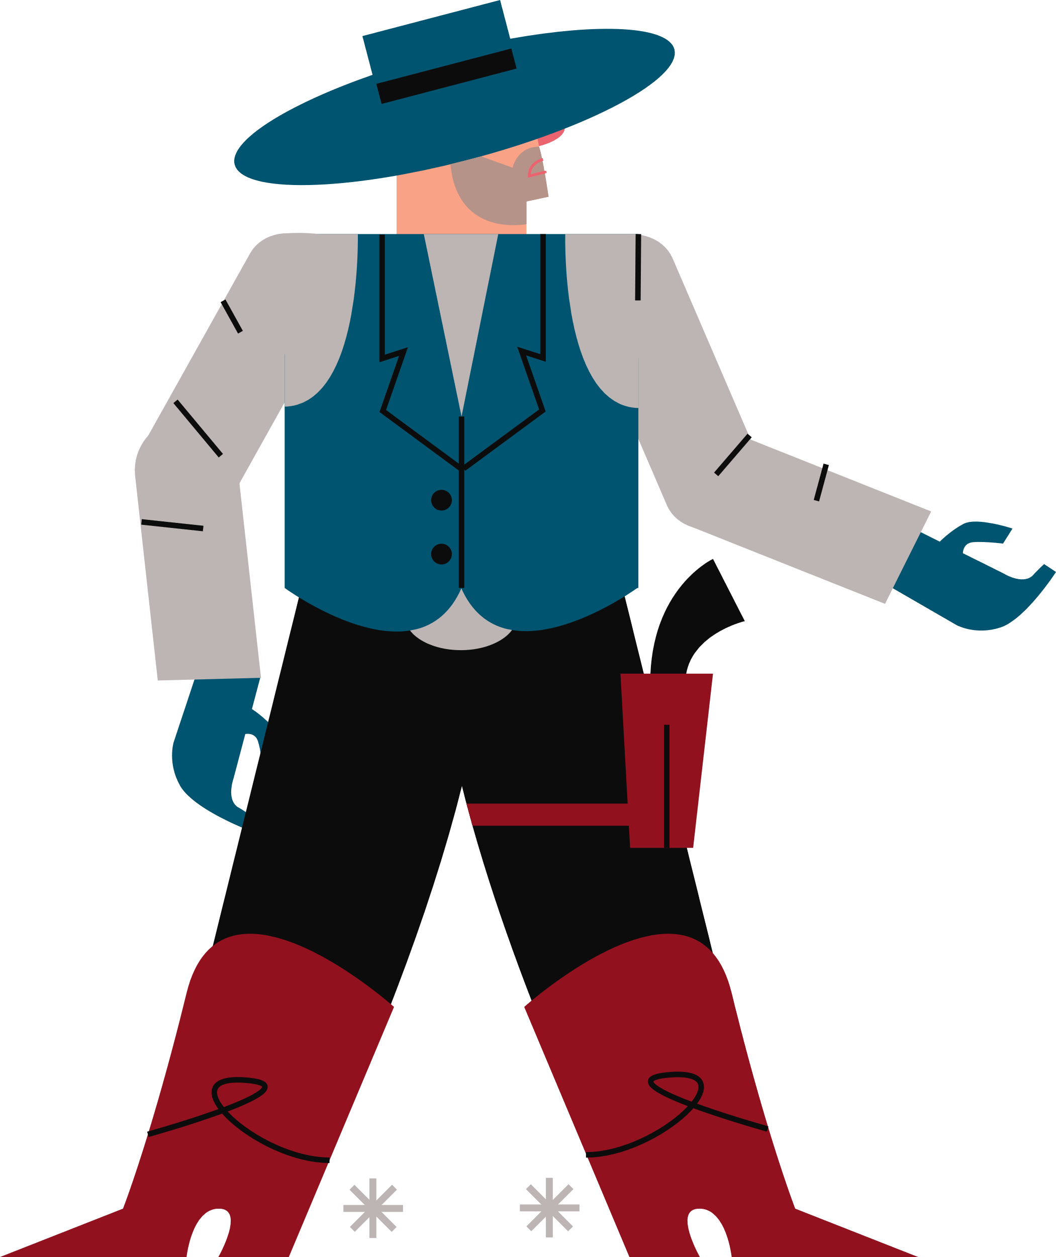
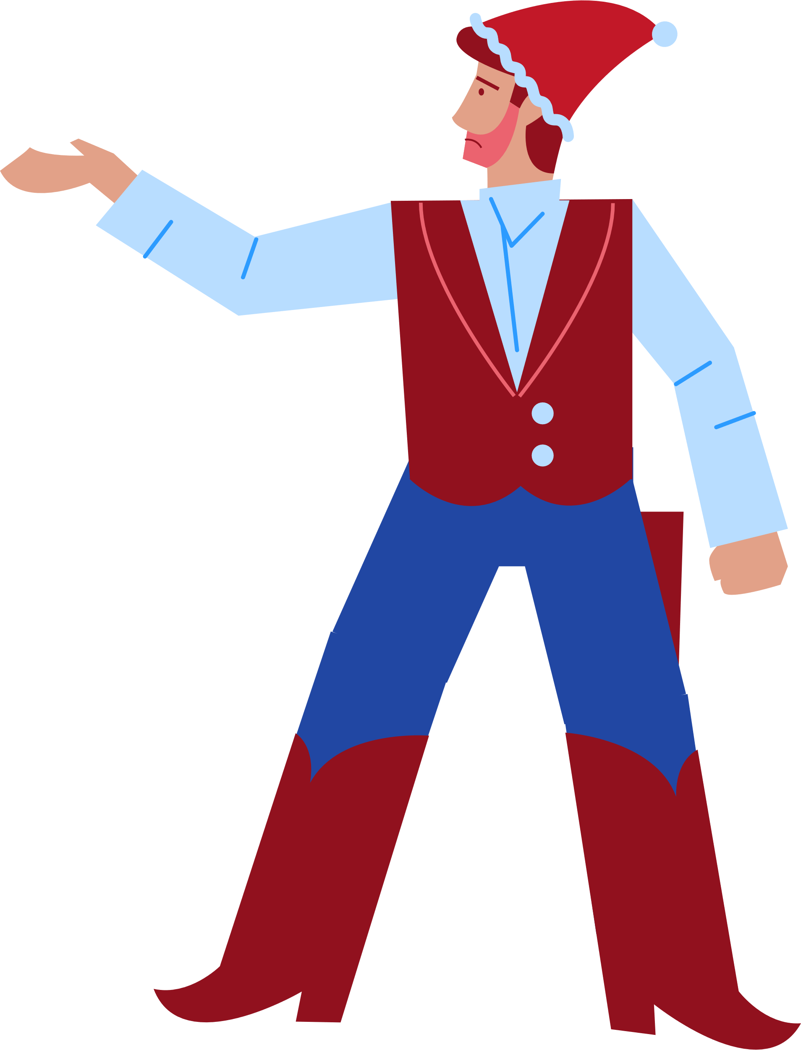
c
You’re right Jimmy, there’s something I’ve always wanted to do…
We got ourselves a
Christmas miracle!
Well I’ll be damned.
Say Chester, how about we put this bloodshed behind us.
In the name of Christmas!

Slide 10
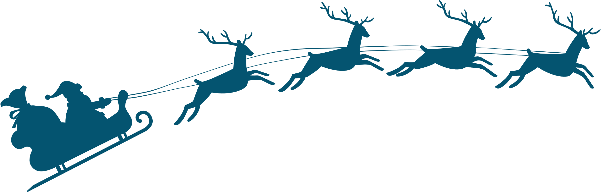



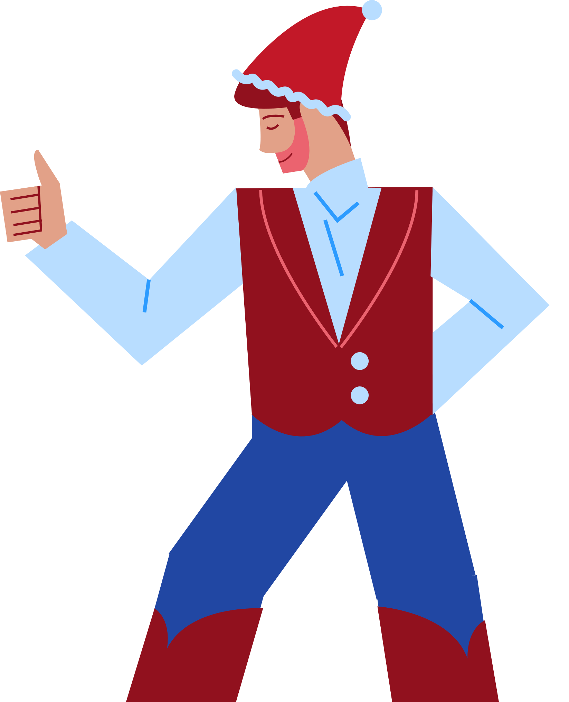
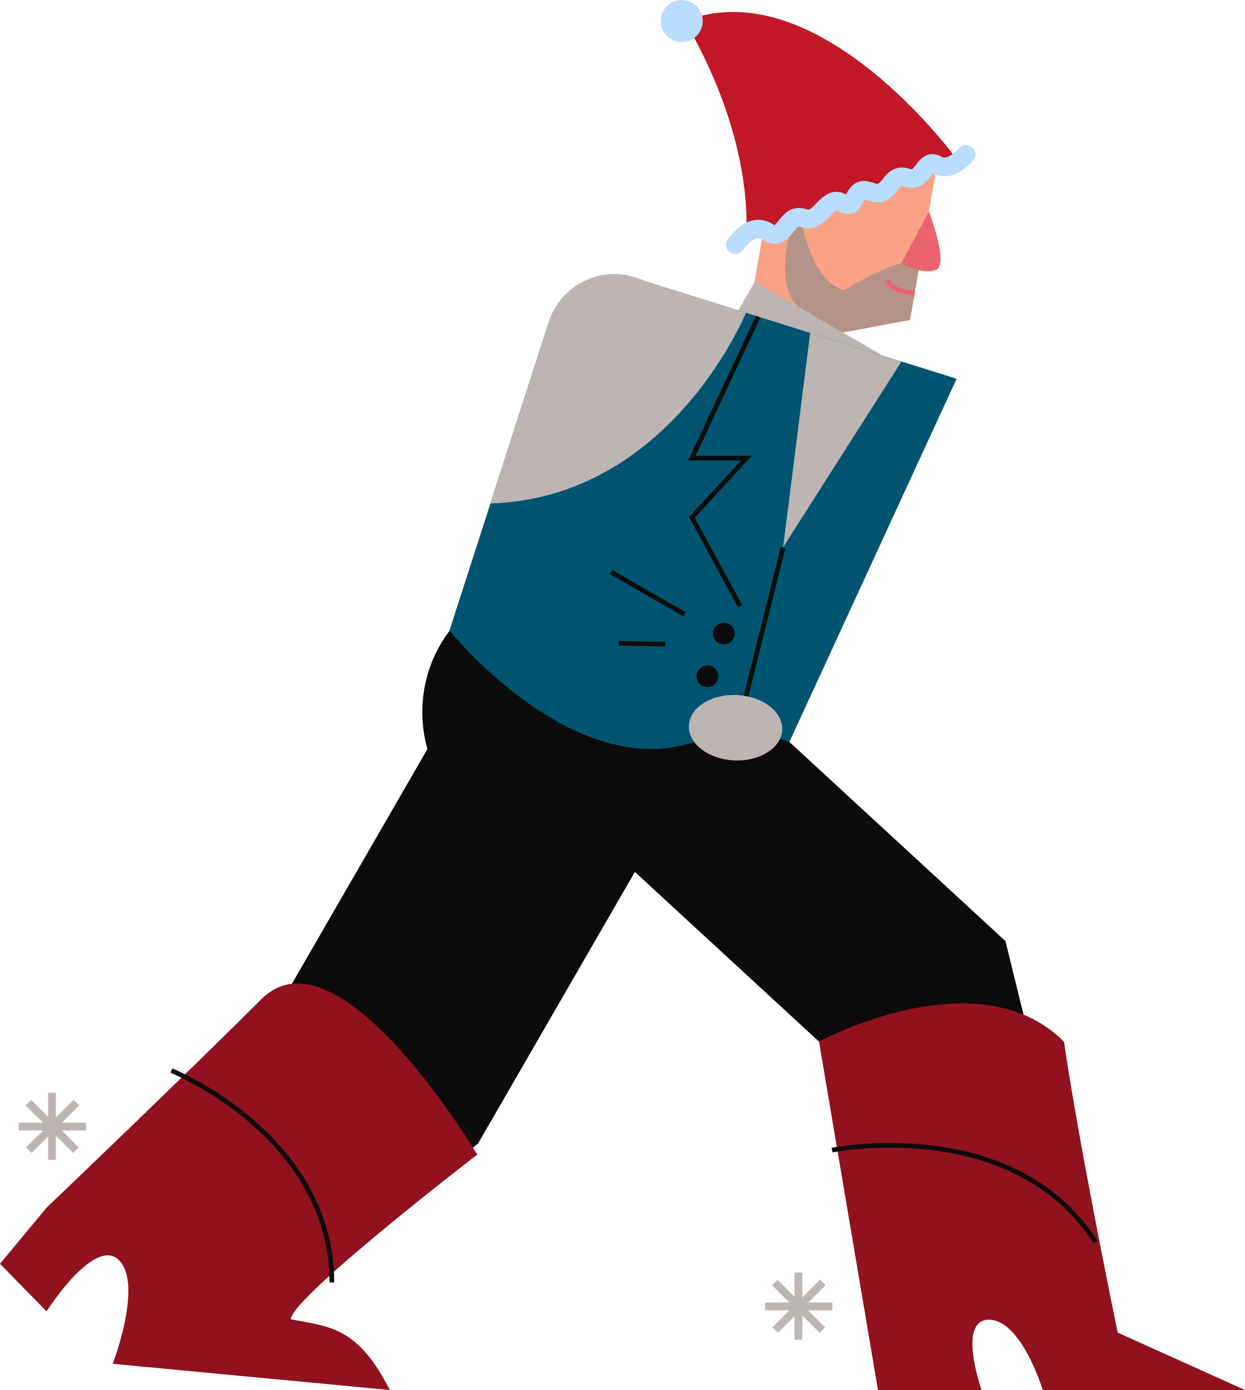




c

Slide 11


Happy holidays, Jimmy!
You too Wade.

Slide 12
HAVE A
ROOTIN’ TOOTIN’
CHRISTMAS
Y’ALL!
From everyone at BrightCarbon

