Slide 1

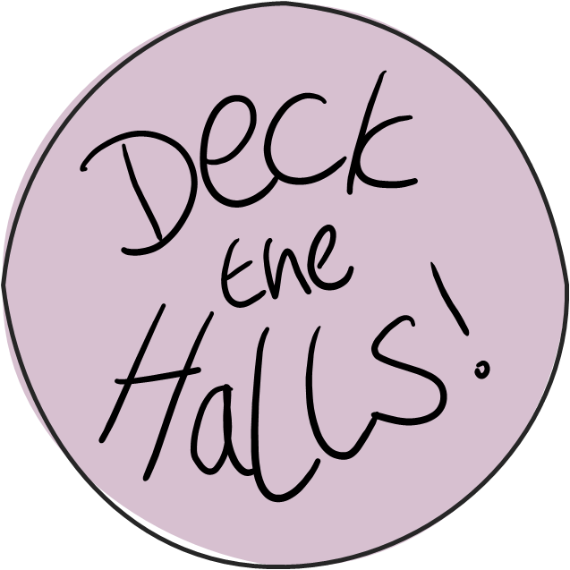

START
HATS
BAUBLES
HOLLY
LIGHTS
SPREAD THE FESTIVE FEELING BY GETTING SOME FAMOUS HALLS DECKED OUT FOR THE HOLIDAYS.
CLICK START TO GET CRACKING!

Slide 2
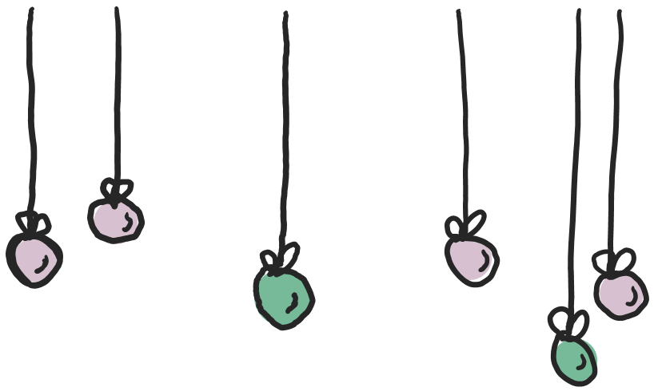
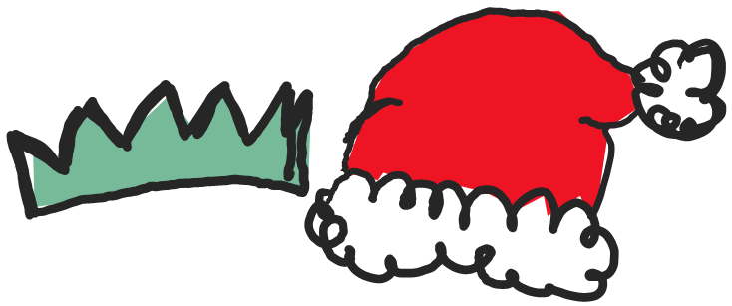
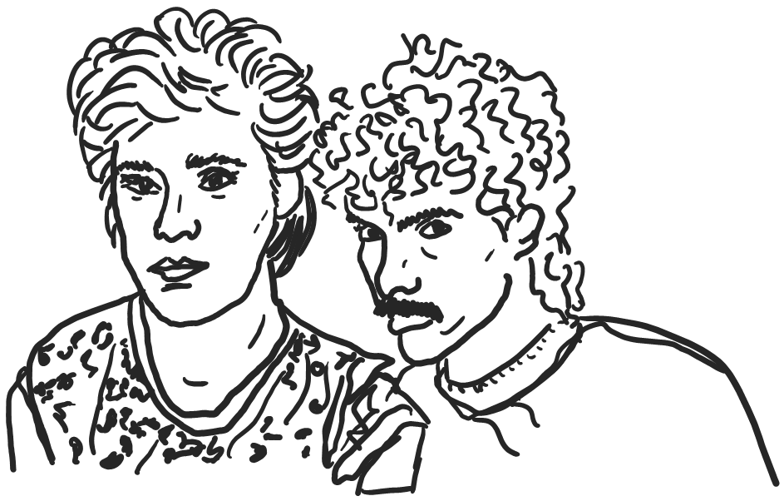
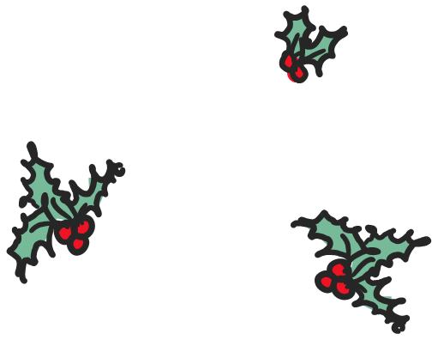
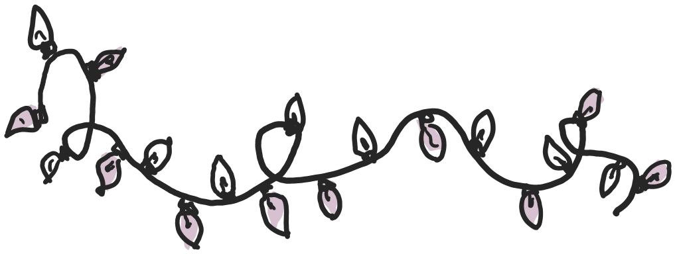
NEXT HALL!
HATS
HATS
BAUBLES
BAUBLES
HOLLY
HOLLY
LIGHTS
LIGHTS
HALL AND OATES

Slide 3

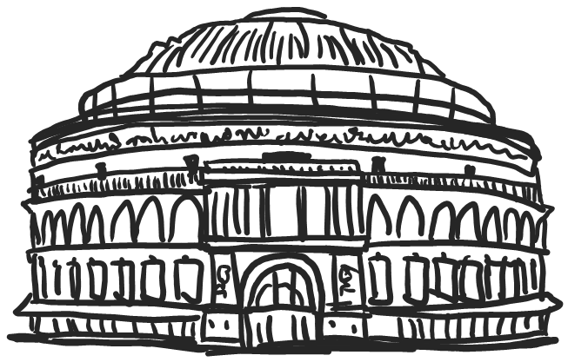


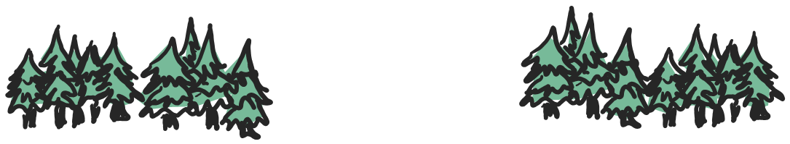
NEXT HALL!
TREES
TREES
STARS
STARS
TINSEL
TINSEL
STOCKINGS
STOCKINGS
ROYAL ALBERT HALL

Slide 4
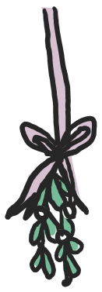
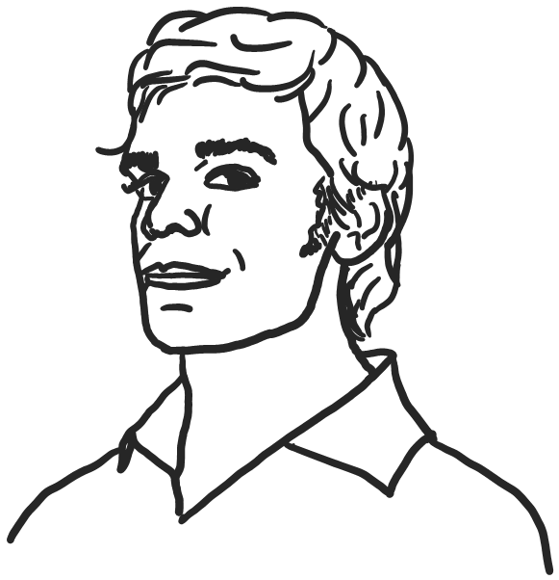
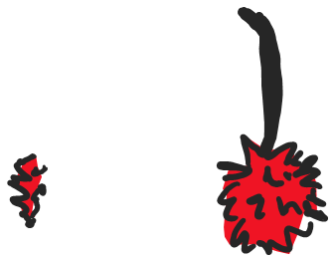

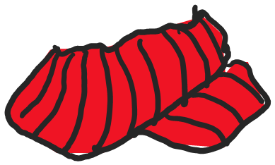
NEXT HALL!
EARMUFFS
EARMUFFS
SCARF
SCARF
MISTLETOE
MISTLETOE
EGGNOG
EGGNOG
MICHAEL C HALL

Slide 5
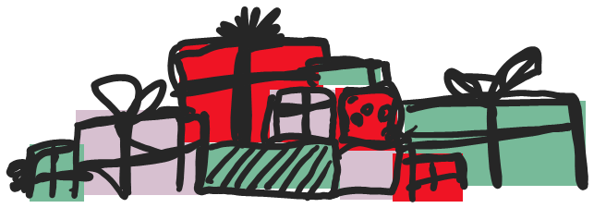
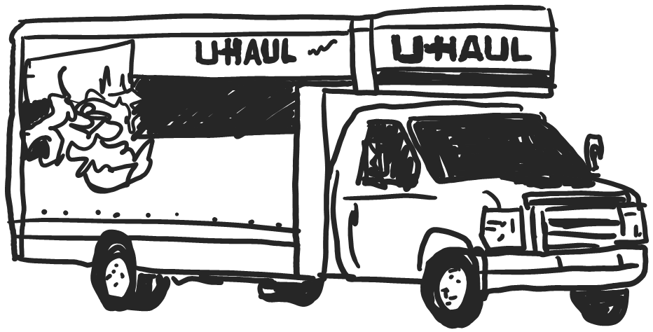
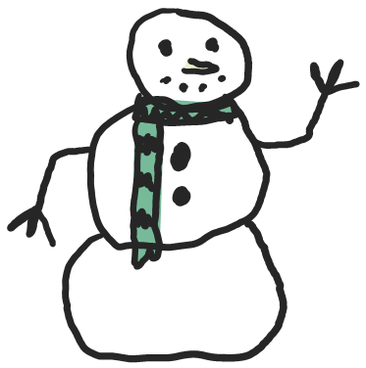

HALL DONE!
GIFTS
GIFTS
SNOWMAN
SNOWMAN
LIGHTS
LIGHTS
WREATH
WREATH
U-HAUL

Slide 6
GIFTS
GIFTS
[INSERT YOUR CHRISTMAS MESSAGE HERE]
SNOWMAN
SNOWMAN
LIGHTS
LIGHTS
DO IT HALL AGAIN!
WREATH
WREATH

