Slide 1



DECK
DECK
THE HALLS WITH

Slide 2

FA-LA-LA-LA, LA-

Slide 3
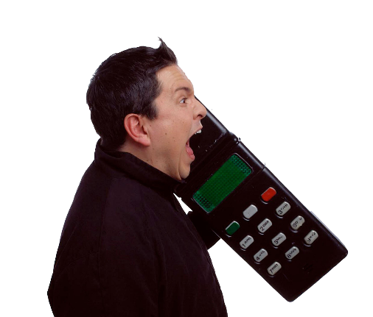
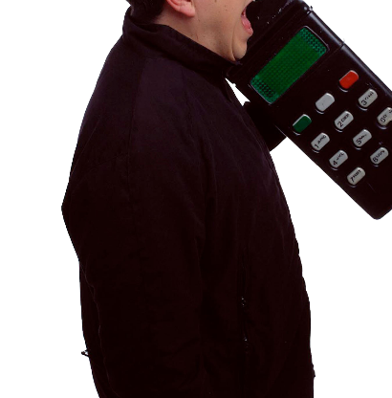
TO BE
‘TIS THE SEASON
‘TIS
‘TIS

Slide 4

FA-LA-LA-LA, LA-

Slide 5

DON
WE NOW OUR

Slide 6

FA-LA-LA
FA-LA-LA
LA-LA-LA

Slide 7


TROLL
TROLL
TROLL
YULE TIME
THE ANCIENT

Slide 8


FA-LA-LA-LA, LA-

Slide 9
WISHING YOU
A MERRY CHRISTMAS
FROM EVERYONE AT
BRIGHTCARBON

