Slide 4
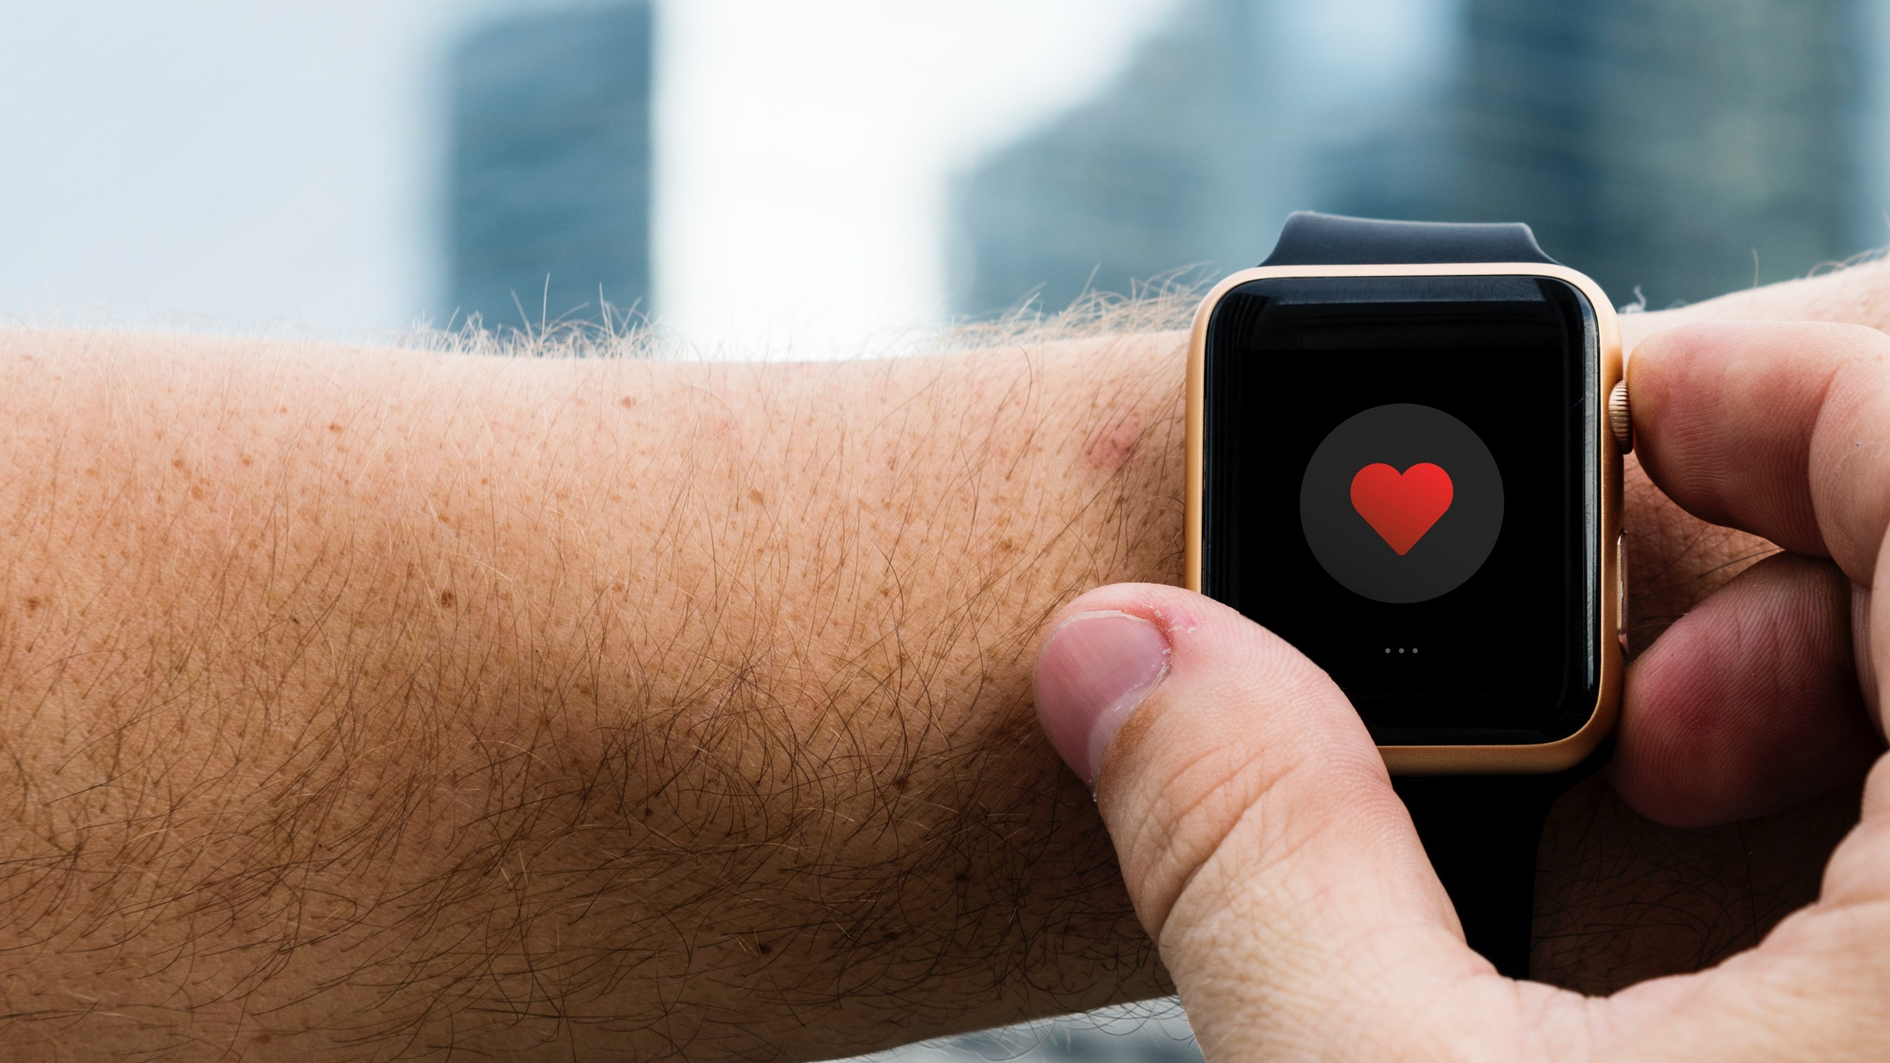
iHeart App
Motivates you to reach your health and fitness goals by tracking your activity, exercise, sleep, weight, and more.
Heart Rate Tracking
Health & Fitness Tracking
4+ Day Battery Life
Real Time Notifications

