Slide 1










Competition!
Best Snow Penguin
Team Pebbles
Team
Sardine
Louis

Slide 2

Competition!
Best Snow Penguin
Team Pebbles
Team
Sardine
Louis

Slide 3
Competition!
Best Snow Penguin
Team Pebbles
Team
Sardine
Louis

Slide 4






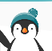






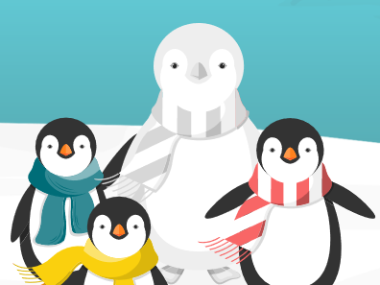

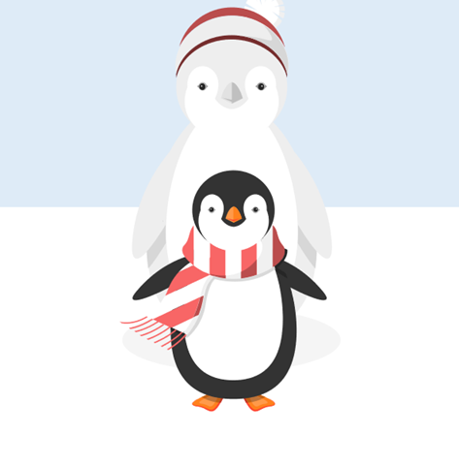

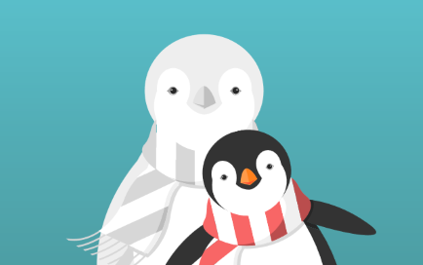

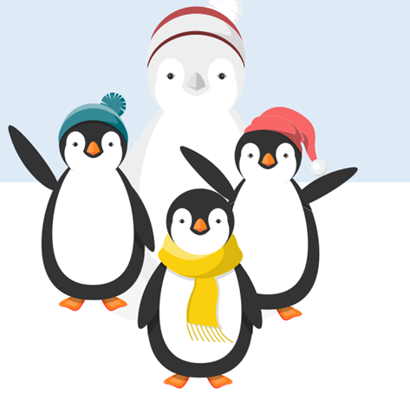


fishbook
Icestagram
Search
Status
Photo
Check-in
Archie
Flippers
Just now
My amazing snowpenguin
Like
Comment
Share
Beak ID
Pebbles
Just now
Archie Could build these things all day! Winter is the best ☺ #snowday #snowpenguin #wintergoals
Squad Goals!!!
Gerry
Like
Comment
Share
Peggy
6 min ago
Loving the snow ☺
Gerry What a day to build a snowpenguin ^_^ #Christmas #nopenguinlikesnowpenguin
Mackintosh
Like
Comment
Share
Phoebe
11 min ago
#snowpenguin #winterfun
Mackintosh The only question is.. Is one snow penguin enough?? #HappyChristmas #snowday #penguinsonparade
Like
Comment
Share

Slide 5
sigh
Louis

Slide 6







Search

Slide 7
Search

Slide 8
Search

Slide 9
Louis

Slide 10

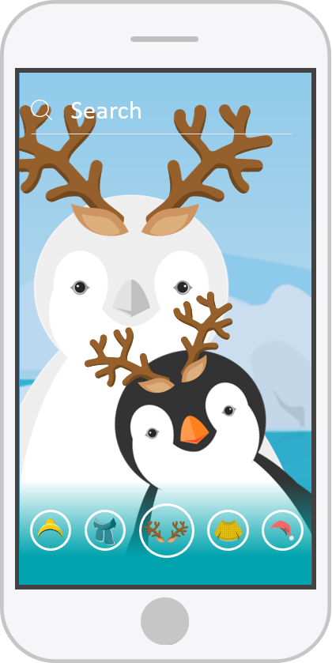
Icestagram
Louis
15,436
Louis Feelin’ very Christmas-y today with my deer friend! #Christmas #holidayvibes #reindeer #deer
Gerry

Slide 11
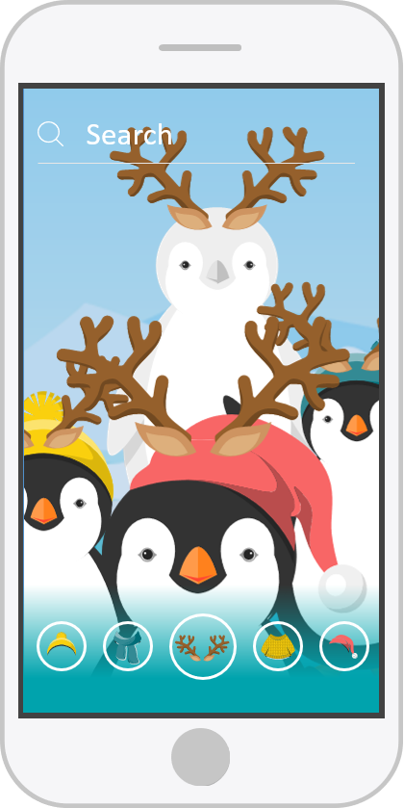
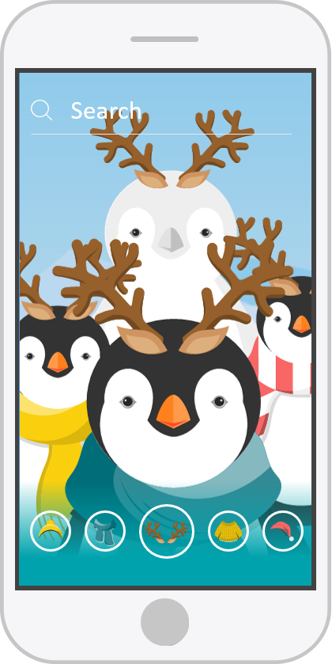
1,342
4,213
30,660

Slide 12

Competition!
Best Snow Penguin
Merry Christmas!
Louis
From: BrightCarbon

Slide 13
Competition!
Best Snow Penguin
Merry Christmas!
Louis
From: BrightCarbon

