Slide 1




Slide 2





Slide 3
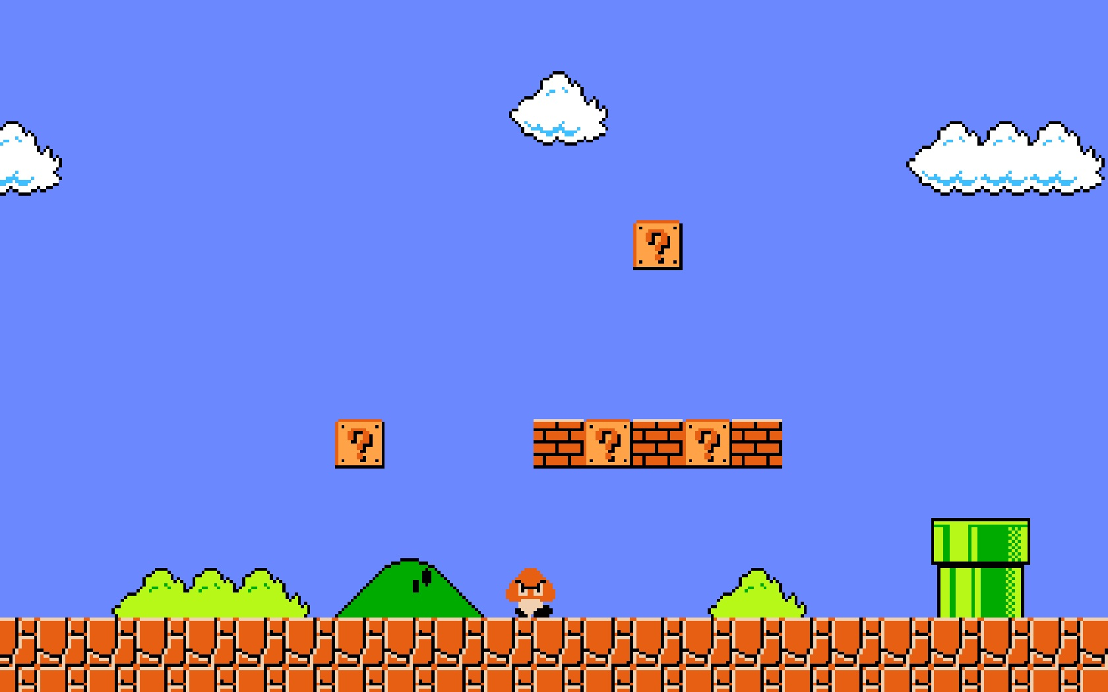


Slide 5

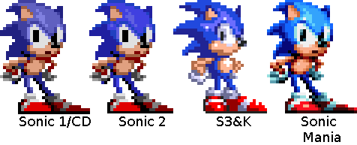

Slide 7
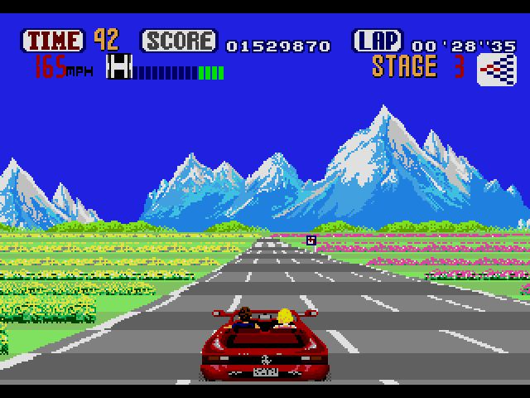



Slide 8
Game over
Happy Holidays from everyone at BrightCarbon!

