Slide 1





Santa’s House

Slide 2
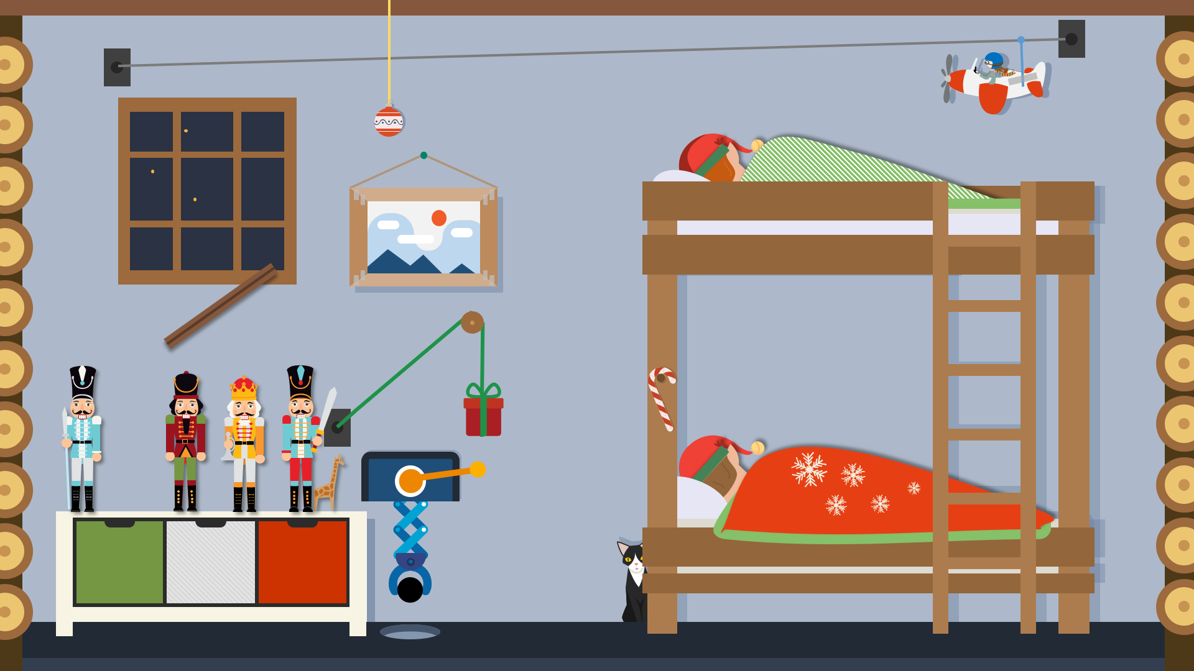
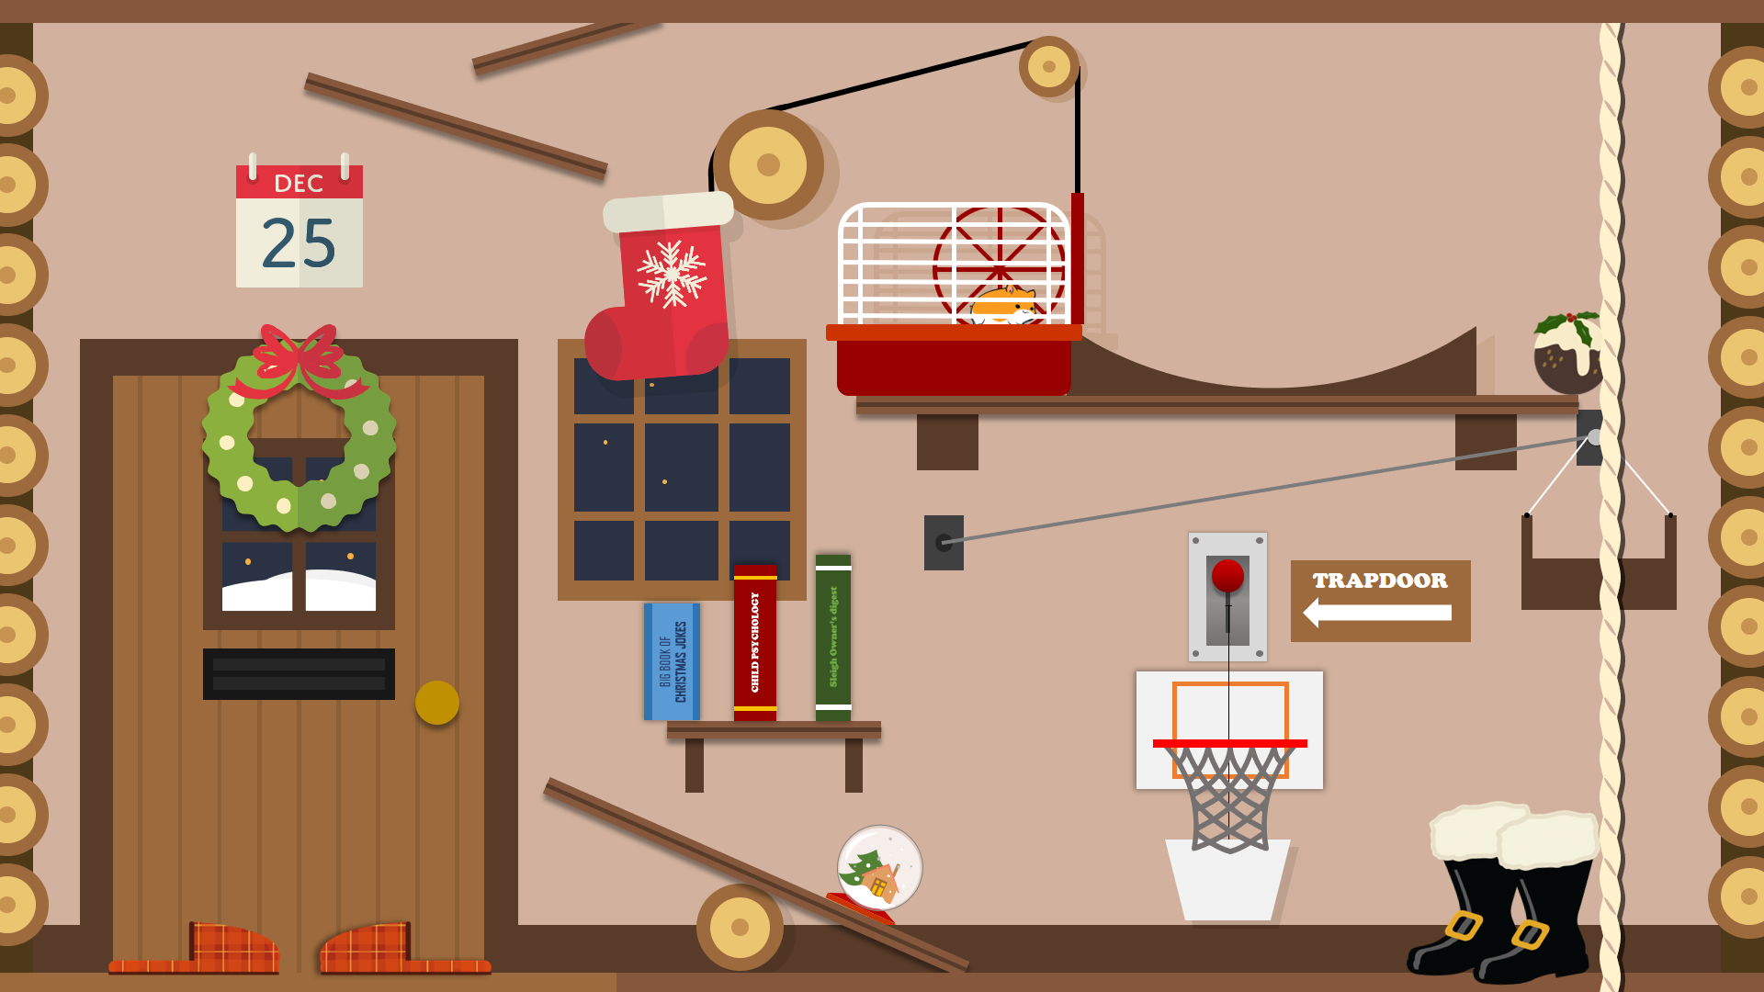



Ah, the
big day is finally here!
PULL FOR ATTENTION
SANTA
SLIPPER
EXPRESS

Slide 3
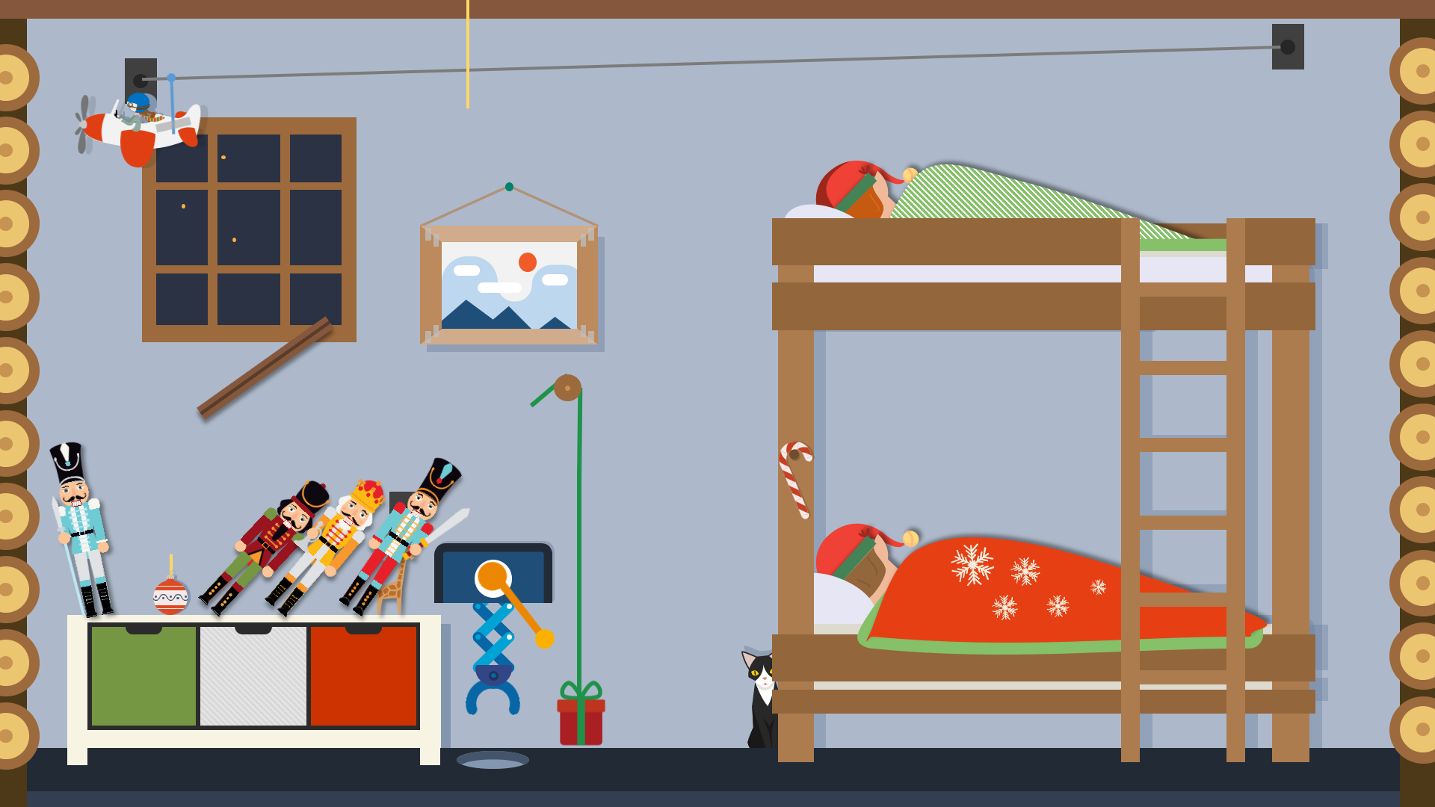




Slide 4
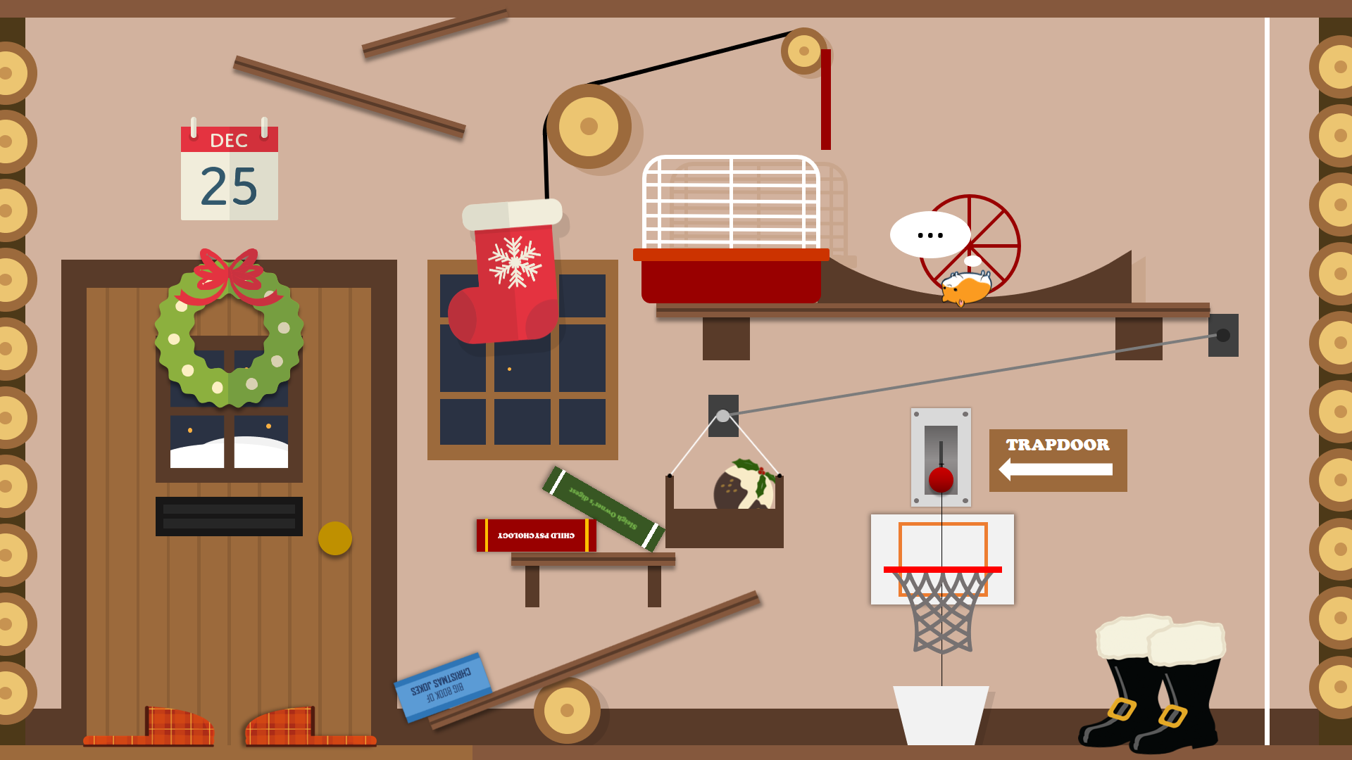




…
TRAPDOOR
Sleigh Owner’s digest
CHILD PSYCHOLOGY
BIG BOOK OF CHRISTMAS JOKES
BIG BOOK OF CHRISTMAS JOKES
PULL FOR ATTENTION
PULL FOR ATTENTION
SANTA
SLIPPER
EXPRESS

Slide 5
Merry Christmas from everyone at BrightCarbon!
So it’s time to put your feet up and relax!
PULL FOR ATTENTION
SANTA
SLIPPER
EXPRESS
SANTA
SLIPPER
EXPRESS
SANTA
SLIPPER
EXPRESS

