Slide 1



Notes:
Leaf falls, then zoom into hole in tree.

Slide 2
Notes:
Leaf falls, then zoom into hole in tree.

Slide 3





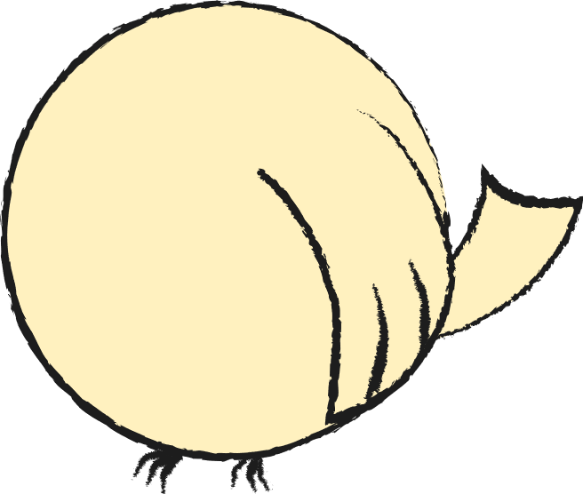
Notes:
2 birds fly out

Slide 4
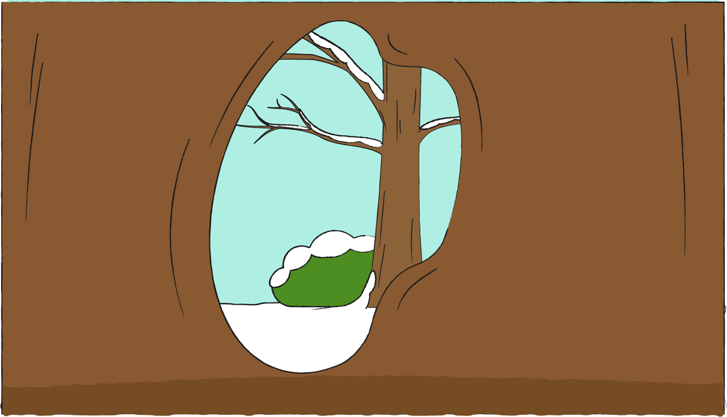
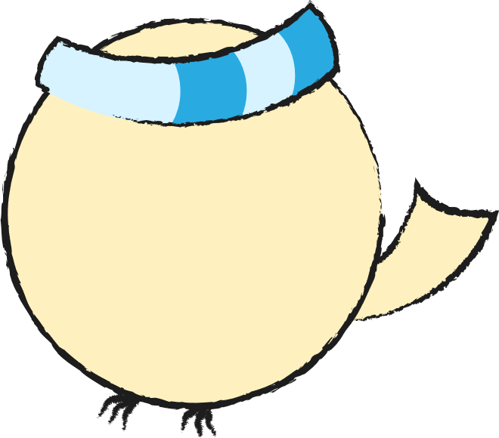


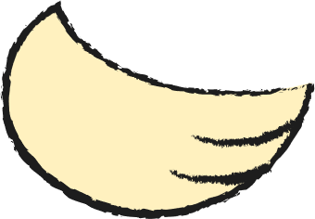
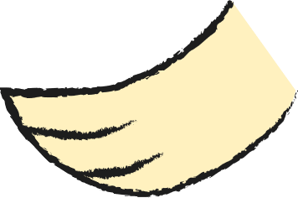
Notes:
Cross fade to winter, grandpa trying to keep warm

Slide 5



Notes:
Cross fade to winter, grandpa trying to keep warm

Slide 6



Slide 7



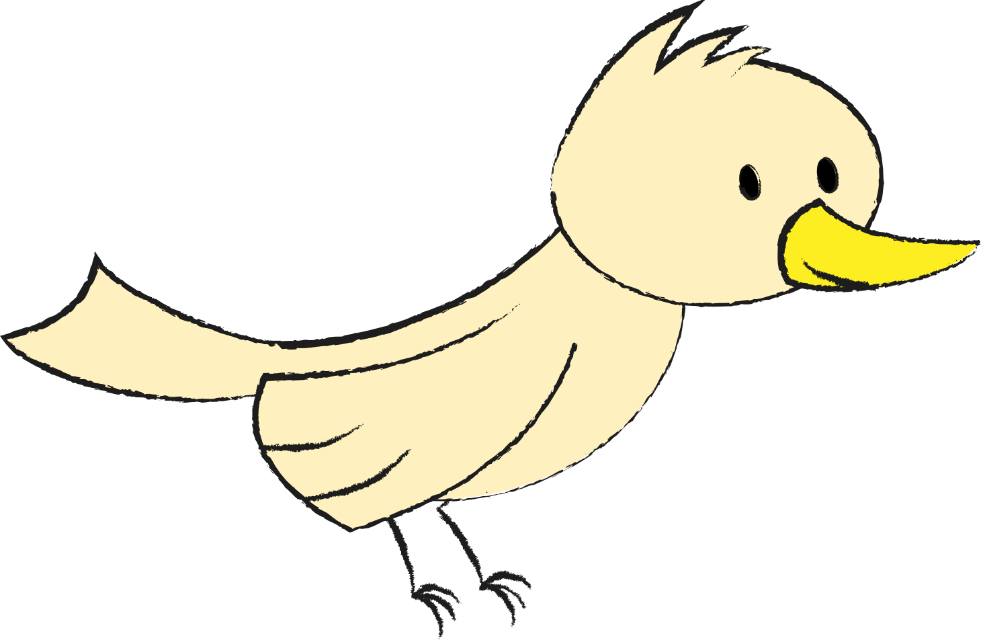


Slide 8

from: BrightCarbon

