Slide 1



Slide 2


Slide 3
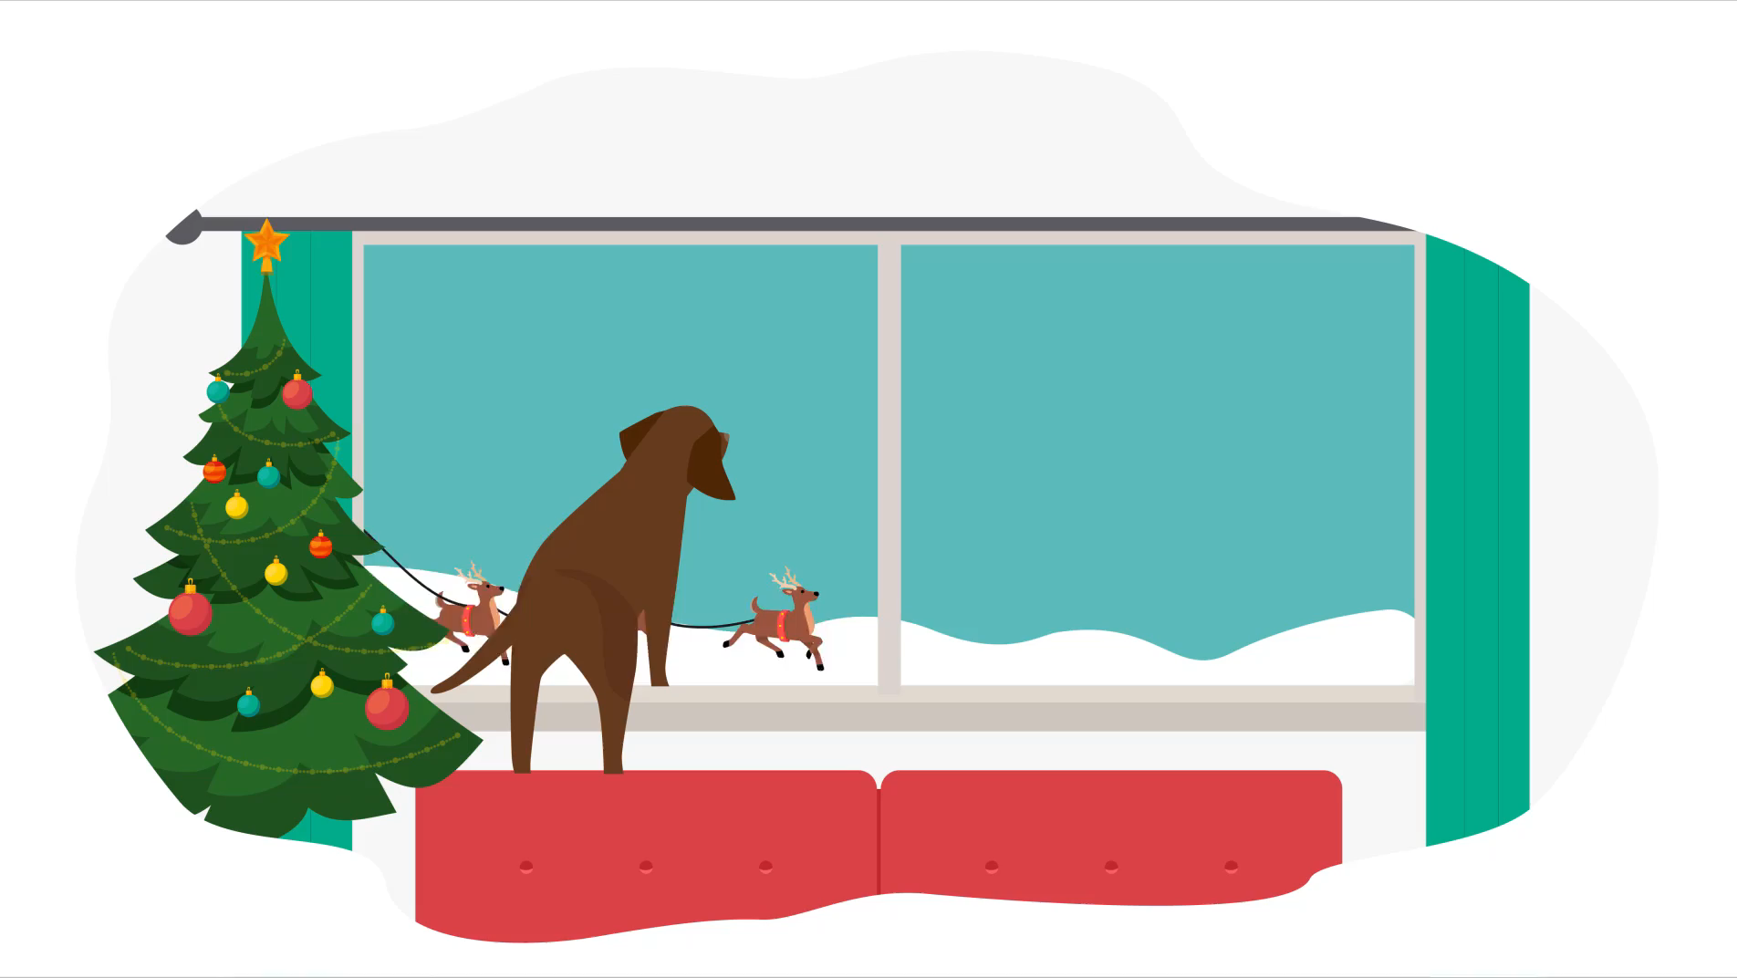

Slide 4
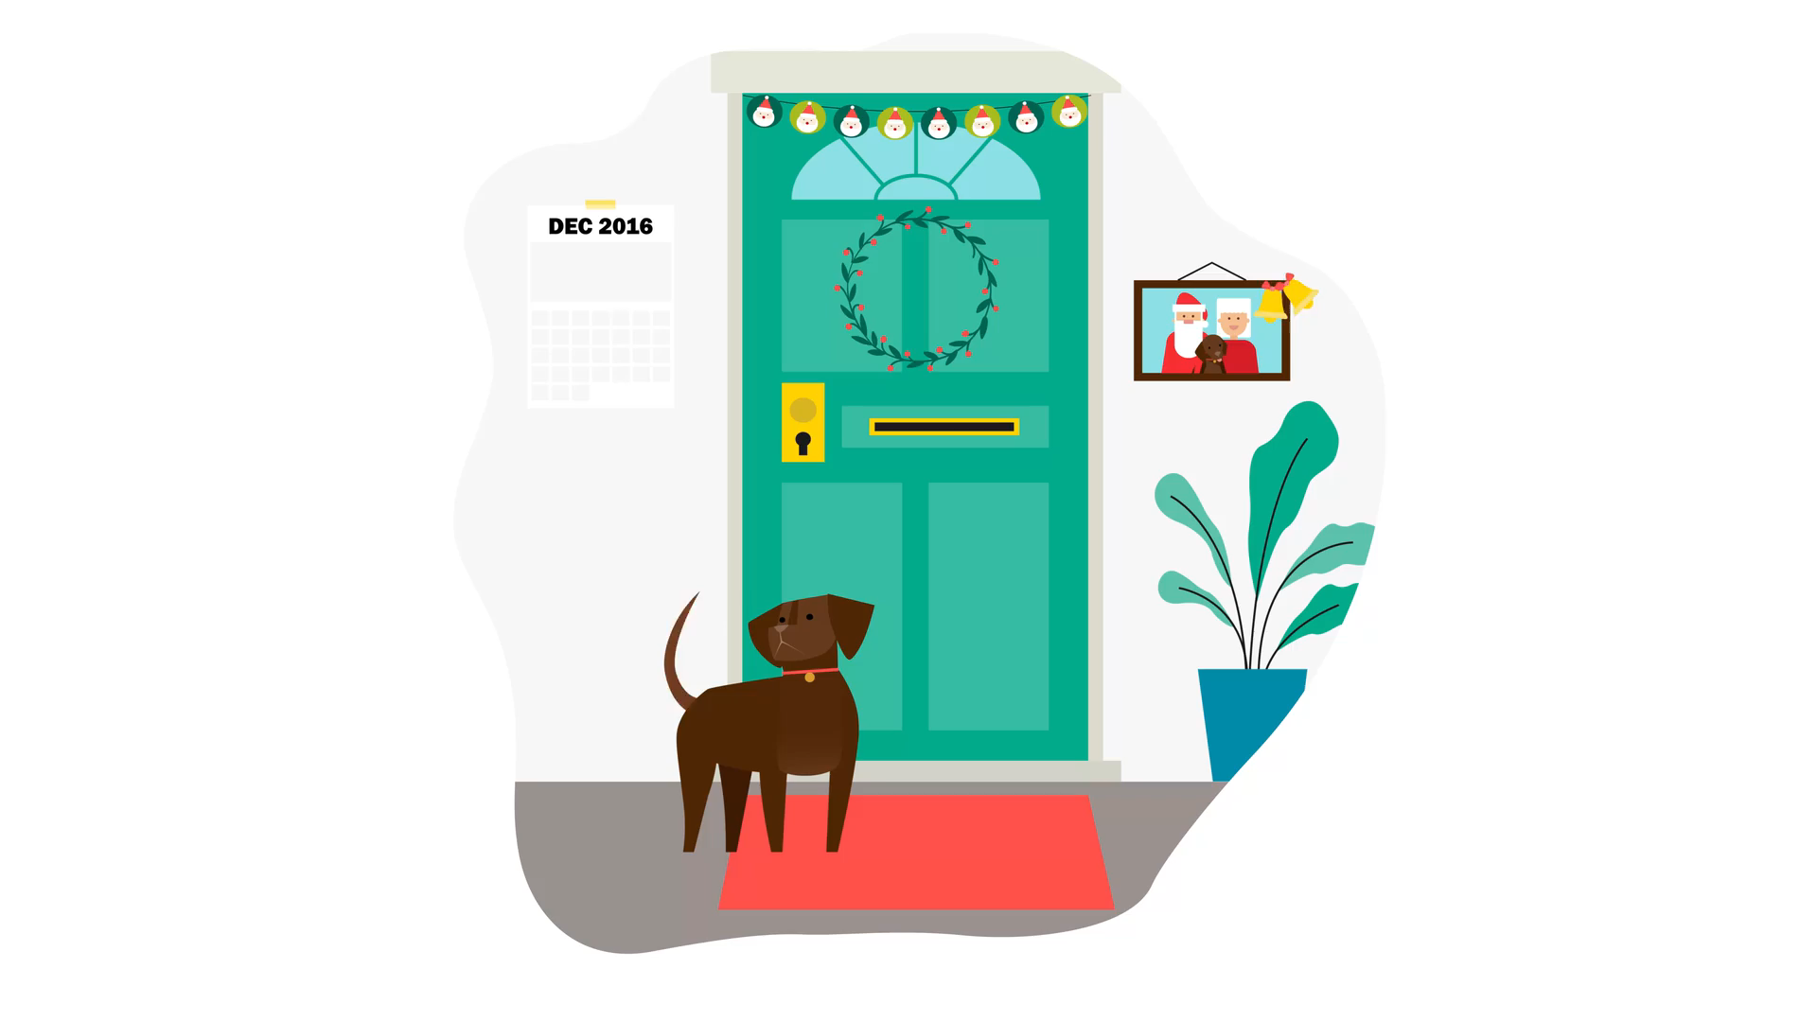

Slide 6
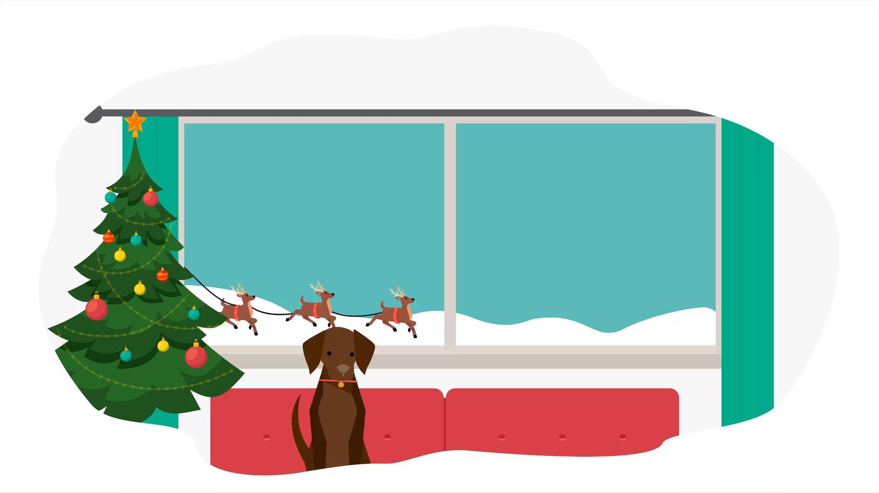

Slide 7


Slide 8


Slide 9
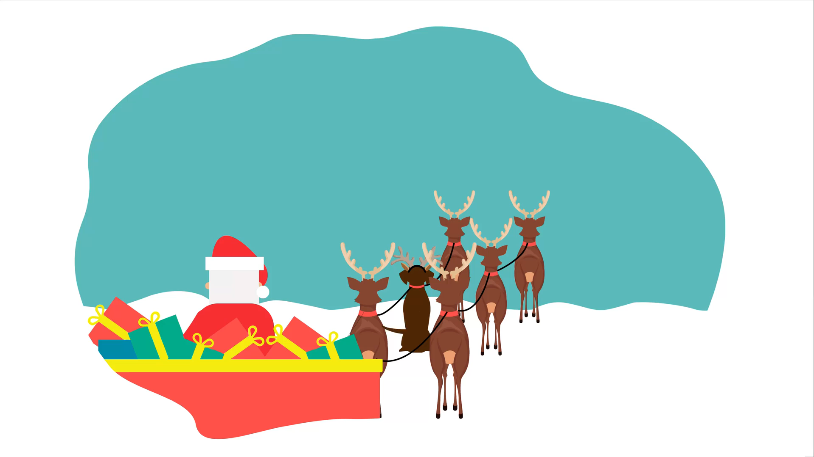

Slide 10


Slide 11


Slide 12

Merry Christmas
With love from,
BrightCarbon

