Slide 1




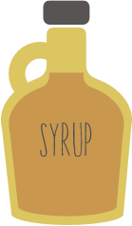



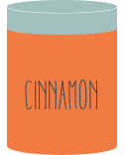


Notes:
flour, bicarbonate of soda, ground ginger, ground cinnamon, butter, brown sugar, an egg, golden syrup

Slide 2

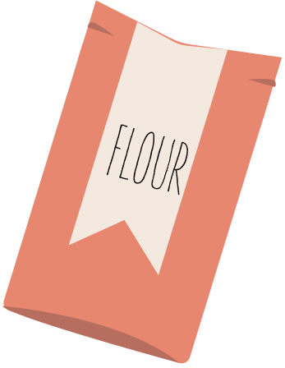

Slide 3





Slide 5



Slide 6



