Slide 1

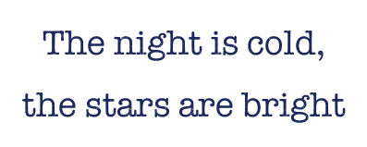





Slide 2
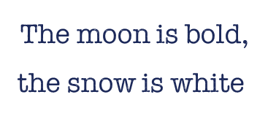

Slide 3
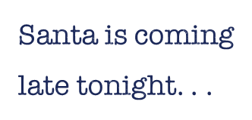



Slide 4

z
z
z

Slide 5



Slide 6




Slide 7




Slide 8
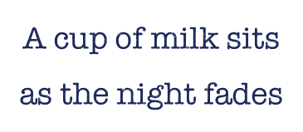


Slide 9
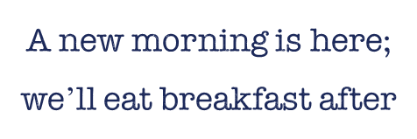

Slide 10
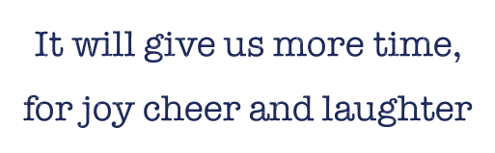

Slide 11



Slide 12


Slide 13

[Insert name here]
Source: https://www.familyfriendpoems.com/poem/holiday-cheer

