Slide 1



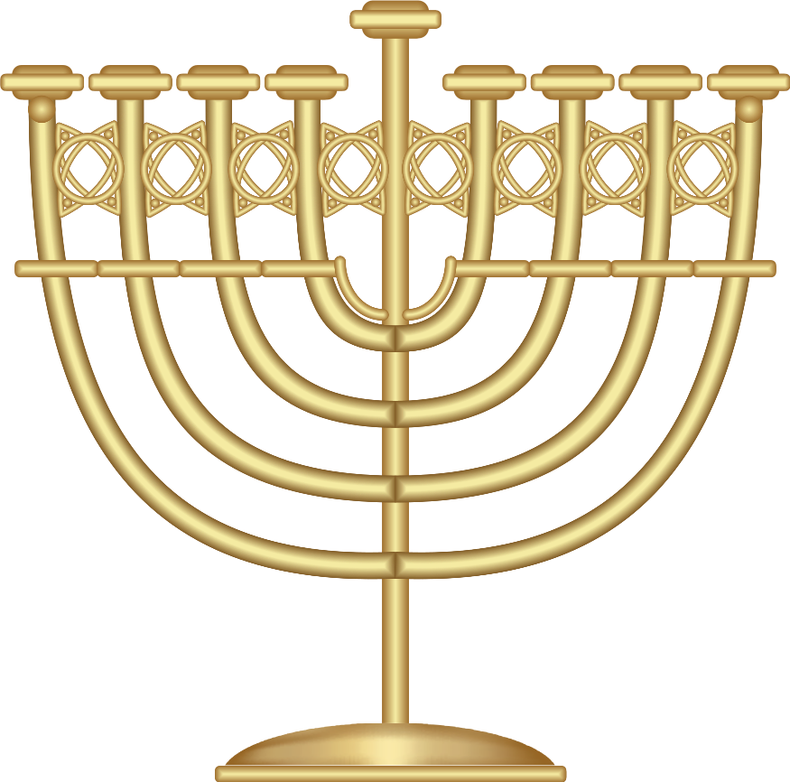


Hello, I am the Hanukkat
BrightCarbon
Click to
light a candle !
Happy holidays!
To:
Everyone
From:
BrightCarbon

Slide 2
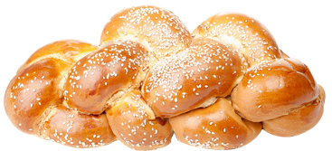
Happy ‘Challah’-days!!
Mmmmmmm..

Slide 3
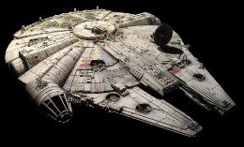

Keep the ‘Han’ in Hannukah

Slide 4


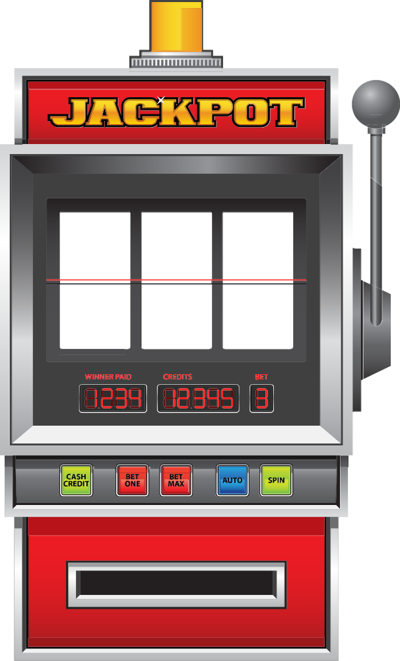
Oy-vey! I already get enough Gelt from my mother!

Slide 5

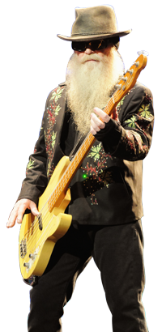

Gimmel all your lovin’!

Slide 6
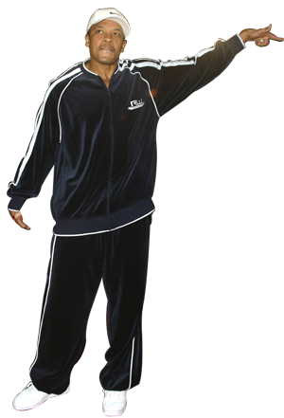
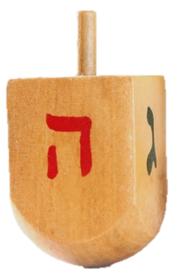
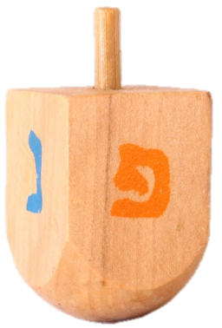
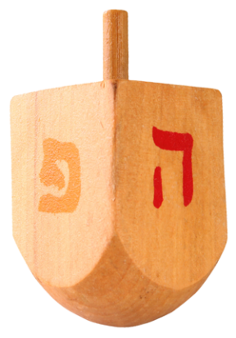
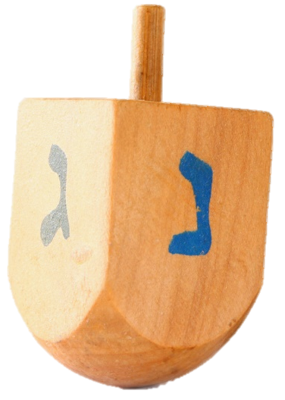
Happy Hanukkah from
Doctor Dre-idel !

Slide 7

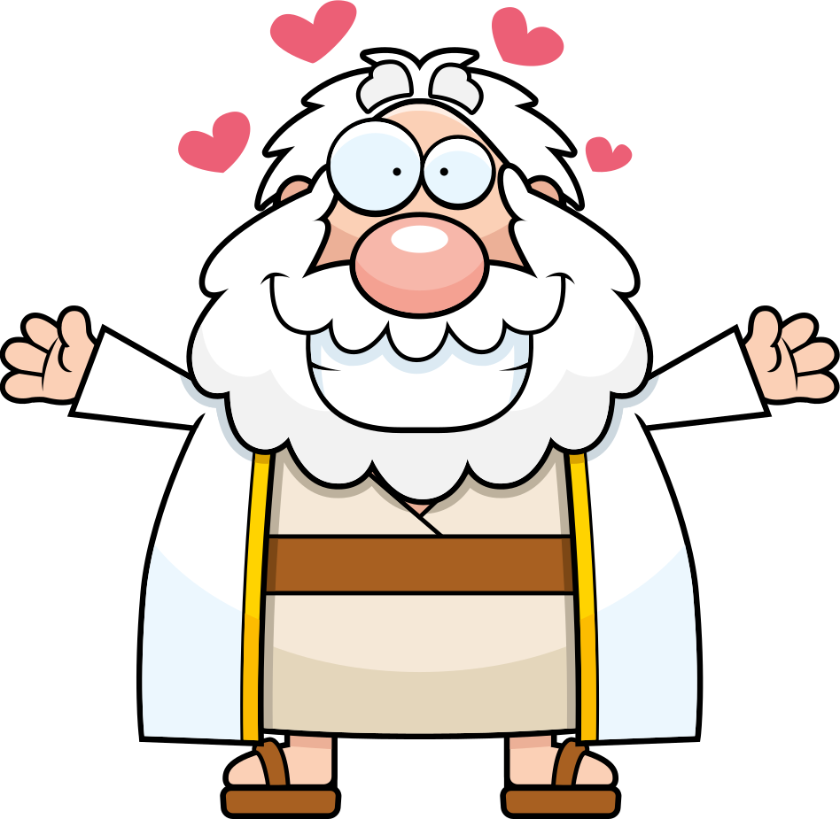
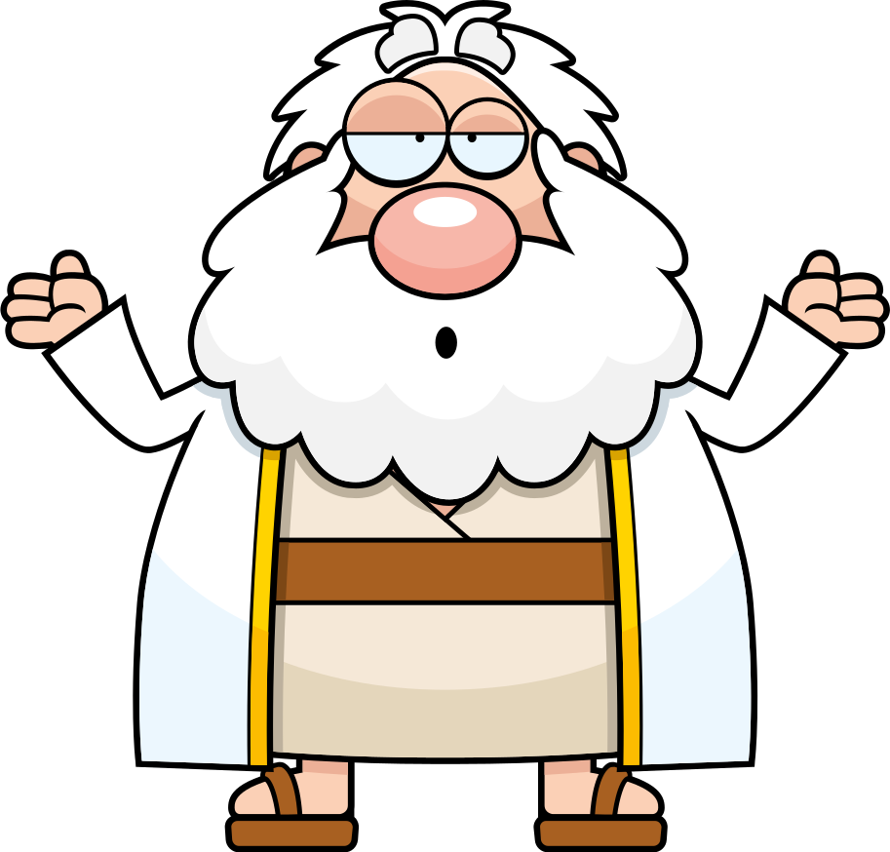

How does Moses make his Tea?
Hebrews it!!

Slide 8
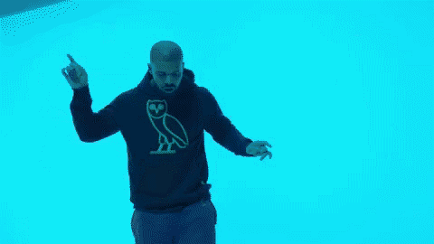
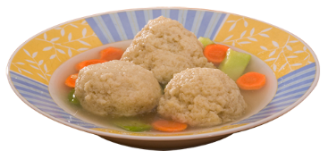

Have a Matzah ball!

Slide 9
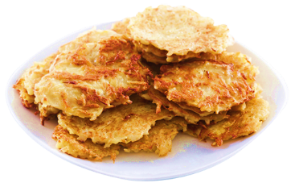
Wishing you a latke happiness !

